Slide 1
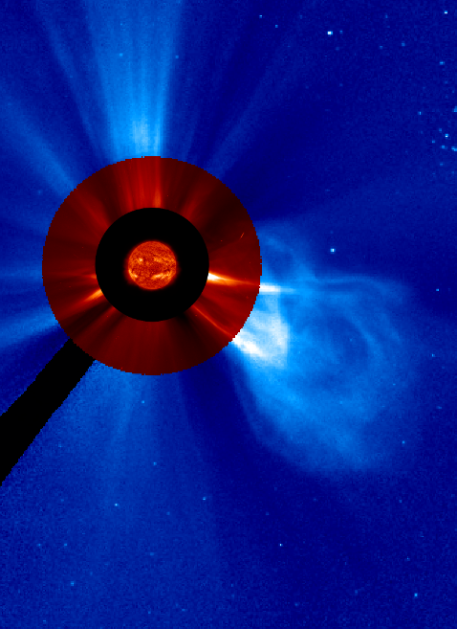
White-Light and Low Frequency Radio Remote-Sensing of Coronal Mass Ejections
Jason E. Kooi^{1,2} and Steven R. Spangler²
  ¹ U.S. Naval Research Laboratory, Code 7213
  ² Department of Physics and Astronomy, University of Iowa
Science at Low Frequencies III

Slide 2
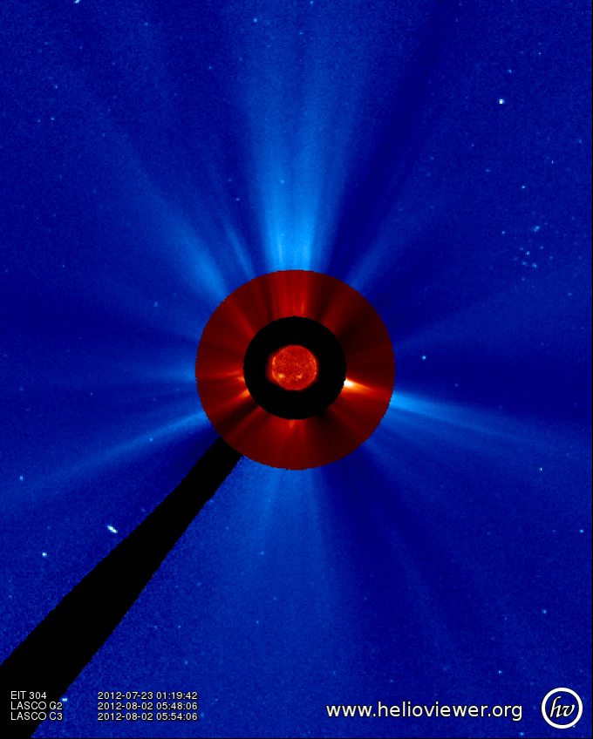
Coronal Mass Ejections (CMEs)
Scientifically interesting
  Plasma Shocks
  Magnetic Flux Ropes
  Plasma Waves
How do they initiate?
  What causes shift to non-equilibrium
  How are they accelerated after launch
Huge role in Space Weather!
  Satellite Communications
  Geomagnetic Storms/Aurora
Remote-Sensing
  Near-Sun
  Insights into CME plasma structure
Dec. 9, 2016
Science at Low Frequencies III

Slide 3
We Study the CME’s Structure with
Faraday Rotation (FR)
χ₀
Δχ
Polarized radio source
Observer
Magnetized Plasma (e.g., CME)
χ : measured position angle
χ₀ : intrinsic polarization angle
λ : wavelength
C_{FR} : FR constant 2.631×10⁻¹⁷ rad G⁻¹
n_{e} : electron density
B : magnetic field
RM : rotation measure [rad/m²]
Dec. 9, 2016
Science at Low Frequencies III

Slide 4
We Study the CME’s Structure with
Faraday Rotation (FR)
χ₀
Δχ
Polarized radio source
Observer
Magnetized Plasma (e.g., CME)
χ : measured position angle
χ₀ : intrinsic polarization angle
λ : wavelength
C_{FR} : FR constant 2.631×10⁻¹⁷ rad G⁻¹
n_{e} : electron density
B : magnetic field
RM : rotation measure [rad/m²]
Dec. 9, 2016
Science at Low Frequencies III

Slide 5
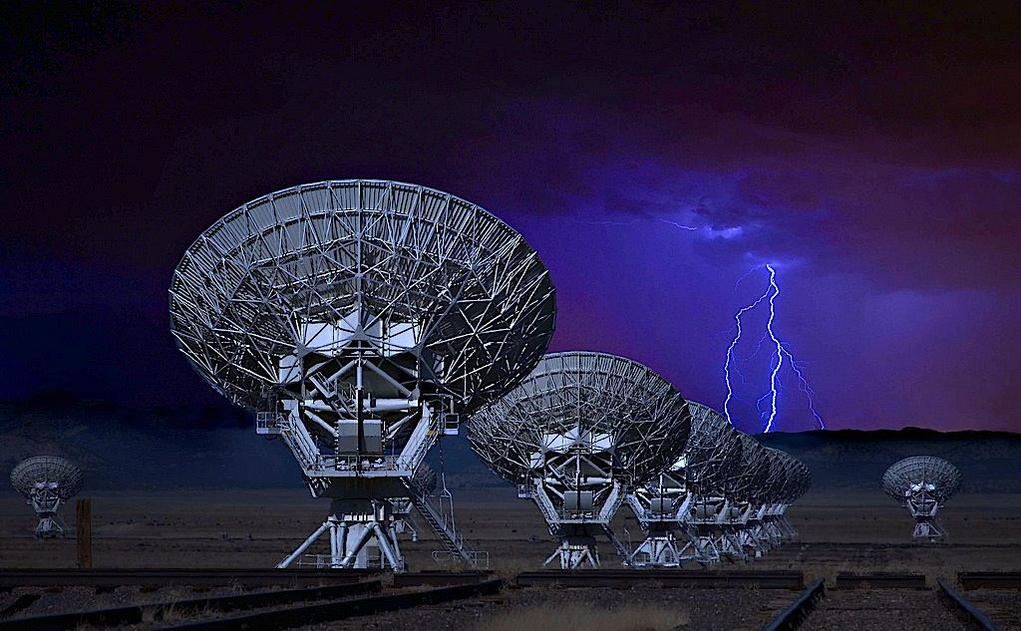
Karl G. Jansky Very Large Array (VLA)
27 dishes 25m in diameter . . . . . . . . . . High sensitivity measurements
Observing Frequencies 1 – 2 GHz . . . . Large FR signature
B array configuration . . . . . . . . . . . . . . Minimizes effect of the Sun
Photo Courtesy of Donald Palansky
Dec. 9, 2016
Science at Low Frequencies III

Slide 6
Tracking CME Leading Edges
SOHO, Stereo-A, Stereo-B
Dec. 9, 2016
Science at Low Frequencies III

Slide 7
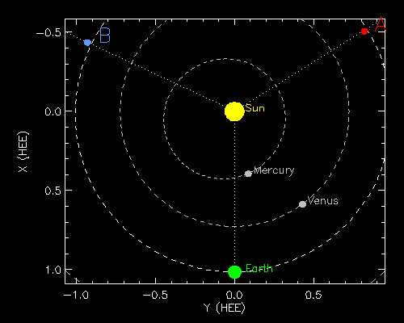
Stereo-A, Stereo-B, and SOHO
Positions at 18:00 UT on August 2, 2012
http://stereo-ssc.nascom.nasa.gov/
Dec. 9, 2016
Science at Low Frequencies III

Slide 8
Separating n_{e} and B_{LOS} Contributions …
SOHO, Stereo-A, Stereo-B
Optical Thomson scattering n_{e}
Radio Faraday rotation B_{LOS}
Dec. 9, 2016
Science at Low Frequencies III

Slide 9
Extragalactic Radio Sources
Measure χ where polarized intensity, P, is strongest … better SNR
2
1
1.85 GHz reference observations
Grayscale in Stokes P
Contours:
-5, 5, 10, 25, 50, 75% of Stokes I
Line orientation gives χ
FWHM is 4″
Dec. 9, 2016
Science at Low Frequencies III

Slide 10
Extragalactic Radio Sources
2
1
RM_{corona} ≈ –10.58 ± 0.13 rad/m²
We can subtract a set of reference observations to directly determine
RM_{corona} ≈ –11.03 ± 0.57 rad/m²
Dec. 9, 2016
Science at Low Frequencies III

Slide 11
Coronal Occultation Only
1
2
0846+1459 . . . R₀: 11.1 – 11.4R
Dec. 9, 2016
Science at Low Frequencies III

Slide 12
Coronal Occultation Only
1
Fit coronal n_{e} = N₀ r ^{– 2.36} [cm^{– 3}]
2
Model coronal B = 1.01 r ^{– 2} e_{r} [G]
0846+1459 . . . R₀: 11.1 – 11.4R
Sakurai & Spangler (1994), ApJ, 434, 773
Spangler (2005), SSR, 121, 189
Ingleby et al. (2007), ApJ, 668, 520
Kooi et al. (2014), ApJ, 784, 68
Science at Low Frequencies III

Slide 13
Occultation by a Single CME
0842+1835 . . . R₀: 9.6 – 10.6R
Dec. 9, 2016
Science at Low Frequencies III

Slide 14
Occultation by a Single CME
Leading Edge
0842+1835 . . . R₀: 9.6 – 10.6R
N_{cme} = 6.9 ± 0.5 x 10³ cm^{– 3}
B_{cme} = 10.4 ± 0.4 mG
H = – 1
Dec. 9, 2016
Science at Low Frequencies III

Slide 15
Occultation by a Single (jet-like) CME
2
1
0900+1832 . . . R₀: 8.0 – 8.6R
Dec. 9, 2016
Science at Low Frequencies III

Slide 16
Occultation by a Single (jet-like) CME
2
Leading Edge
1
0900+1832 . . . R₀: 8.0 – 8.6R
N_{cme} = 11.2 ± 0.3 x 10³ cm^{– 3}
B_{cme} = 2.4 ± 0.3 mG
H = – 1
Dec. 9, 2016
Science at Low Frequencies III

Slide 17
Occultation by two CMEs
2
1
Fit CME-1 to (half of) 0843 data
CME-2 N_{cme}, B_{cme}, H from 0842
This is why multiple LOS and viewpoints are necessary!
(SOHO and STEREO-A)
Dec. 9, 2016
Science at Low Frequencies III

Slide 18
Occultation by two CMEs
2
Leading Edge 1
Leading Edge 1
Leading Edge 2
1
0843+1547 . . . R₀: 9.9 – 10.5R
N_{cme} = 21.4 ± 0.6 x 10³ cm^{– 3}
B_{cme} = 11.3 ± 0.4 mG
H = + 1
Fit
Prediction
Dec. 9, 2016
Science at Low Frequencies III

Slide 19
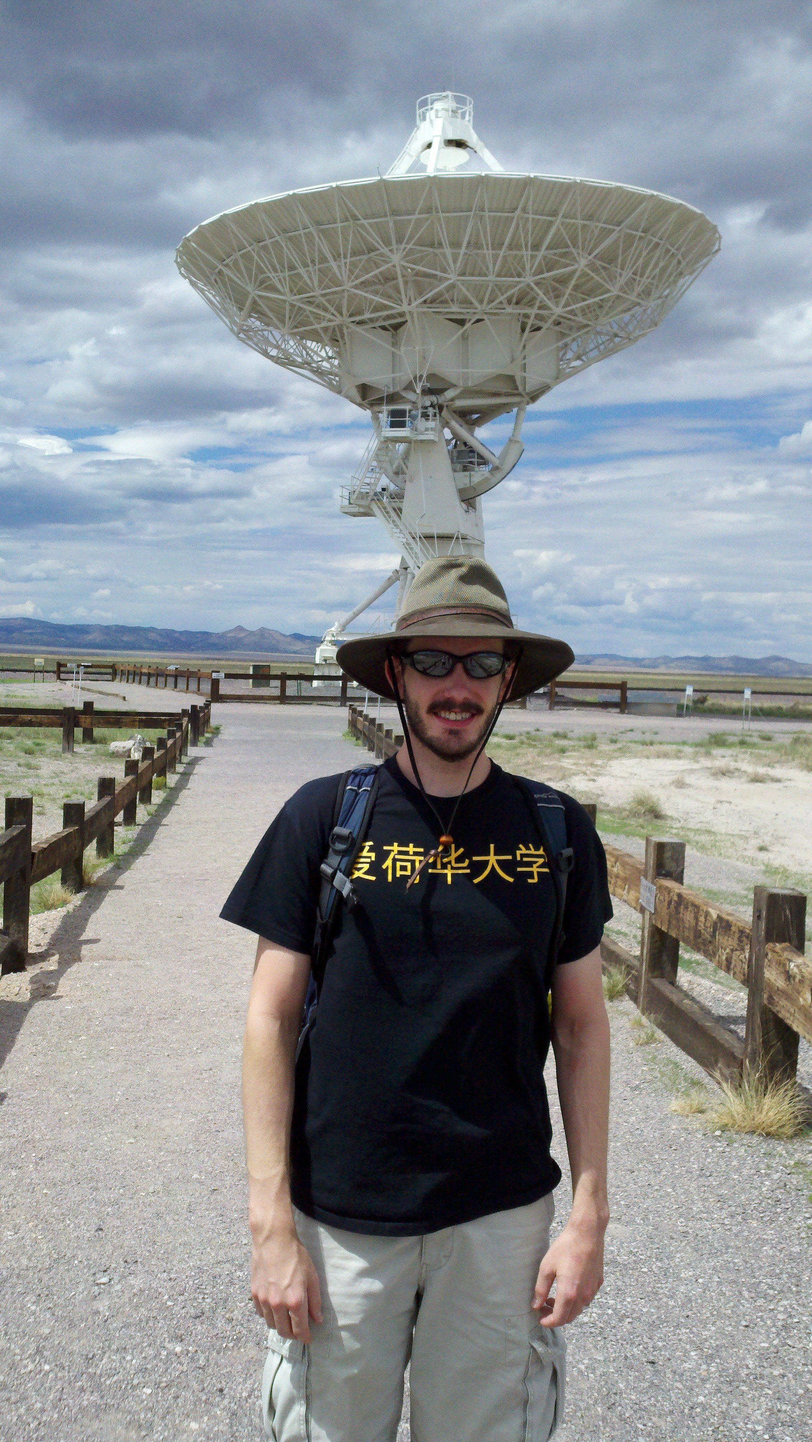
Future Work and Research Opportunities
Submitted to Solar Physics
arXiv: 1611.01445
VLA triggered observations of CME FR
VLITE observations of ionospheric transients associated with CME–induced geomagnetic storms
MHD simulations of CME FR
Support for undergrad/graduate students
NRC postdoctoral positions open
Dec. 9, 2016
Science at Low Frequencies III

