Slide 1
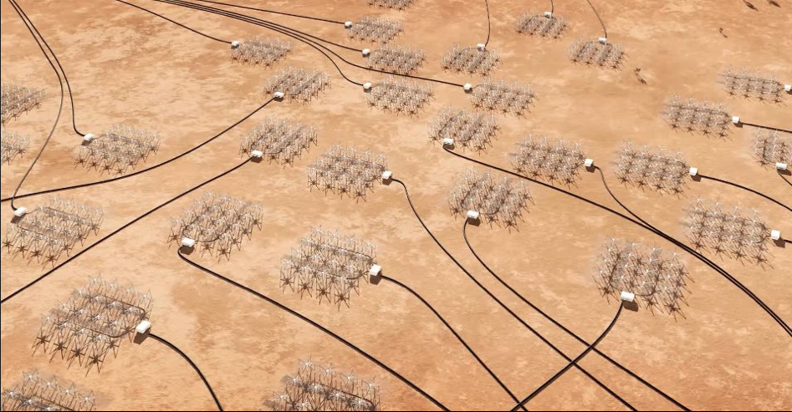



Low frequency transients and variables with the MWA.
Martin Bell, Paul Hancock, Tara Murphy, David Kaplan, Simon Johnston,, Randall Wayth, Natasha Hurley-Walker, Joe Callingham, Antonia Rowlinson with the Variables and Slow Transients (VAST) science project and MWA science team.

Slide 2
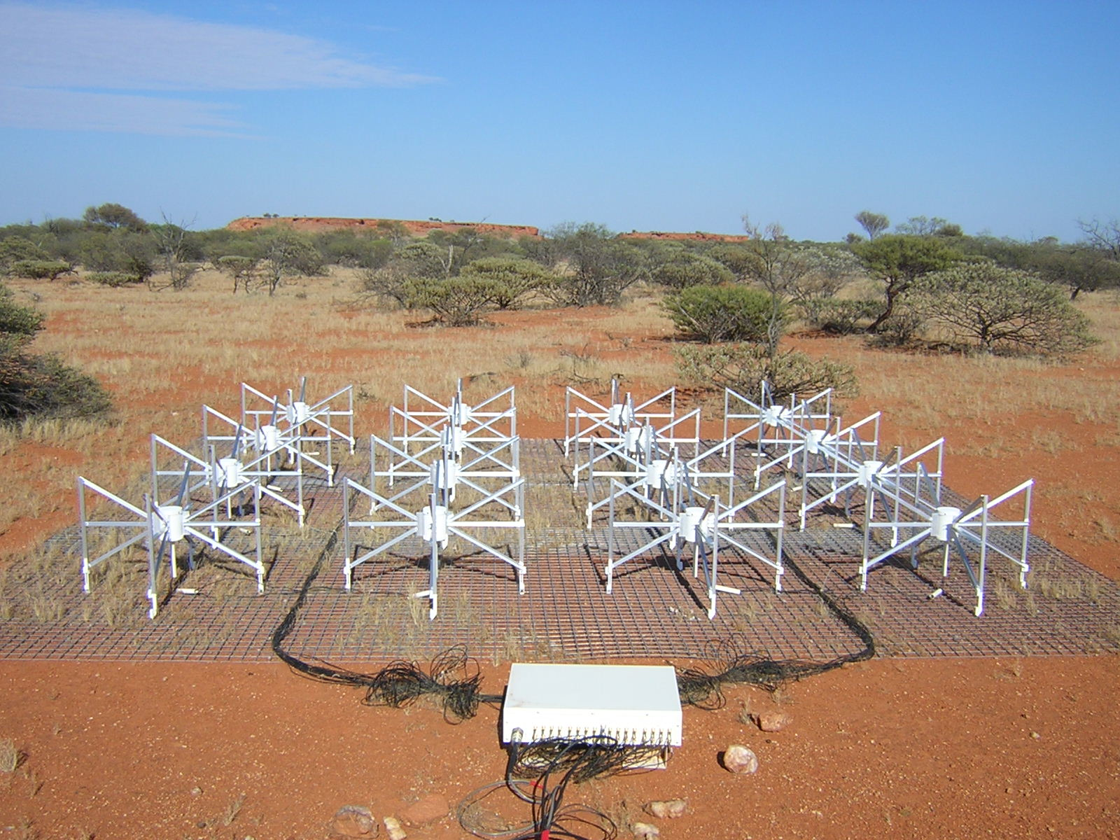
The Murchison Widefield Array Transients Survey (MWATS)
Frequency: 154 MHz.
Method: Drift scans at +1.6, -26 and -55
Survey area: Entire Southern hemisphere.
Cadence: One night per month.
Integration time: Two minutes per snapshot.
Survey length: 3.5 years.
Total images: 8k
FoV: 1000 square degrees per image.

Slide 3



Science goals
1.) A time-domain compendium to GLEAM: Measure the variability of every object currently detectable in Southern hemisphere at low frequencies (>500k objects), probing both intrinsic and extrinsic variability.
2.) The unknown: Discover new classes of low frequency radio transients that previously remained undetected and obscured from multi-wavelength discovery
3.) The future: To place rigorous statistics on the occurrence of both transients and variables prior to the SKA era

Slide 4
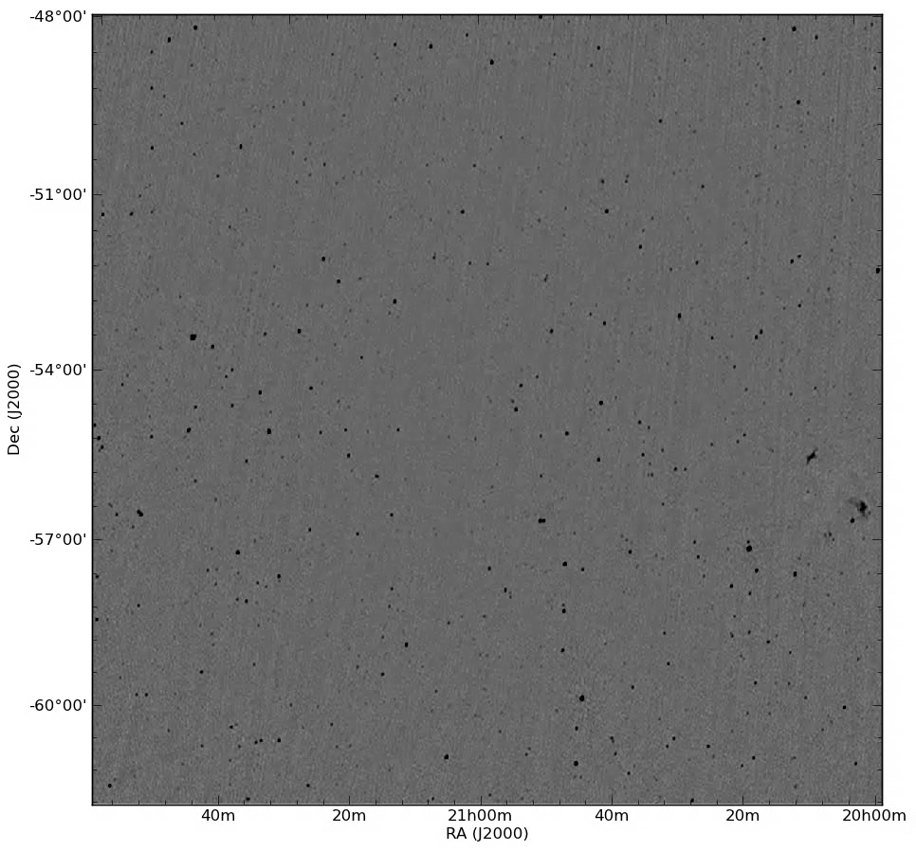
The sky as observed by the MWA (zenith)

Slide 5

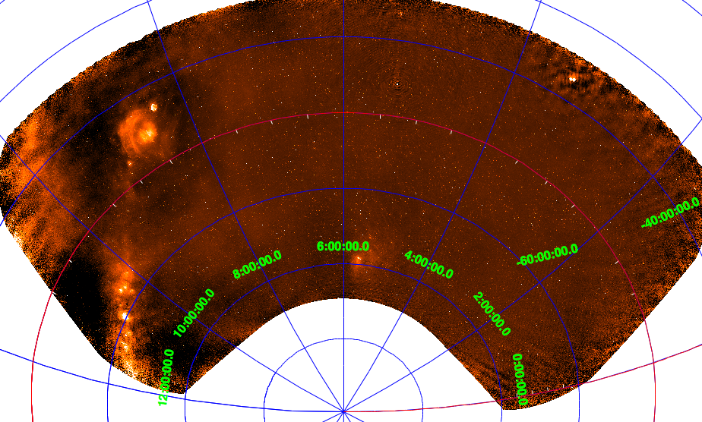

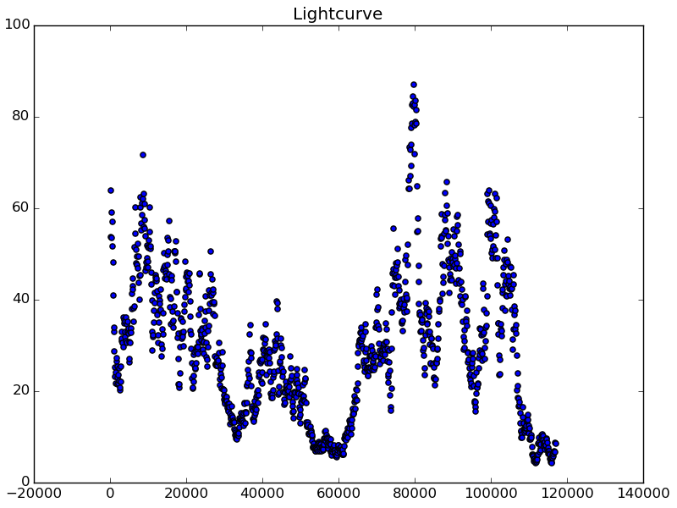
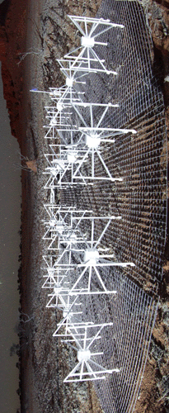
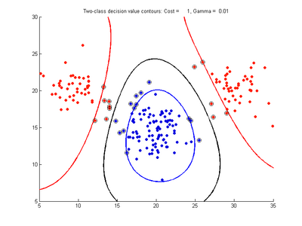
Our pipeline
Position
350k objects.
8000 images.
Both Galactic and extragalactic.
Point sources only.

Slide 6
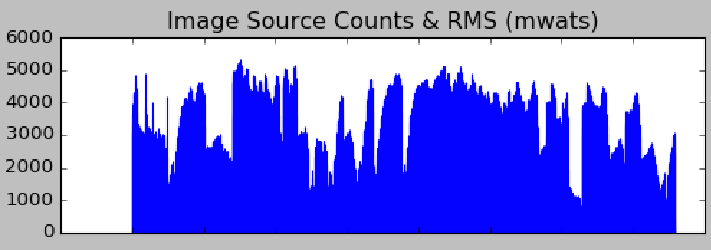
Our pipeline
Position
350k objects.
8000 images.
Both Galactic and extragalactic.
Point sources only.
N sources
Image

Slide 7

Curation
350k radio sources
times
200 data points
over
8000 images.
…covering the entire southern hemisphere
…..is the selection, preservation, maintenance, collection and archiving of digital assets.

Slide 8
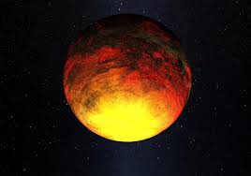
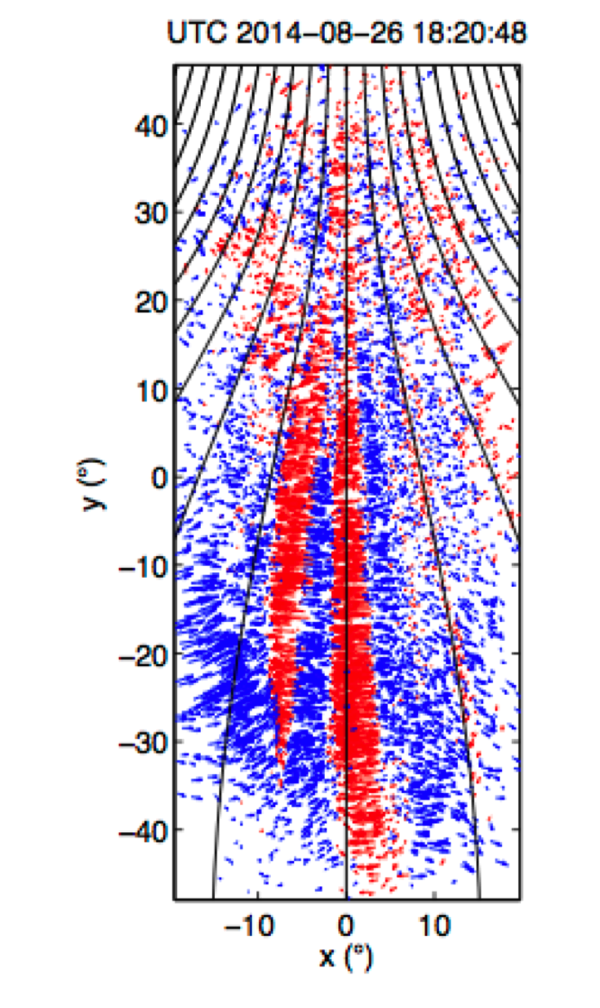
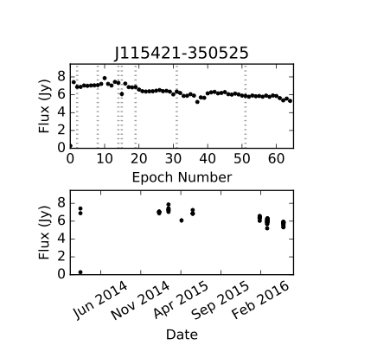
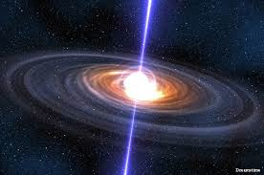
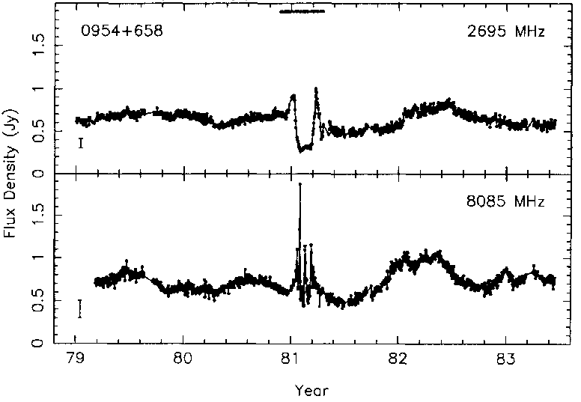
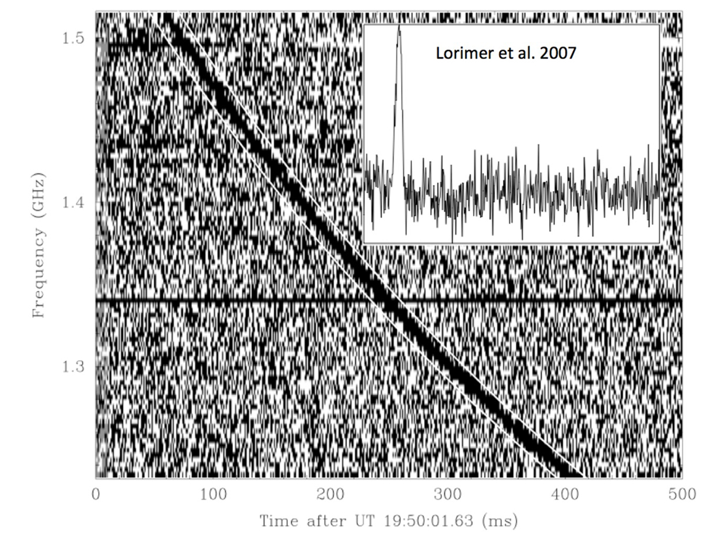
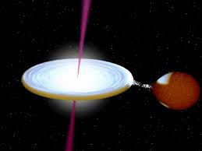
Some MWATS science highlights
Low Frequency Variables
TODO
Ionospheric
Exoplanets
Murphy et al. (2015)
Full source based transients analysis.
Pulsars
Bell et al. (2016).
Loi et al. 2015 (a)
Loi et al. 2015 (b)
Loi et al. 2016
FRBS
Rowlinson et al. (2016)
MWATS data reduction pipeline
DONE

Slide 9
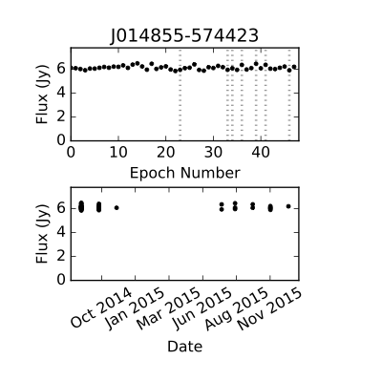
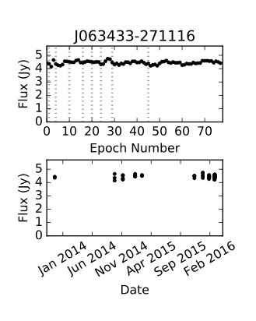
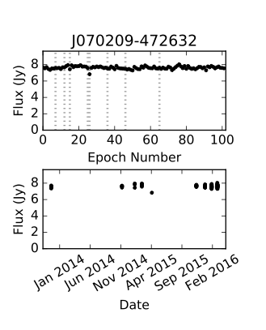
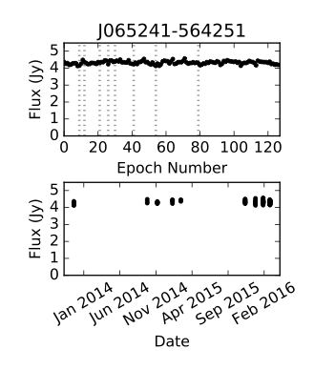
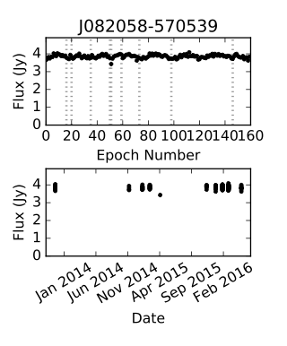
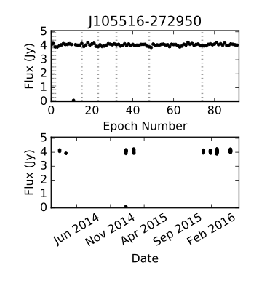
Data quality
Modulation indices < 5%

Slide 10
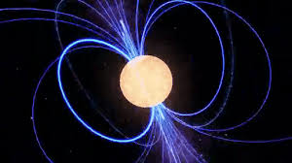
We have found transients!
Pulsars are the most dynamic and transient objects we have found - so far – in this survey.

Slide 11

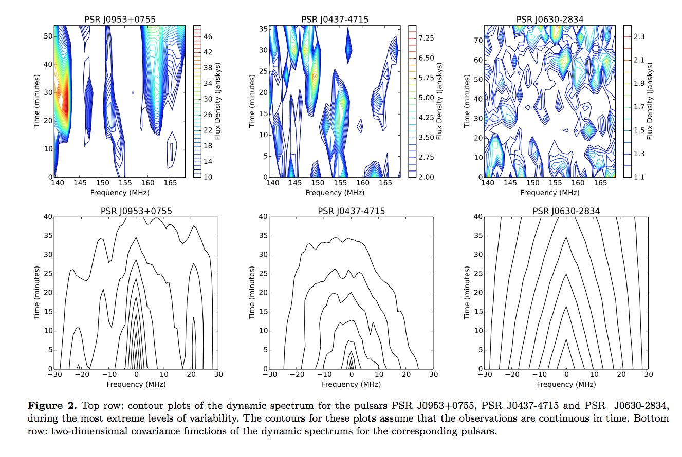
J0953+0755
Pulsar J0953+0755.
Spectacular variability.
DM = 2.96.
Diffractive scintillation.
Bell et al (2016)

Slide 12
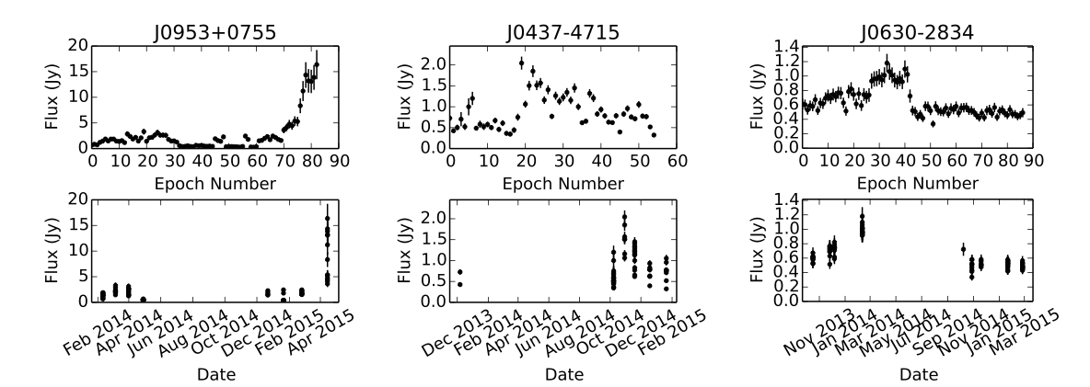
Pulsar dynamic spectra and light-curves
PSR J0953+0755
PSR J0437-4715
PSR J0630-2834
Diffractive scintillation
Diffractive scintillation
Refractive scintillation

Slide 13
What about intermittent pulsars?
J0828-3417

Slide 14
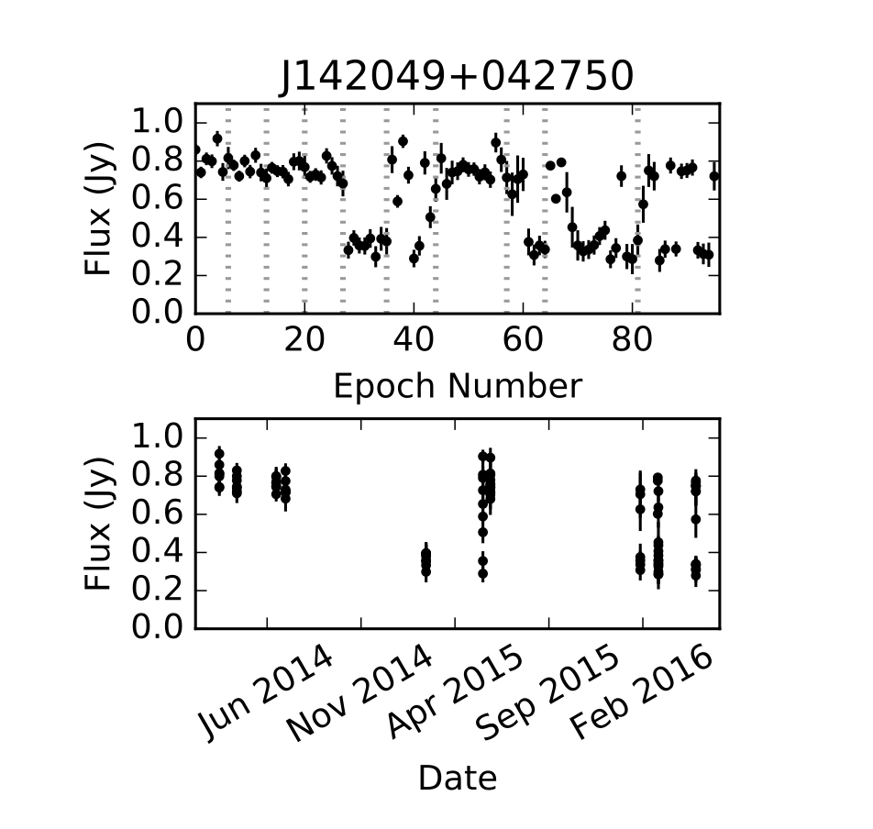
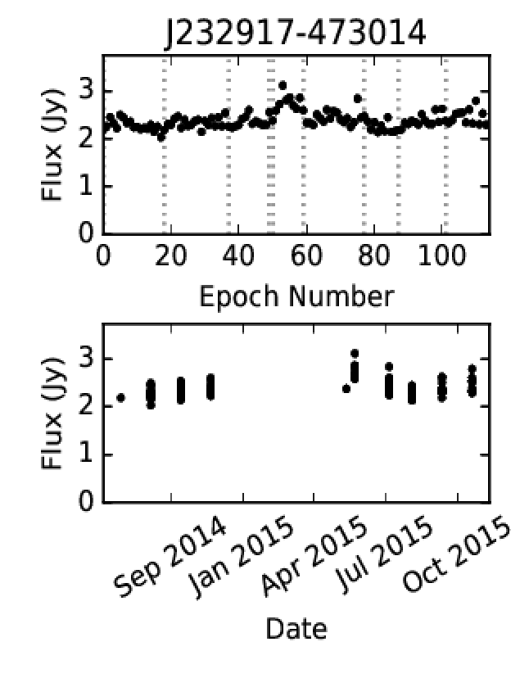
Low Frequency Variables
Generate light-curves for all point sources > 4 Jy.
Generate light-curves for all flat spectrum sources.
Refractive scintillation is a proxy for compactness, as is spectral index.
We can access sub-arcsec resolutions with MWA using the time and spectral domains.

Slide 15
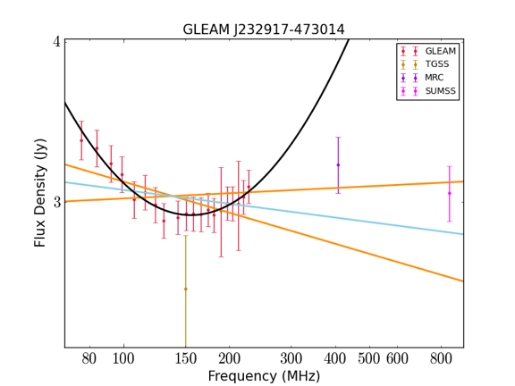
Low Frequency Variables
SEDs courtesy of Joe Callingham

Slide 16
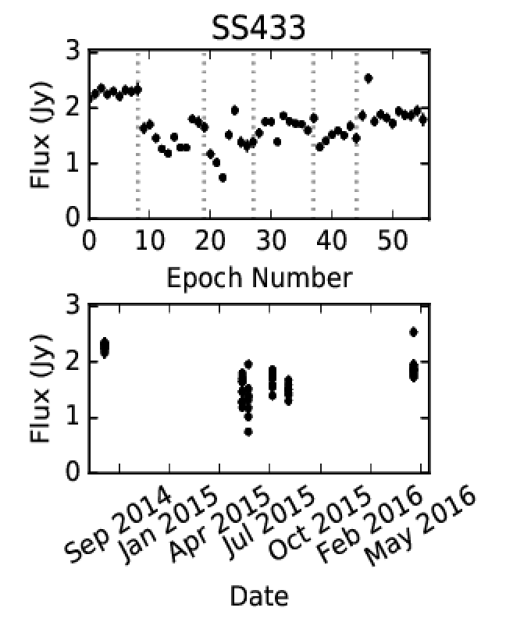
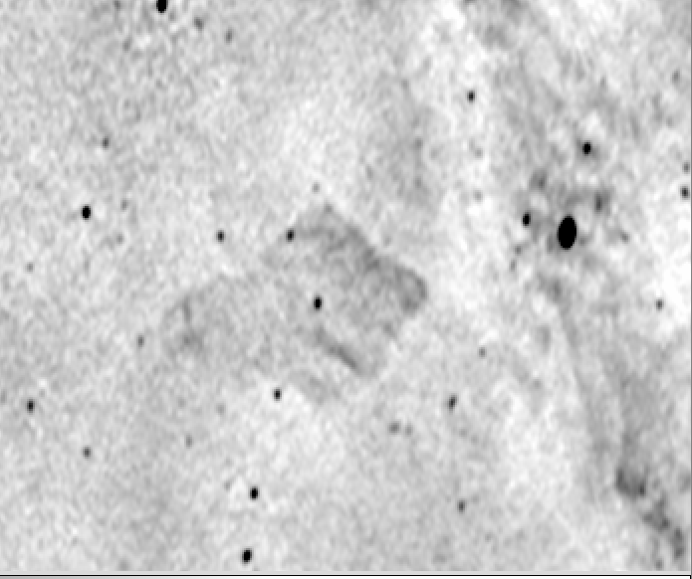
SS433 Galactic microquaser

Slide 17
Conclusions
Measuring the variability of all GLEAM sources (>350k) now a reality.
The currently the GLEAM catalog is only extragalactic. MWATS is both galactic and extragalactic.
Refractive scintillation allows us to find and probe sub-arcsec structure with the MWA.
Full transients analysis is underway. Watch this space!

