Slide 1
All-sky transient monitoring with the OVRO-LWA
Marin M. Anderson (Caltech)
Extrasolar space weather
Compact object mergers

Slide 2
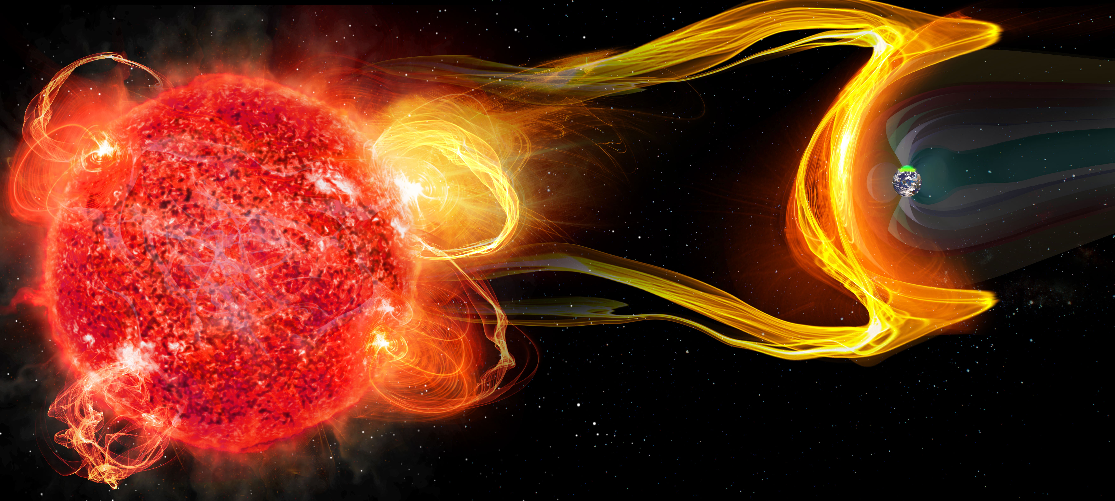
Both stellar magnetic activity, and planetary magnetic fields, are critical for defining habitability.
Stellar flares and CMEs
Exoplanet magnetospheric emission
…events indicative of stellar magnetic activity and their impact on planetary companions.
Extrasolar space weather
Image: C. Carter and G. Hallinan

Slide 3
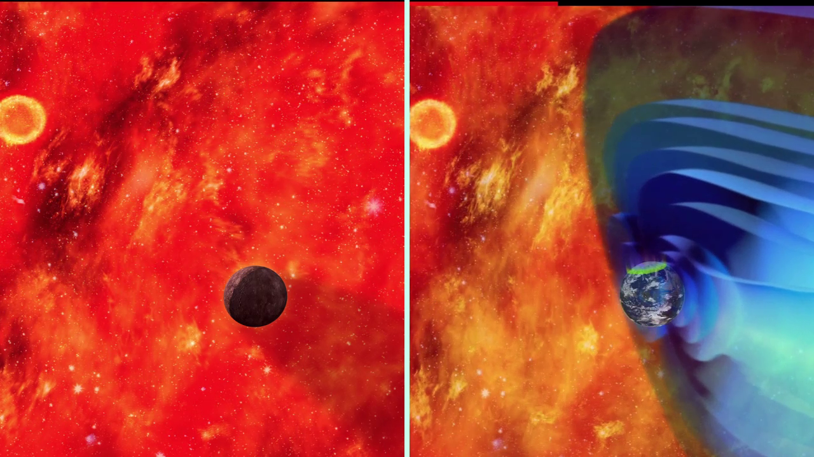
Both stellar magnetic activity, and planetary magnetic fields, are critical for defining habitability.
Stellar flares and CMEs
Exoplanet magnetospheric emission
…events indicative of stellar magnetic activity and their impact on planetary companions.
Extrasolar space weather
We want to understand the implications of stellar activity and planetary magnetic fields on exoplanet atmospheres and habitability.
Image: C. Carter and G. Hallinan

Slide 4
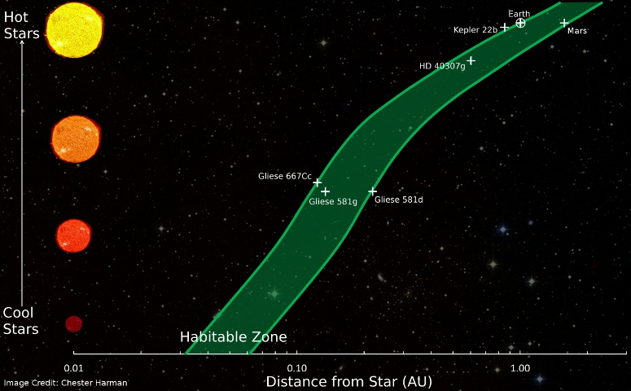
Both stellar magnetic activity, and planetary magnetic fields, are critical for defining habitability.
Stellar flares and CMEs
Exoplanet magnetospheric emission
…events indicative of stellar magnetic activity and their impact on planetary companions.
Extrasolar space weather
Image: C. Carter and G. Hallinan

Slide 5
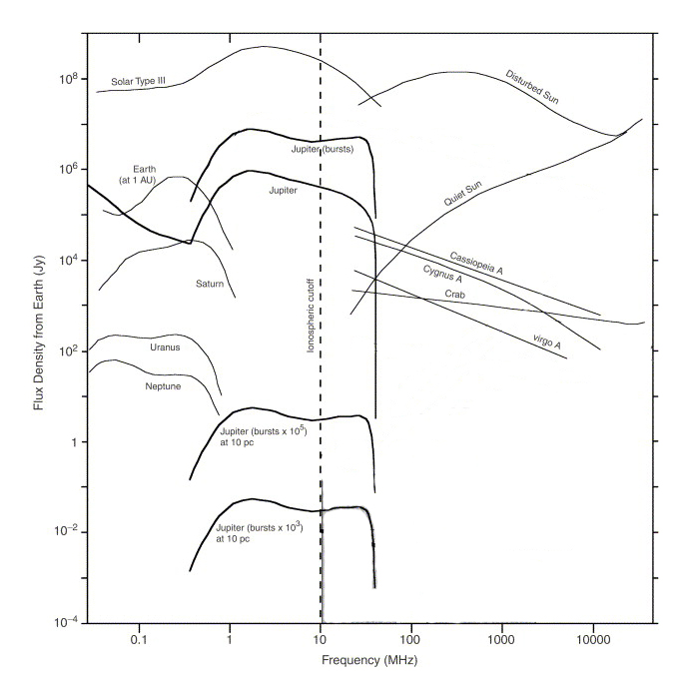
The interaction between Solar wind and planetary magnetosphere is observable through auroral emission.
Solar Type III
Jupiter (bursts)
Jupiter DAM
Jupiter
Quiet Sun
Flux Density from Earth (Jy)
Hot Jupiters?
Zarka 2007
Frequency (MHz)

Slide 6
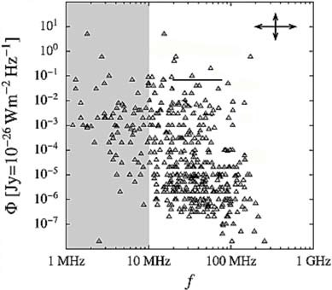
Previous searches for exoplanetary radio emission have resulted in non-detections.
Maximum frequency of ECM emission given by f_{ce} [MHz] = 2.8 B [G]
For Jupiter DAM, this corresponds to a strict emission cut-off at ~35 MHz
1
Restricted to
ν >100 MHz
Grießmeier et al. 2011

Slide 7
Previous searches for exoplanetary radio emission have resulted in non-detections. Why?
Maximum frequency of ECM emission given by f_{ce} [MHz] = 2.8 B [G]
For Jupiter DAM, this corresponds to a strict emission cut-off at ~35 MHz
1
Restricted to
ν >100 MHz
Emission is highly beamed, modulated by the planetary rotation period
Need to observe planet over entire rotation period
2
Short-duration observations

Slide 8
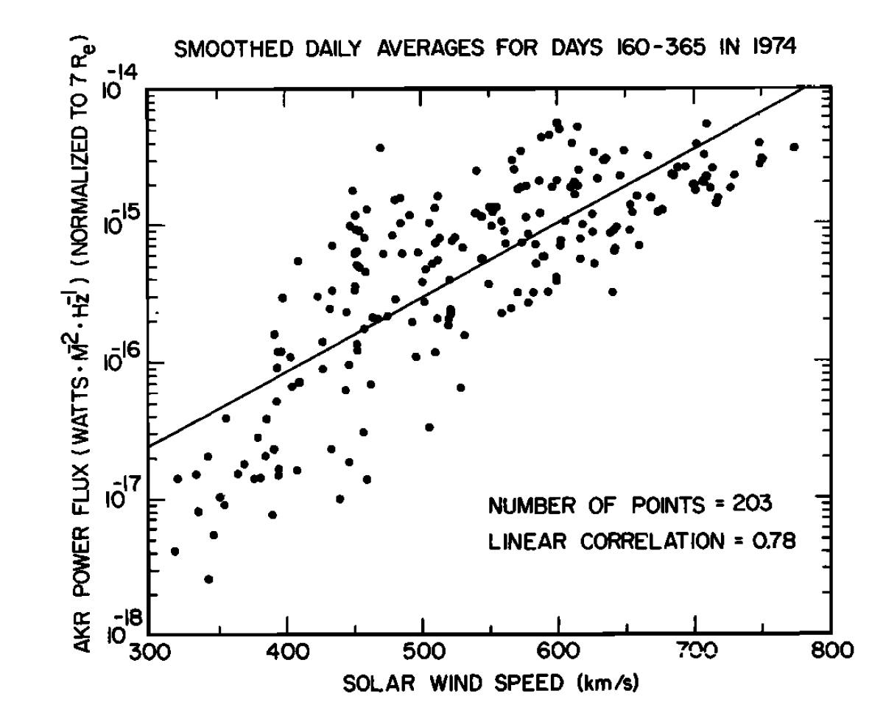
Previous searches for exoplanetary radio emission have resulted in non-detections. Why?
Maximum frequency of ECM emission given by f_{ce} [MHz] = 2.8 B [G]
For Jupiter DAM, this corresponds to a strict emission cut-off at ~35 MHz
1
Restricted to
ν >100 MHz
Earth’s Auroral Emission
Emission is highly beamed, modulated by the planetary rotation period
Need to observe planet over entire rotation period
2
Short-duration observations
Power
1000x increase during Solar CME!
Targeting only a few systems at a time
Not sensitive to rarer brightening events associated with CME-driven events
3
Solar wind speed [km/s]
Gallagher and D’Angelo 1981

Slide 9
Wide-field, long-duration surveys at <100 MHz capable of monitoring thousands of objects simultaneously are needed
Grießmeier et al. 2011

Slide 10
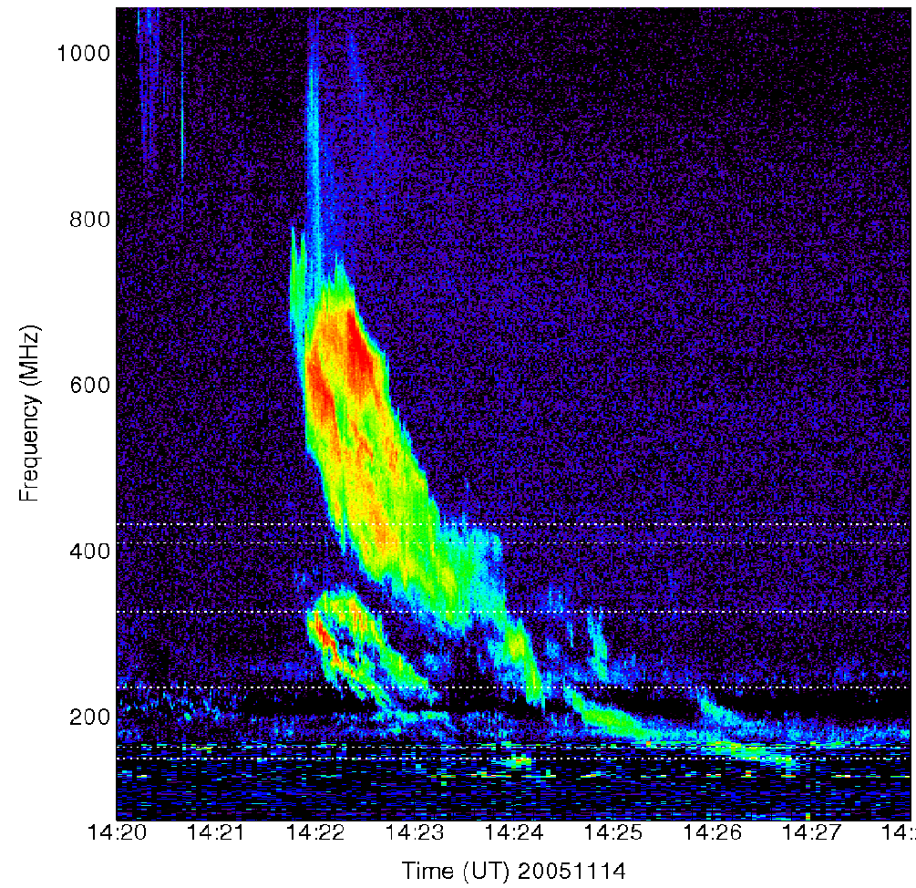
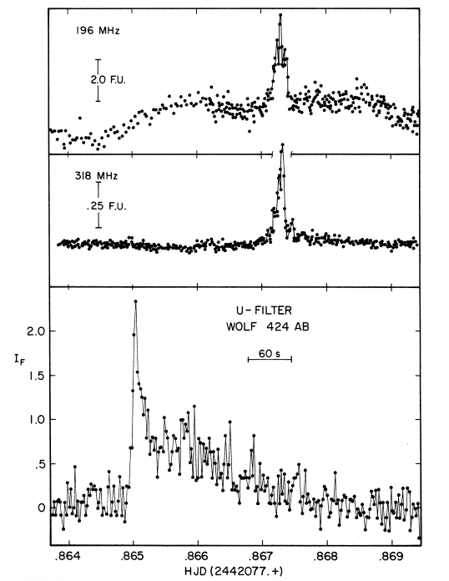
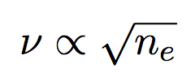
The low frequency (<100 MHz) sky is the ideal place to monitor for stellar flares and CMEs.
1000
196 MHz
Solar ‘Type II’ burst
Radio flare, reaching ~5 Jy at 196 MHz
318 MHz
Frequency [MHz]
Wolf 424
Optical flare
200
Stephen White
Green Bank Solar Radio Burst Spectrometer
Time [UT]
Spangler & Moffett 1976

Slide 11
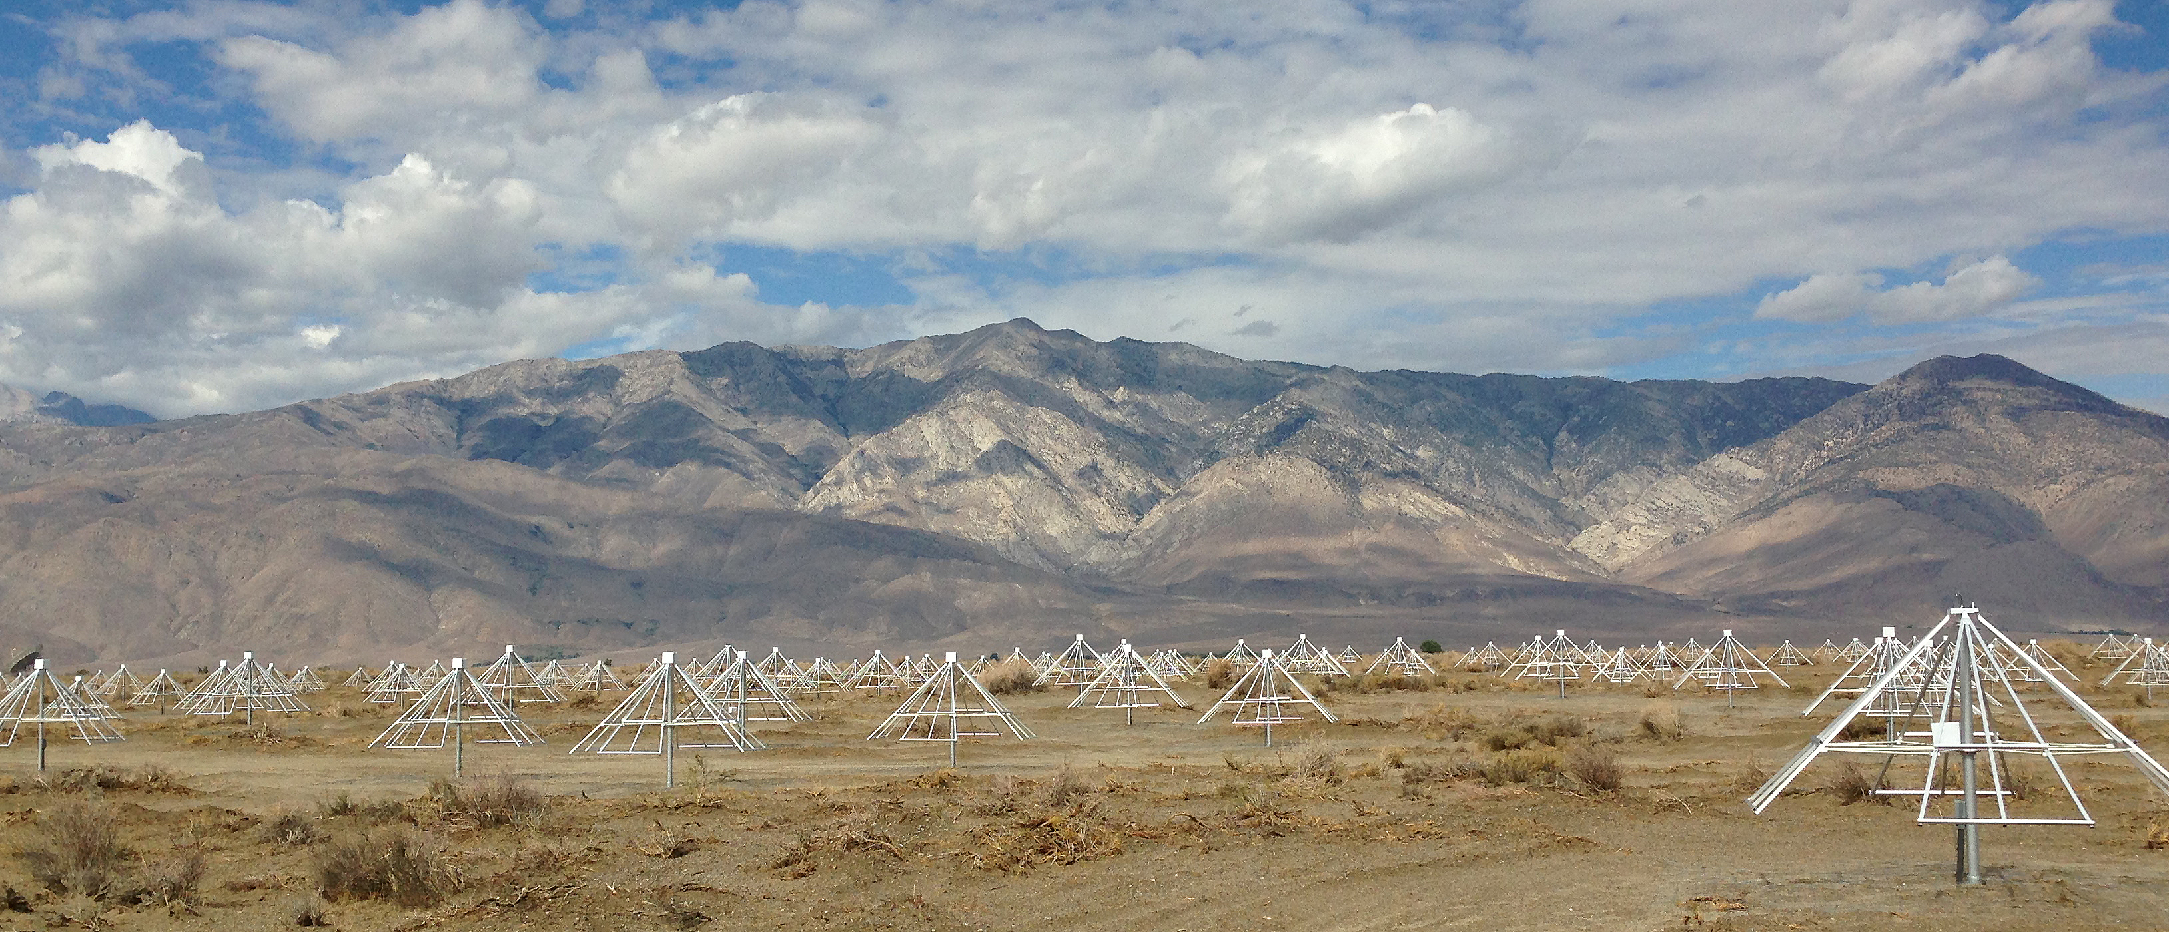
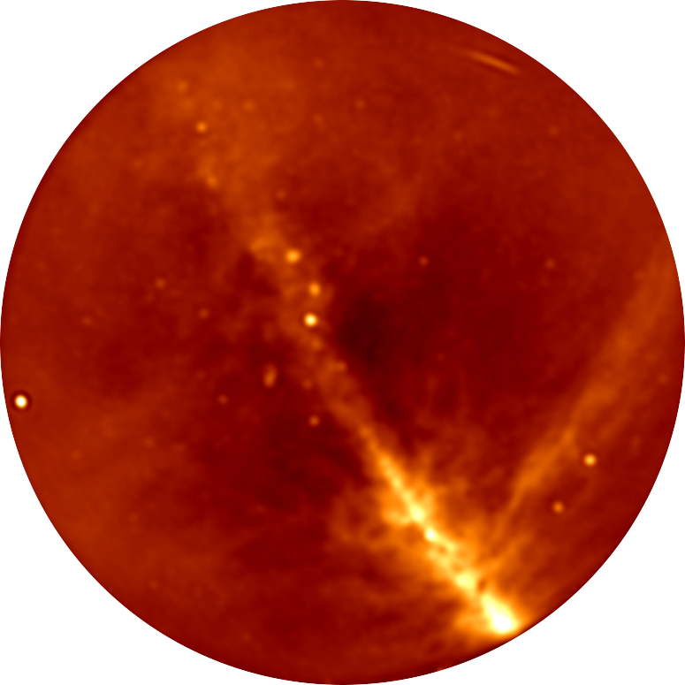
The Owens Valley Radio Observatory
Long Wavelength Array (OVRO-LWA)
256 crossed-dipoles
Spread out across 200-m diameter core
1
Image with
the core

Slide 12
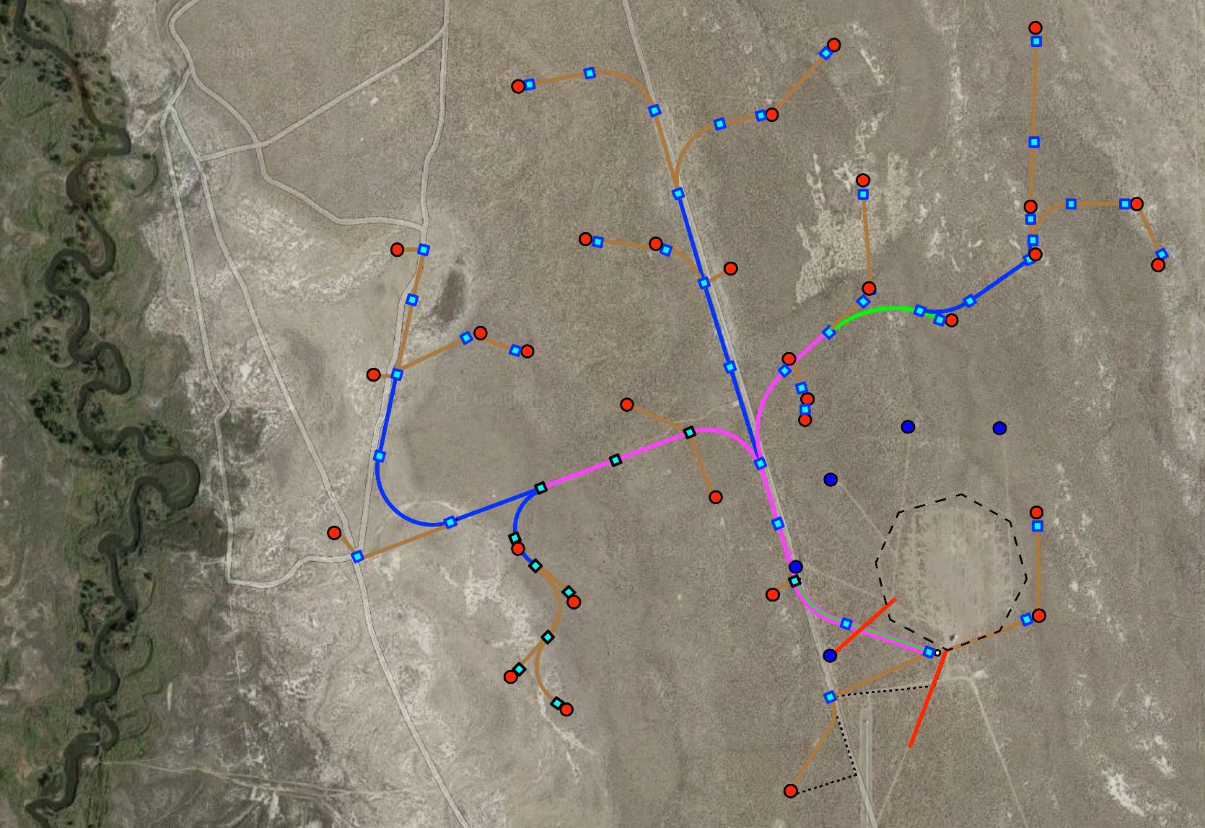
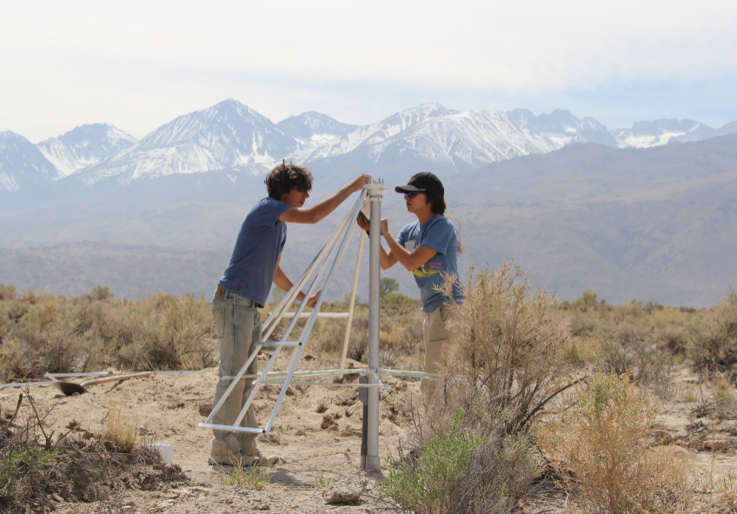
The Owens Valley Radio Observatory
Long Wavelength Array (OVRO-LWA)
256 crossed-dipoles
Spread out across 200-m diameter core
Added 32 additional dipoles
Increased maximum baseline out to ~1.5-km
1
2

Slide 13
OVRO-LWA – purpose-built to be a radio transient machine!
Simultaneously monitor thousands of sources
Sensitive to rare and serendipitous events
1
All-sky FOV
Continuously monitor sources with high time-resolution
2
Obs time
Better sensitivity + at the right frequencies
Able to characterize sources spectrally
3
Large BW
Get down below confusion noise…
4
Stokes V

Slide 14
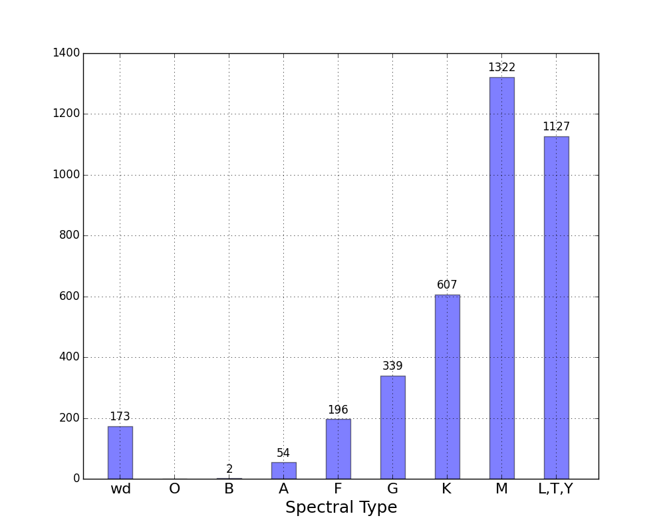
OVRO-LWA 100-Hour Survey
25-pc catalog
Monitor ~4000 objects out to 25 pc
Both Stokes I and V
Continuously, for the duration of the 100-hour run, at 13-second cadence
Between 25-82 MHz with
2.6 kHz resolution
Number of objects
Spectral Type

Slide 15

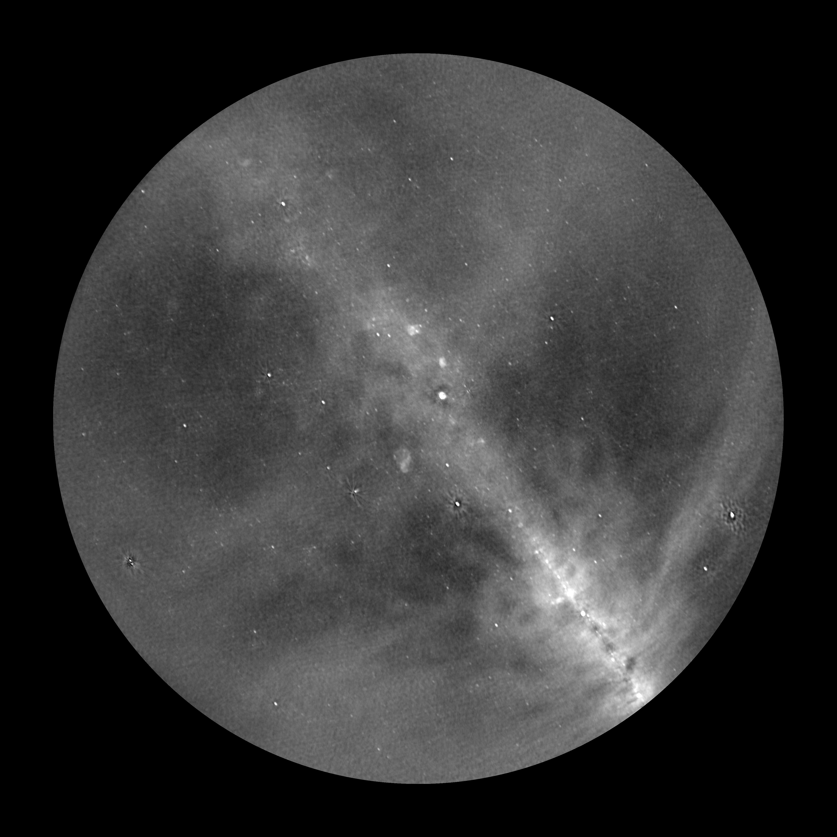

Slide 16
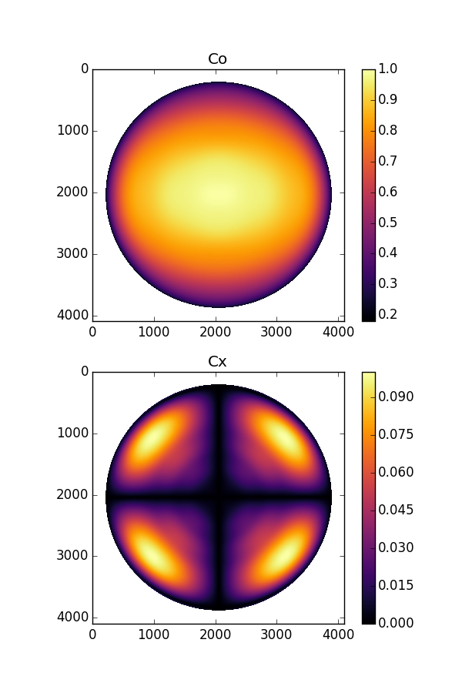
Polarization calibration
LWA dipole far-field complex voltage pattern, from D. Woody’s simulation
Beam pattern in Ludwig’s 3rd polarization coordinate system
Co
Cx
J_{beam} =
-Cx₉₀
Co₉₀
Beam pattern for two crossed-dipoles in all four Stokes parameters

Slide 17
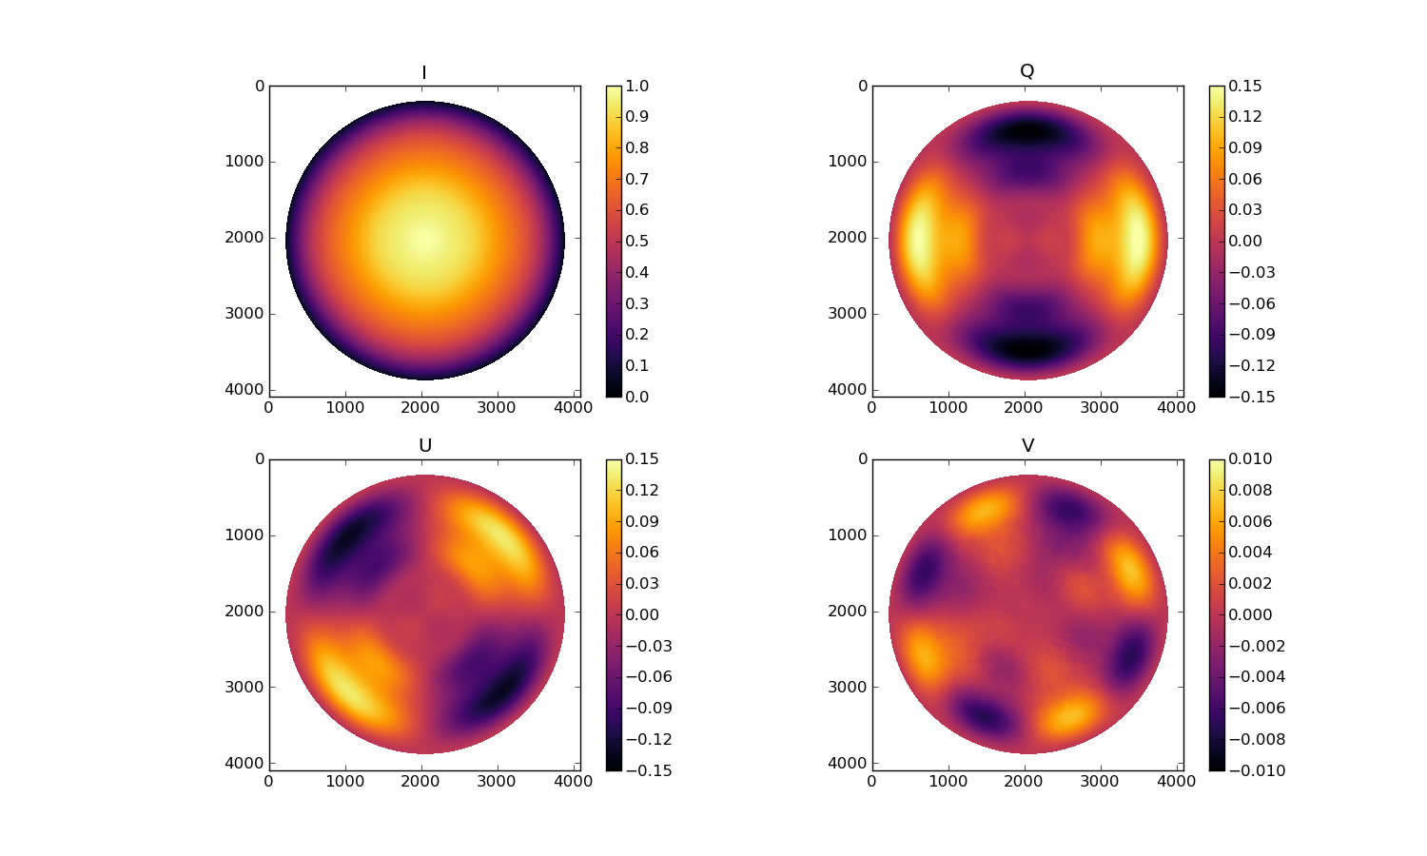
OVRO-LWA Polarized Beam

Slide 18
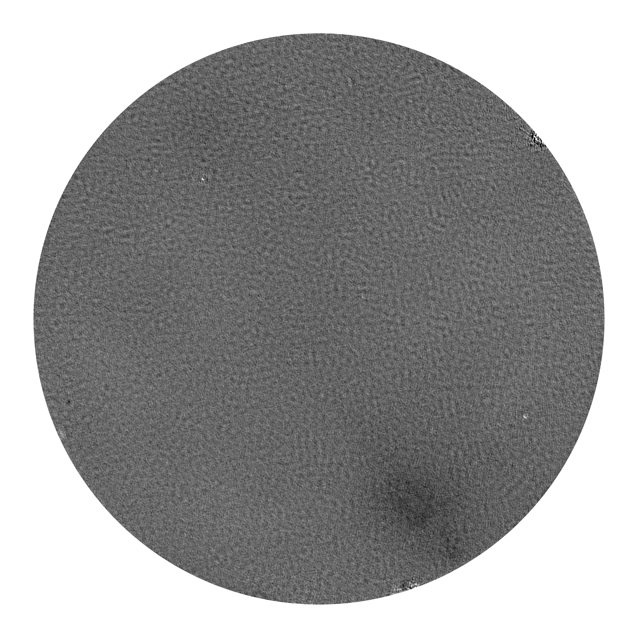
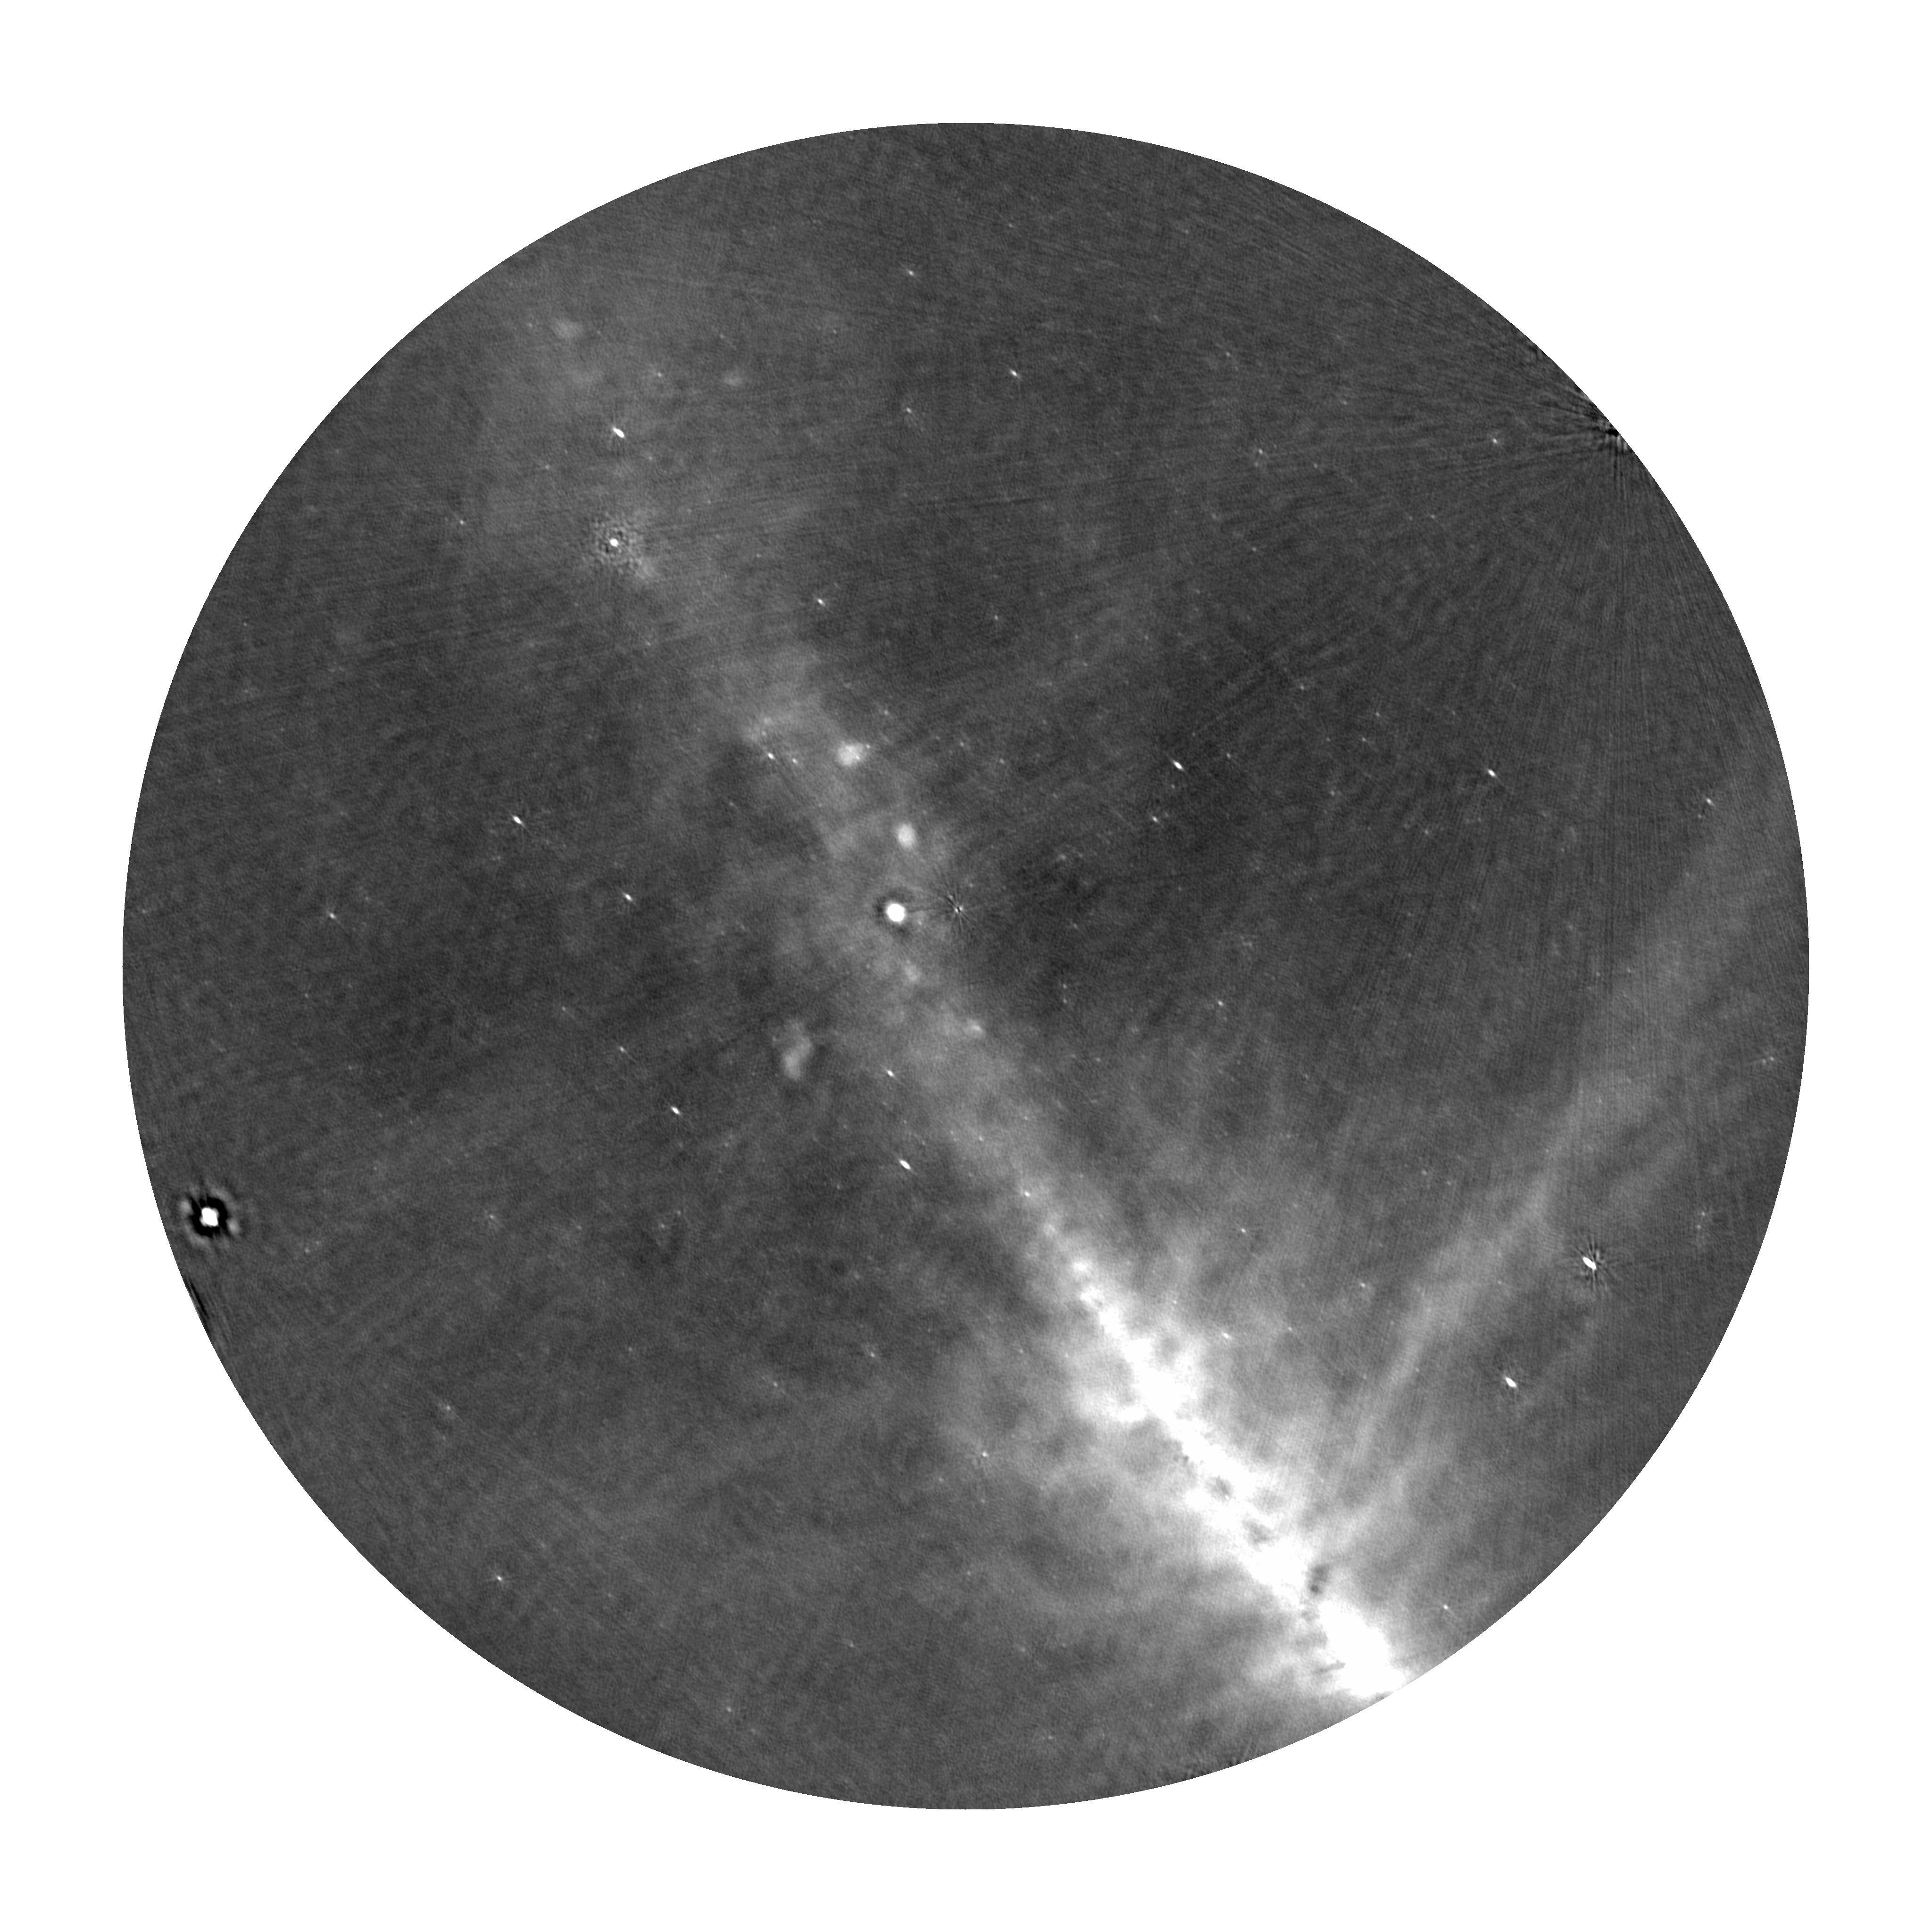
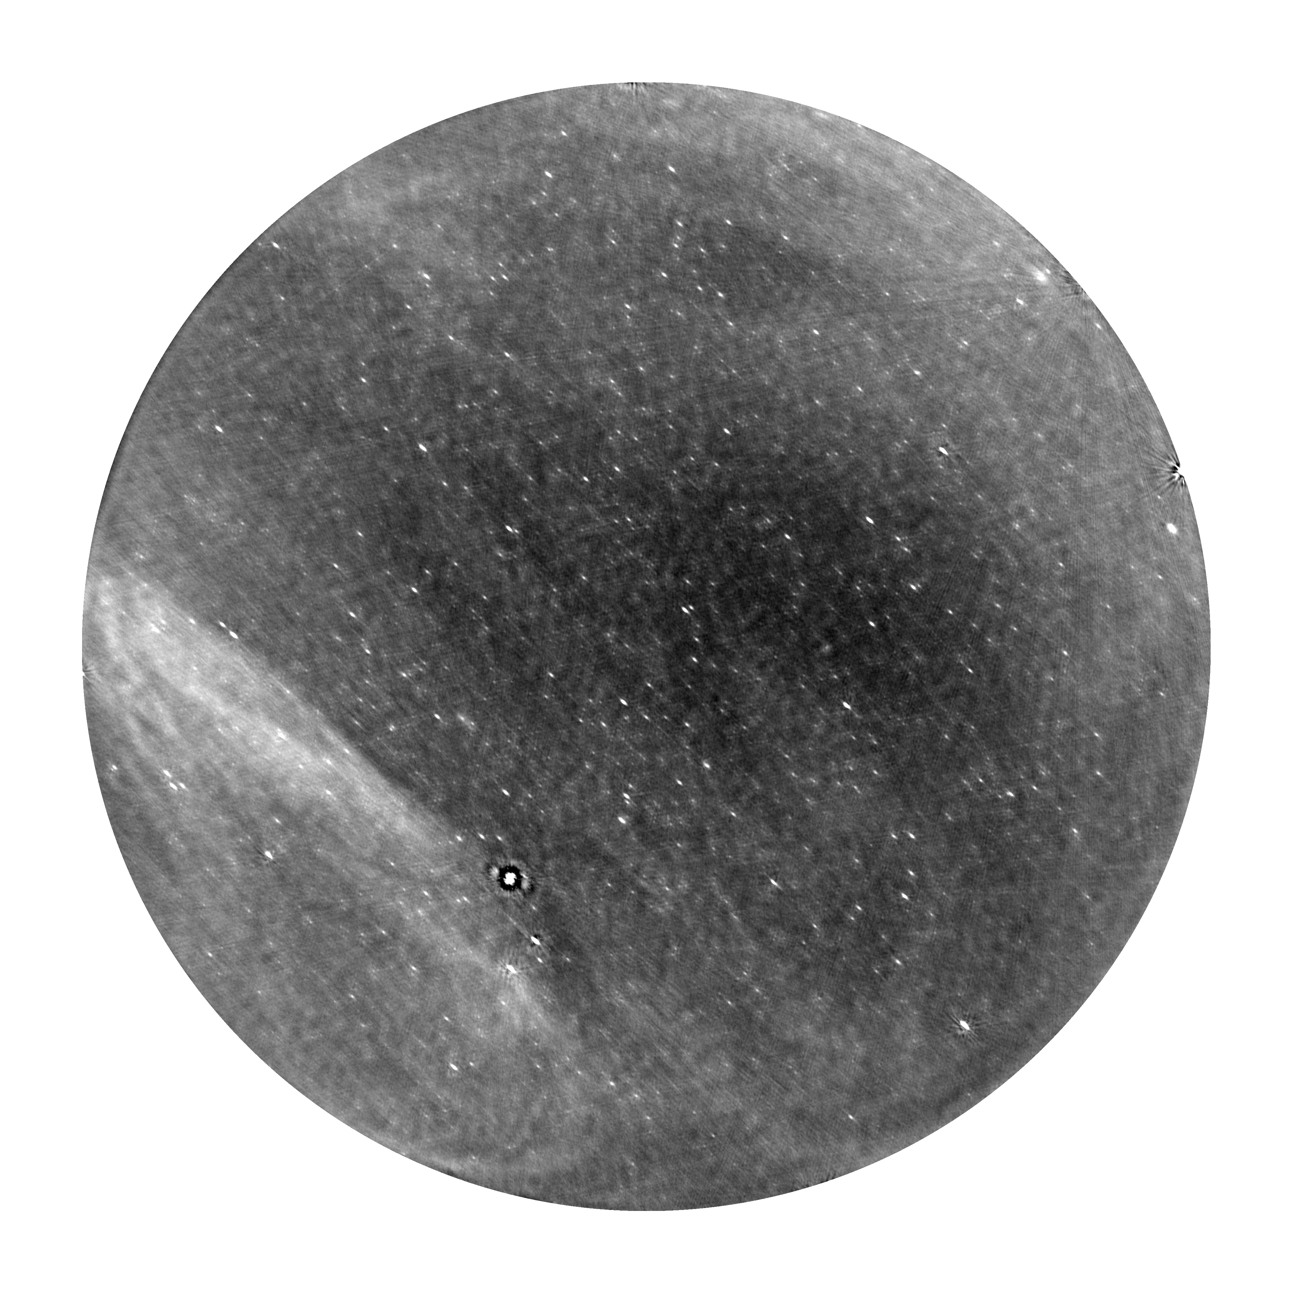
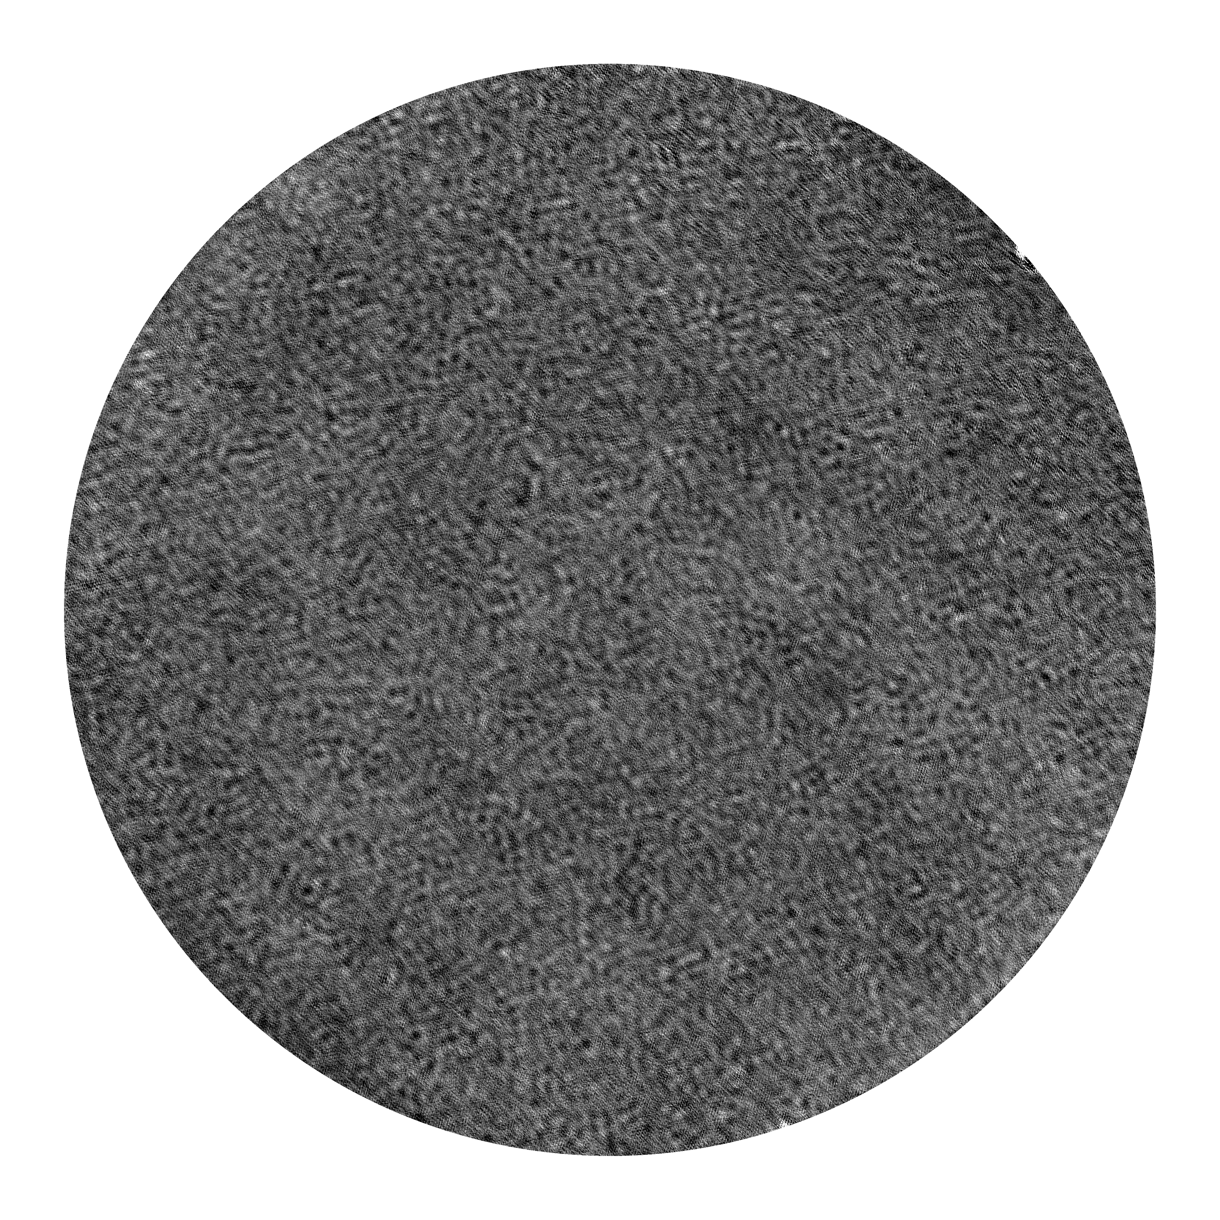
Searching in Stokes V removes the haystack from the needle.

Slide 19
Polarization calibration
Target sensitivity in Stokes V
Grießmeier et al. 2011

Slide 20
The Owens Valley Radio Observatory
Long Wavelength Array (OVRO-LWA)
256 crossed-dipoles
Spread out across 200-m diameter core
Added 32 additional dipoles
Increased maximum baseline out to ~1.5-km
Final array of 352 antennas
New correlator for 704 inputs
1
2
3

Slide 21
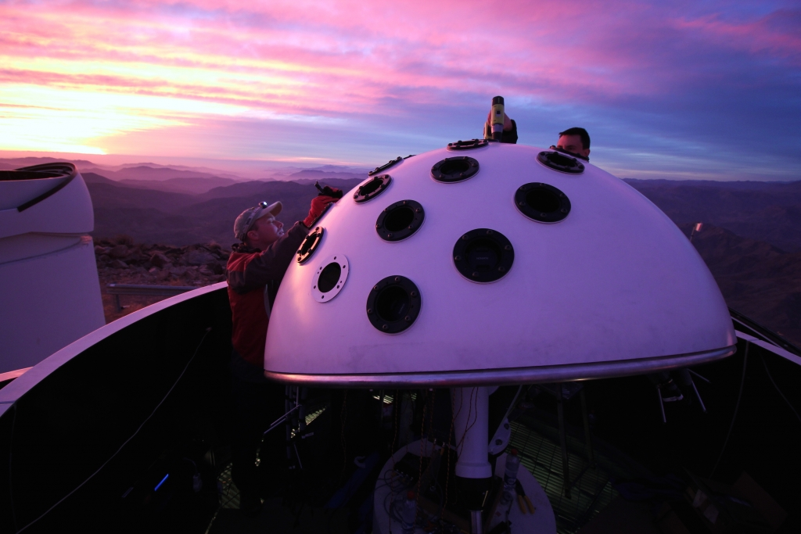
Survey with the full, Stage III array will use simultaneous radio and optical observations.
LWA
Evryscope
Nicholas Law et al.
All-sky radio
All-sky optical
Will form Stage III 1000-Hour Survey

Slide 22
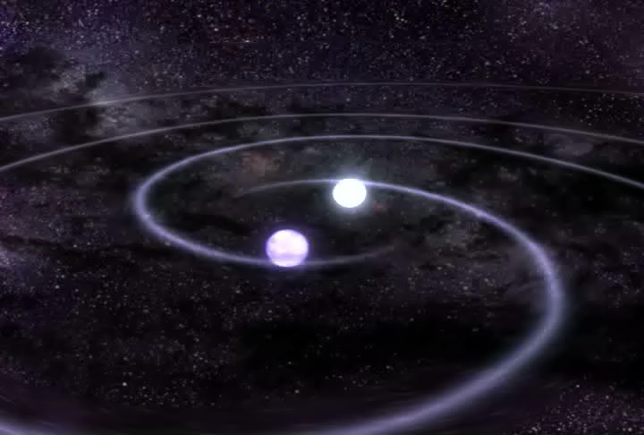
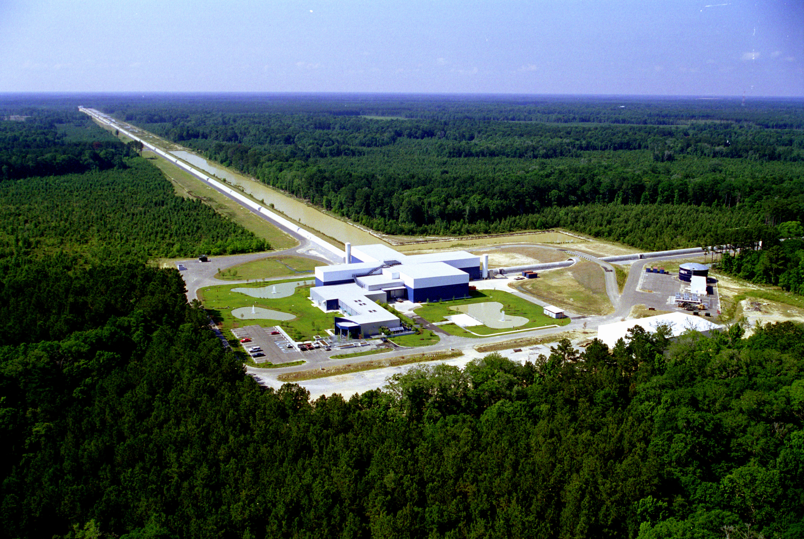
Binary neutron star mergers
Prompt, coherent low frequency radio emission detectable following GW or GRB trigger.
Theoretically predicted (but highly speculative), coherent low frequency counterpart to GW event.

Slide 23
Low frequency counterparts to high-energy and aLIGO triggers
Currently conducting continuous observations with 2-day buffer
Enables response to GRB and aLIGO triggers
OVRO-LWA
Buffer mode
Detection by OVRO-LWA provides temporal + spatial localization
Buffer mode enables response to all Swift triggers.
Compact object mergers
Singer et al. 2014

Slide 24
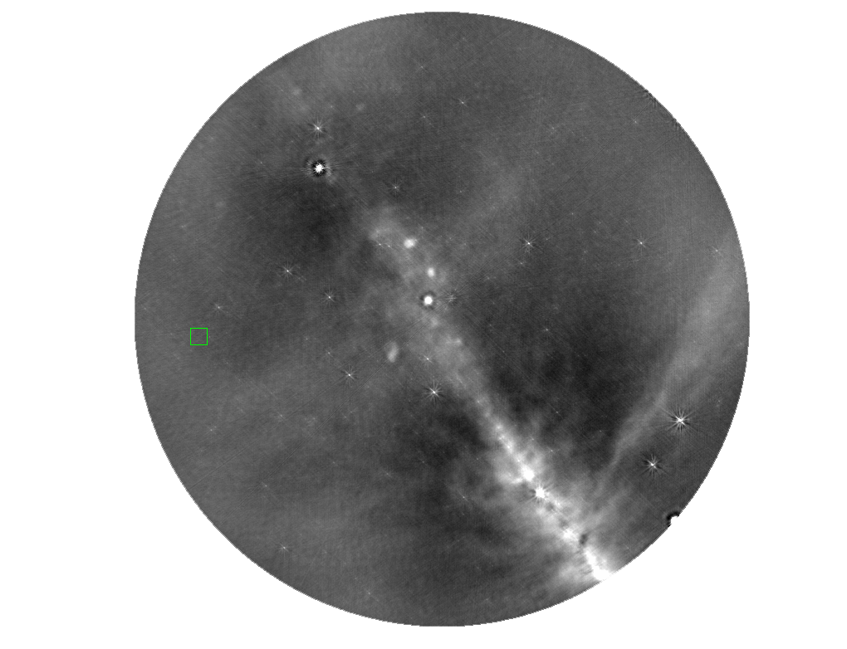
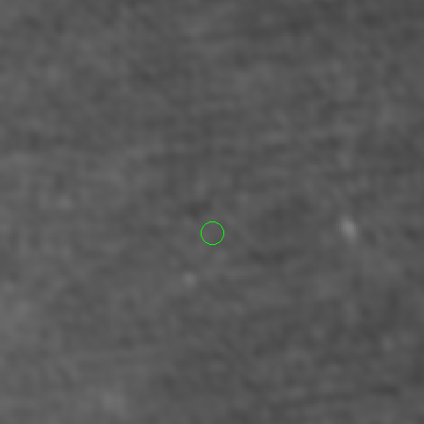
Long GRB 161202A detected by Swift

Slide 25
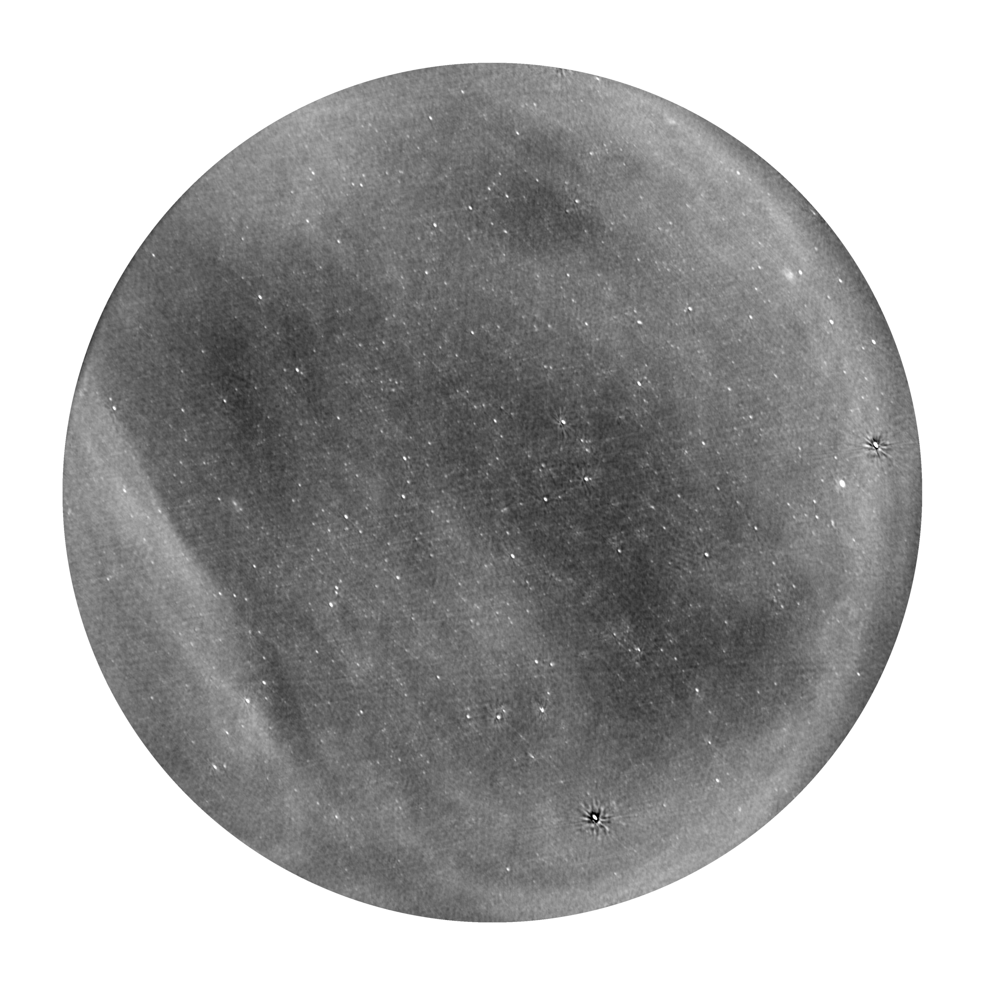
Summary
OVRO-LWA 100-Hour Survey: Monitoring nearly 4000 systems out to 25 pc for extrasolar space weather events. Exciting times…watch this space!
OVRO-LWA Buffer Mode of Operation: 2-day long buffer allows us to respond to Swift and aLIGO O2 triggers to look for low frequency counterparts coincident with, as well as preceding, NS-NS mergers.

