Slide 1






Searching for Transient Sources at Low Radio Frequencies
Antonia Rowlinson
9th December 2016
Notes:
Highlights from MWA and LOFAR
See also talks by Martin Bell and Christine Lynch

Slide 2
Thanks to…
LOFAR Transients Team
MWA Transients Team
Jess Broderick (ASTRON)
Dario Carbone (UvA)
Yvette Cendes (UvA)
Rob Fender (Oxford)
Alexander van der Horst (GWU)
Folkert Huizinga
Mark Kuiack (UvA)
Gijs Molenaar (UvA)
Peeyush Prasad (UvA)
Bart Scheers (UvA)
Tim Staley (Oxford)
Adam Stewart (Oxford)
John Swinbank (Princeton)
Ralph Wijers (UvA)
Keith Bannister (CSIRO)
Martin Bell (CSIRO)
Steve Croft (Berkeley)
Paul Hancock (Curtin)
David Kaplan (UWM)
Cleo Loi (Cambridge)
Christine Lynch (Sydney)
Tara Murphy (Sydney)
Steven Tingay (INAF/Curtin)

Slide 3
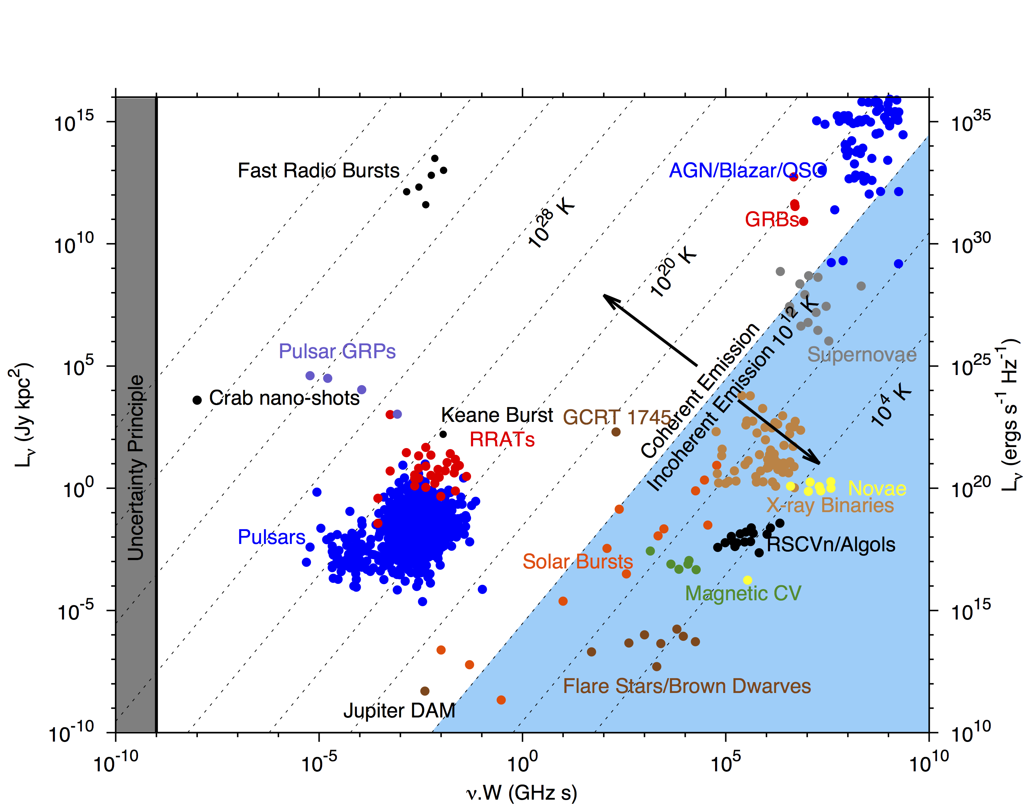
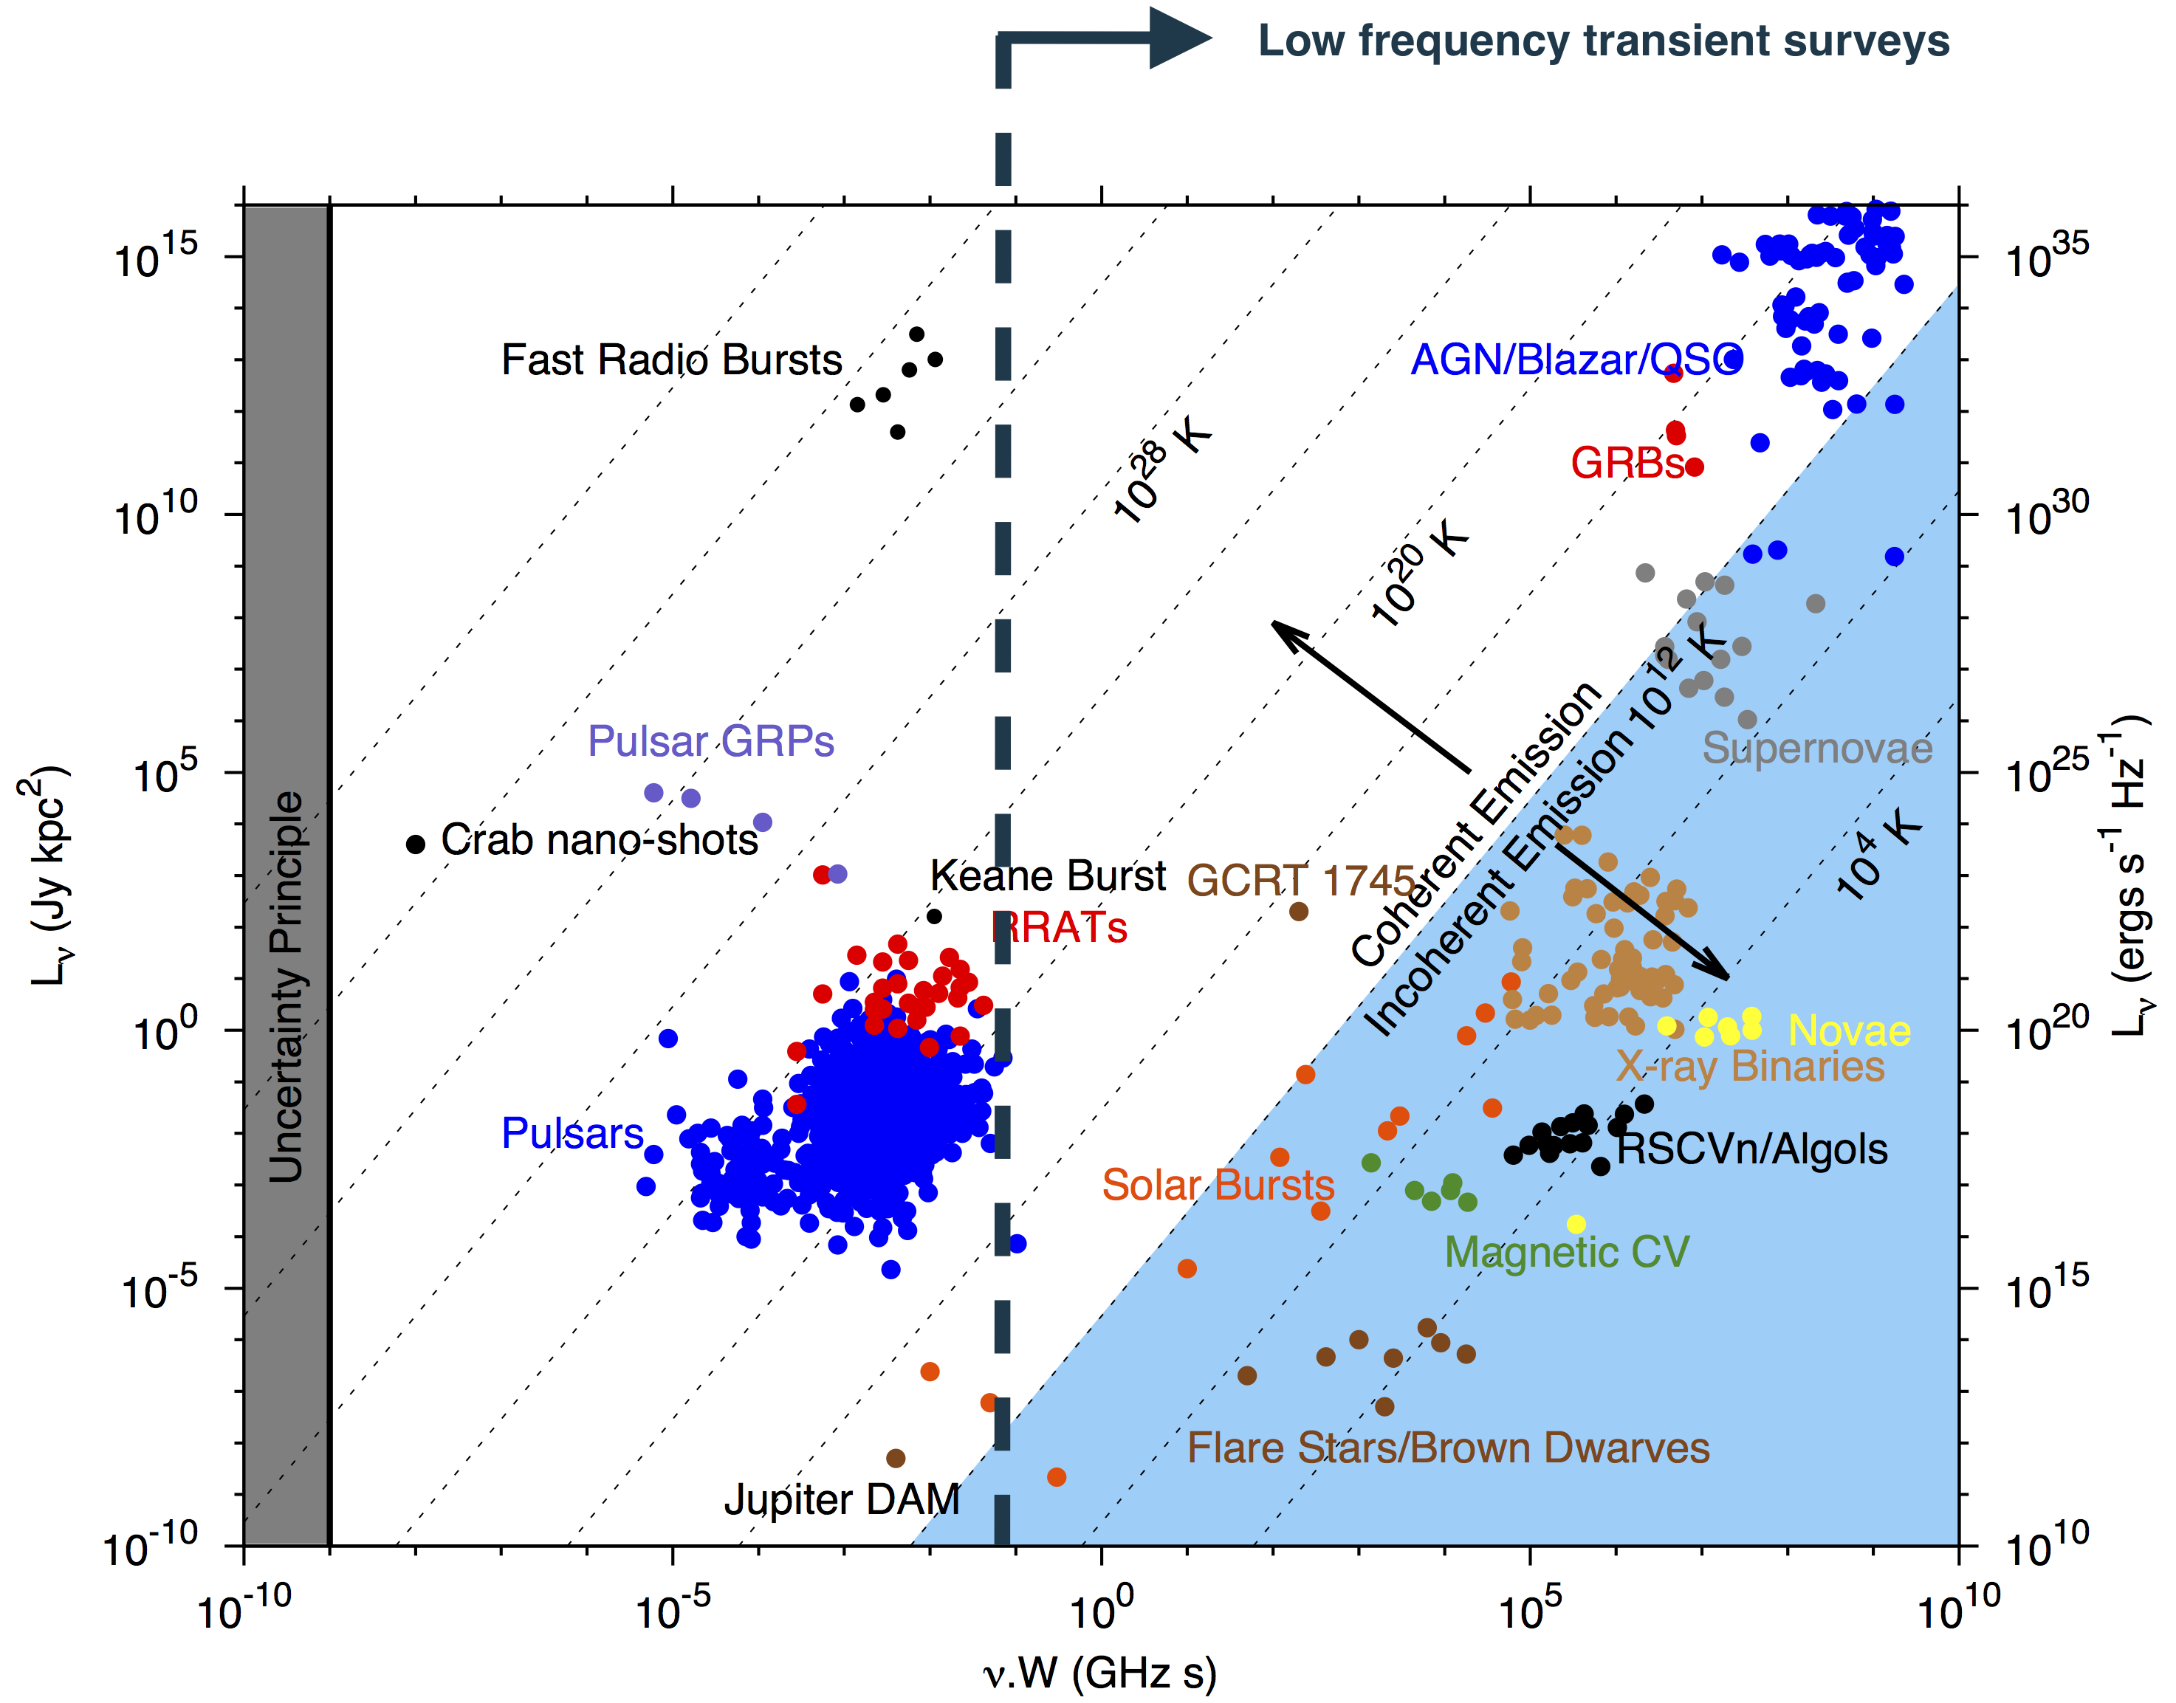
Relatively
Unexplored Territory
Pietka et al. (2015)
Notes:
TB < 10^12 synchrotron emitters, timescales months to years at low frequencies. We’re looking but this is not our target parameter space – we’re after the relatively unexplored region between high time res and synchrotron.
GCRT – 1745 : detected five bursts of radio waves about 1 meter in wavelength (frequency 330 MHz) during a seven-hour period from September 30 to October 1, 2002. The five bursts were of equal brightness, with each lasting about 10 minutes, and occurring every 77 minutes.^{[2]}

Slide 4
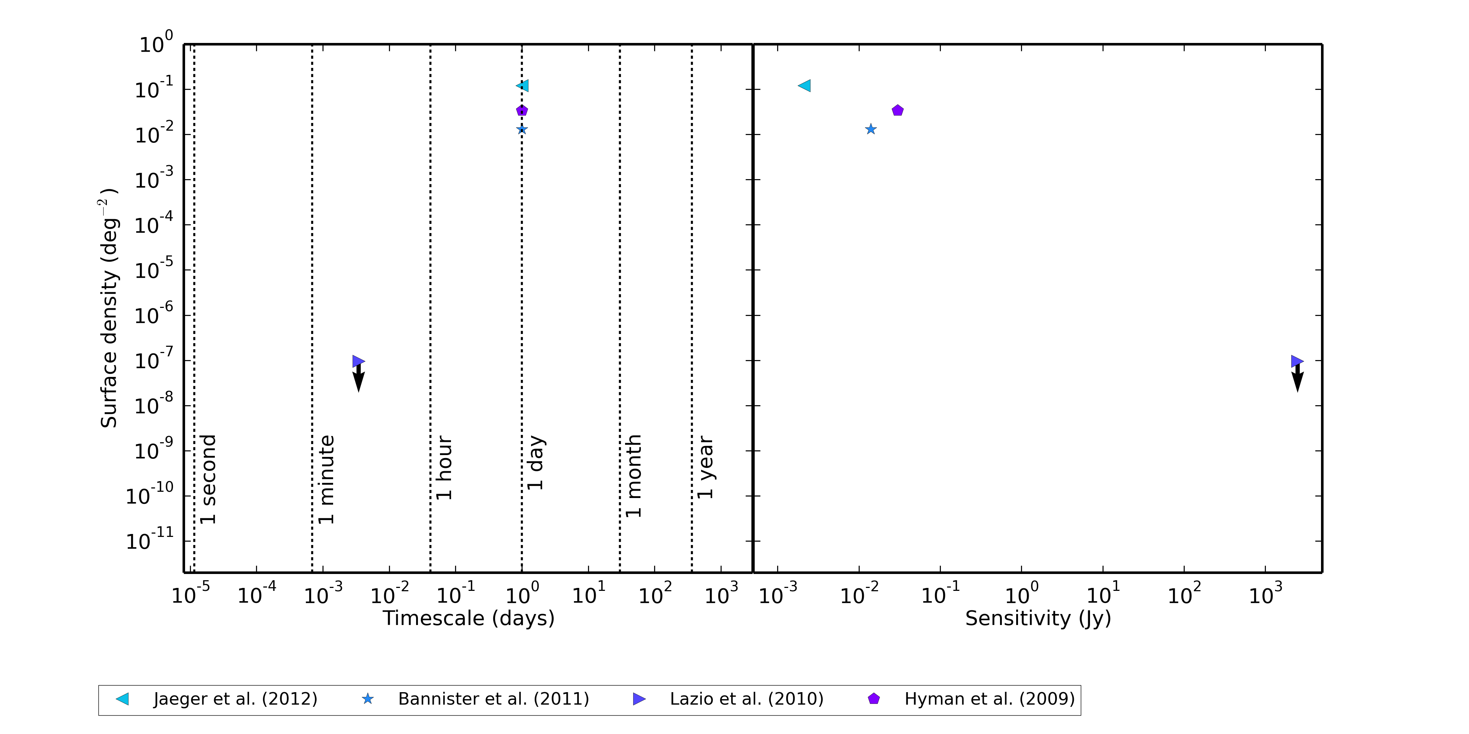
Transient surveys <1 GHz prior to 2014
Notes:
Prior to 2014, transients at low radio frequencies were relatively unconstrained
New facilities have opened up this parameter space with orders of magnitude increase in sensitivity and short snapshot capabilities
But wait…

Slide 5
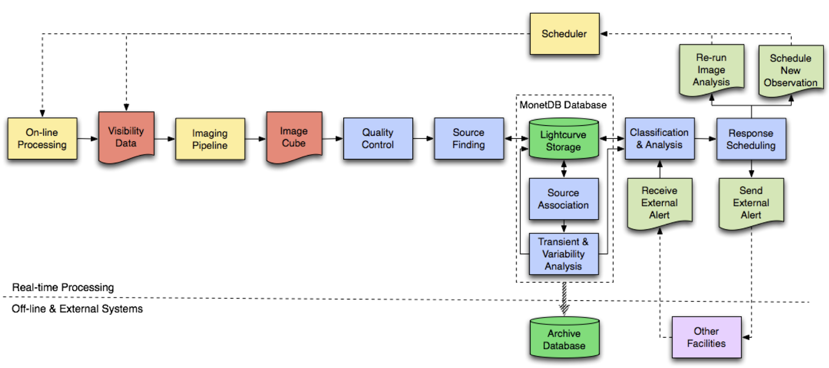
LOFAR Transients Pipeline (TraP)
TraP
Free and publicly available:
  http://docs.transientskp.org (Documentation)
  https://github.com/transientskp/tkp (Code)
Swinbank et al. (2015)
See also the VAST Pipeline (Murphy et al. 2013)

Slide 6
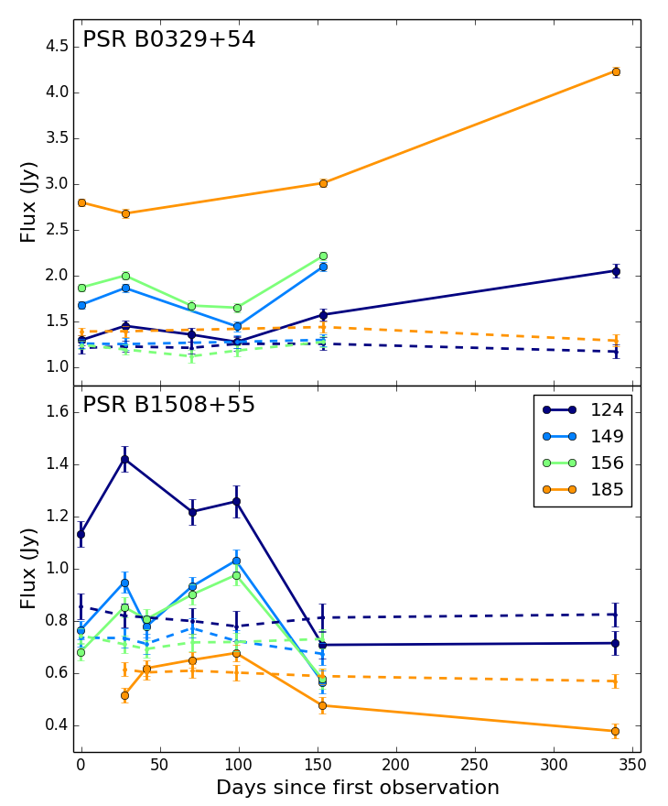
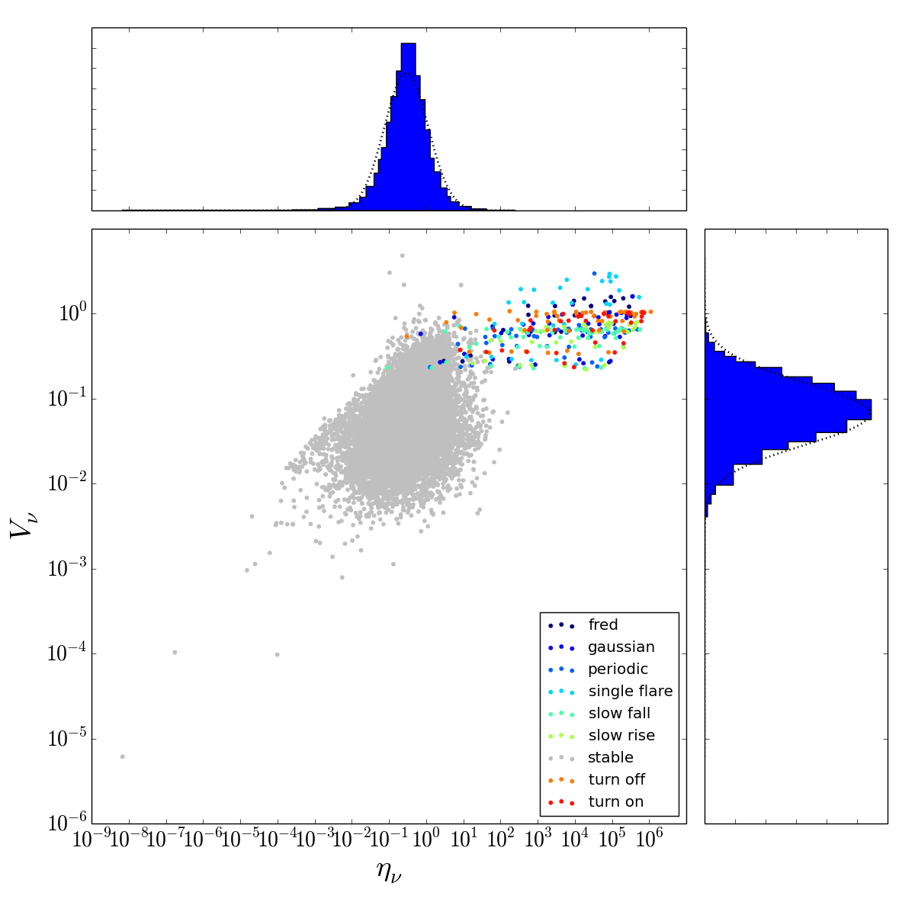
Interpreting TraP results
TraP stores variability parameters for all sources in a database
Using machine learning strategies we can identify transient and variable sources
Variability Index
Reduced Weighted Χ²
Rowlinson et al. (in prep)

Slide 7
The first low frequency transient
Frequency 57 MHz
Duration ~4 minutes
Stewart et al. (2016)
Notes:
What we know:
Likely a coherent emitting source or very nearby
No variable source or potentially variable source (e.g. M star) in optical follow-up of error box
Incoherent origin – not inconsistent with a flare star but emission is too long in duration and unusual that no other bursts seen and non-detection in optical would mean it is eiither too luminous in radio or the star would have to be substellar
Coherent origin – too luminous and long for a single FRB, though could be a bunch of FRBs combined

Slide 8

Pietka et al. (2015)
Notes:
Adam’s transient similar to GCRT 1745, both several minutes, both low frequency, both steep spectra. GCRT thought to be Galactic. But Adam’s is much lower frequency.

Slide 9
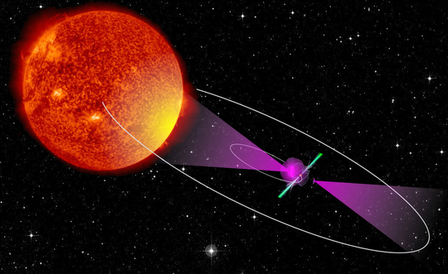
Redback pulsar J2215+5135
Broderick et al. (2016)

Slide 10
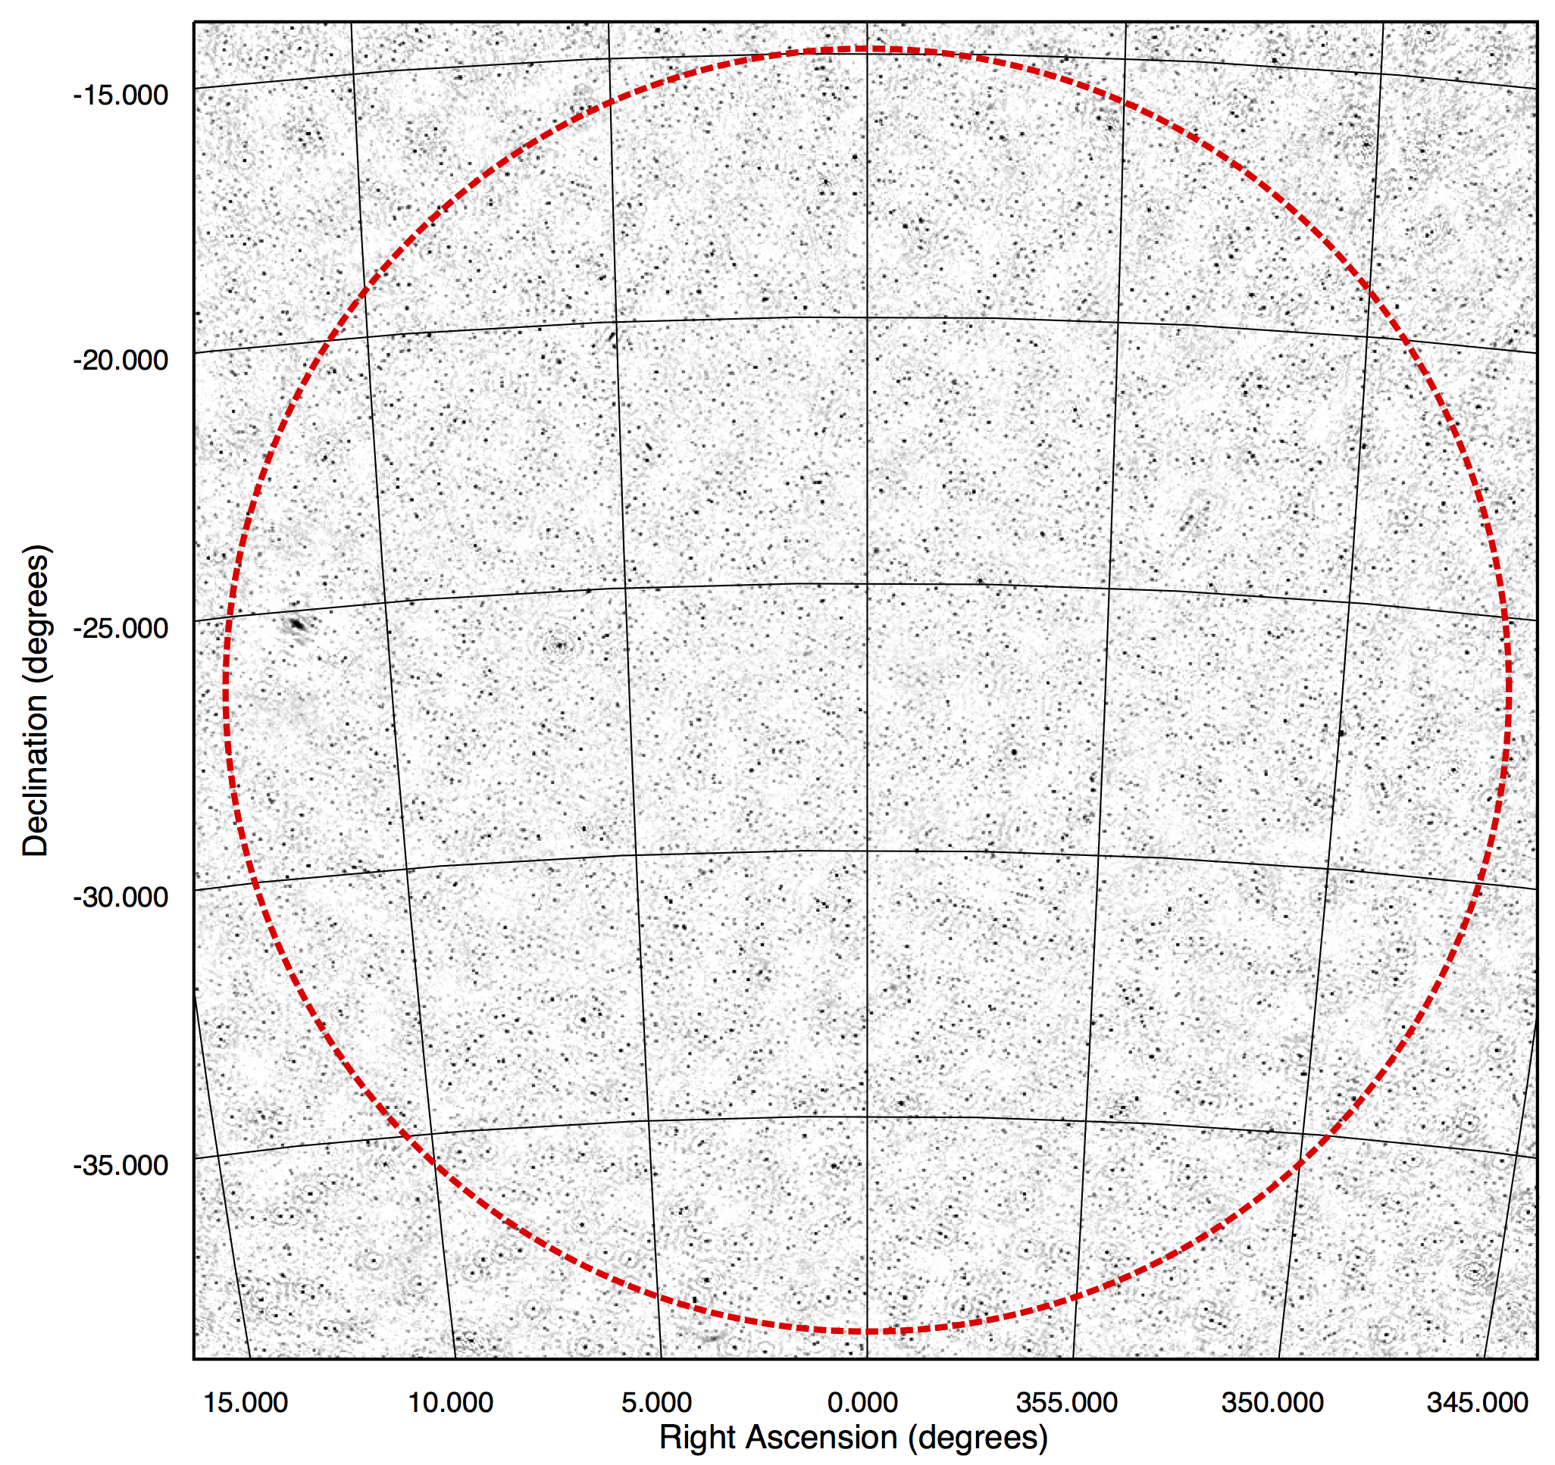
MWA commensal transient searches
EoR Observations (EoR0 field)
28 second images targeting a wide range of timescales (30 seconds to 1 year)
Processed with TraP
No transients detected using comparison to deep median image
No sources with >20% variability
Median image of the surveyed field, ~5000 sources
Rowlinson et al. (2016)

Slide 11
GLEAM-TGSS Transient Search
Comparison of GLEAM (Hurley-Walker et al. 2017) to TGSS (Intema et al. 2016) at 150 MHz
304 mJy candidate detected in TGSS but not in GLEAM, archival data or dedicated follow-up
Murphy et al. (2017)

Slide 12
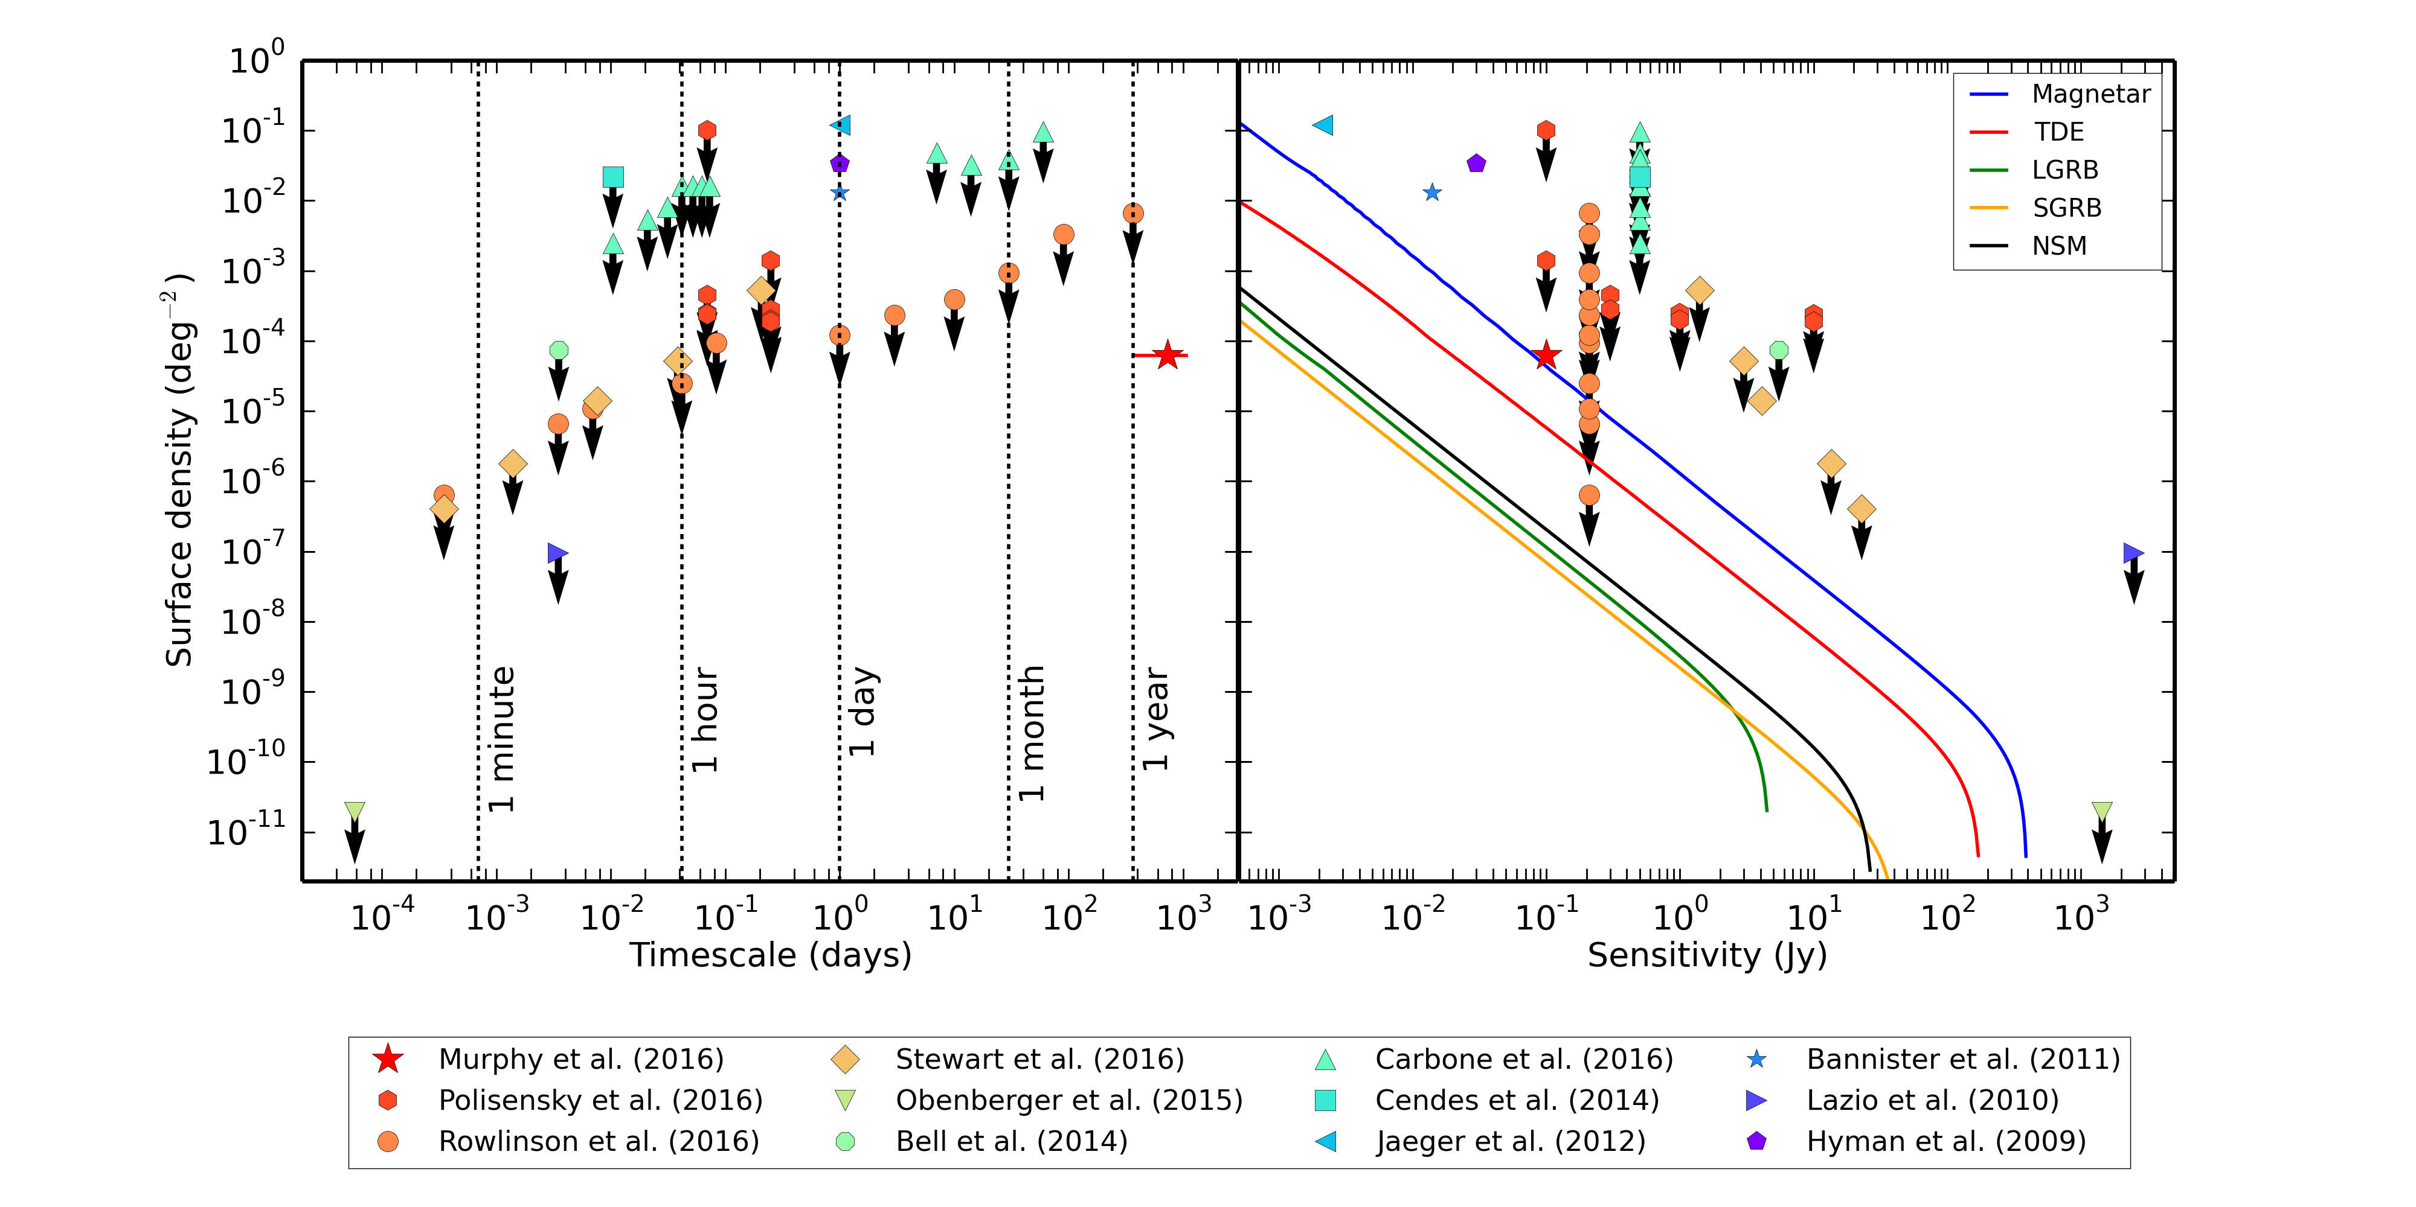
Progress 2014 - now
Murphy et al. (2017)
Notes:
Non detection of Stewart et al. transients so spectral slope must be very steep (>-3)

Slide 13
Advances in interpreting limits
Carbone et al. (2016a, 2016b)

Slide 14
All-Sky Monitoring
Very rapid timescales (~seconds)
  Technological challenge to image and process in real-time
Targeting rare, bright and coherent transient sources
Pioneering instruments are LWA-OVRO (see talks by Greg Hallinan & Marin Anderson) and AARTFAAC

Slide 15
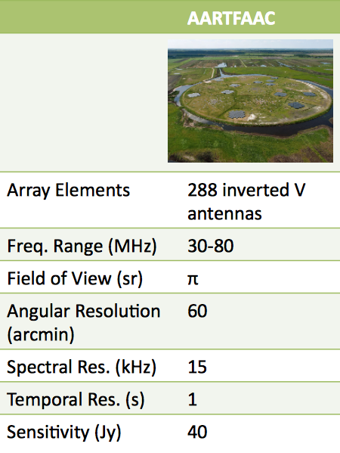

AARTFAAC
Amsterdam-ASTRON Radio Transients Facility & Analysis Centre
Prasad et al. (2014, 2016)
Credit: Mark Kuiack
Notes:
Movie is 16 subbands integrated and 1 second time resolution, RMS is a few Jy.
Could do image plane de-dispersion
AARTFAAC 6, but upgrading soon to include 6 more LOFAR stations – improving sensitivity by factor of 2 and significantly improving positions
12 hour AARTFAAC dataset that we are currently processing – this movie is made by selecting 1 image every minute
Flux calibrated and primary beam corrected images
Galactic plane
With uncertain rate from Stewart et al. transient, we expect 1-3 per day

Slide 16
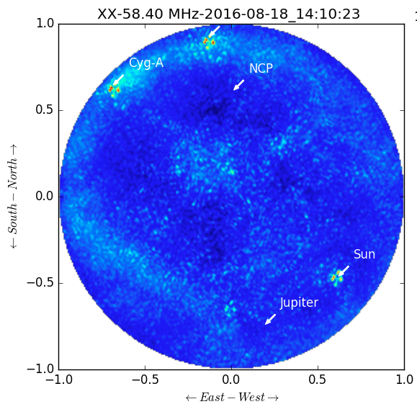
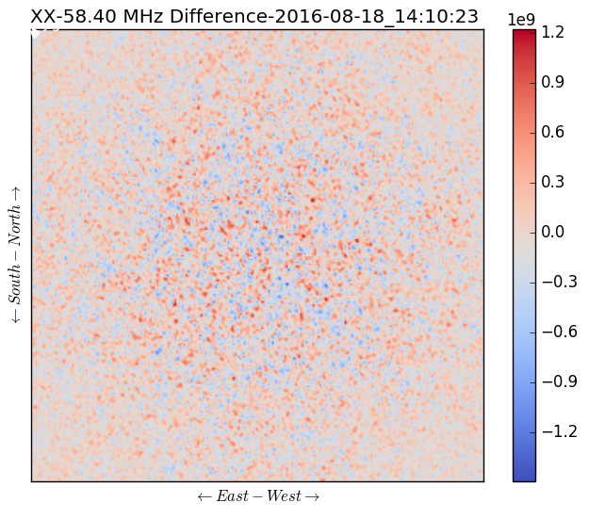
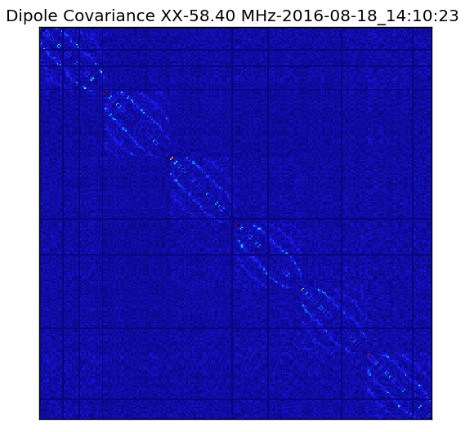
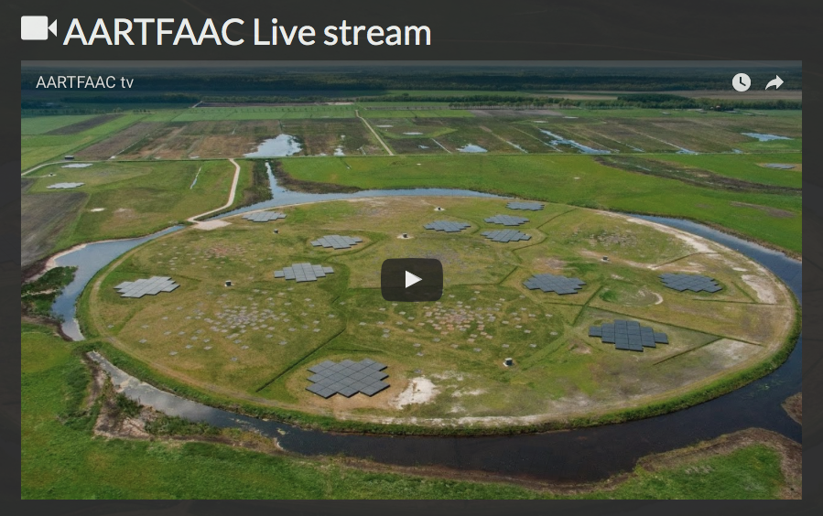
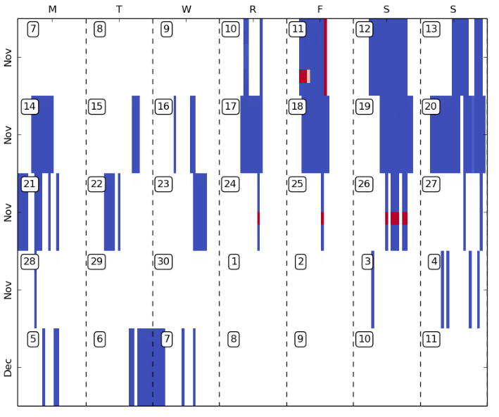
AARTFAAC – real time monitoring

Slide 17
AARTFAAC – commissioning phase
Whole sky integrated image
Credit: Mark Kuiack
Data now being obtained with all LOFAR LBA observations
Monitoring system and Live TV website nearing completion
Real-time interface to TraP implemented and in testing phase
Improved flux calibration method to be implemented soon
TraP database querying methods being finalised

Slide 18
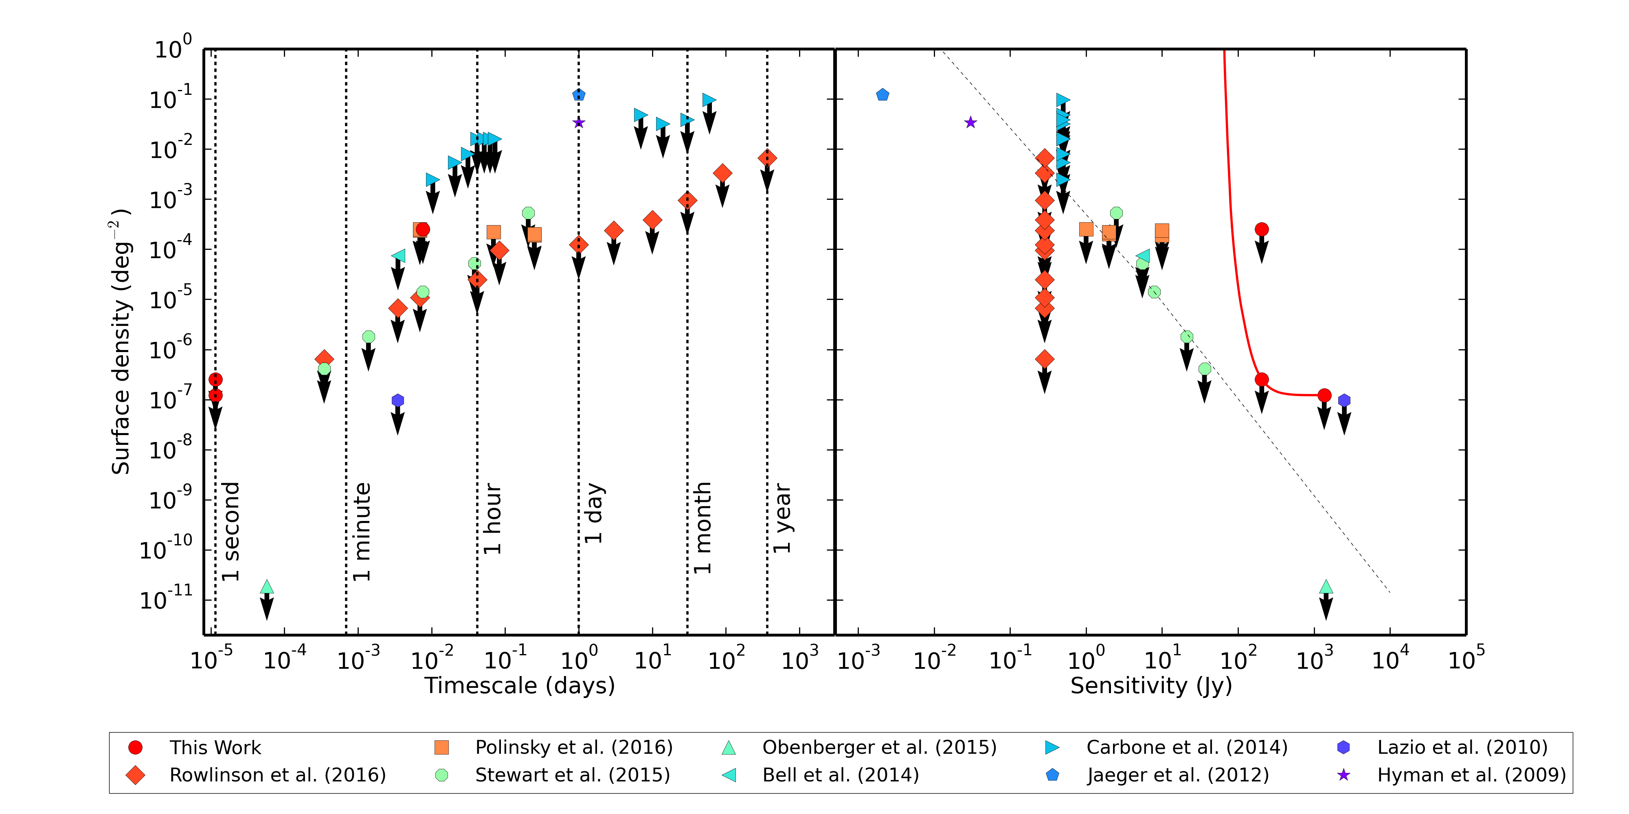
Progress 2014 - now
~4 hours
1 subband
Cendes et al. (in prep)
Notes:
Next survey (Kuiack et al. in prep) 72 hours and 16 subbands

Slide 19
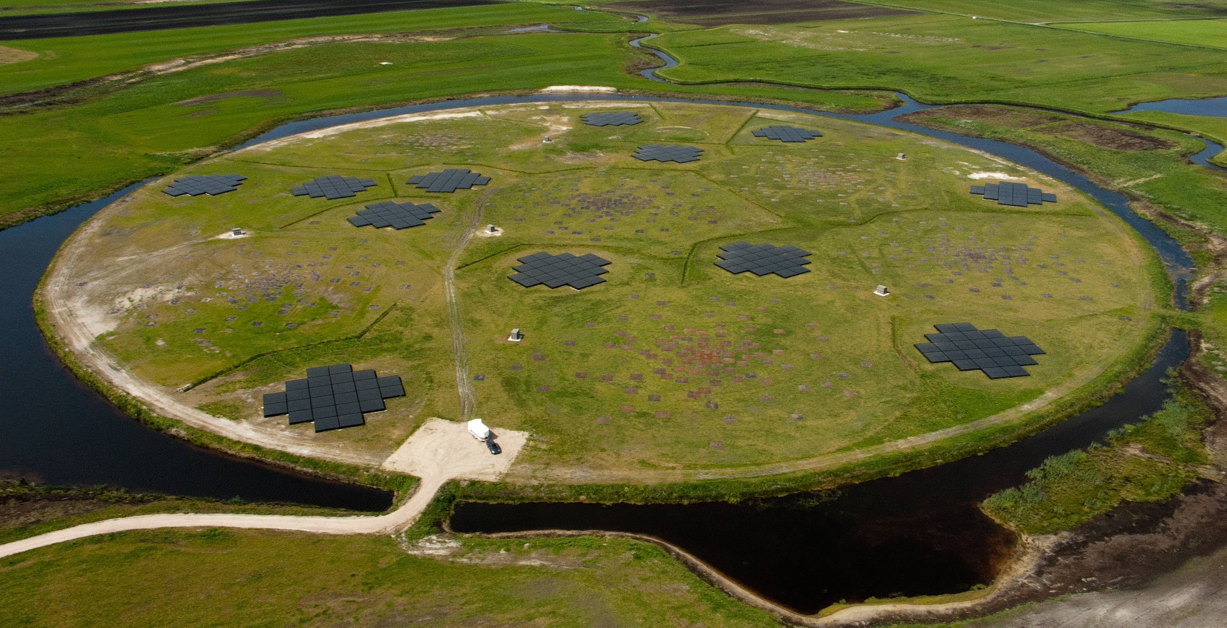
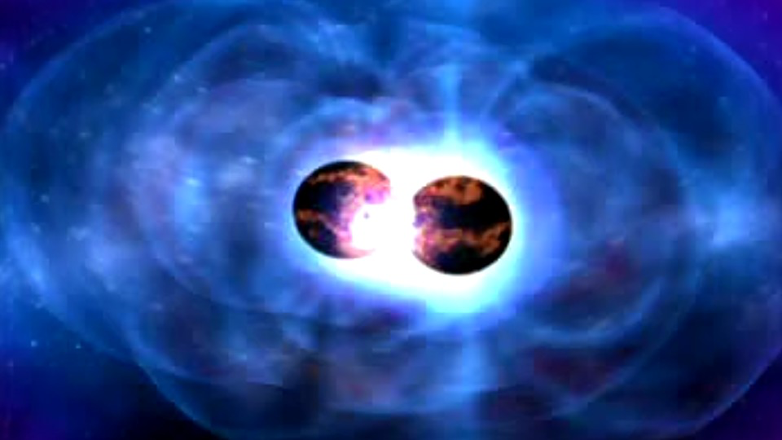
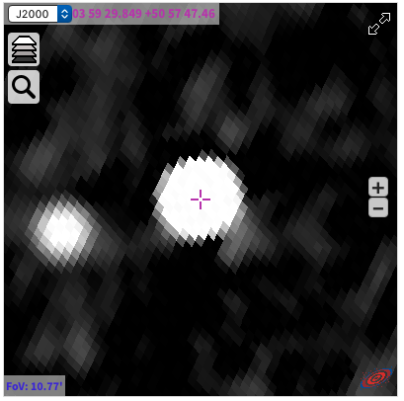
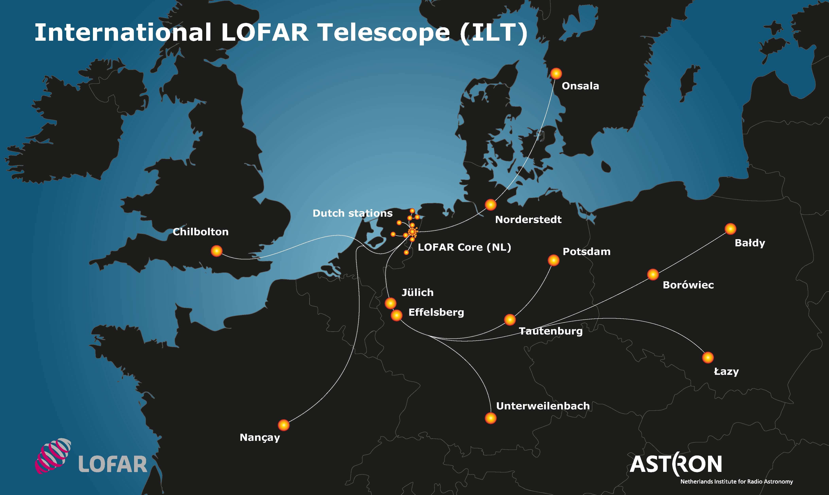
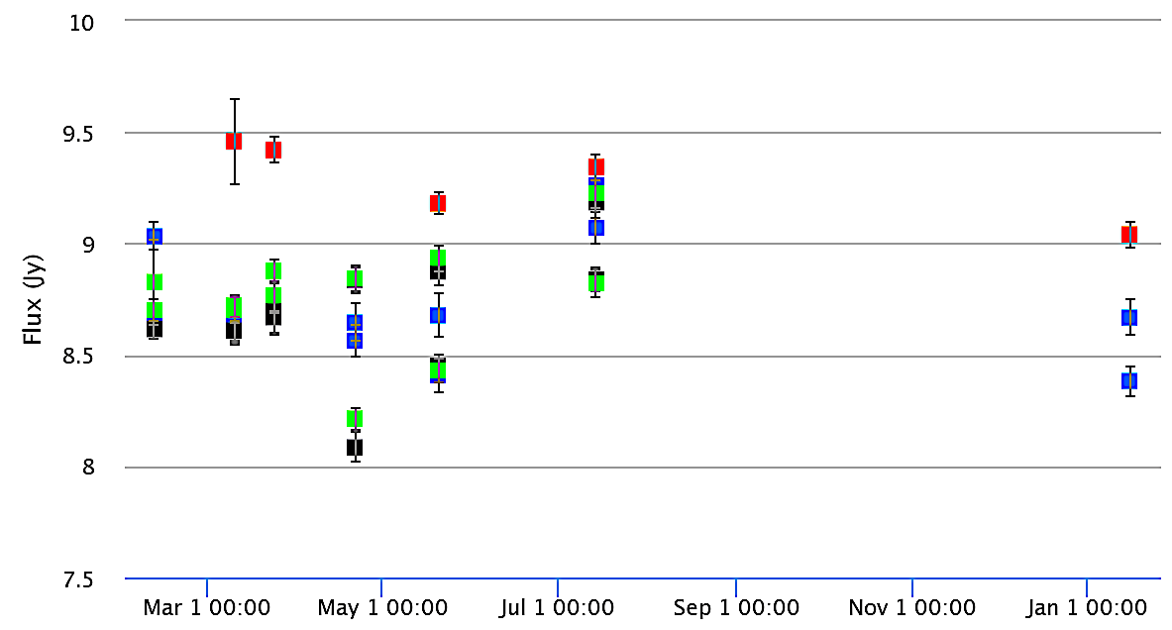
Find
transient
Identify source
Trigger
observations
Constrain properties
Notes:
Once we find an event, we want to identify what it is. But AARTFAAC has poor spatial res (1 deg) and sensitivity, so not ideal instrument for monitoring.
But is imbedded in LOFAR! So we will rapidly trigger full LOFAR observations to monitor the position. I am leading the development and commissioning of this mode with the Radio Observatory at ASTRON.
These observations will be used to obtain lightcurves, positions that are orders of magnitude better that can be used for follow-up and spectra
With the follow-up we will be able to identify/constrain the source.

Slide 20
Rapid triggering at low frequencies
Coherent Emitters
Incoherent Emitters
MWA capability
Future…
Coming soon!
LOFAR capability
Notes:
Poor localisations – can use temporal coincidence in field alongside extremely low transient rates at these frequencies.

Slide 21
Short GRB 150424A
(MWA triggered observation)
26 seconds after GRB
10 seconds after VOEvent
Kaplan et al. (2015)

Slide 22
Multi-wavelength follow-up of GW 150914
Majority of localisation region covered at each wavelength
MWA and LOFAR both conduct wide field follow-up of these events
Low frequency follow-up strategies being enhanced (Kaplan et al. 2016)
Abbott et al. (2016a, 2016b)

Slide 23
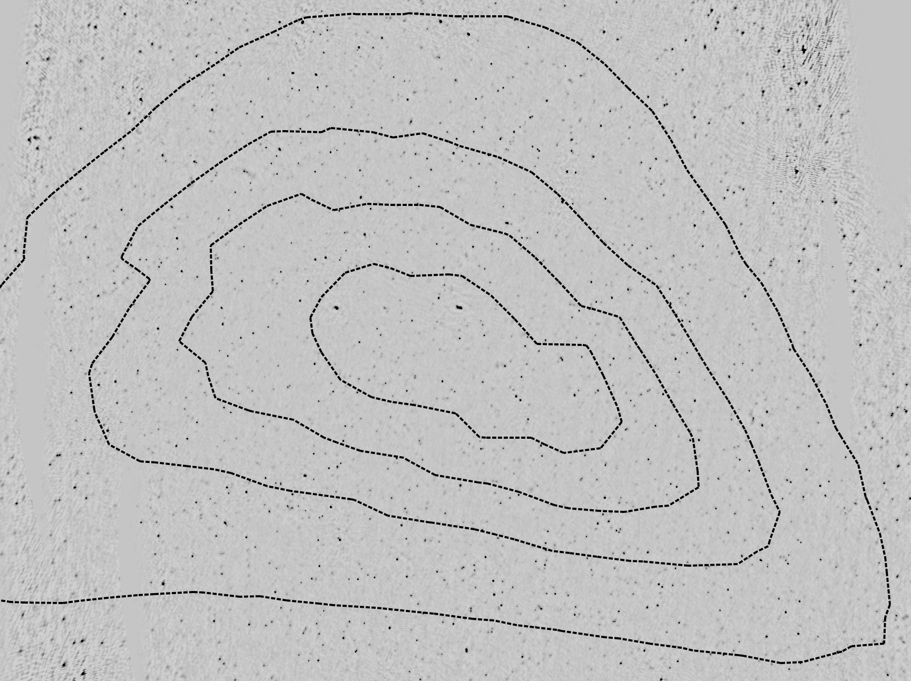
LOFAR follow-up of GW 150914
Mosaic of 8 SAPs at 145 MHz with a bandwidth of 11.9 MHz
Resolution 50”
RMS noise ~2.5 mJy and >2000 sources
Contours: cWB probability map
Timescales of 1 week, 1 month and 3 months
No transients down to ~30 mJy
Broderick, Rowlinson et al. (in prep)

Slide 24
Summary
Very rapid progress in both blind and triggered searches at low radio frequencies by LWA, MWA & LOFAR
Automated tools (e.g. TraP & VAST pipeline) exist to process large numbers of images
Real-time radio sky monitors (OVRO-LWA & AARTFAAC) will revolutionise our understanding of rare, bright transients
Rapid response modes for coherent low frequency radio transients are available with MWA and coming soon for LOFAR

Slide 25
Spare slides…

Slide 26
Expected emission
(with 1 or more neutron stars)
Coherent
Synchrotron
Chu, Howell, Rowlinson et al. (2016)

