Slide 1
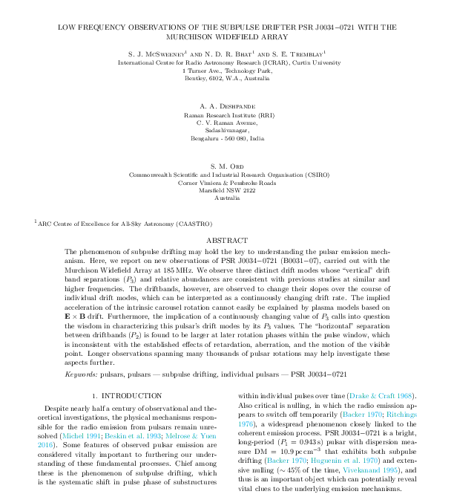
Attacking the
Pulsar
Emission Mechanism Problem
with the
MWA
Sam McSweeney
Ramesh Bhat
Steven Tremblay
Avinash Deshpande

Slide 3
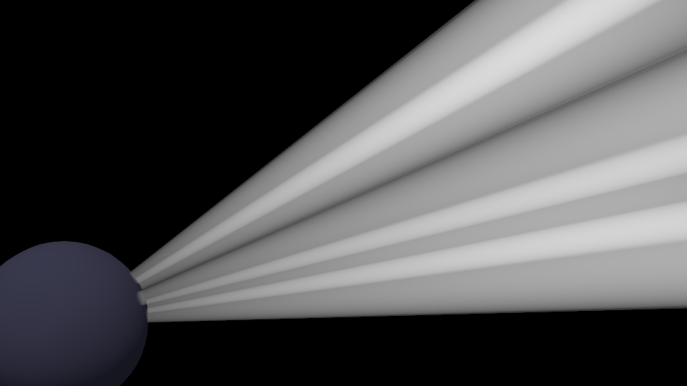
Plasma Models
Beam Geometry
Observed Emission

Slide 4
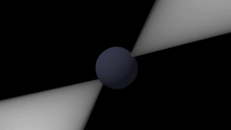
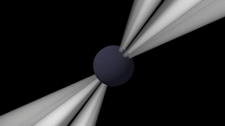
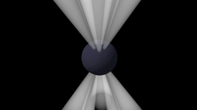
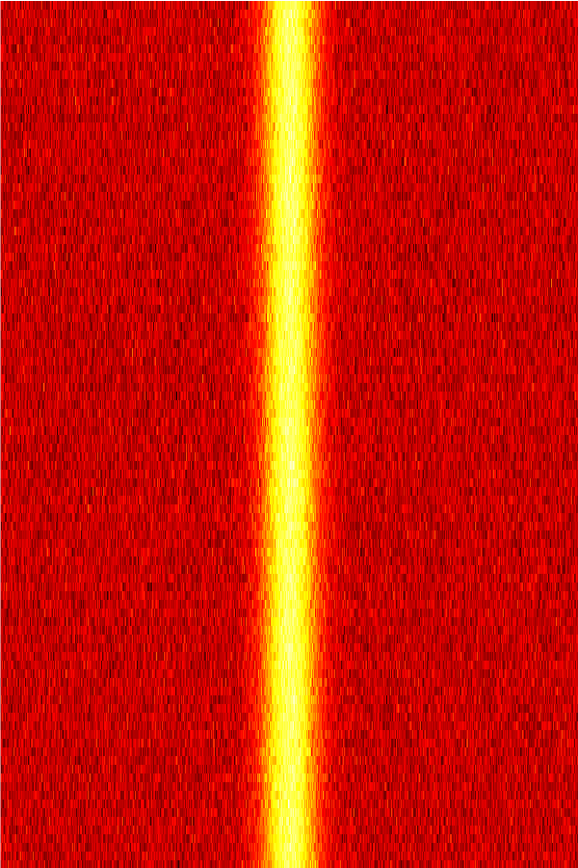
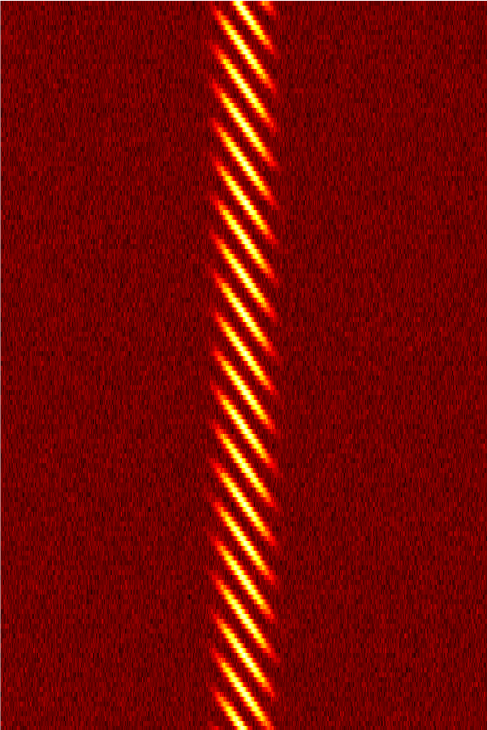
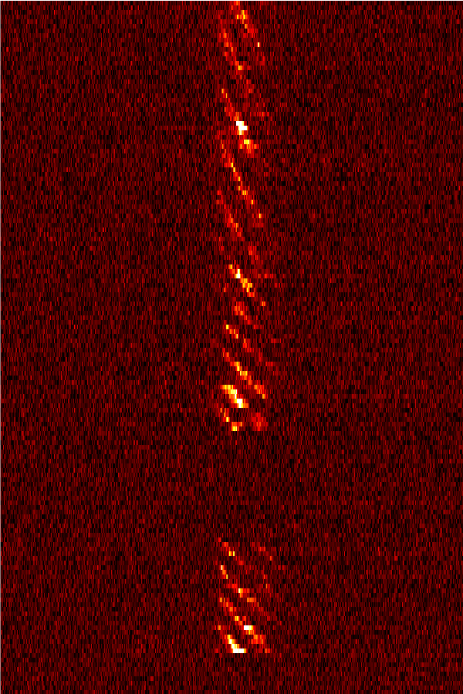
“Lighthouse”
Simulation
“Carousel”
Simulation
Real data
(PSR J0034-0721)
Time
Time
1 pulsar rotation

Slide 5
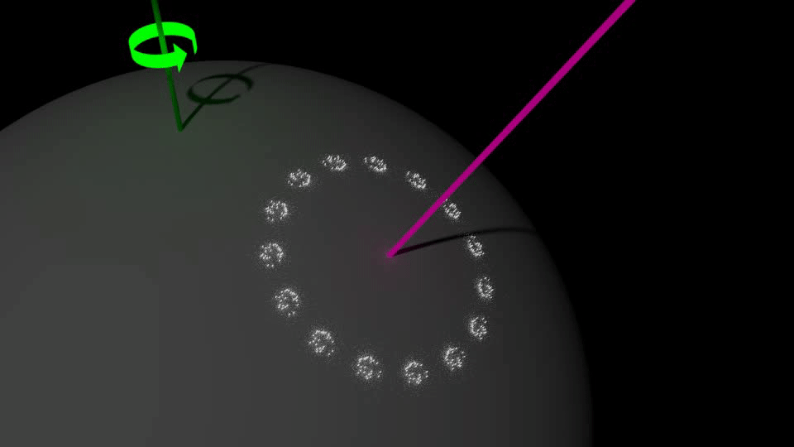

Slide 6


Slide 7
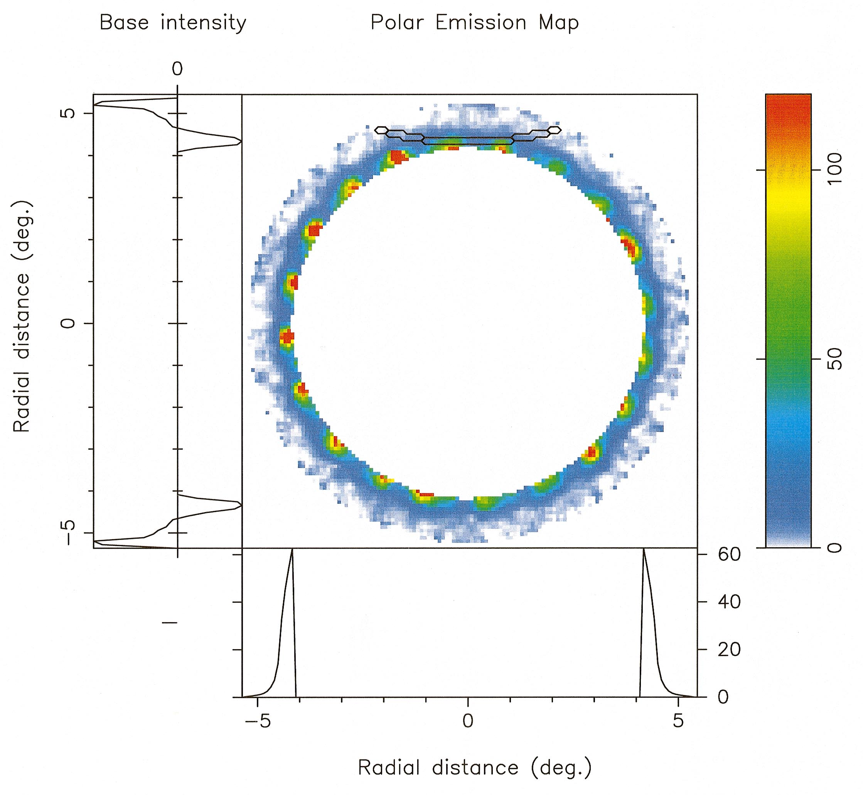
Lower frequency
emission
Deshpande & Rankin (2000)
Higher frequency
emission
PULSAR SURFACE

Slide 8
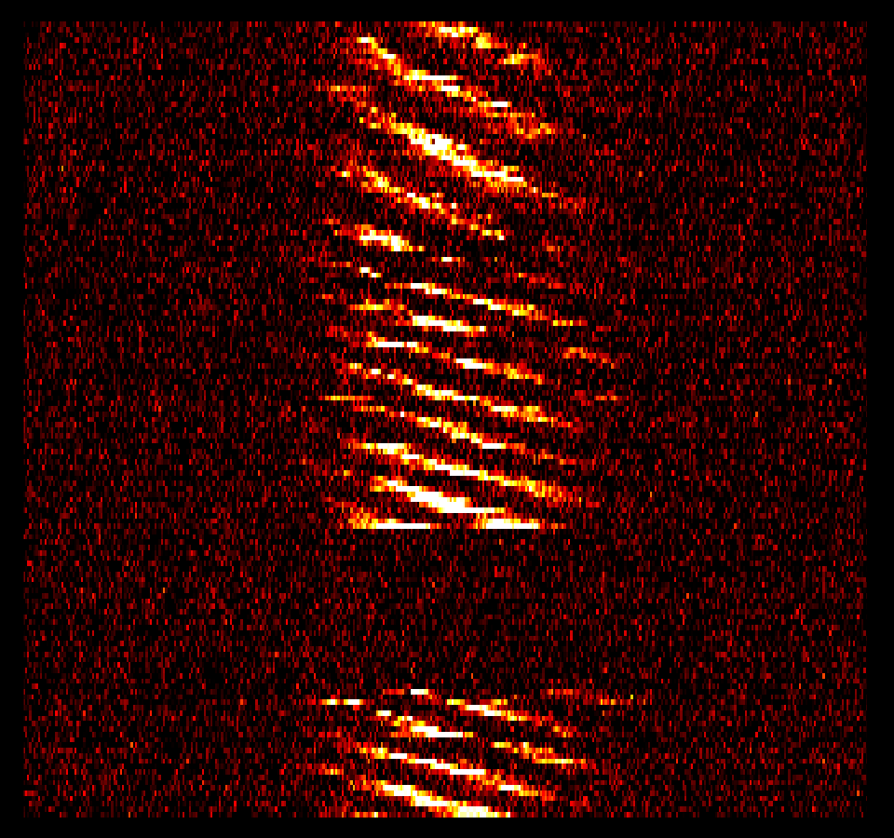
PSR J0034-0721

Slide 9
PSR J0034-0721
“Slower” rotation
“Faster” rotation
Null
(pulsar “switches off”)

Slide 10
PSR J0034-0721
Rotation changes gradually

Slide 13
Plasma Models
Beam Geometry
Observed Emission

Slide 14
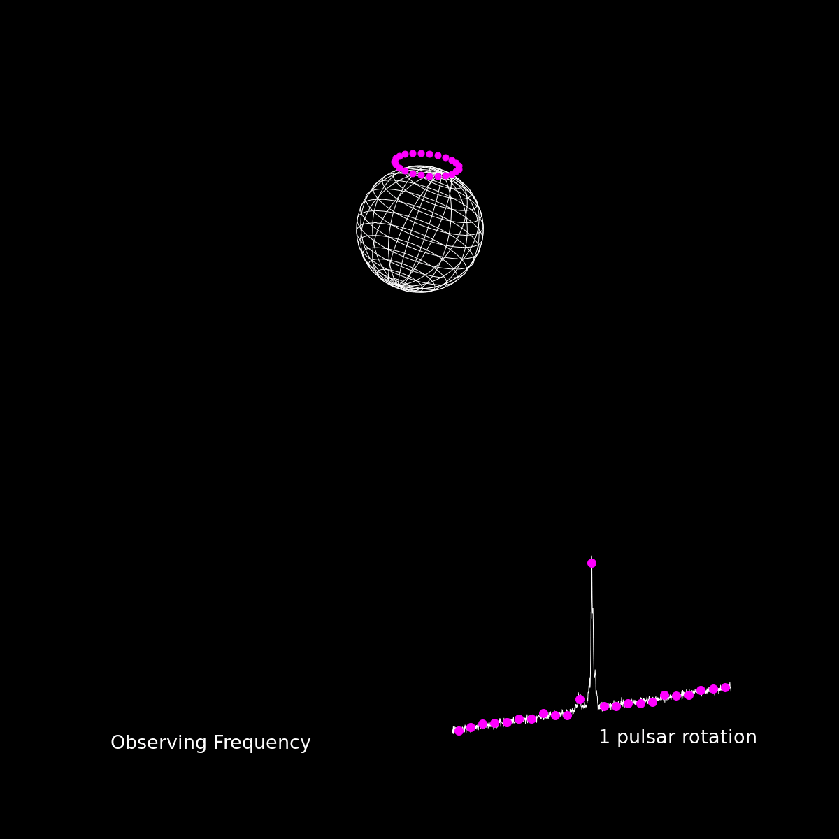

Slide 15
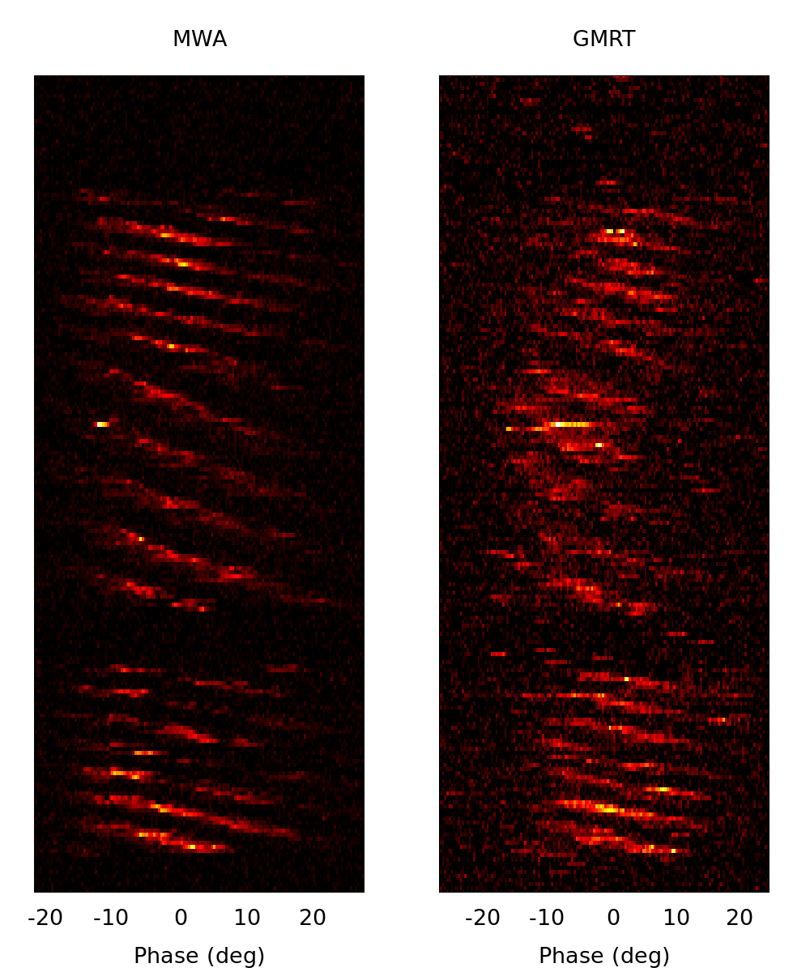



185 MHz
~600 MHz
~1400 MHz

Slide 16
Thanks

Slide 17
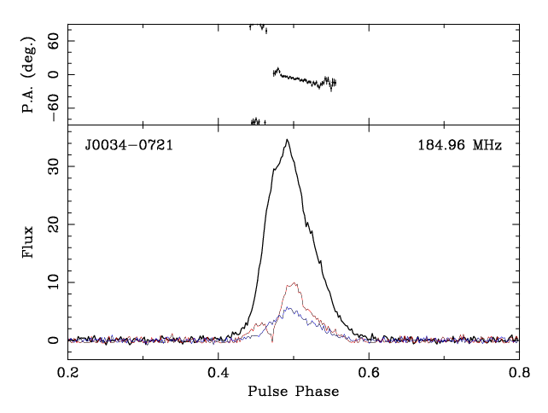
Full Polarization
Linear pol.
Circular pol.
Credit: Charlotte Sobey

