Slide 1



A polarimetric approach for constraining the dynamic foreground spectrum for global 21-cm measurements
(with applications for DARE)
Bang D. Nhan
University of Colorado at Boulder
Grote Reber Predoctoral Fellow at
NRAO Central Development Laboratory
(bang.nhan@colorado.edu)

Slide 2
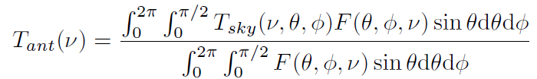
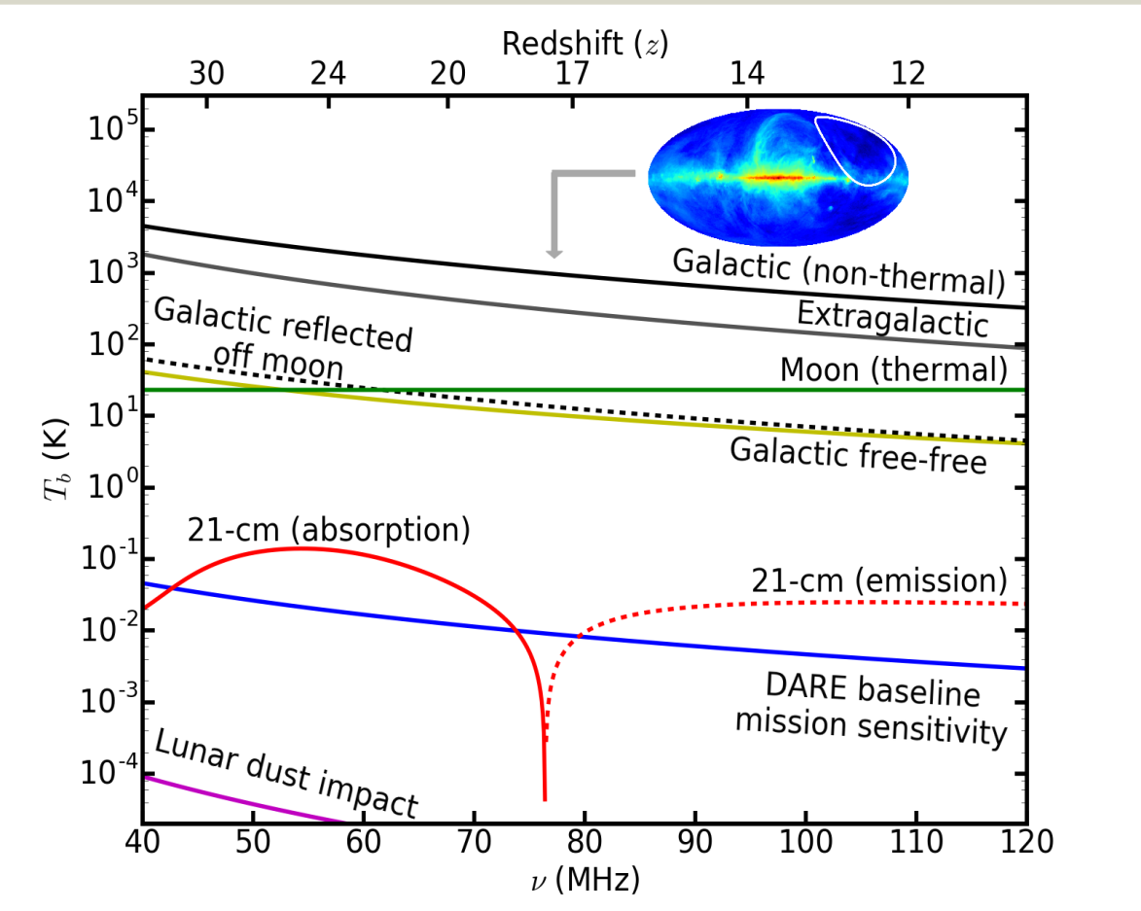
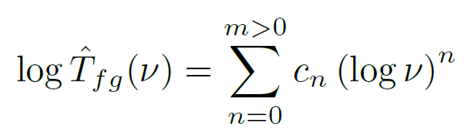
Current challenges
(Foreground+ 21 cm)
Foreground parametrization:
→ Subtracting two large numbers to recover a small number
→ 4-6 orders of magnitude
Burns et al. (In-prep)

Slide 3
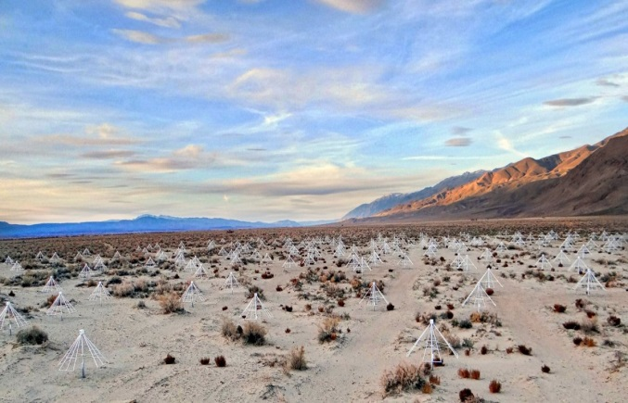
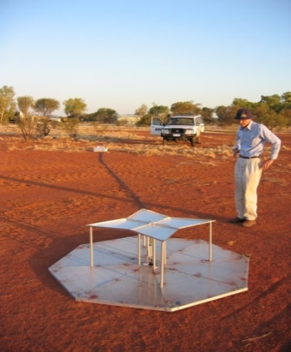
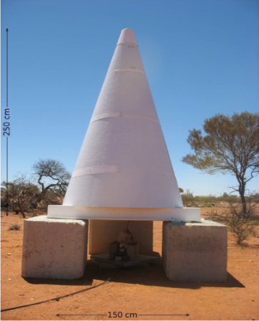
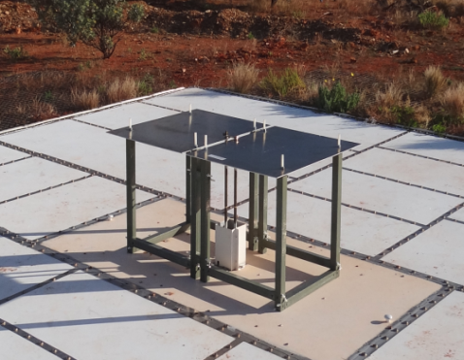
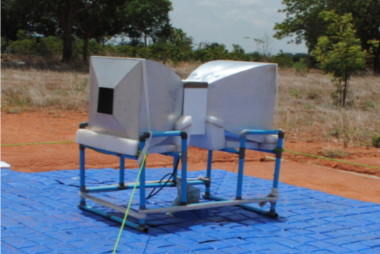
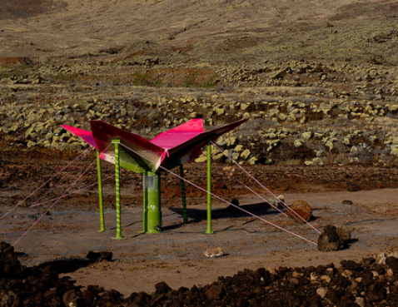
Current observational efforts
Interferometry
Single element
LEDA/LWA (USA)
EDGES (USA)
BIGHORNS (AU)
EDGES II (USA)
Antennas pointing at zenith
Total power measurement (Foreground + 21 cm)
SARAS (IN)
SCI-HI (MEX/USA)
→ Environment, measurement & systematic variations

Slide 4
What do we want and need?
High-accuracy foreground measurement to capture the foreground spectral structures
Measure it independently without “contaminated” the background 21-cm signal

Slide 5
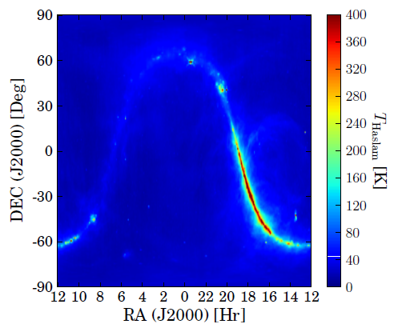
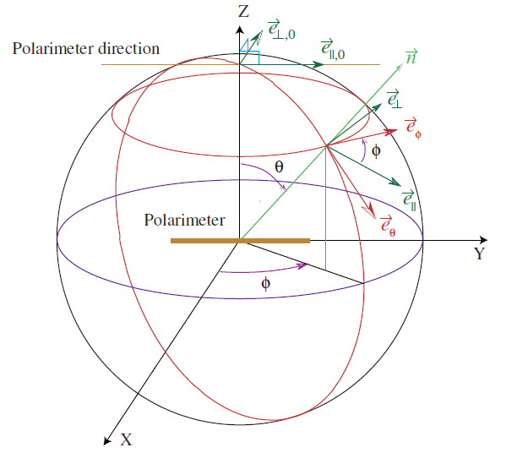
Projection-induced polarization
Anisotropy
Haslam map
@ 408 MHz
Kaplan, J. (2001)
→ Project a net composite polarization on
the dipole pair on XY-plane
NOT intrinsic foreground polarization

Slide 6
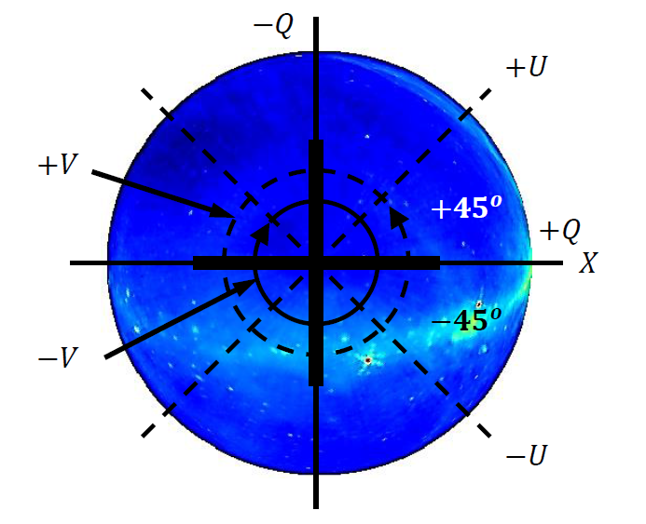
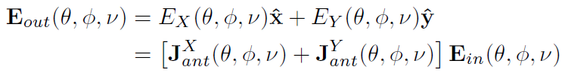
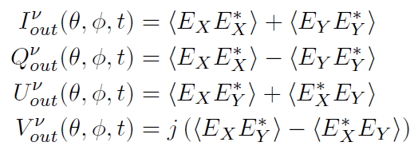
Stokes vector formalism
Incoming E-fields:
Measured E-fields:
Antenna Beam Field Pattern
Total Stokes parameters:
→ Net Stokes vector measures
the projection-induced polarization
Foreground ONLY

Slide 7
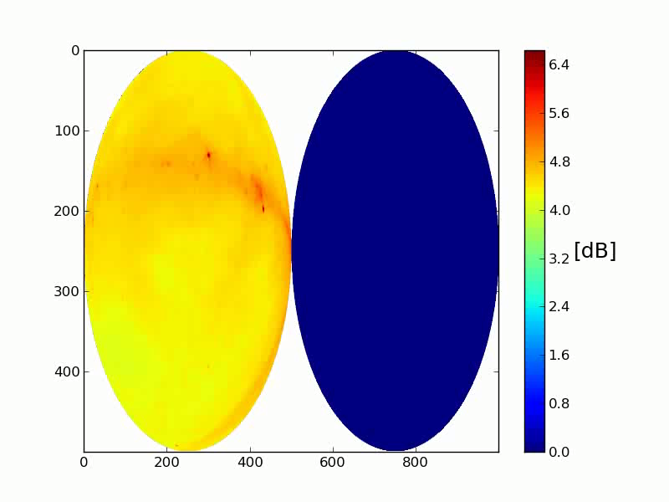
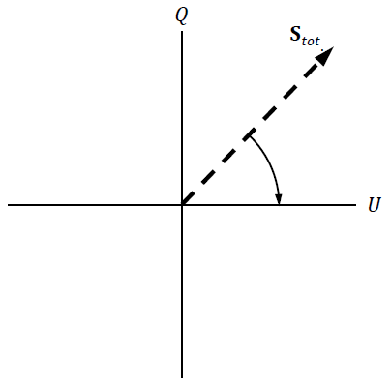
Dynamic foreground modulation about celestial pole

Slide 8
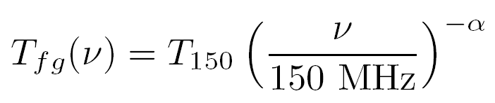
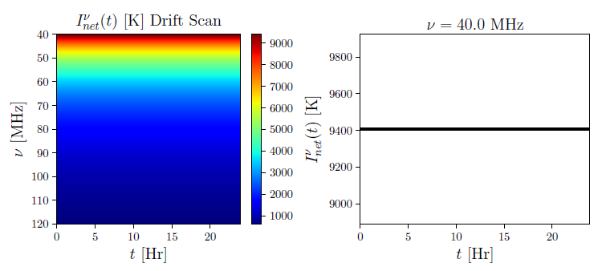
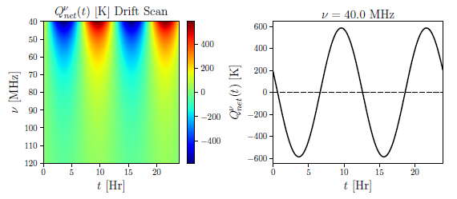
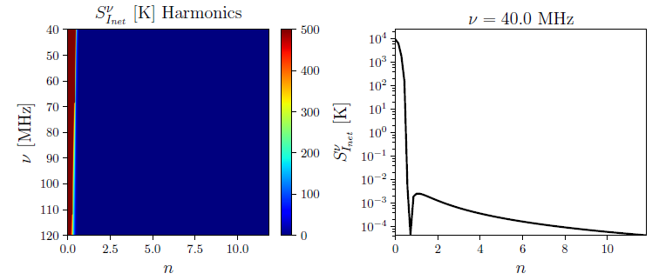
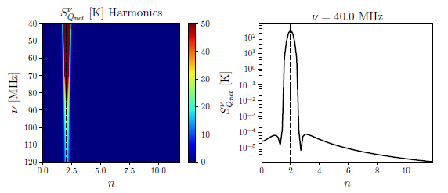
Simulation:
Total Stokes I
Net Stokes Q
FFT
FFT
Foreground + 21-cm
Foreground only

Slide 9

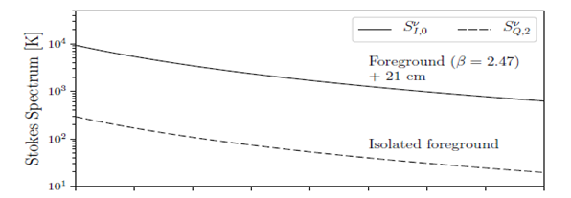
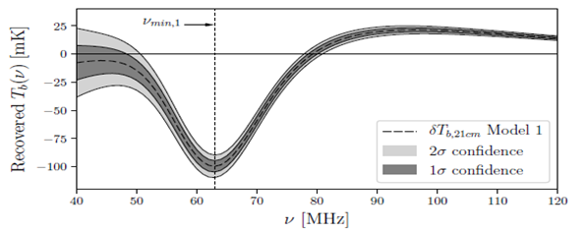
Foreground subtraction with induced Stokes spectra
Scale & subtract
Only scaling error
Nhan et al. (submitted)

Slide 10
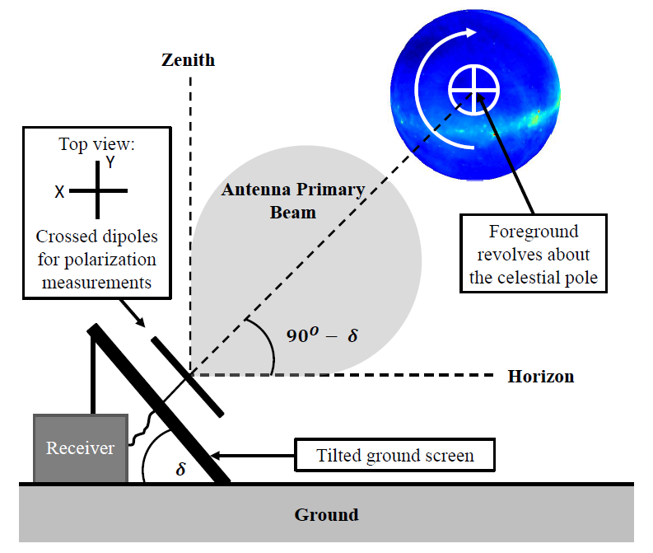
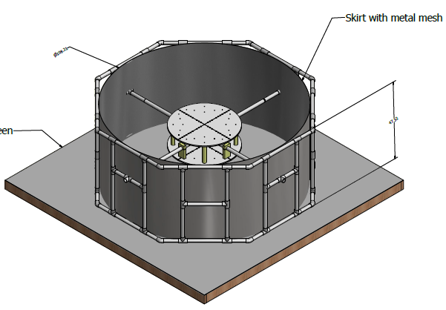
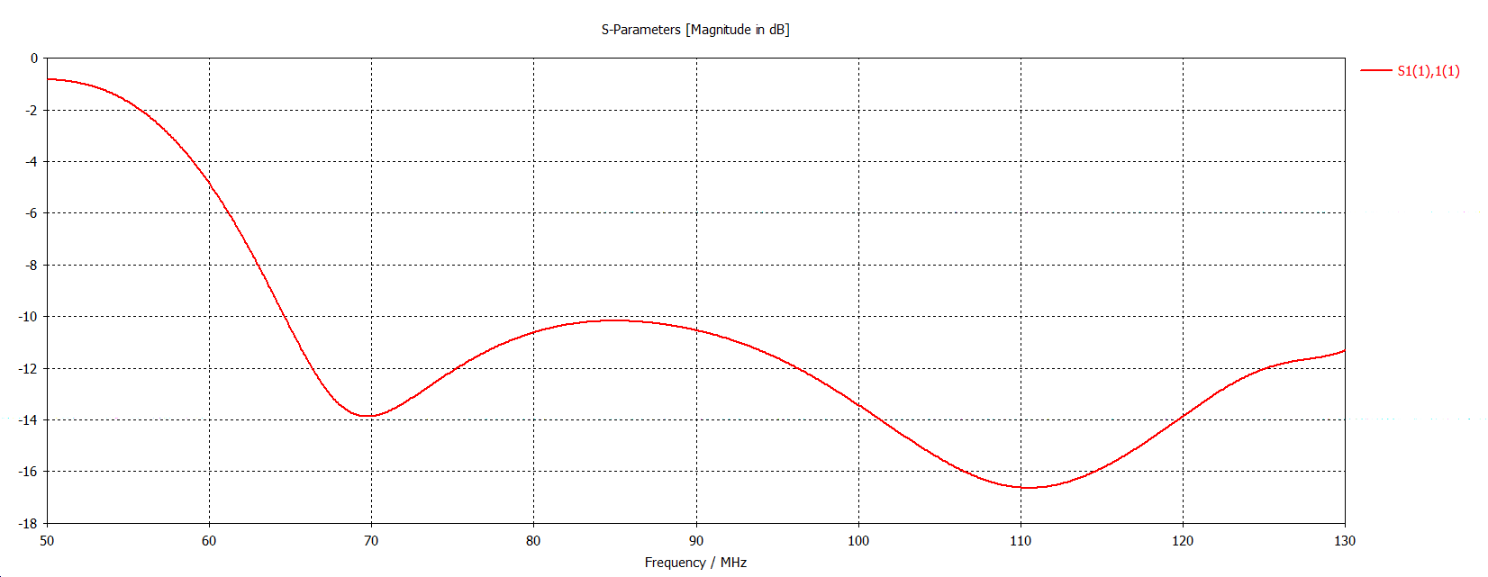
Cosmic Twilight Polarimeter (CTP)
Sleeved Dipole
(60-120 MHz)
Nhan et al. (submitted)

Slide 11
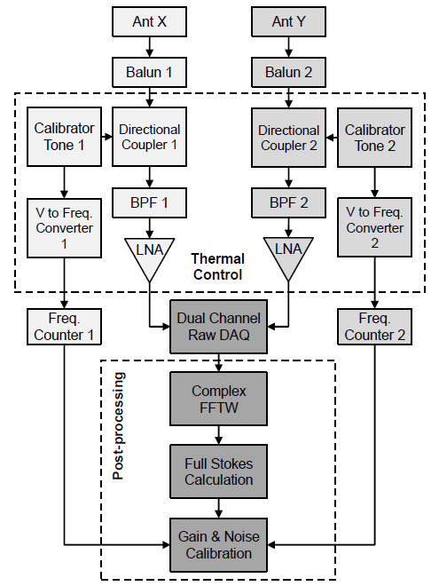
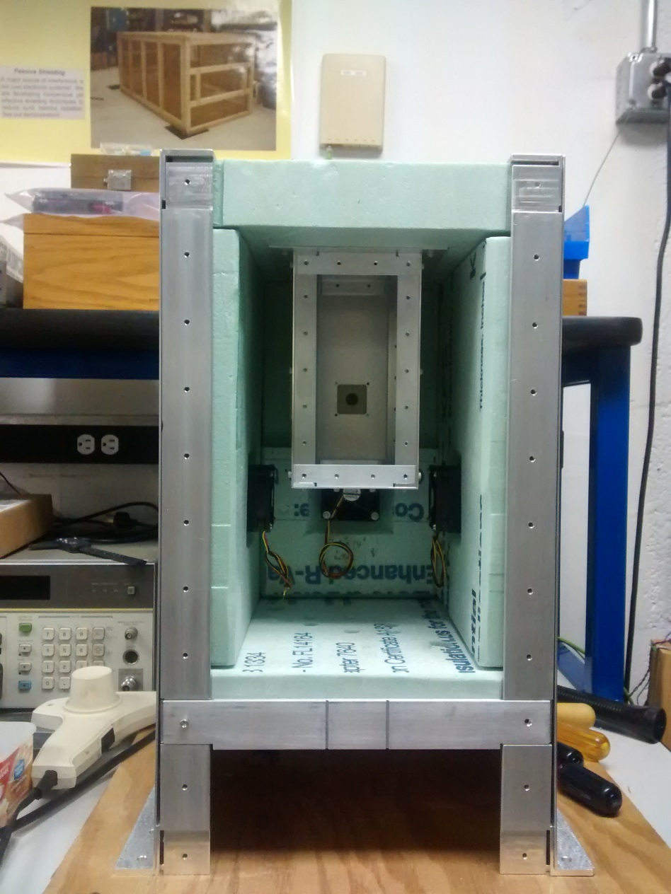
Frontend Unit
Two-stage thermal control
± 0.1 deg C
Outdoor Temp
± 5 deg C

Slide 12
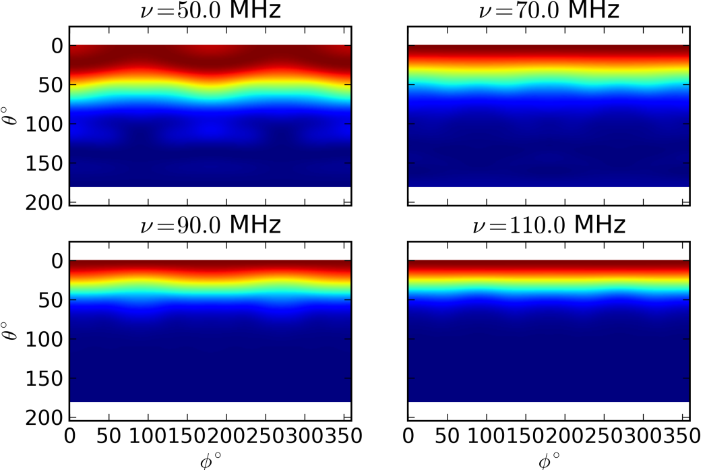
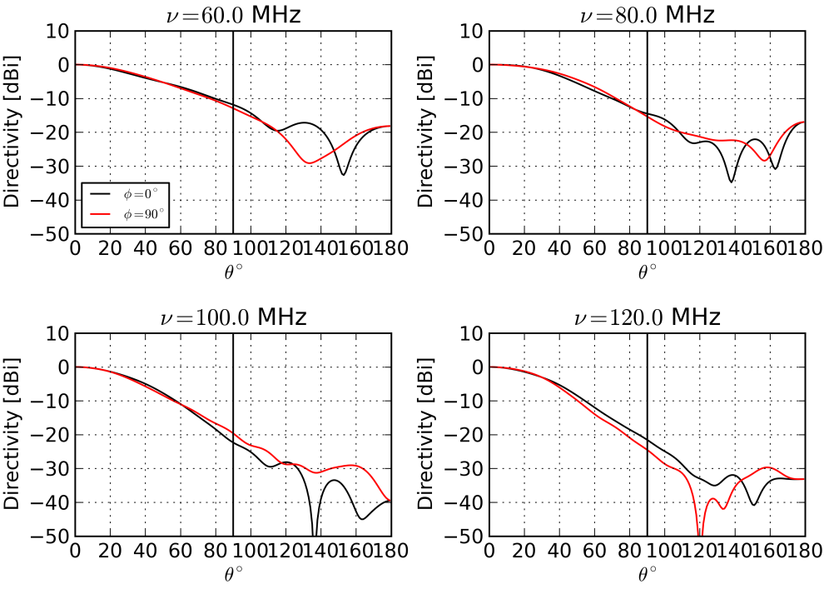
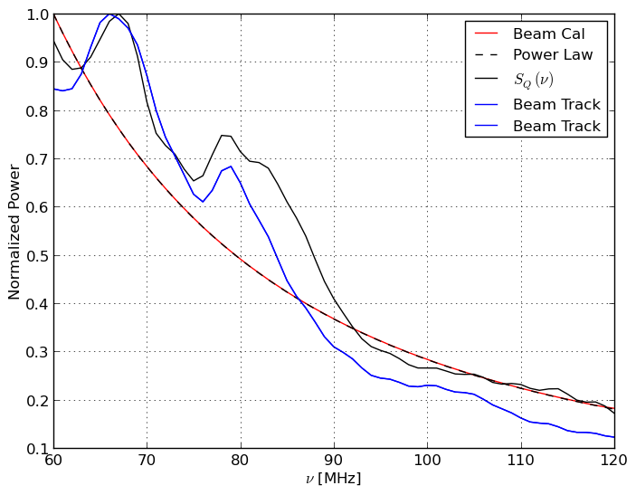
Frequency-dependent antenna beam
Spectral Structures from Beam on Twice Diurnal Term
Realistic Beam Model

Slide 13
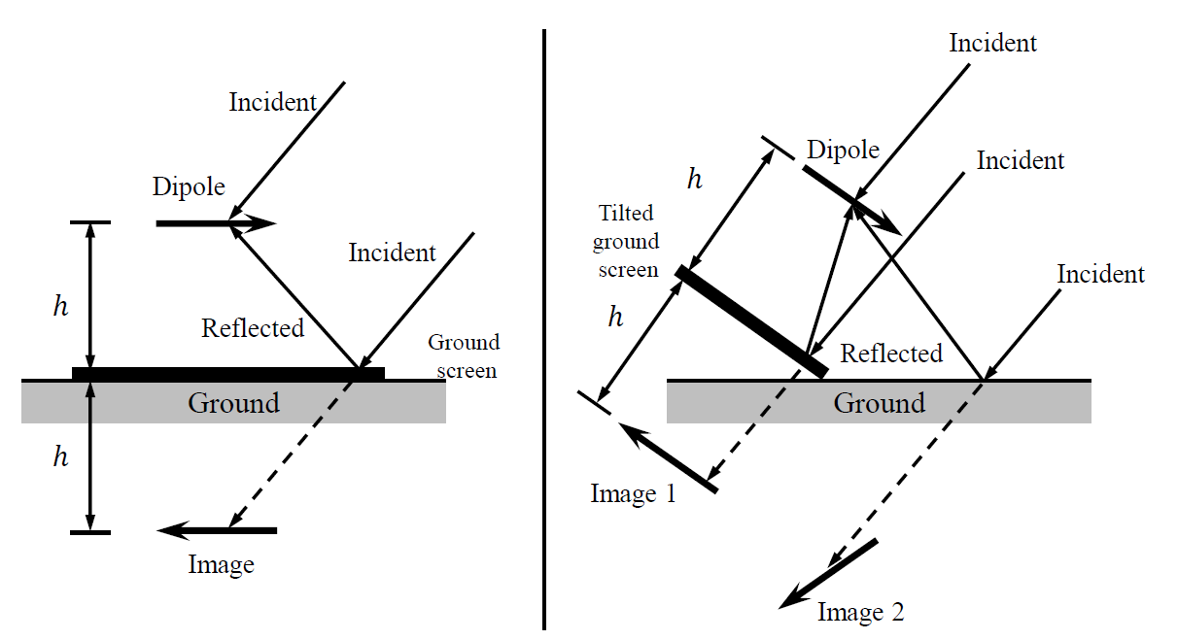
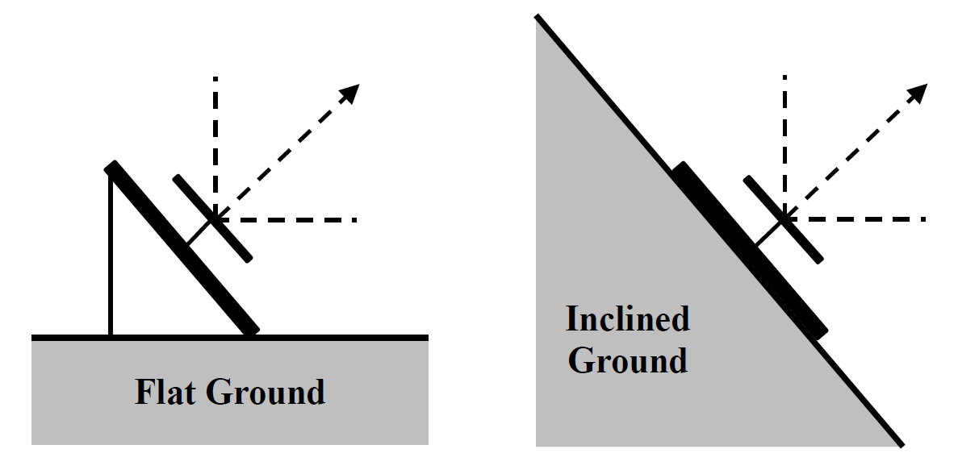
Ground effects

Slide 14
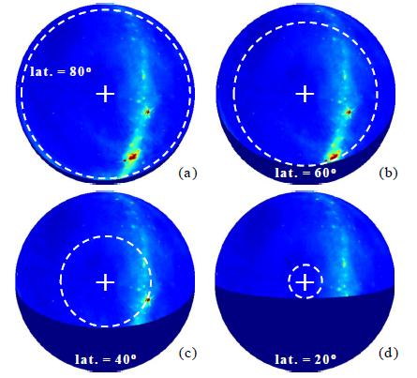
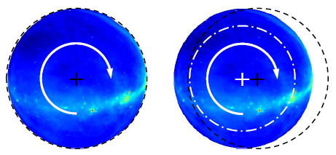
Horizon Obstruction
Pointing error

Slide 15
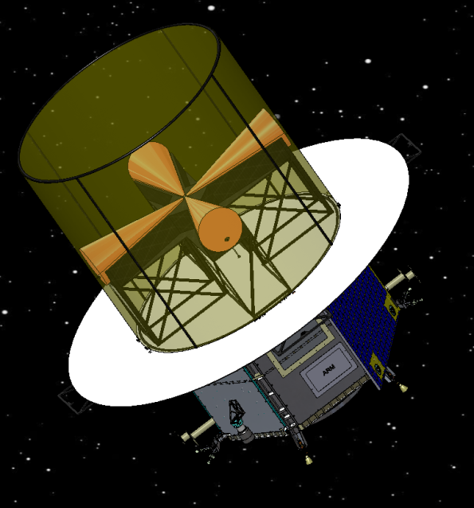
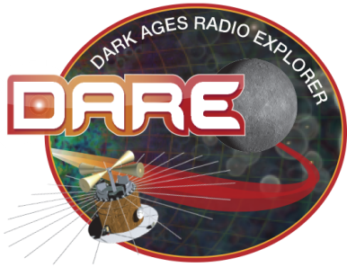
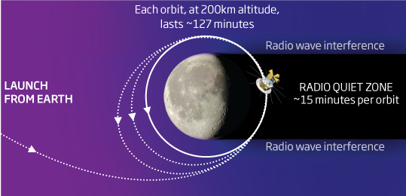
DARE (Dark Age Radio Explorer)
Most pristine radio environment in inner solar system (Alexander & Kaiser 1976)
No ionosphere !!
Modulate foreground projection-induced polarization by rotating the spacecraft
More freedom in sky region selection
Modulation heritage from CMB – QUIET (Kusaka, et al. 2014)
Burns et al. (2012)

Slide 16
Takeaways
Obtain a model-independent & direct foreground measurement separated from the static 21-cm background
Minimize measurement and system variations
Shift modeling to the instrument which is more accessible (high-accuracy antenna and receiver models) to mitigate unwanted instrumental spectral features
Use harmonic analysis to identify markers associated with instrumental effects

