Slide 1
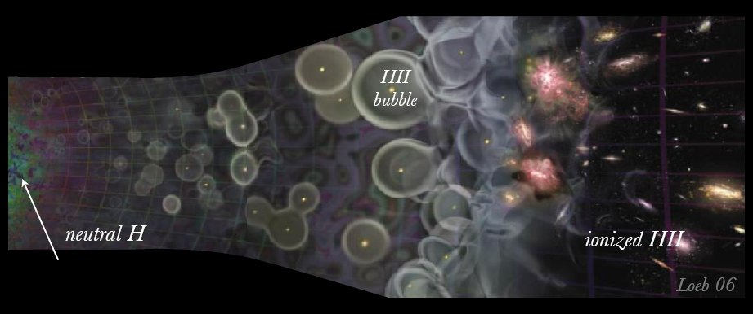
MWA/GLEAM
EoR power spectrum systematics
(It’s all about the bass, no treble)
Cathryn Trott
ICRAR-Curtin University
9 December 2016
Notes:
Thanks. Great to be back here
From ICRAR/Curtin, we run and operate MWA for an international consortium
4 decades of wavelengths cover
MWA image: false colour Vela SNR

Slide 2
Motivation
The Epoch of Reionisation represents an unchartered frontier
It is intrinsically coloured, providing different astrophysical information as a function of redshift and spatial scale
Line-of-sight spatial structure is accessed via mapping of spectral modes to depth, fundamentally entangling chromaticity and physical structure
Accessing the EoR and Cosmic Dawn requires techniques to peer through the chromatic fog of the Universe coupled with the instrument
Will review:
chromatic components of the signal chain
recent work highlighting key challenges
Caltech Low-Frequency – December 2016

Slide 3
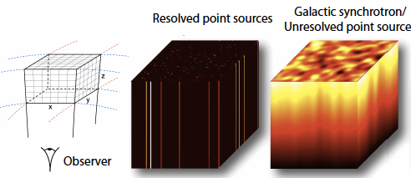
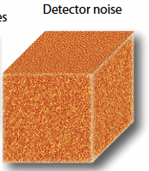
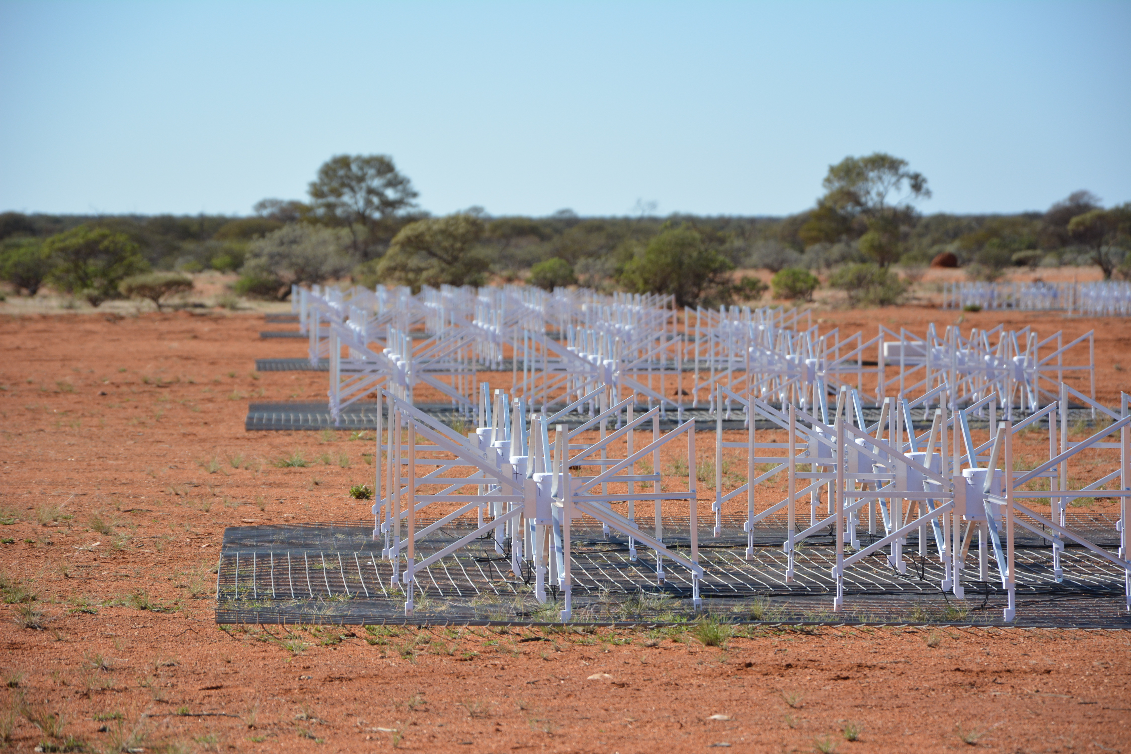
Motivation
Liu & Tegmark (2011)
INSTRUMENT
Caltech Low-Frequency – December 2016

Slide 4
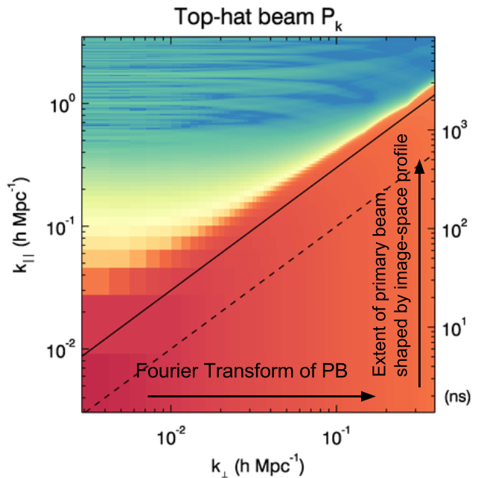
The spatial power parameter space
Spatial signature of foregrounds, as observed through the instrument, is complicated.
Caltech Low-Frequency – December 2016

Slide 5
The spatial power parameter space
Spatial signature of foregrounds:
Angular scale versus frequency:
(u , freq)
Frequency-dependent source number counts
Spatial Fourier Transform of frequency-dependent station primary beam (circularly-symmetric beam)
Caltech Low-Frequency – December 2016

Slide 6
Frequency-dependent Gaussian beam
Spatial signature of foregrounds:
Spectral Fourier Transform
Modulated line-of-sight modes
Decays with angular modes
Beam effect is station-size dependent
Caltech Low-Frequency – December 2016

Slide 7
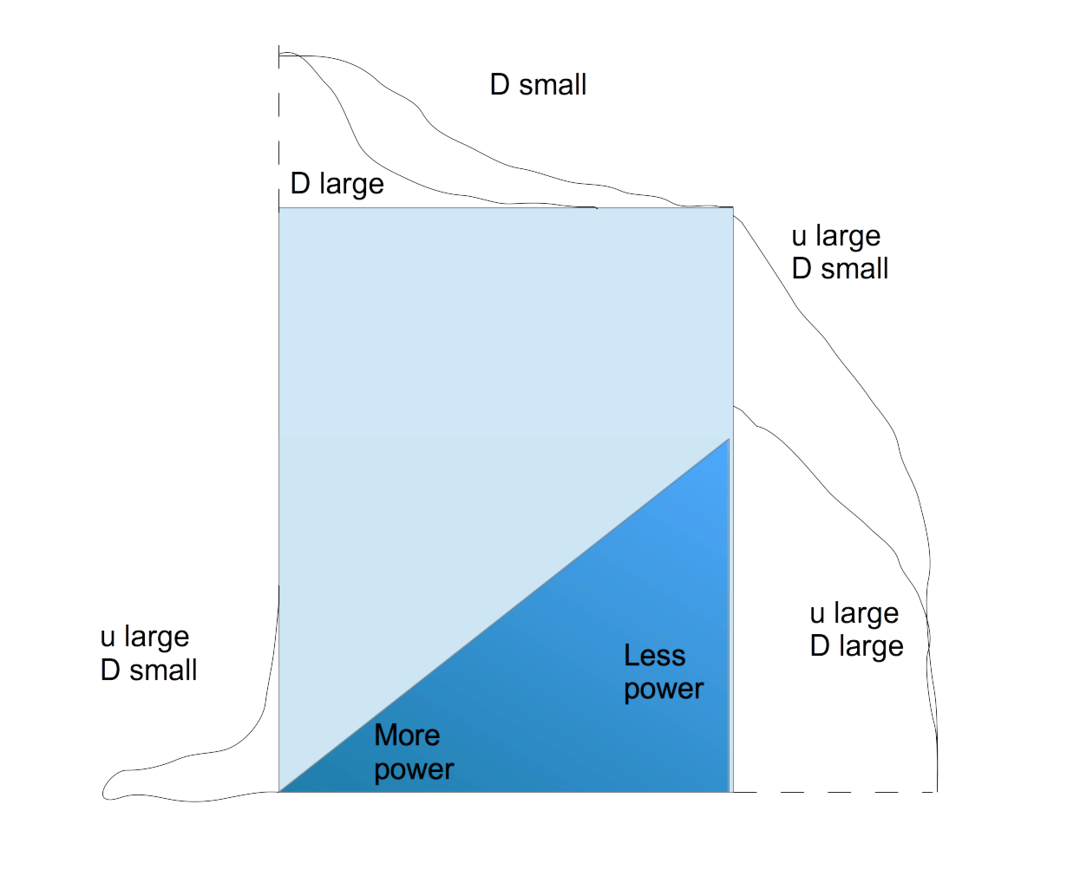
And now in a picture…
Residual sources + residual structure
Caltech Low-Frequency – December 2016

Slide 8
And now in a picture…
The signature of foregrounds is a complicated entanglement of primary beam shape, array layout, bandpass shape, fractional bandwidth………
Residual sources + residual structure
Caltech Low-Frequency – December 2016

Slide 9
What about the foregrounds?? Recent work
Offringa et al. (2016)
Spectral analysis of sources in MWA EoR field
Dominated by source confusion and instrument bandpass
Trott & Wayth (2016)
Calibration of SKA-Low bandpass through low-order polynomials
Less parameters required; attempts to avoid sidelobe confusion
Barry et al. (2016) – see talk in this session
Simulation of MWA bandpass calibration residuals
Sidelobe contamination biases output
Patil et al. (2016)
Analysis of LOFAR EoR “Excess Noise”
Attributed to noise-like residual sidelobe signal from incomplete sky model
Ewall-Wice et al. (2016) – see talk in this session
Theoretical analysis propagating calibration residuals from incomplete source model to EoR power spectrum.
Caltech Low-Frequency – December 2016

Slide 10
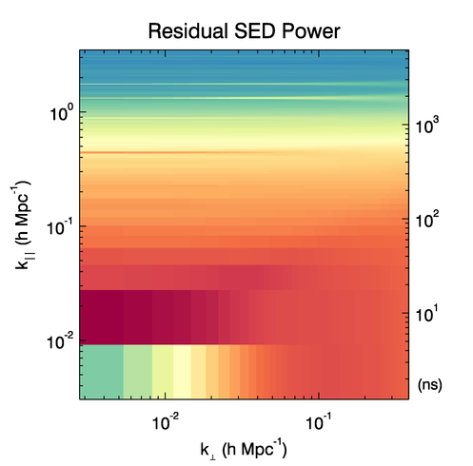
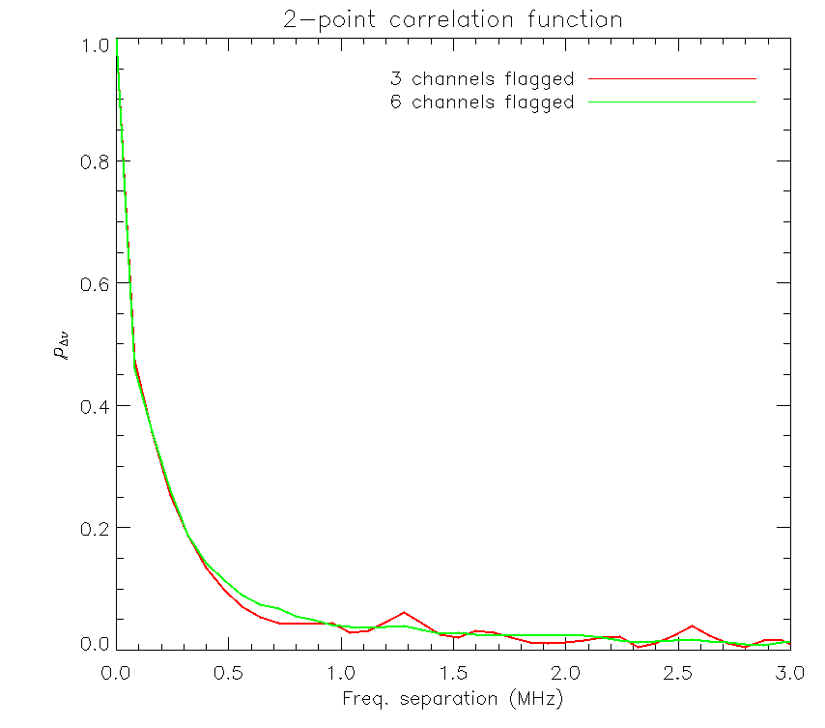
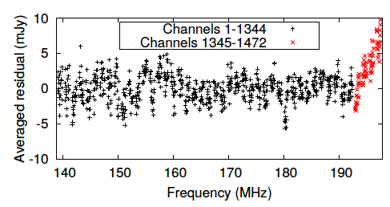
What about the foregrounds?? Recent work – Offringa et al. (2016)
Spectral analysis of sources in MWA EoR field
Dominated by source confusion and instrument bandpass
EoR power spectrum residuals show non-noiselike residuals
Caltech Low-Frequency – December 2016

Slide 11
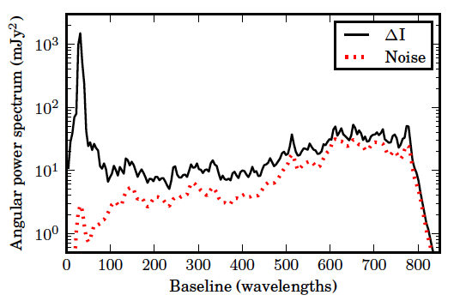
What about the foregrounds?? Recent work – Patil et al. (2016)
Analysis of LOFAR EoR “Excess Noise” in EoR variance statistic, compared with thermal noise expectations from Stokes V images
Attributed to noise-like residual sidelobe signal from incomplete sky model
Figure: Residual power in angular power spectrum compared with noise, for a simulation with remaining discrete and diffuse emission.
Caltech Low-Frequency – December 2016

Slide 12
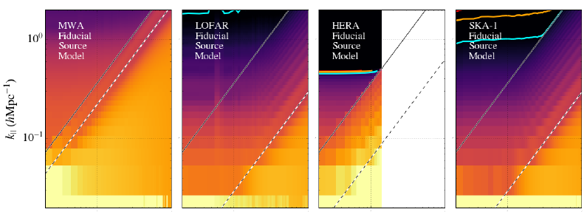
What about the foregrounds?? Recent work – Ewall-Wice et al. (2016) (arXiv, under review)
Theoretical analysis propagating calibration residuals from incomplete source model to EoR power spectrum – studied structure of spectral residuals in EoR power spectrum for current and future experiments
Figure: Foreground contamination due to unmodelled sources in calibration
Suggestion: Gaussian-weighting baseline contributions to calibration solution optimises balance between FOV and array layout for mitigating sidelobes.
Caltech Low-Frequency – December 2016

Slide 13
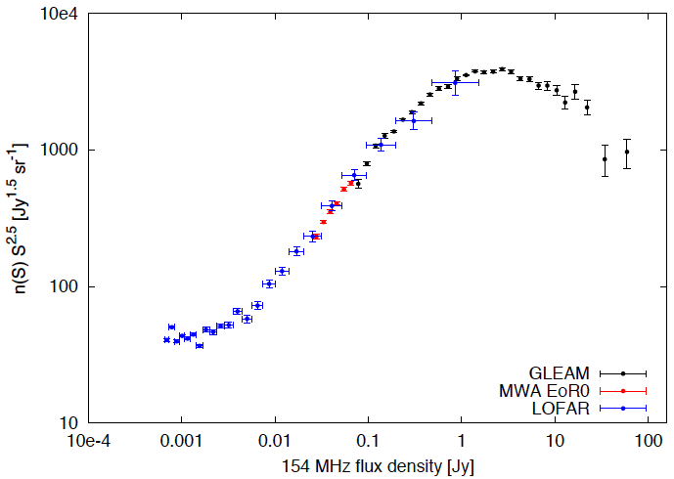
Key regions of source flux density
Residual sidelobe confusion
Excess noise
Calibrators
Sky model
Courtesy Tom Franzen & Carole Jackson
Caltech Low-Frequency – December 2016

Slide 14
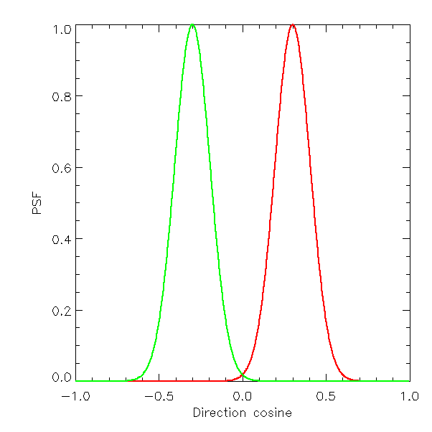
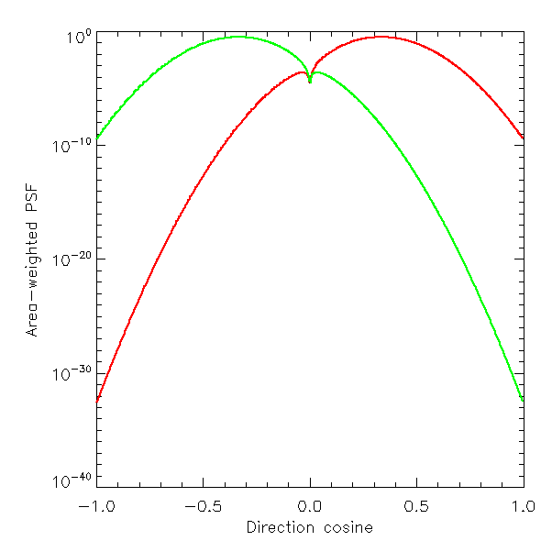
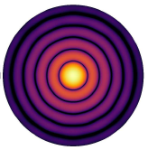
PSF properties and structure
PSF contributing to central sky location
r*PSF showing peak sidelobe contribution
Caltech Low-Frequency – December 2016

Slide 15
Redundant arrays: not a silver bullet
Redundancy allows one to calibrate the antenna gains without the need for a sky model, decoupling source model incompleteness from calibration.
However, redundant calibration only provides a relative gain solution (relative to amplitude and phase of reference), thereby requiring some sky model component to set reference values
Redundant calibration generally is applied independently for each spectral channel, leaving these methods open to the same problems.
DeBoer et al. (2016)
Caltech Low-Frequency – December 2016

Slide 16
Options and trade-offs
(Ewall-Wice) Reduce calibration errors from sidelobe sources by restricting uv distance of bandpass calibration (decouple foreground fringing from bandpass solution)
Perform parametric (Trott & Wayth) or spatially-clustered (Offringa) bandpass calibration to decohere sidelobes
Use an external, deeper sky model (higher spatial resolution; independent calibrator measurement to mitigate re-substitution bias)
Restrict field-of-view: incorporate a few larger stations to disentangle beam-edge source contributions from EoR signal.
EoR science is bright! We have made major advances in the past 1-2 years in our understanding of systematics
We have also started having far more useful and beneficial sharing of lessons between the current experiments
Not a “first past the post” game: detection is the tip of a very large and exciting iceberg.
Caltech Low-Frequency – December 2016

Slide 17
Frequency-dependent Gaussian beam
CASES:
DC term (η = 0) Shaped by primary beam
u small, D large Beam decays slower: power decoheres
u large, D small Beam decays quickly: weighted cosine
Caltech Low-Frequency – December 2016

Slide 18
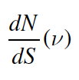
Regimes of residual structure
Simple number counts model:
At a given sky location, sidelobe signal is contributed by sources according to synthesized beam properties and total flux density.
Flux density:
→ Dominated by sources just below threshold
Properties of PSF (array layout) determines regimes…
Spectral structure:
→ Strong spectral dependence
Caltech Low-Frequency – December 2016

Slide 19
PSF properties and structure
Source numbers are in Gaussian regime. Deep subtraction required to reach “excess noise” regime
Highly-dependent on Poisson statistics of immediate field (sidelobe confusion is position-dependent). Deep subtraction required to reach “excess noise” regime
Summation of independent sidelobe contributors places one in excess noise regime for a shallower subtraction, however excess noise levels are large.
Caltech Low-Frequency – December 2016

Slide 20
PSF properties and structure
Ewall-Wice (LOFAR small primary beam)
SKA-Low far sidelobes??
Barry (shallow subtraction; MWA sidelobe-confusion residual structure)
Offringa (measuring individual source spectra; MWA sidelobe-confusion and bandpass)
Patil (deep subtraction; LOFAR excess noise in EoR power spectrum)
Ewall-Wice (MWA large primary beam)
Caltech Low-Frequency – December 2016

