Slide 1
Low Frequency Radio Constraints on the Synchrotron Cosmic Web
Science at Low Frequencies – Pasadena 2016
Tessa Vernstrom
Bryan Gaensler, Shea Brown, Emil Lenc, Ray Norris
Notes:
TITLE SLIDE #1
Notes about changing the images in the template:
As a general rule, place an astronomical image in the larger circle, and a people/instrument/observatory image in the smaller circle. The rule of thumb is that the larger image illustrates the “bigger” picture, while the smaller image illustrates a human or technological detail related to the bigger picture; e.g. a big image of GPI on the telescope and a small image of someone working on a GPI component in the lab.
To begin, you must first have your desired photos on your computer in square format.
Click on the "Themes" tab, click on "Edit Master.” From the “Edit Master” drop down menu, select "Slide Master.”
All of the page templates will appear in the left hand pane. From the pane, choose the slide you would like to edit.
Double click on the photo you would like to change. The “Format” menu will appear. Choose "Fill” (with the bucket icon), then “Fill Effects.”
Select "Picture or Texture”; click on “Choose Picture.” Once the photo is in place, press Ok.
From the “Themes” tab, click on "Close Master.”

Slide 2
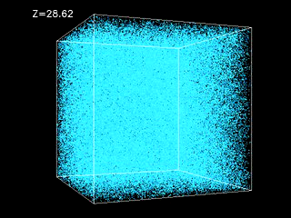
What is the Cosmic Web?
Fluctuations in the primordial matter density result in the growth of large-scale structure (LSS)
The Cold Dark Matter (CDM) theory predicts that massive galaxies and galaxy clusters were built from smaller galaxies that collided and merged
Result is clusters, filaments, and voids we see today which form a “web” like structure
(Movie: http://cosmicweb.uchicago.edu/ )
Notes:
Content Slide

Slide 3
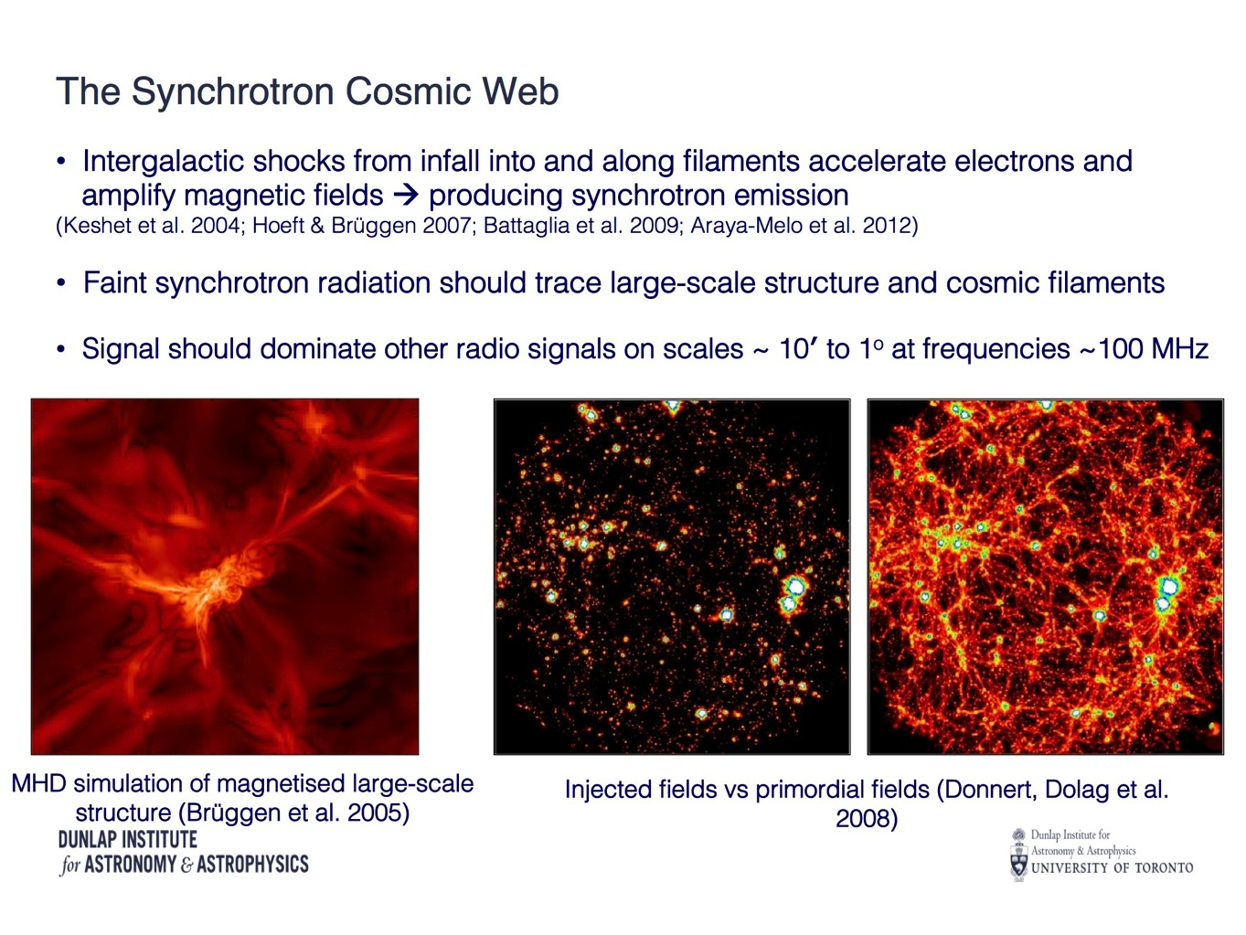
Notes:
Content Slide

Slide 4
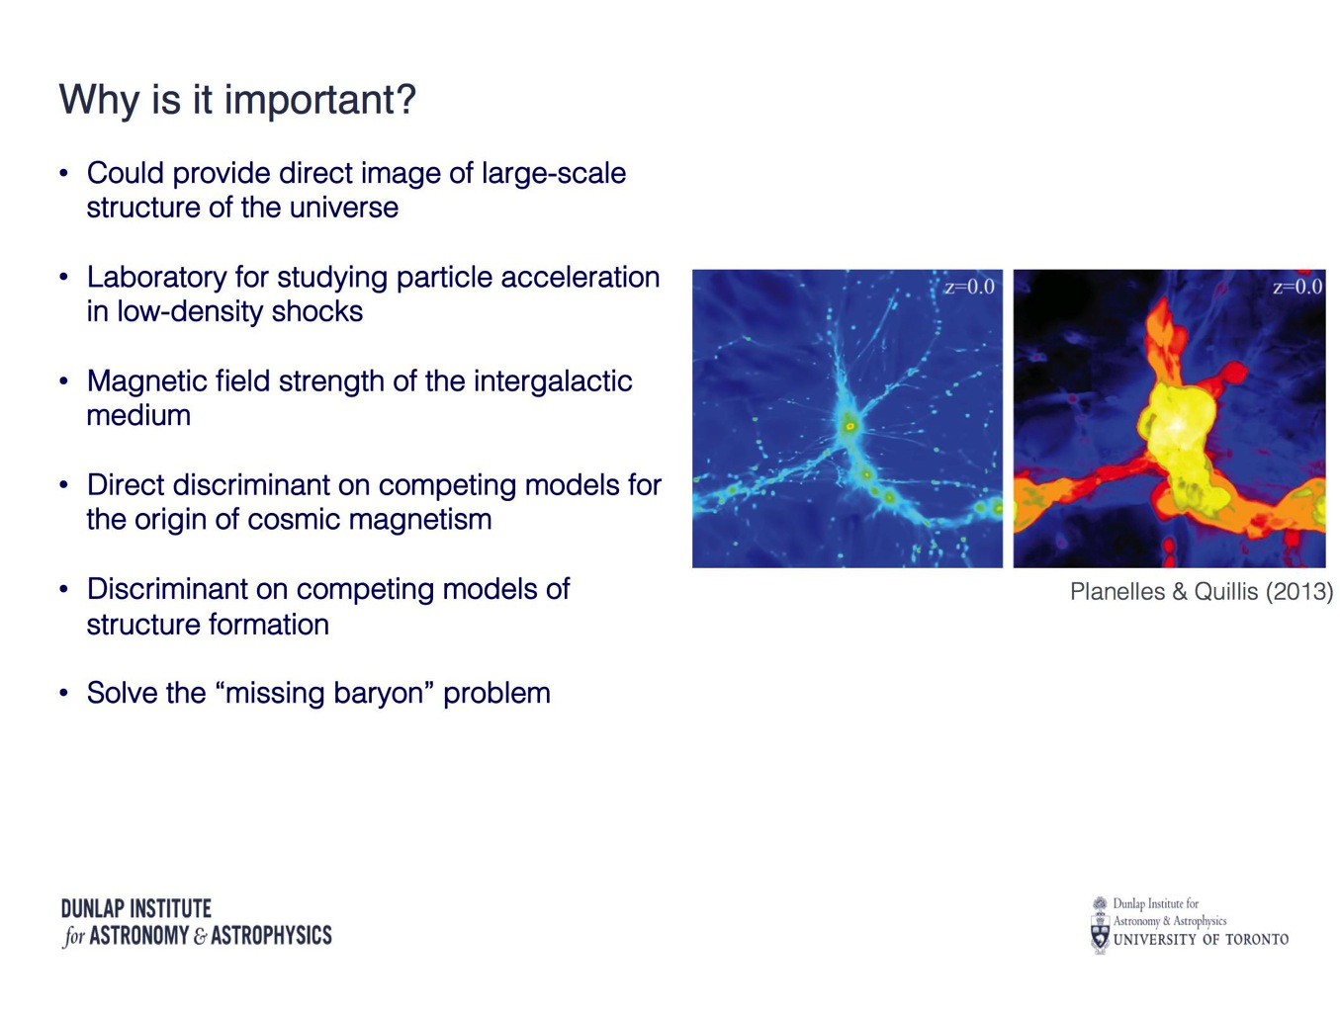
Why is it important?
Notes:
Content Slide

Slide 5
How can we detect it?
Direct imaging
(Bagchi et al. 2002; Wilcots 2004; Vazza et al. 2014)
Statistical methods:
Cross Correlation
(Brown et al. 2010, 2011)
Stacking
Polarisation:
Faraday rotation from background AGN
Dispersion from fast radio bursts
Also stacking and cross correlation
Notes:
Content Slide

Slide 6
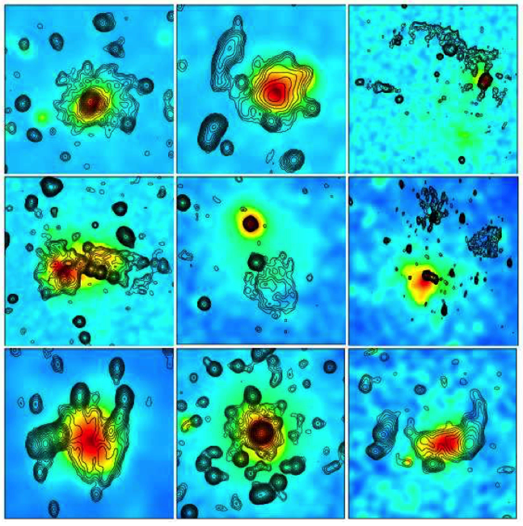
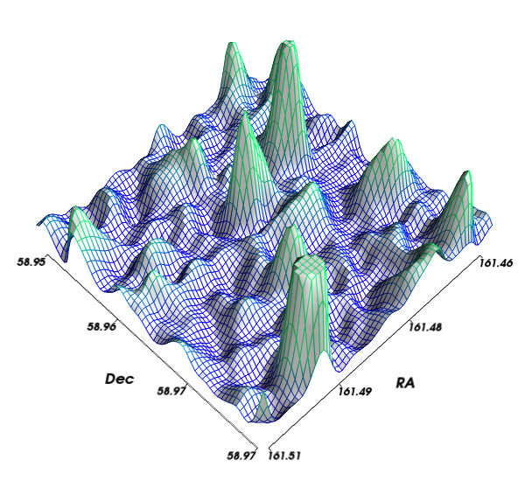
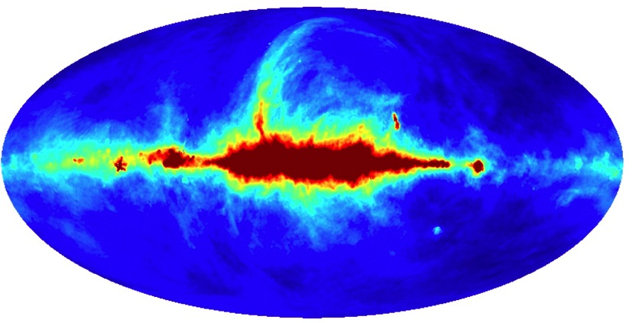
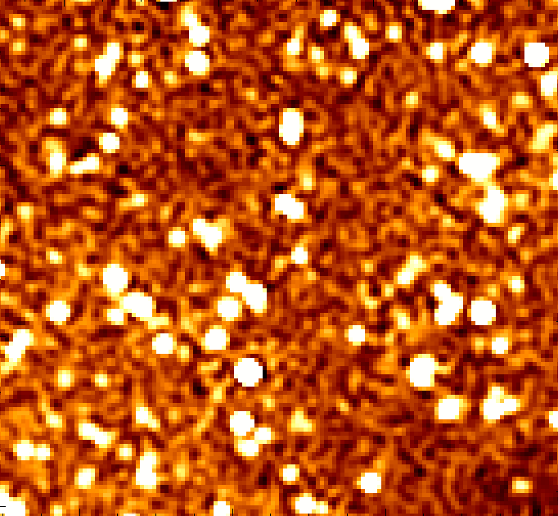
Direct Imaging
We have detected diffuse emission in clusters
Halos
Mini-halos
Relics
But only ~50-100 detected
No detection of filaments yet
Complications:
Predicted emission faint and low surface brightness
Predicted sub μJy/arcmin² to mJy/arcmin²
Requires high sensitivity to large angular scales
Sizes on Mpc scales
Difficult for radio interferometer telescopes
Bright Galactic foregrounds
Bright point sources
Faint point source confusion
Ferretti et al., 2012
Notes:
Content Slide

Slide 7
Cross Correlation
Galaxy number density → traces thermal baryon distribution → should correlate with diffuse synchrotron
Notes:
Content Slide

Slide 8
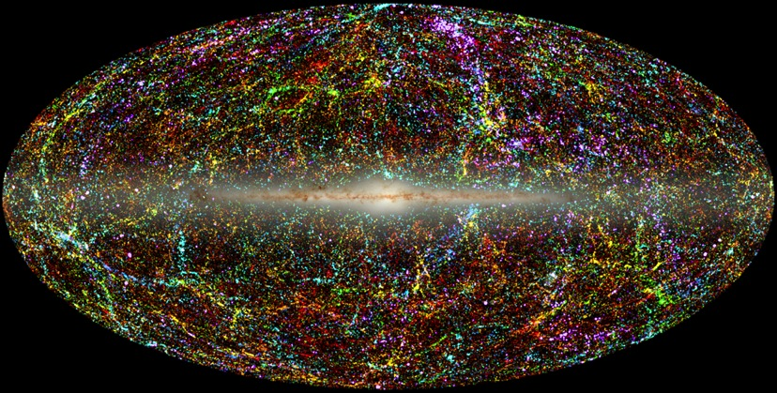
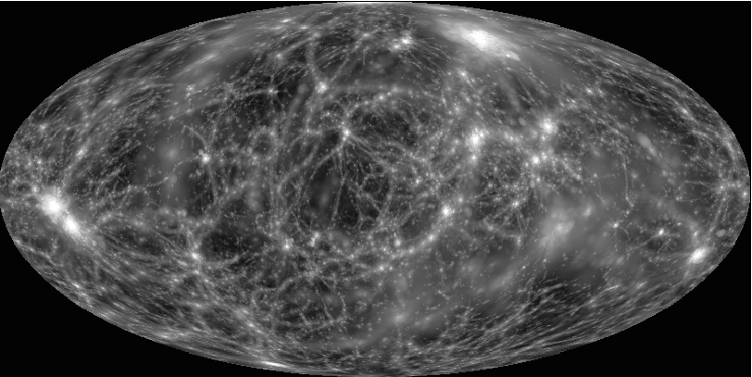
Cross Correlation
Galaxy number density → traces thermal baryon distribution → should correlate with diffuse synchrotron
2MASS Galaxy Distribution coded by redshift
(photo credit :Thomas Jarrett (IPAC/Caltech)
Simulated radio synchrotron (credit: Klaus Dolag)
Notes:
Content Slide

Slide 9

Cross Correlation
Galaxy number density → traces thermal baryon distribution → should correlate with diffuse synchrotron
How correlated as a function of distance or angular scale?
Unknown
How correlated?
Unknown
Cross correlation function: how correlated as a function of angular distance – image plane
Cross power spectrum: how correlated as a function of angular size – Fourier plane
Reasons for a positive correlation:
AGN (core)
Starbursts and disk emission
AGN (WAT and NAT associated with clusters)
Cluster halos
Cluster relics
Synchrotron cosmic web
Reasons for a negative correlation:
Galactic extinction (galaxy number counts down, synchrotron up)
Increasing angular
scale
Notes:
Content Slide

Slide 10
Cross Correlation with MWA
The MWA:
Frequency range: 80 – 300 MHZ
2048 dual polarization dipoles
Number of antenna tiles: 128
Number of baselines: 8128
Approximate collecting area: 2000 sq. meters
Field of view: 15 - 50 deg. (200 - 2500 sq. deg.)
Instantaneous bandwidth: 30.72 MHz
Spectral resolution: 40 kHz
Temporal resolution: 0.5 seconds
Polarization: I, Q, U, V
Photo credit: Natasha Hurley-Walker
Good sensitivity to large angular scales
low frequency, large field of view
Notes:
Content Slide

Slide 11
Cross Correlation with MWA - Radio
Point source sub
Field: EoR0 RA=0 Dec= -27
υ = 180 MHz
Beam 2.3’ – 2.9’
σ_{n}= 0.6 – 0.96 mJy beam⁻¹
σ_{c} = 4.4 - 9.5 mJy beam⁻¹
Subtraction limit ~ 50 mJy
Full
Point source & Galaxy sub
Notes:
Content Slide

Slide 12
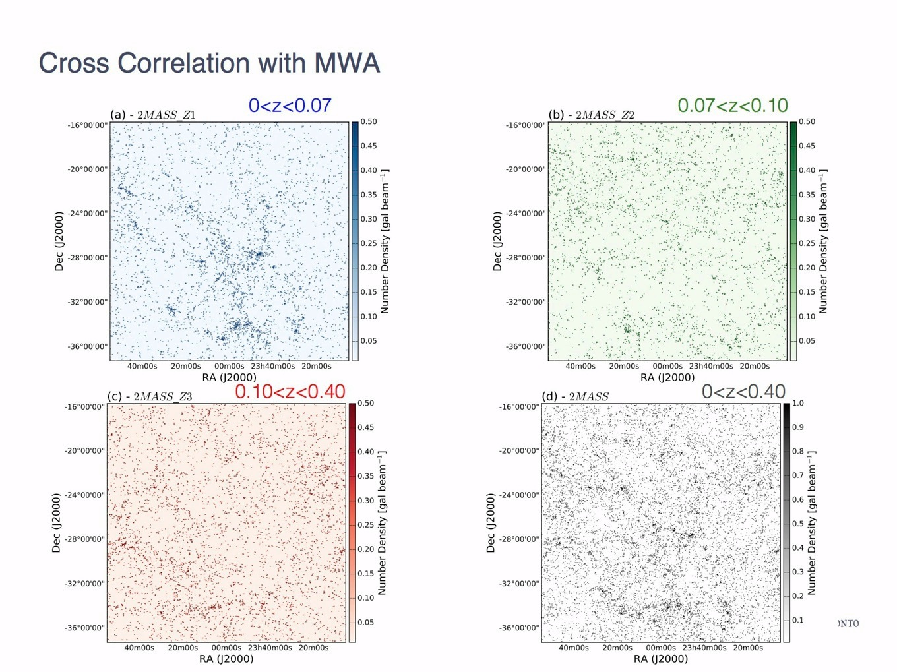
- 2MASS Galaxy Density
Notes:
Content Slide

Slide 13
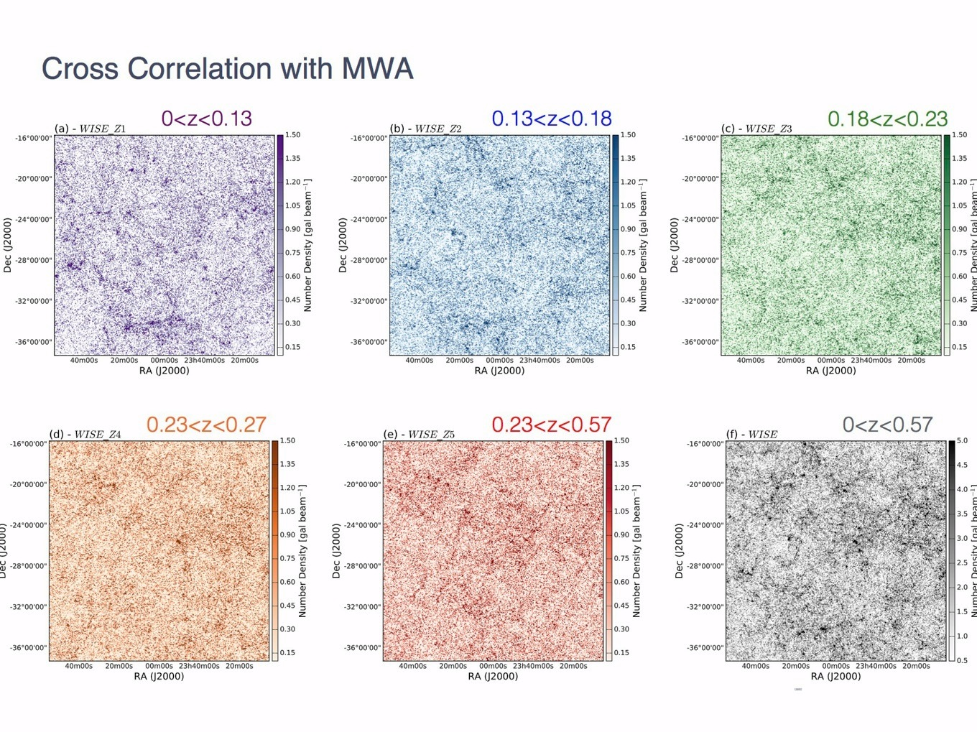
- WISE Number Density
Notes:
Content Slide

Slide 14
Cross Correlation with MWA
Take radial average
Δθ
Δθ
Notes:
Content Slide

Slide 15
Cross Correlation with MWA
Point Sources→
smaller than beam
Diffuse emission → larger than beam
Still some point
source contribution
So how much diffuse
is there ???
Notes:
Content Slide

Slide 16
Cross Correlation with MWA
Notes:
Content Slide

Slide 17
Cross Correlation with MWA – Emission Upper Limits
Galaxy number
density
Gaussian
Smoothing
Diffuse number density model
convolve
Diffuse number density model
Radio image
beam
Diffuse radio sky model
convolve
Notes:
Content Slide

Slide 18
Cross Correlation with MWA – Emission Upper Limits
Diffuse radio sky model
Cross correlate
Galaxy number density
CCF
Scale CCF until > 3σ
0.09 < S [mJy beam⁻¹] < 2.2
0.01< S [mJy arcmin⁻²] < 0.3
Notes:
Content Slide

Slide 19
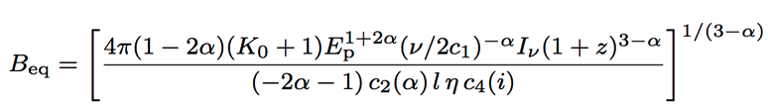
Cross Correlation with MWA – Magnetic Field Limits
K₀ - ratio of number densities
of cosmic ray protons and electrons
per particle energy interval
α – spectral index
η – Volume filling
factor
Notes:
Content Slide

Slide 20
Cross Correlation with MWA – Magnetic Field Limits
1 < K₀ < 300 0.01 < η < 1 -0.6 < α < -2.25
0.03 < B_{eq} [μG] < 1.98
K₀=100 η=1.0 α = -1.5
0.22 < B_{eq0} [μG] < 0.62
Notes:
Content Slide

Slide 21
Cross Correlation with MWA
Paper submitted Oct 2016 to MNRAS
Next Steps
Other tests:
Cross power
Wavelet covariance
Stacking
Other Data:
Different MWA field (GLEAM)
Other low frequency (VLA P-band, LOFAR, GMRT)
1.4 GHz (e.g. ATCA, ASKAP, MeerKAT)
Multi-wavelength
Other LSS tracers ( X-ray? )
Polarisation data
Things to consider:
Beam shapes
Point source subtraction
Imaging techniques: multi-scale, IUWT
Other effects (Galaxy, ionosphere, etc.)
Realistic models → need help from simulations
Notes:
Content Slide

Slide 22
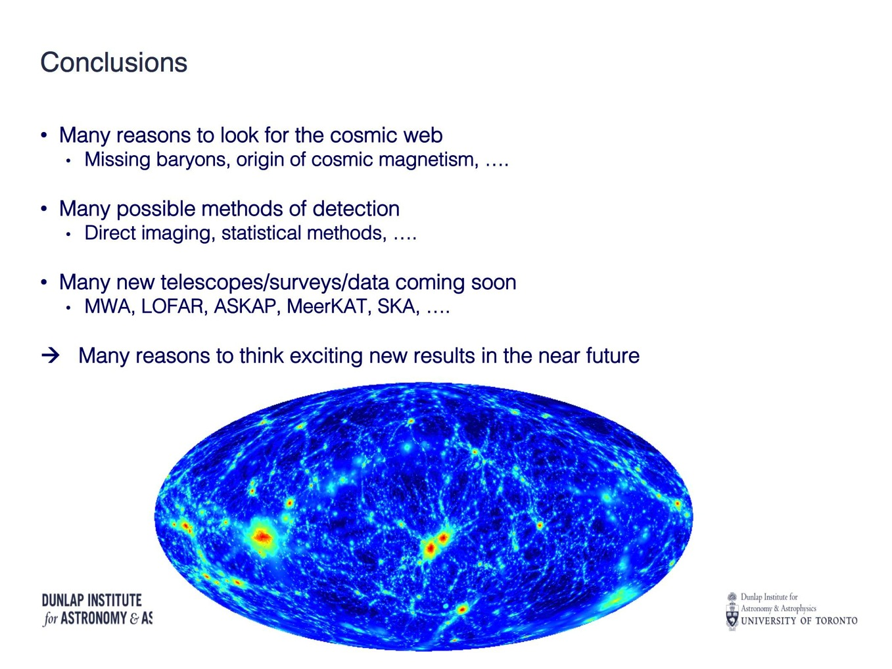
Conclusions
Paper submitted Oct 2016 to MNRAS
Notes:
Content Slide

Slide 23
Ideal Observational Setup
Frequency
Low (ish)
Too low → stronger Galaxy
Too high → weaker signal
Field
Large area
Low Galactic contamination
Multi-wavelength coverage
uv coverage
Good (continuous) coverage
Minimize sidelobes
Deeper cleaning
Resolution
High (arcsecs)
Point source subtraction
Low (arcmins)
Diffuse emission
Sensitivity
Low instrumental rms
Good sensitivity to large and small angular scales
Notes:
Content Slide

