Slide 1



1500 New Peaked-Spectrum Radio Sources Identified with the MWA
Natasha Hurley-Walker ;
Feain et al. (2011)
Joseph Callingham
(University of Sydney / CSIRO)
Bryan Gaensler
(University of Toronto)
on behalf of the
MWA GLEAM collaboration

Slide 2
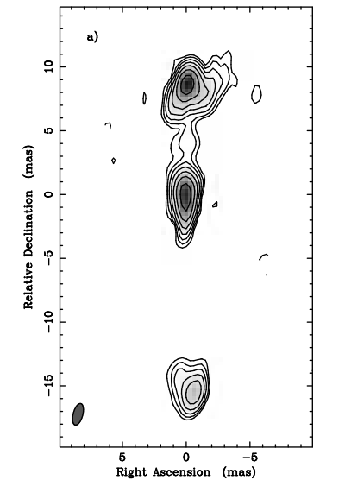
What are GPS/CSS Sources?
GPS = gigahertz-peaked spectrum ; CSS = compact steep spectrum
  powerful AGN with concave radio spectra
  GPS turnover ~ 1 GHz ; CSS turnover ~ 150 MHz (?)
  small physical sizes: GPS < 1 kpc, CSS ~ 1 – 10 kpc
  hosts vary: quasars, radio galaxies and Seyferts
0710+439 (Owsianik et al. 1998)

Slide 3
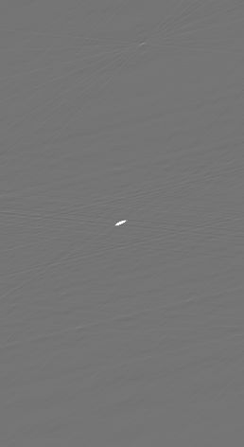
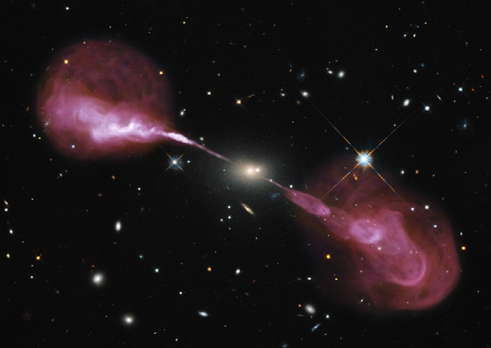
Why Study GPS/CSS Sources?
Unique view of early AGN stages; probe of environment at scal of tens of parsecs
Which radio galaxies evolve into
“A team” sources (Cyg A, Her A, etc)?
Are they confined to small spatial scales due to youth, frustration, or both?
Cause of the turnover in spectrum? Free-free vs synchrotron self absorption
(see Peck et al. 1999; Kameno et al. 2000; Marr et al. 2001,
2014; Orienti & Dallacasa 2008; Tremblay et al. 2008;
Tingay et al. 2015, Callingham et al. 2015)
NASA, ESA, S. Baum and C. O'Dea (RIT), R. Perley and
W. Cotton (NRAO/AUI/NSF), and the Hubble Heritage Team

Slide 4

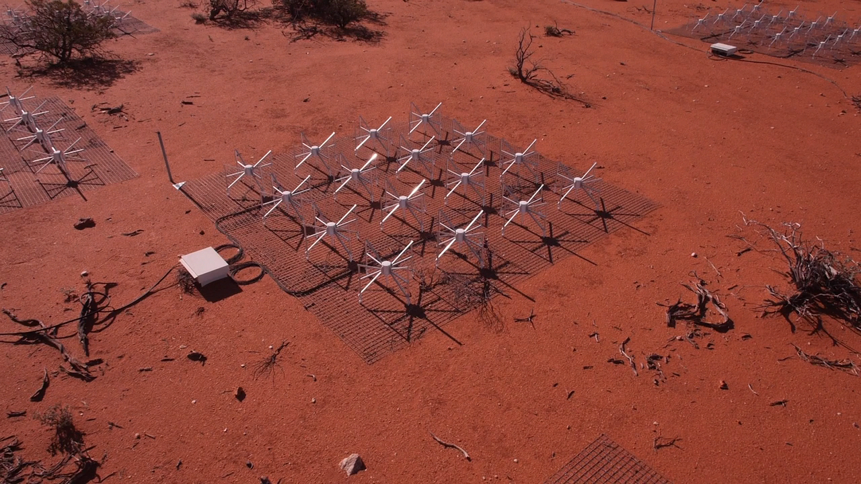
The SED Revolution with GLEAM
MWA GLEAM (Hurley-Walker et al. 2016)
  305,615 sources over 59% of the sky at 2’ resolution, σ ~ 10 mJy
  every source: 20 fluxes spanning 72－231 MHz
MWA
GLEAM
TGSS
MRC
Callingham et al. (2016)
NVSS
BBC Two Horizon

Slide 5
Extreme GPS Source PKS B0008-421 (I)
Number of Galaxies
Spectral Index (MWACS)
Callingham et al. (2015)

Slide 6
Extreme GPS Source PKS B0008-421 (II)
Callingham et al. (2015)

Slide 7
Extreme GPS Source PKS B0008-421 (III)
PKS B0008-421
PKS B1718-641
Flux Density (Jy)
Flux Density (Jy)
Frequency (GHz)
Frequency / GHz
Callingham et al. (2015)

Slide 8
Extreme GPS Source PKS B0008-421 (IV)
Flux Density (Jy)
B ~ 6.2 mG
t ~ 550 years
Frequency / GHz
Callingham et al. (2015)

Slide 9
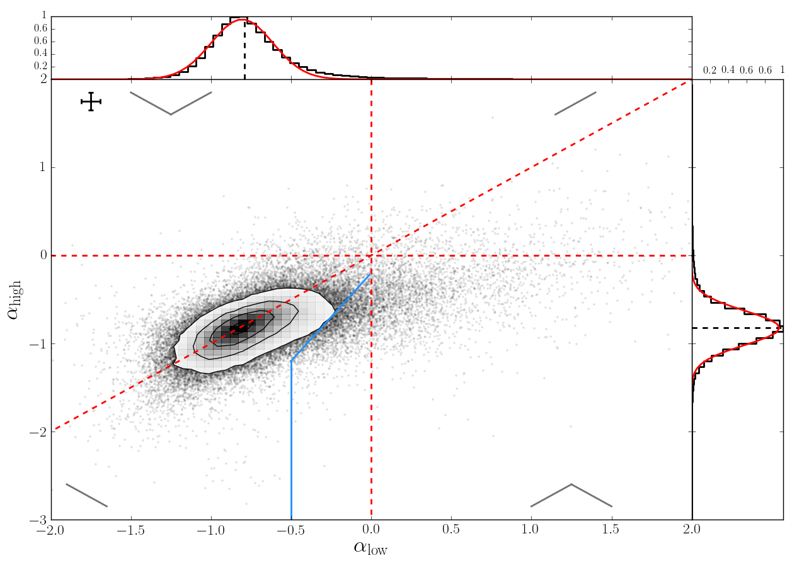
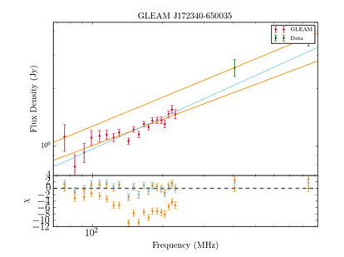
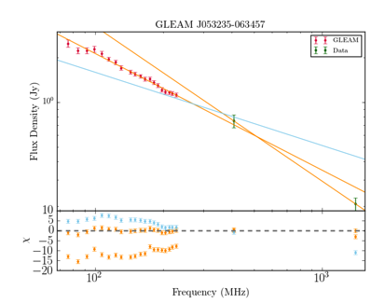
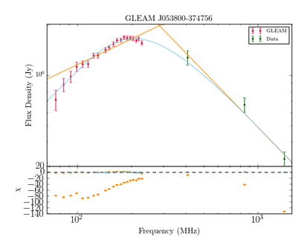
GLEAM Color-Color Diagram
96,628 sources
α_{high} (230－1000 MHz)
α_{low} (70－230 MHz)
Callingham et al. (2016)

Slide 10
New Peaked-Spectrum Source (I)
Callingham et al. (2016)

Slide 11
New Peaked-Spectrum Source (II)
Callingham et al. (2016)

Slide 12
New Peaked-Spectrum Source (III)
Callingham et al. (2016)

Slide 13
New Peaked-Spectrum Source (IV)
Callingham et al. (2016)

Slide 14
New Peaked-Spectrum Source (V)
Callingham et al. (2016)

Slide 15
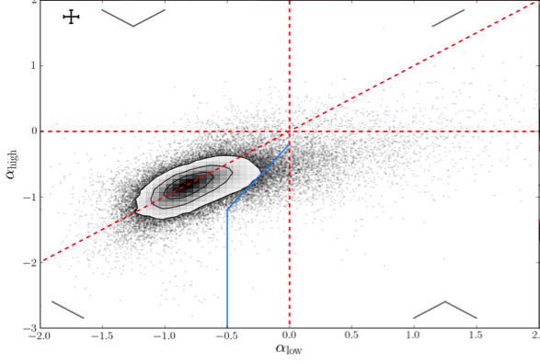
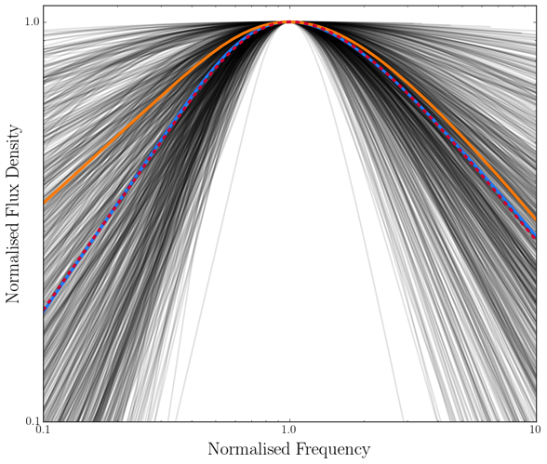
GLEAM Peaked-Spectrum Sample
1483 peaked-spectrum sources from GLEAM
  4.5% of GLEAM sample
  only 73 are previously known!
Previous samples, e.g.:
  O’Dea et al. (1998): 69
  Snellen et al. (1998): 47
230 have spectroscopic redshifts
430 have VLBI information
Wide spread in α_{low} :
varied environments?
  six have α_{low} > 2.5, violating synch. self-absorption limit
Callingham et al. (2016)

Slide 16
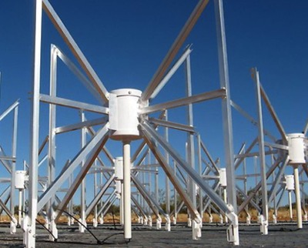


Summary
MWA / Hurley-Walker
GLEAM: widest ever fractional-bandwidth radio survey
  ideal for finding peaked-spectrum sources
New catalogue of 1483 peaked-spectrum sources
  low-frequency analogues to GPS & CSS sources
  95% are new detections
  more sources than all previous efforts combined
Additional thoughts and future work
  convex population: multiple epochs of AGN activity
  low-freq turnover & high-freq steep spectrum:
  indicator of high-redshift (z > 2) galaxies?
  no redshift dependence of turnover: mix of local
  and distant populations, decouple by source extent
  H I absorption to further test “frustration” scenario
NASA, ESA, RIT, NRAO /
AUI / NSF, Hubble Heritage
J. M. Flagg / US Library of Congress

Slide 18
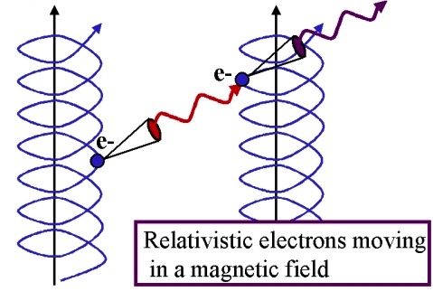
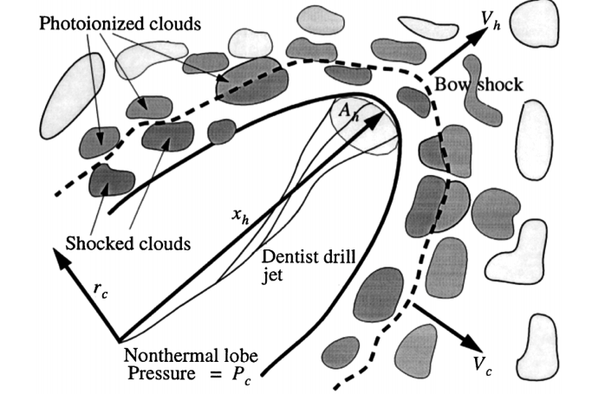
Possible Absorption Mechanisms
Free-Free Absorption
Synchrotron Self-Absorption
Bicknell et al. (1997)
Kellermann (1966)

Slide 19
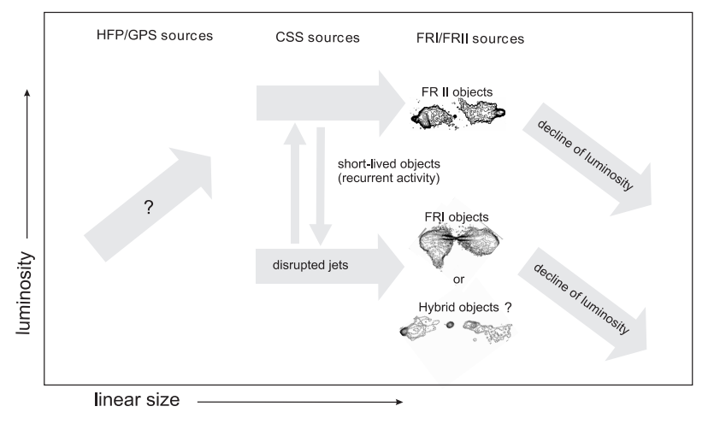
Possible Evolutionary Picture
Kunert-Bajraszewska et al. (2010)

Slide 20
Ultra-Steep Spectrum Source
Callingham et al. (2016)

Slide 21
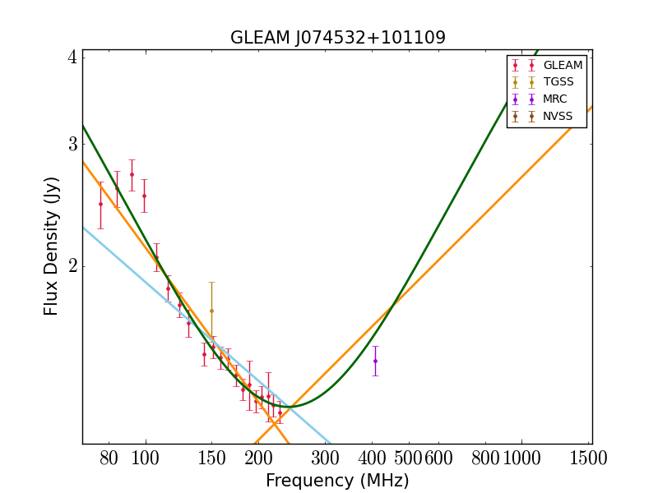
Convex Source (I)
Callingham et al. (2016)

Slide 22
Convex Source (II)
Callingham et al. (2016)

Slide 23
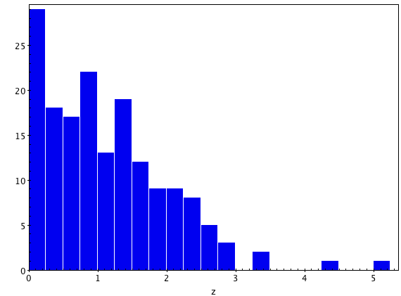
Redshift Distribution
Number of sources
Redshift
Callingham et al. (2016)

Slide 24
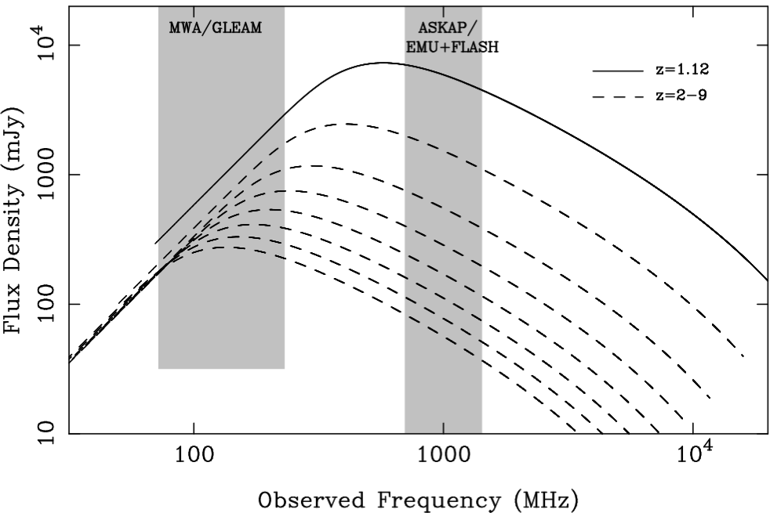
High Redshift Candidates
Nick Seymour
Notes:
Reionisation

