Slide 1
Science from Surveys
Jim Condon
NRAO, Charlottesville

Slide 2
Why make radio surveys?
Detect most sources in flux-limited populations
Discover (detect and recognize) new source types and phenomena
Characterize source populations:
Multiwavelength cross-identifications, redshifts, SEDs
Classify (AGNs, star-forming galaxies, cluster relics, pulsars, …)
Radio spectrum, polarization, angular size, variability, transients, …
Statistical properties (luminosity functions, size distributions,
evolution of AGNs and star formation, ...
Statistical cosmology: BAOs, weak lensing, EOR
Study foregrounds (Galactic magnetic fields, cluster magnetic fields)
Remove foregrounds (from EOR, CMB)
Produce reference sky images and catalogs for others to use

Slide 3
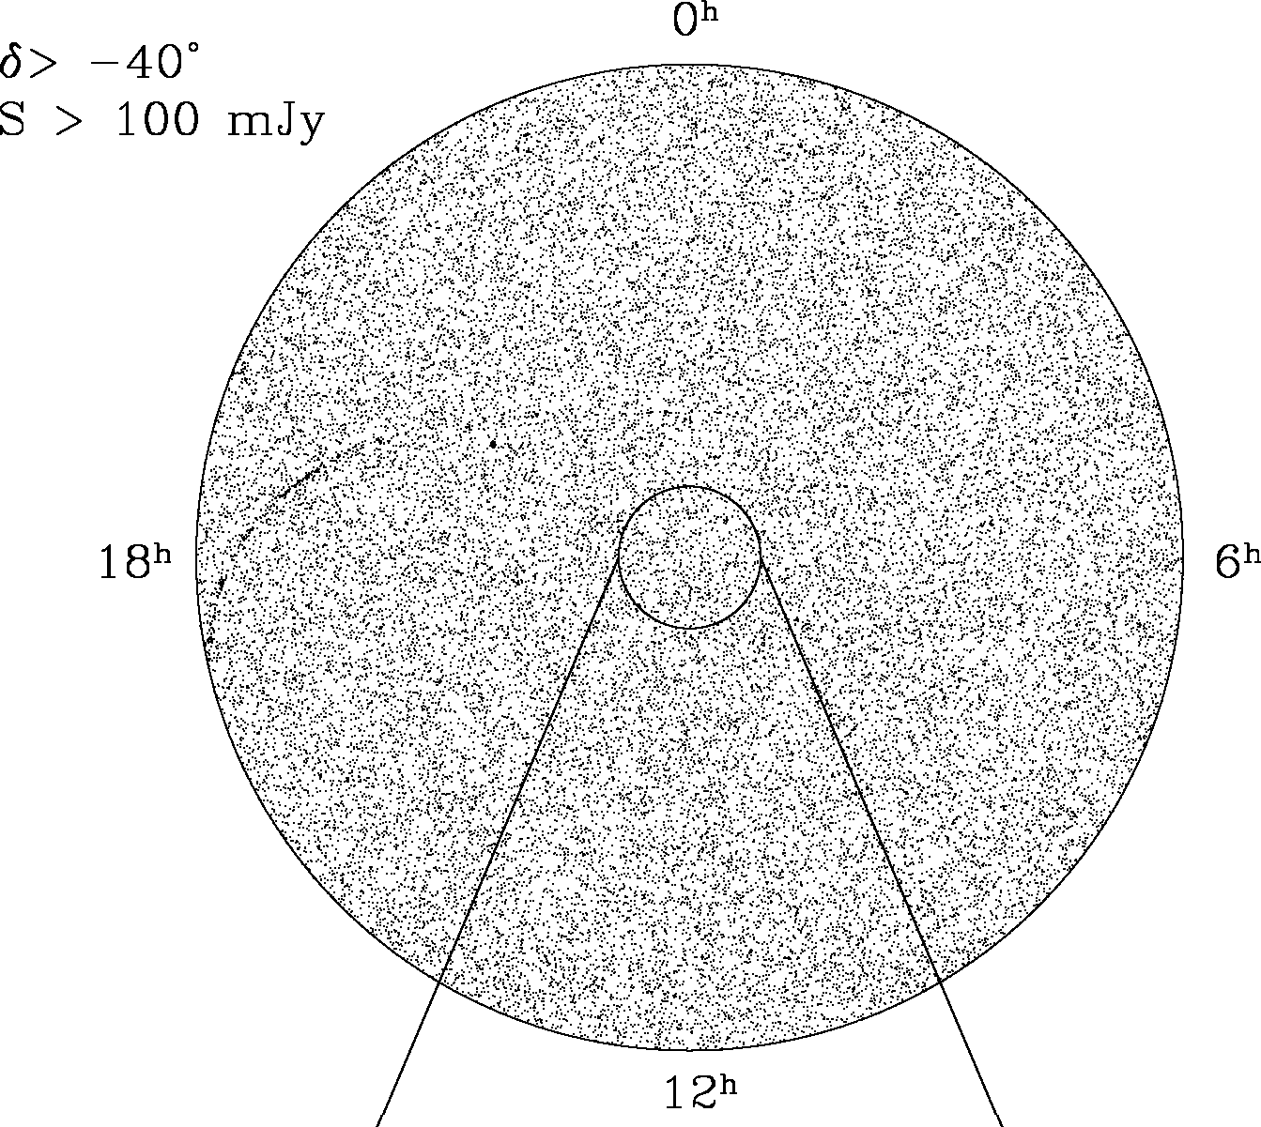


The universe is not empty
Most sources are extragalactic
Galactic
center
Notes:
The universe is not a vacuum; Mmatch surveys to what we know about the sky, mostly from GHz surveys. 1.4 GHz is a “bland” frequency, easy to survey (between low frequency with ionosphere, rfi, dynamic range problems with large FoV, scintillations)
And high frequency (too small FoV, sources weaker, intrinsic variability)

Slide 4
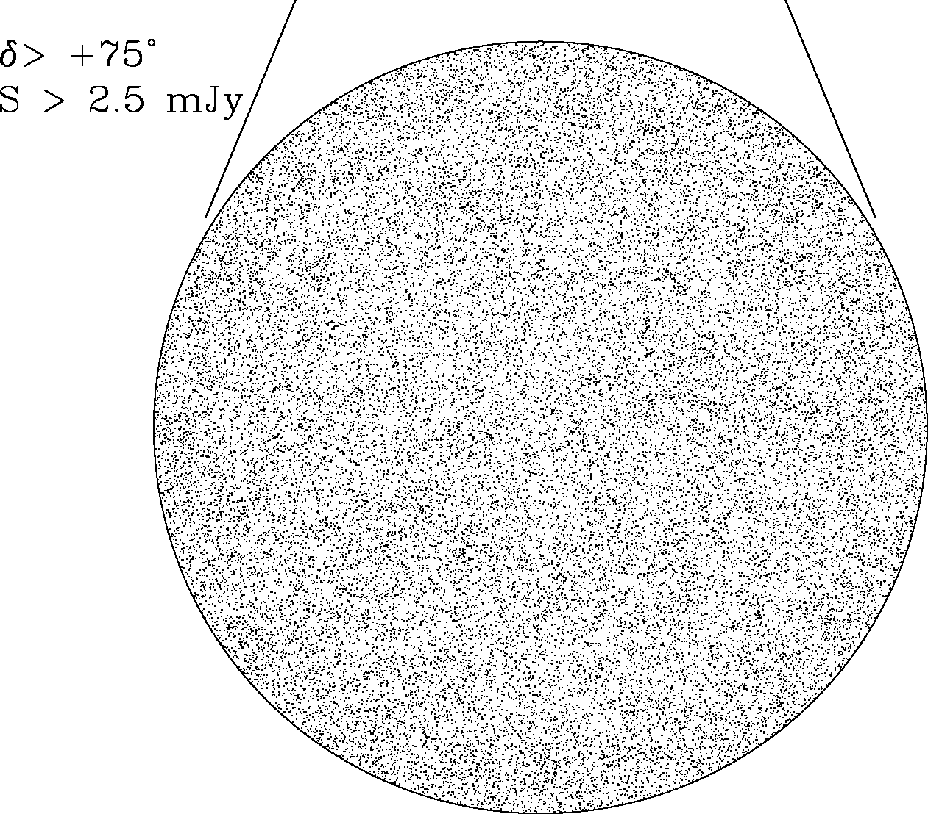
… very extragalactic

Slide 5
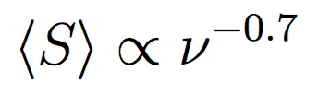
AGNs and star-forming galaxies
Star-forming galaxies
AGN
Notes:
Simple-minded model (Condon 1984; Wilman et al. 2008): Two main populations, powered by AGN (strong sources) and by star formation (fainter sources). Not static Euclidean where S proportional to d^{-2}.
10X luminosity evolution shell model with <z> ~ 0.8, so L is proportional to S, d is nearly independent of S. Scale with frequency using <alpha> ~ -0.7; e,g, S(150) ~ 5S(1400). So LOFAR sigma = 100 muJy detects sources with
S1400 = 100 muJy, gets into most luminous star-forming galaxies. 1 microJy resolves 96% of the sky background.

Slide 6
Source counts and angular sizes?
Notes:
Simple-minded model (Condon 1984; Wilman et al. 2008): Two main populations, powered by AGN (strong sources) and by star formation (fainter sources). Not static Euclidean where S proportional to d^{-2}.
10X luminosity evolution shell model with <z> ~ 0.8, so L is proportional to S, d is nearly independent of S. Scale with frequency using <alpha> ~ -0.7; e,g, S(200) ~ 4S(1400).

Slide 7
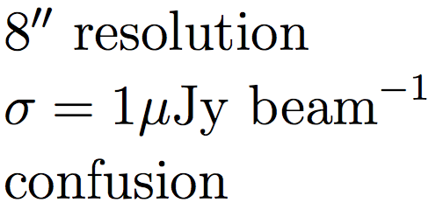
Notes:
JVLA S-band C array rms noise ~ 1 microJy/beam Angular size distribution, surface brightness distribution Brightness sensitivity limited by confusion.

Slide 8

Notes:
JVLA S-band B array, rms noise ~ 1 microJy/beam

Slide 9




Notes:
JVLA S-band A array rms noise ~ 1 microJy/beam. B/A flux ratios indicate <theta1/2> ~ 0.4 arcsec

Slide 10
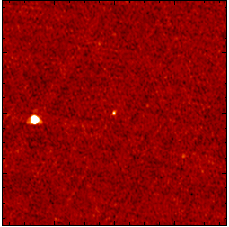
Easy Problems vs Hard Problems
Detect 79 known pulsars with S > 2.5 mJy at 1.4 GHz in the NVSS (Kaplan et al. 1998, ApJS, 119, 75) easy
Locate the LMXB pulsar PSR J1123+0038 because it is bistable easy
Discover all pulsars or stars with S > 2.5 mJy at 1.4 GHz in the NVSS hard

Slide 11
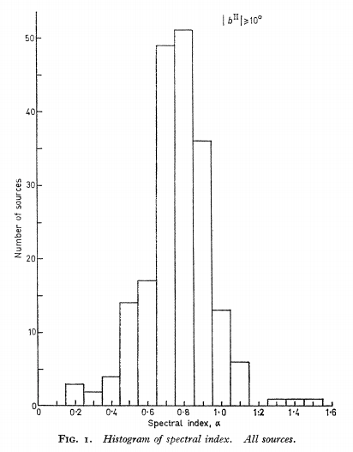

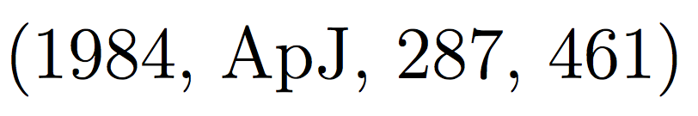
Survey frequency:
How much does it matter scientifically?
4C
Notes:
3CR 178 MHz ~400 sources, 4C 178 MHz S >0.5 Jy spectra in Long et al. 1966, MNRAS, 134, 371. Contain all source types: AGNs (both radio galaxies and quasars), star-forming galaxies (e.g., M82), Seyferts (NGC 1068), steep and flat-spectrum sources, even pulsars (first millisecond pulsar PSR B1937+21 is 4C 21.53, which scintillates and has a steep spectrum alpha ~ -2.
Left plot from Condon 1984b (appendix). Steep sigma = 0.17, (FWHM ~ 0.40) so delta alpha = -.065 from .15 to 1.4 GHz. Flat sigma = 0.38, Delta alpha = -0.28 from 1.4 to 10 GHz.

Slide 12
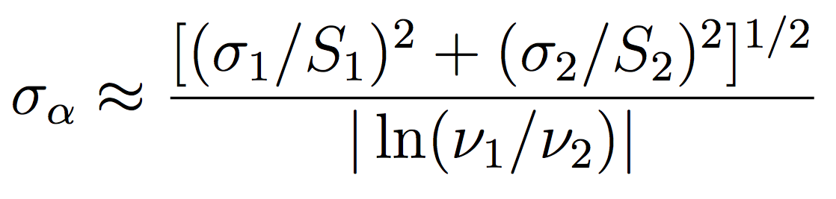
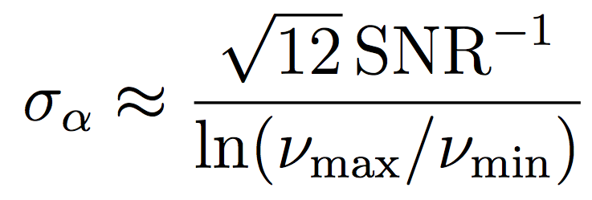
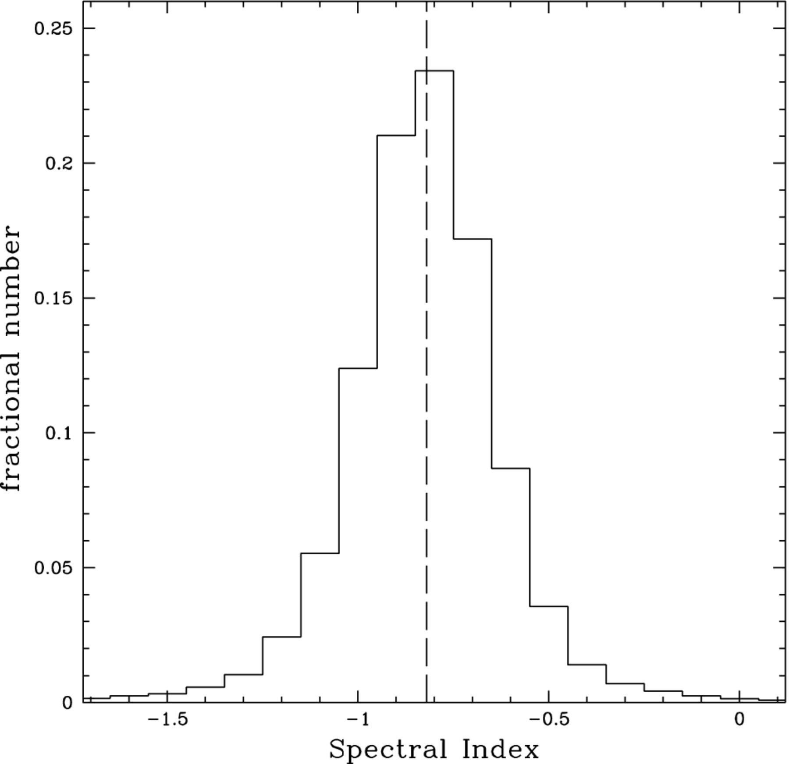
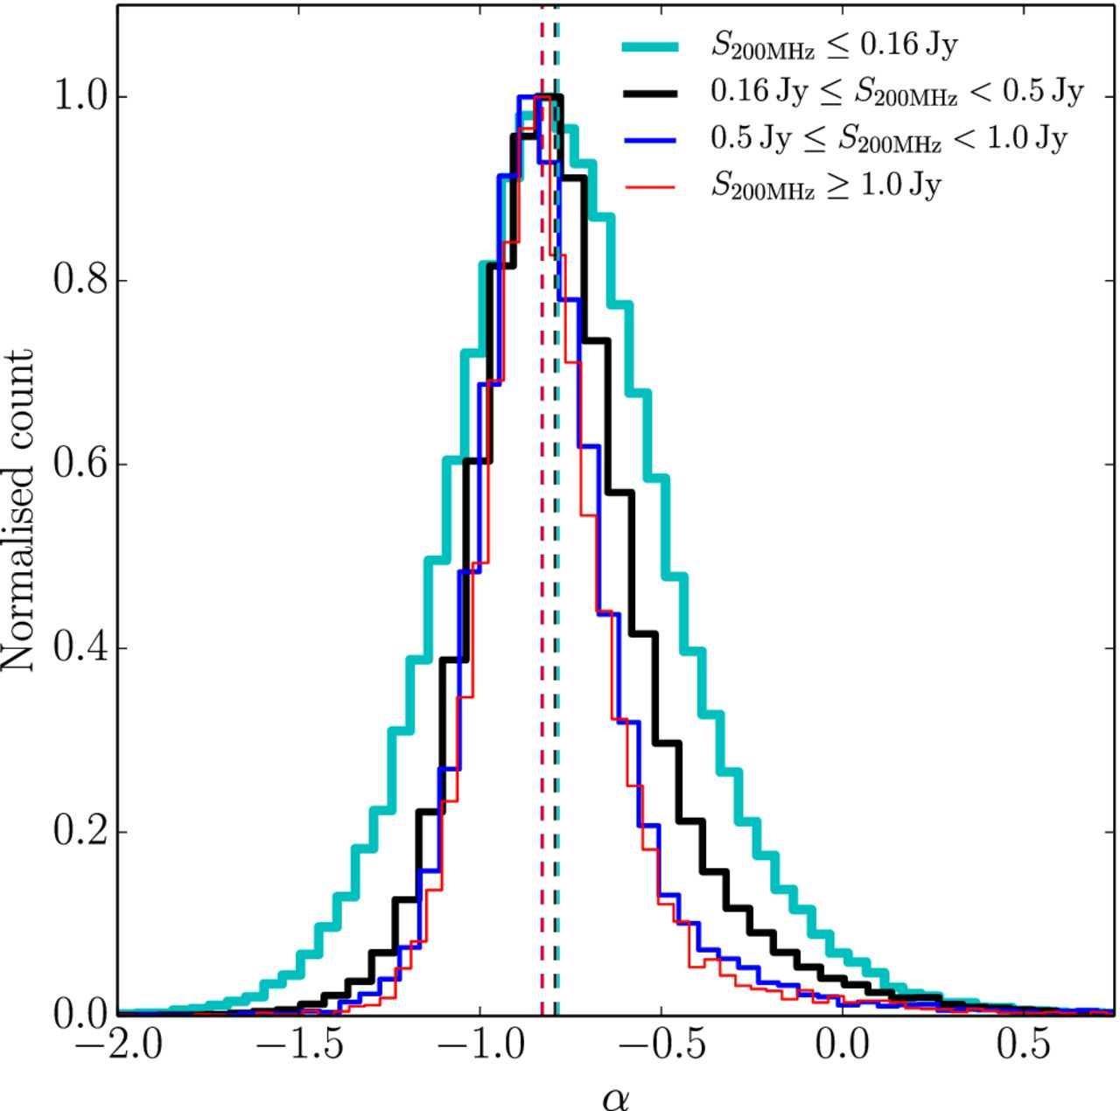
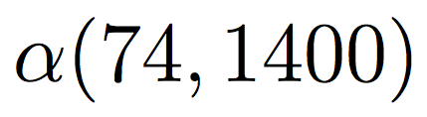
Measuring and using spectral indices
VLSSr / NVSS
GLEAM internal
Notes:
74 MHz VLSSr: Lane et al. 2014, MNRAS, 440, 327; SIQR=0.11; VLA dishes. 200 MHz GLEAM: Hurley-Walker et al. 2017, MNRAS, 464, 1146
Useful sanity check; see if sigma_alpha ~ 0.17 or FWHM ~ 0.4. Better off using two surveys at widely spaced frequencies, important to get accurate flux densities (calibration)

Slide 13
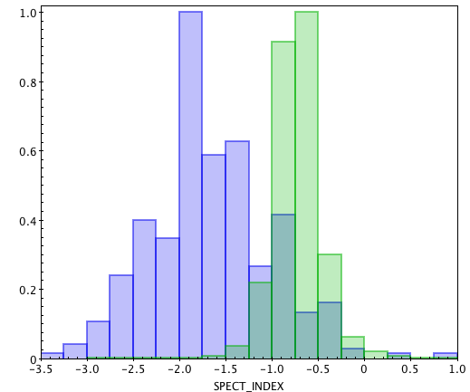

Finding Known and Unknown Pulsars using TGSS/NVSS spectra
TGSS-NVSS Spectral Index Image
An image-based approach used in the past to find pulsars (e.g. B1937+21)
Method selects without regard to period, dispersion measure, orbital parameters and interstellar scattering
Measure compactness, spectrum, polarization, and position
Promising candidates searched for pulsations in gamma-rays and/or radio
Hope is to find exotic PSRs missed by traditional pulsation search methods
62% PSRs
α<-1.5
0.3% AGN
α<-1.5
Notes:
PSR B1937+21 and HII region. Called 4C 21.53 Frail et al. 2016 detected ~300 known PSRs via steep alpha using 555415 NVSS-TGSS sources
Easy problems and hard problems. Ex.: 1998 summer student Dave Kaplan. NVSS Pne, known pulsars vs radio stars, new pulsars. Ex: Fermi pulsars vs “new” pulsars.

Slide 14
Summary:
The universe is not a vacuum. Survey parameters (resolution, sensitivity, dynamic range, position accuracy, sky coverage, …) should be matched to source properties (surface brightness, redshift range, angular size, spectral index, sky density, confusion, optical/IR IDs,…).
Discovery = detection + recognition
Survey frequency is not a strong spectral selector.
Low- and high-frequency surveys complement each other.
The faster the survey speed, the sooner the survey hits the wall of systematic errors (confusion, dynamic range, primary beam errors, clean bias, ionospheric phase errors, …).
Systematic errors dominate, especially at low frequencies, so quality is needed to exploit quantity (be sure to get ground truth on clean bias, ionospheric calibration source suppression, …)
Survey science = survey quality X number of scientists who use it
Notes:
Nonvacuum means instrumental survey speed parms alone are not that useful.

Slide 15

The National Radio Astronomy Observatory is a facility of the National Science Foundation
operated under cooperative agreement by Associated Universities, Inc.
www.nrao.edu • science.nrao.edu

Slide 16
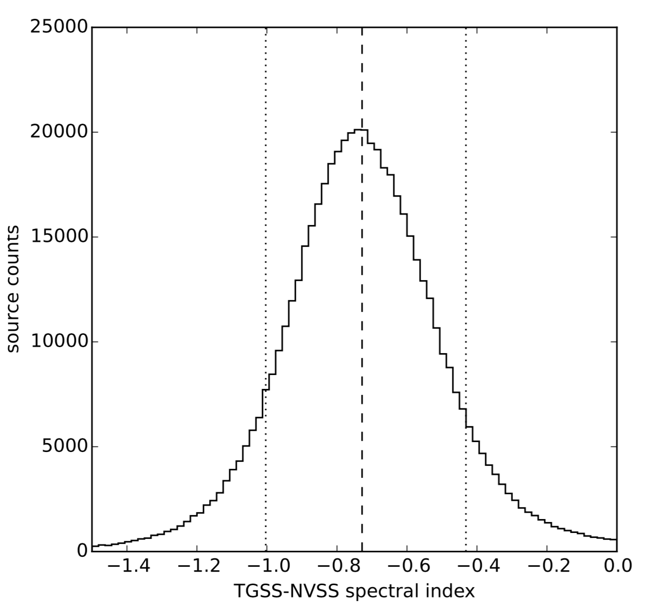
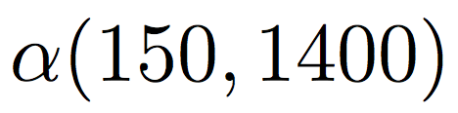

TGSS = black stars
7C = blue and green dots
Deep fields = red, black,
yellow, magenta, grey dots
Notes:
At alpha = -0.73, S150/S1400 = 5.11. Figs from Dale Frail. Nearly all AGNs.

Slide 17
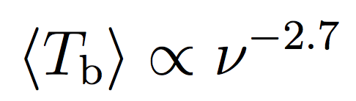
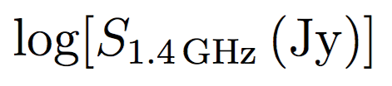
Notes:
Brightness weighting S^2 n(S) units Jy/sr or K of brightness temperature. 96% of source background resolved above 1.7 microJy at 1.4 GHz. AGN peak at log(S) ~ -1.2, star-forming peak at log(S) ~ -4.4.

Slide 18
96% of the radio source
background is resolved by
S_{1.4 GHz} ~ 1.7 μJy
Data points and box: 160 μm
Herschel counts converted to
1.4 GHz by the FIR/radio ratio
q = log(S_{160 μm})/log(S_{1.4 GHz}) = 2.5
Notes:
Really simpleminded universal pure luminosity evolution. 1984 calc,data agrees within a few % of far more sophisticated Wilman et al. 2008, MNRAS, 388,1335 SKA design model.
IRAS FIR/radio correlation makes radio surveys of star-forming galaxies a useful tracer of the star-formation rate evolution.

Slide 19

Notes:
Top: data points and box are Herschel 160 microns converted to 1.4 GHz by q = log(S_{160 μm})/log(S_{1.4 GHz}) = 2.5
Bottom: “Radio” = 3 GHz. 160 microns at z = 1 is 80 microns in source frame.

Slide 20
‘‘Classical’’ confusion
Notes:
Confusion ‘melts away’ below theta ~ 10 arcsec.

Slide 21
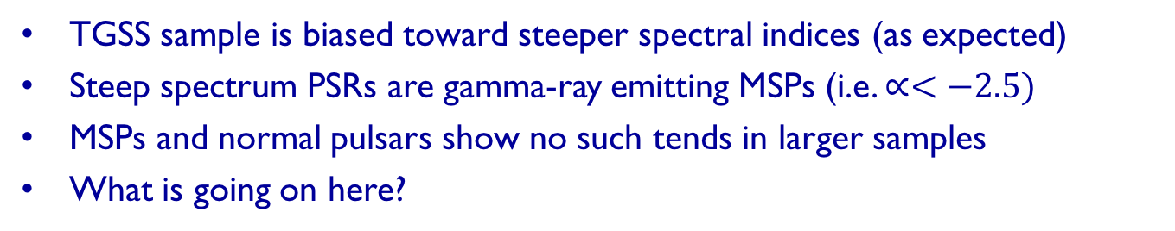
The Case of the Steep Spectrum Pulsars
All PSRs
TGSS PSRs
Frail et al (2016)
TGSS sample is biased toward steeper spectral indices (as expected)
Steep spectrum PSRs are gamma-ray emitting MSPs (i.e. $∝<−2.5)$
MSPs and normal pulsars show no such tends in larger samples
What is going on here?
Notes:
Normalized histogram. Slight bias. As expected for a 150 MHz survey.
All but one of the steep spectrum MSPs have been detected by Fermi
Not the first one sto notice this with Fermi PSRs. Much larger sample.
Low frequency bias. Out of the plane. Easy to detect. But why gamma-rays?
Don’t know but this odd behavior suggested two more science projects involving Fermi puzzles.

