Slide 1

Interferometry with the LWA & VLA below 100 MHz
Frank Schinzel (NRAO)

Slide 2
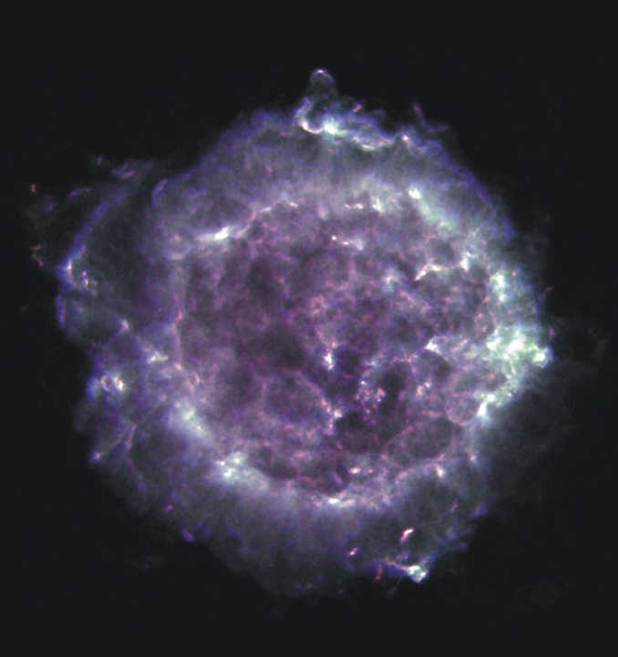
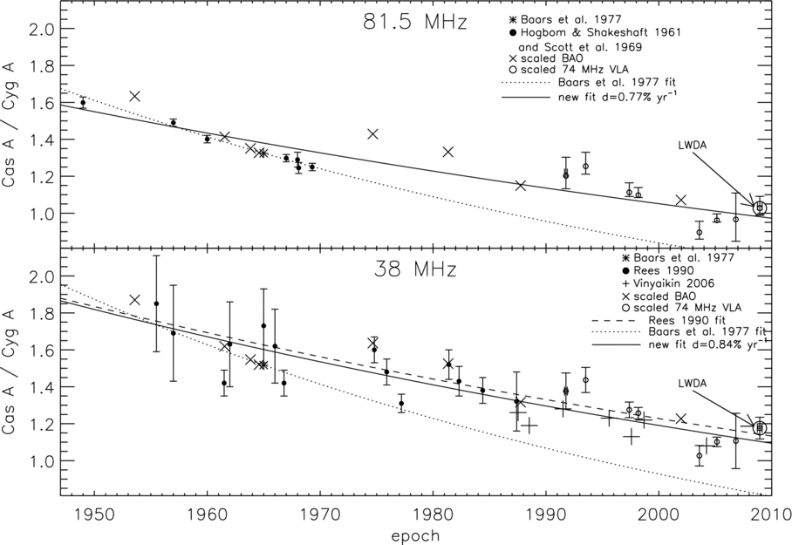
Radio Composite
Cassiopeia A
Regular monitoring of the radio galaxy Cygnus A and SNR Cassiopeia A with LWA1.
At LWA1 wavelength emission is dominated
by free-free absorption from unshocked
ejecta with flattening of the spectral index
below 333 MHz.
Credit: NRAO/AUI
Helmboldt & Kassim (2009)

Slide 3
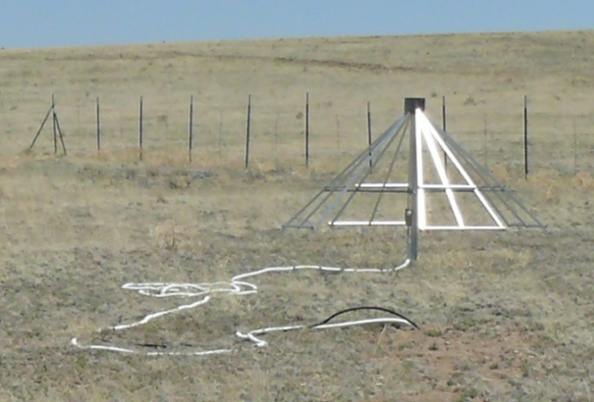
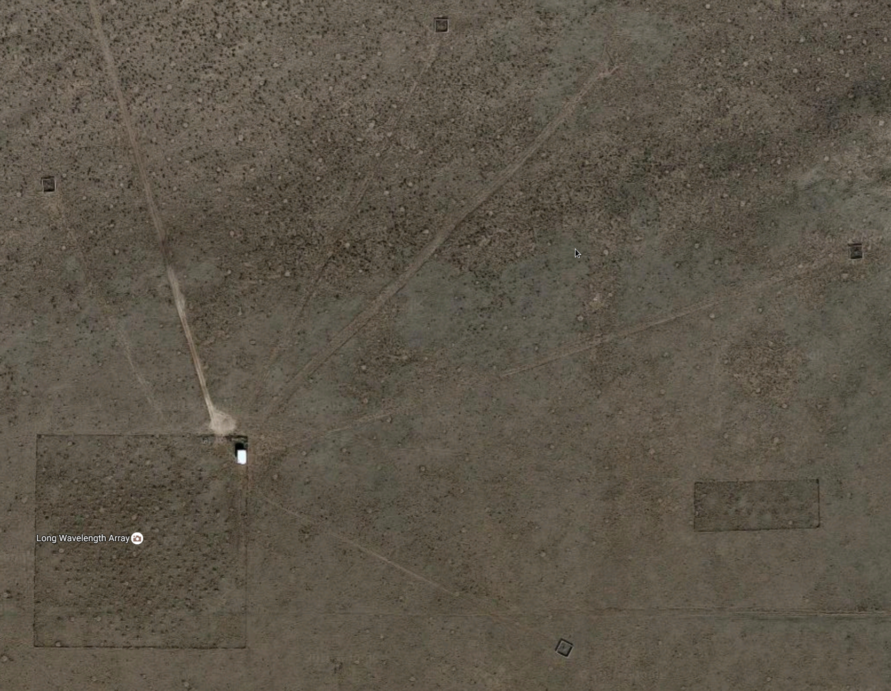
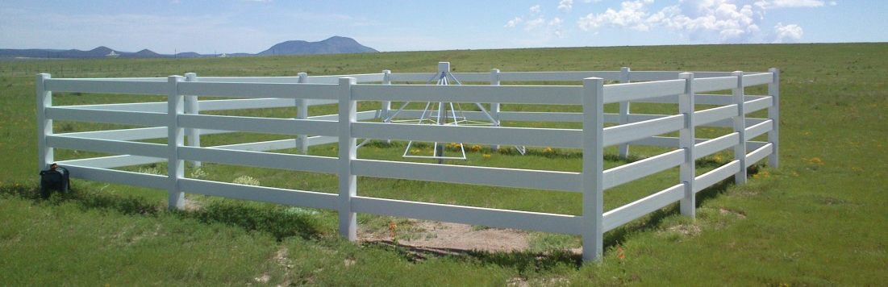
LWA1 + Dipole
Outrigger 1
~340m
~240m
Outrigger 2

Slide 4
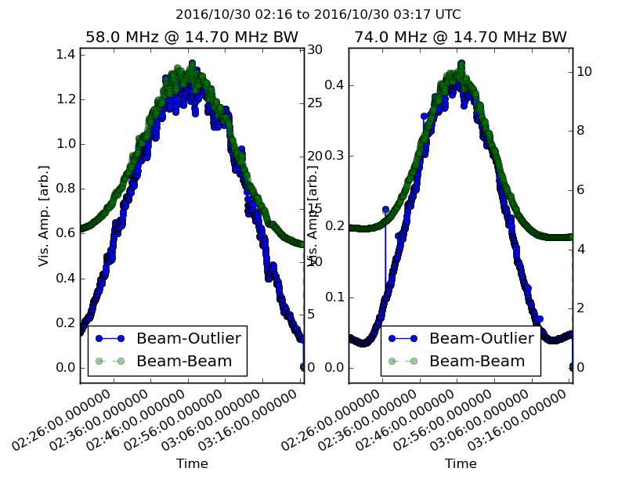
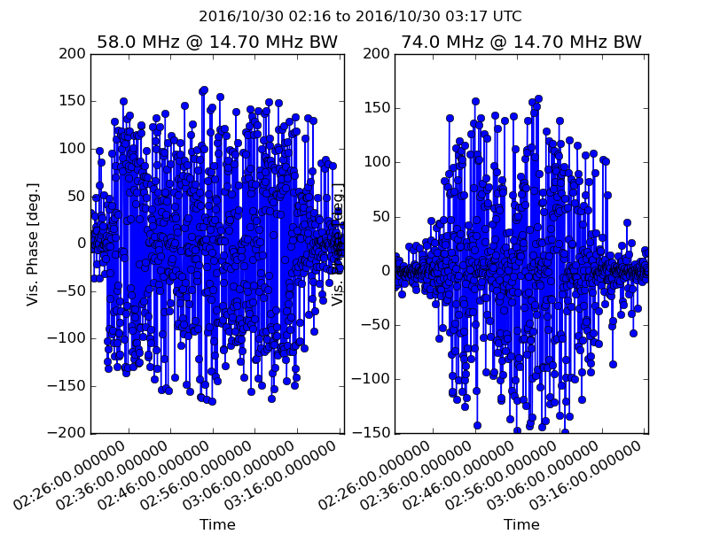
Monitoring Cyg A & Cas A < 100 MHz
Drift scan b/w LWA1 beam & dipole: 2013.5 – now
1611 observations by 11/01/2016 (~3222 beam hours)
Frequency: 48.0 – 83.0 MHz; same LST/elev. for every obs.
Fully automatic scheduling, correlation and q/a manually,
lightcurve analysis automatic with ingestion into database
Phase vs Time
Amplitude vs Time

Slide 5
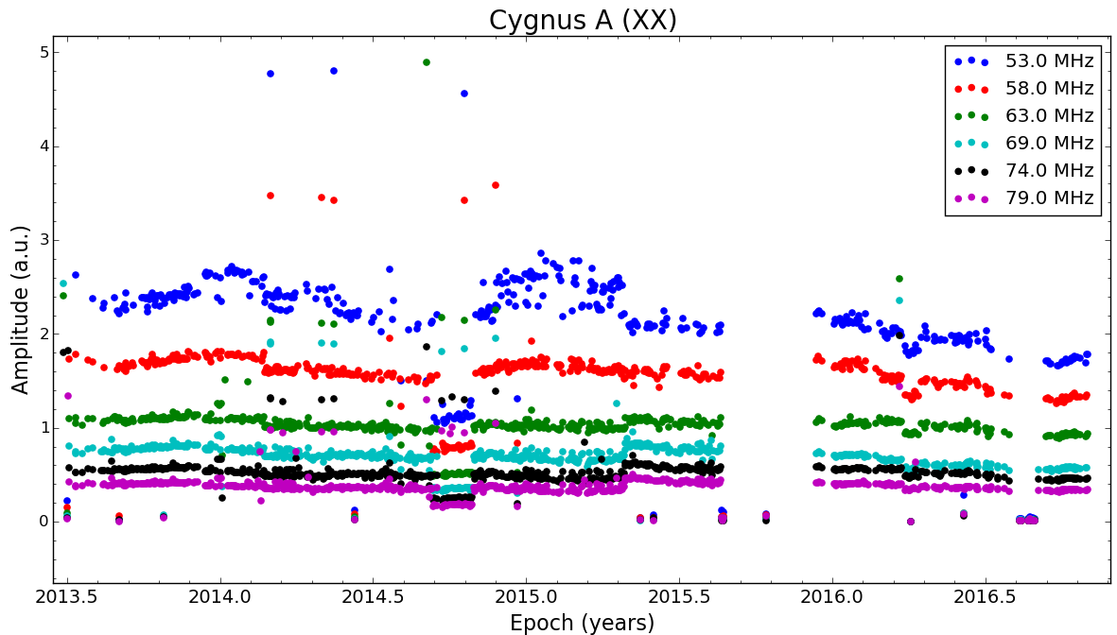
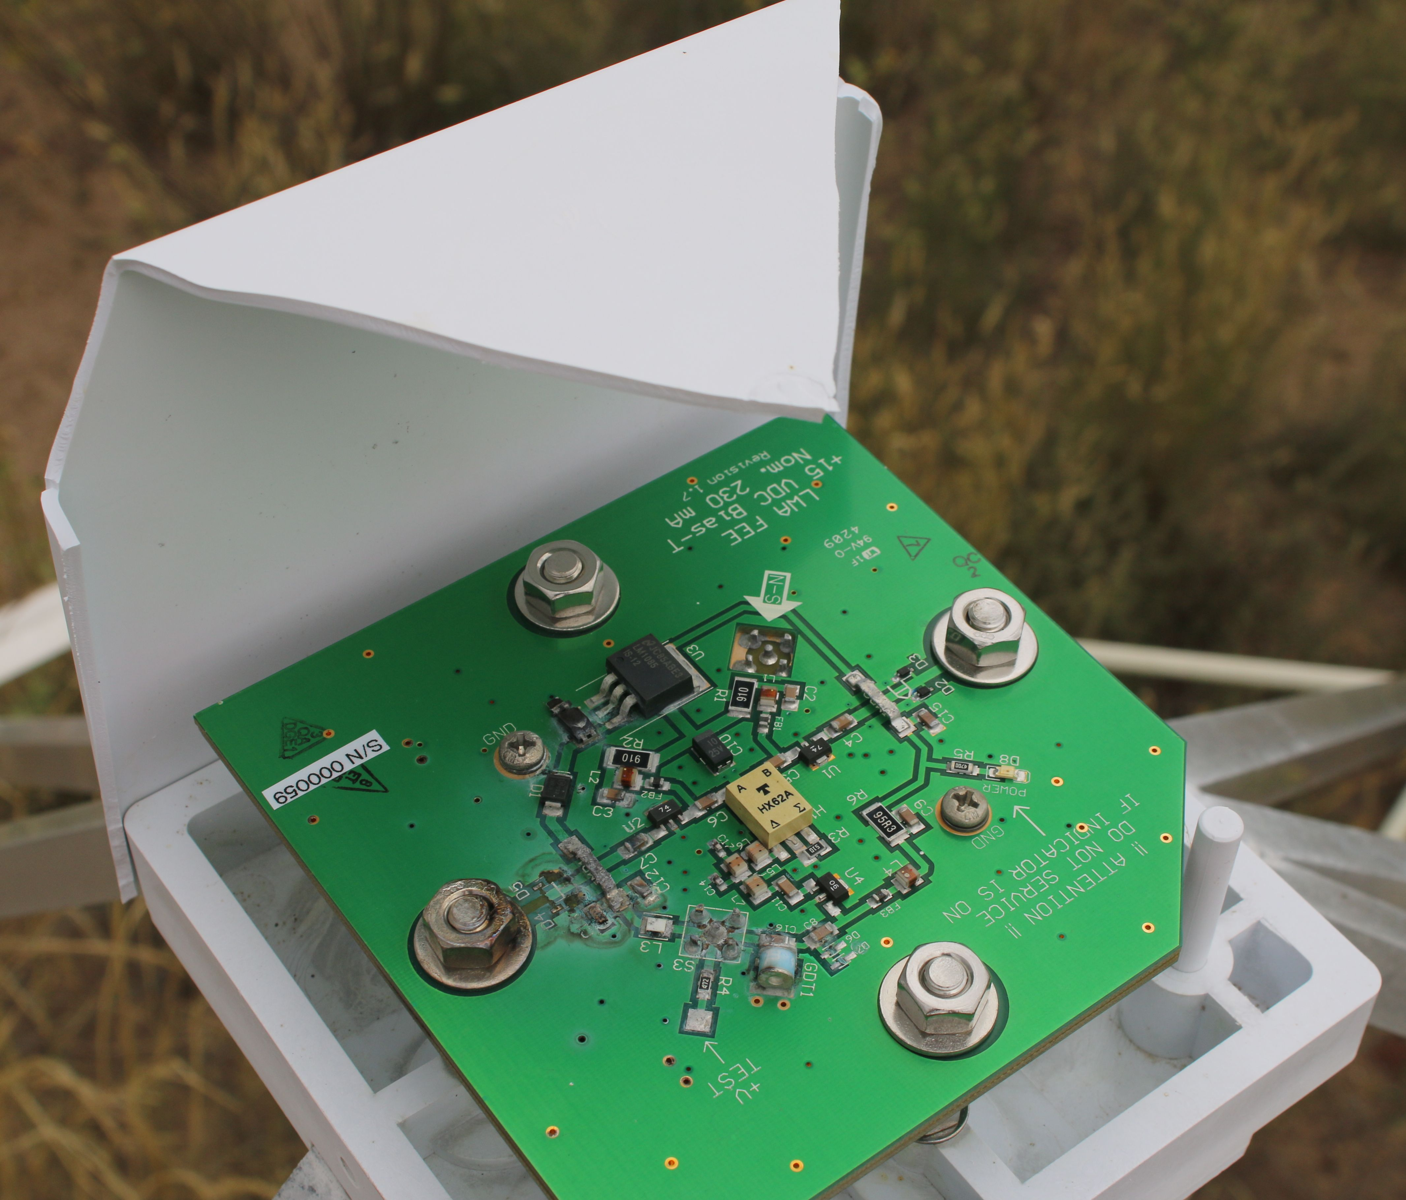
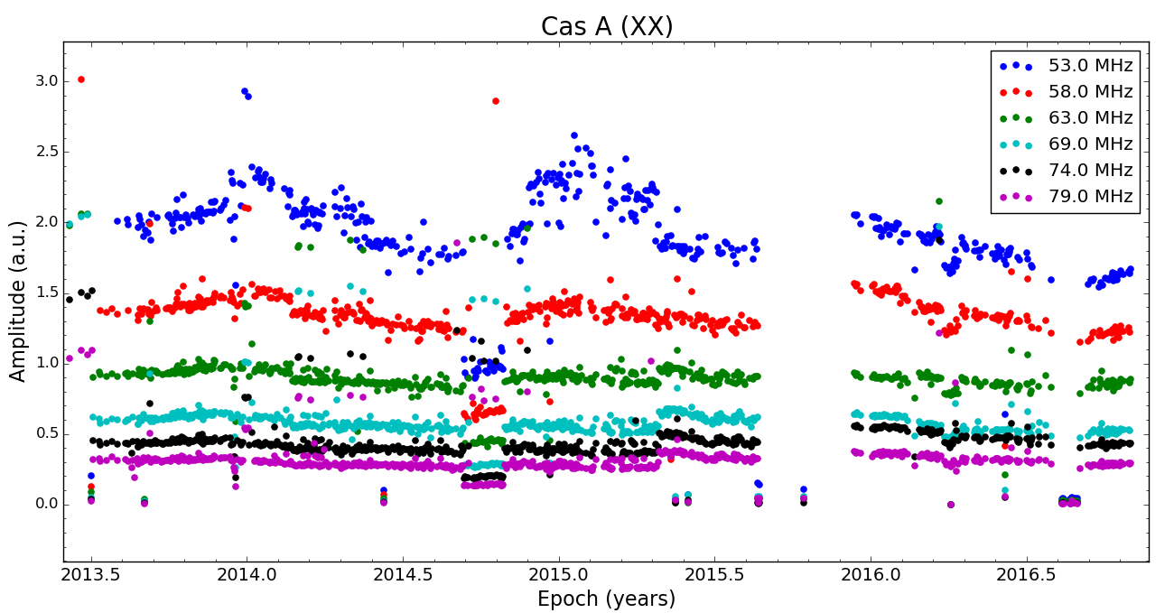
Cyg A/Cas A raw light curves
Winter: variation in
receiver gains due to
ambient temperature
y-pol cable on
outrigger 1 died
(less cross-talk)
Lightning Strike of
LWA1 core, took out
dipole frontend too
new obs. with
outrigger 2
Unpowered
dipole frontend
Changed attenuator
settings on analog
receiver

Slide 6
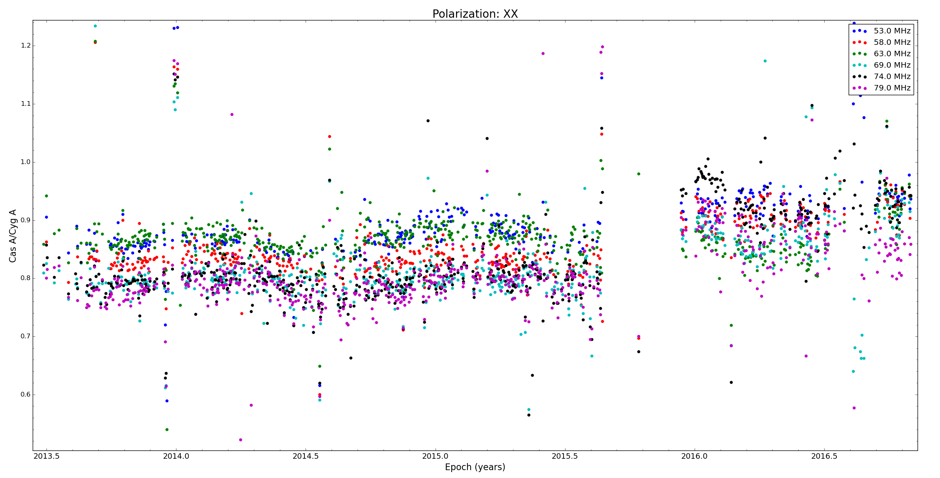
Cyg A/Cas A flux ratios
Outrigger 1
Outrigger 2
~0.8-0.9 Cas A/Cyg A ratio between 52 – 80 MHz depending on spatial structure

Slide 7
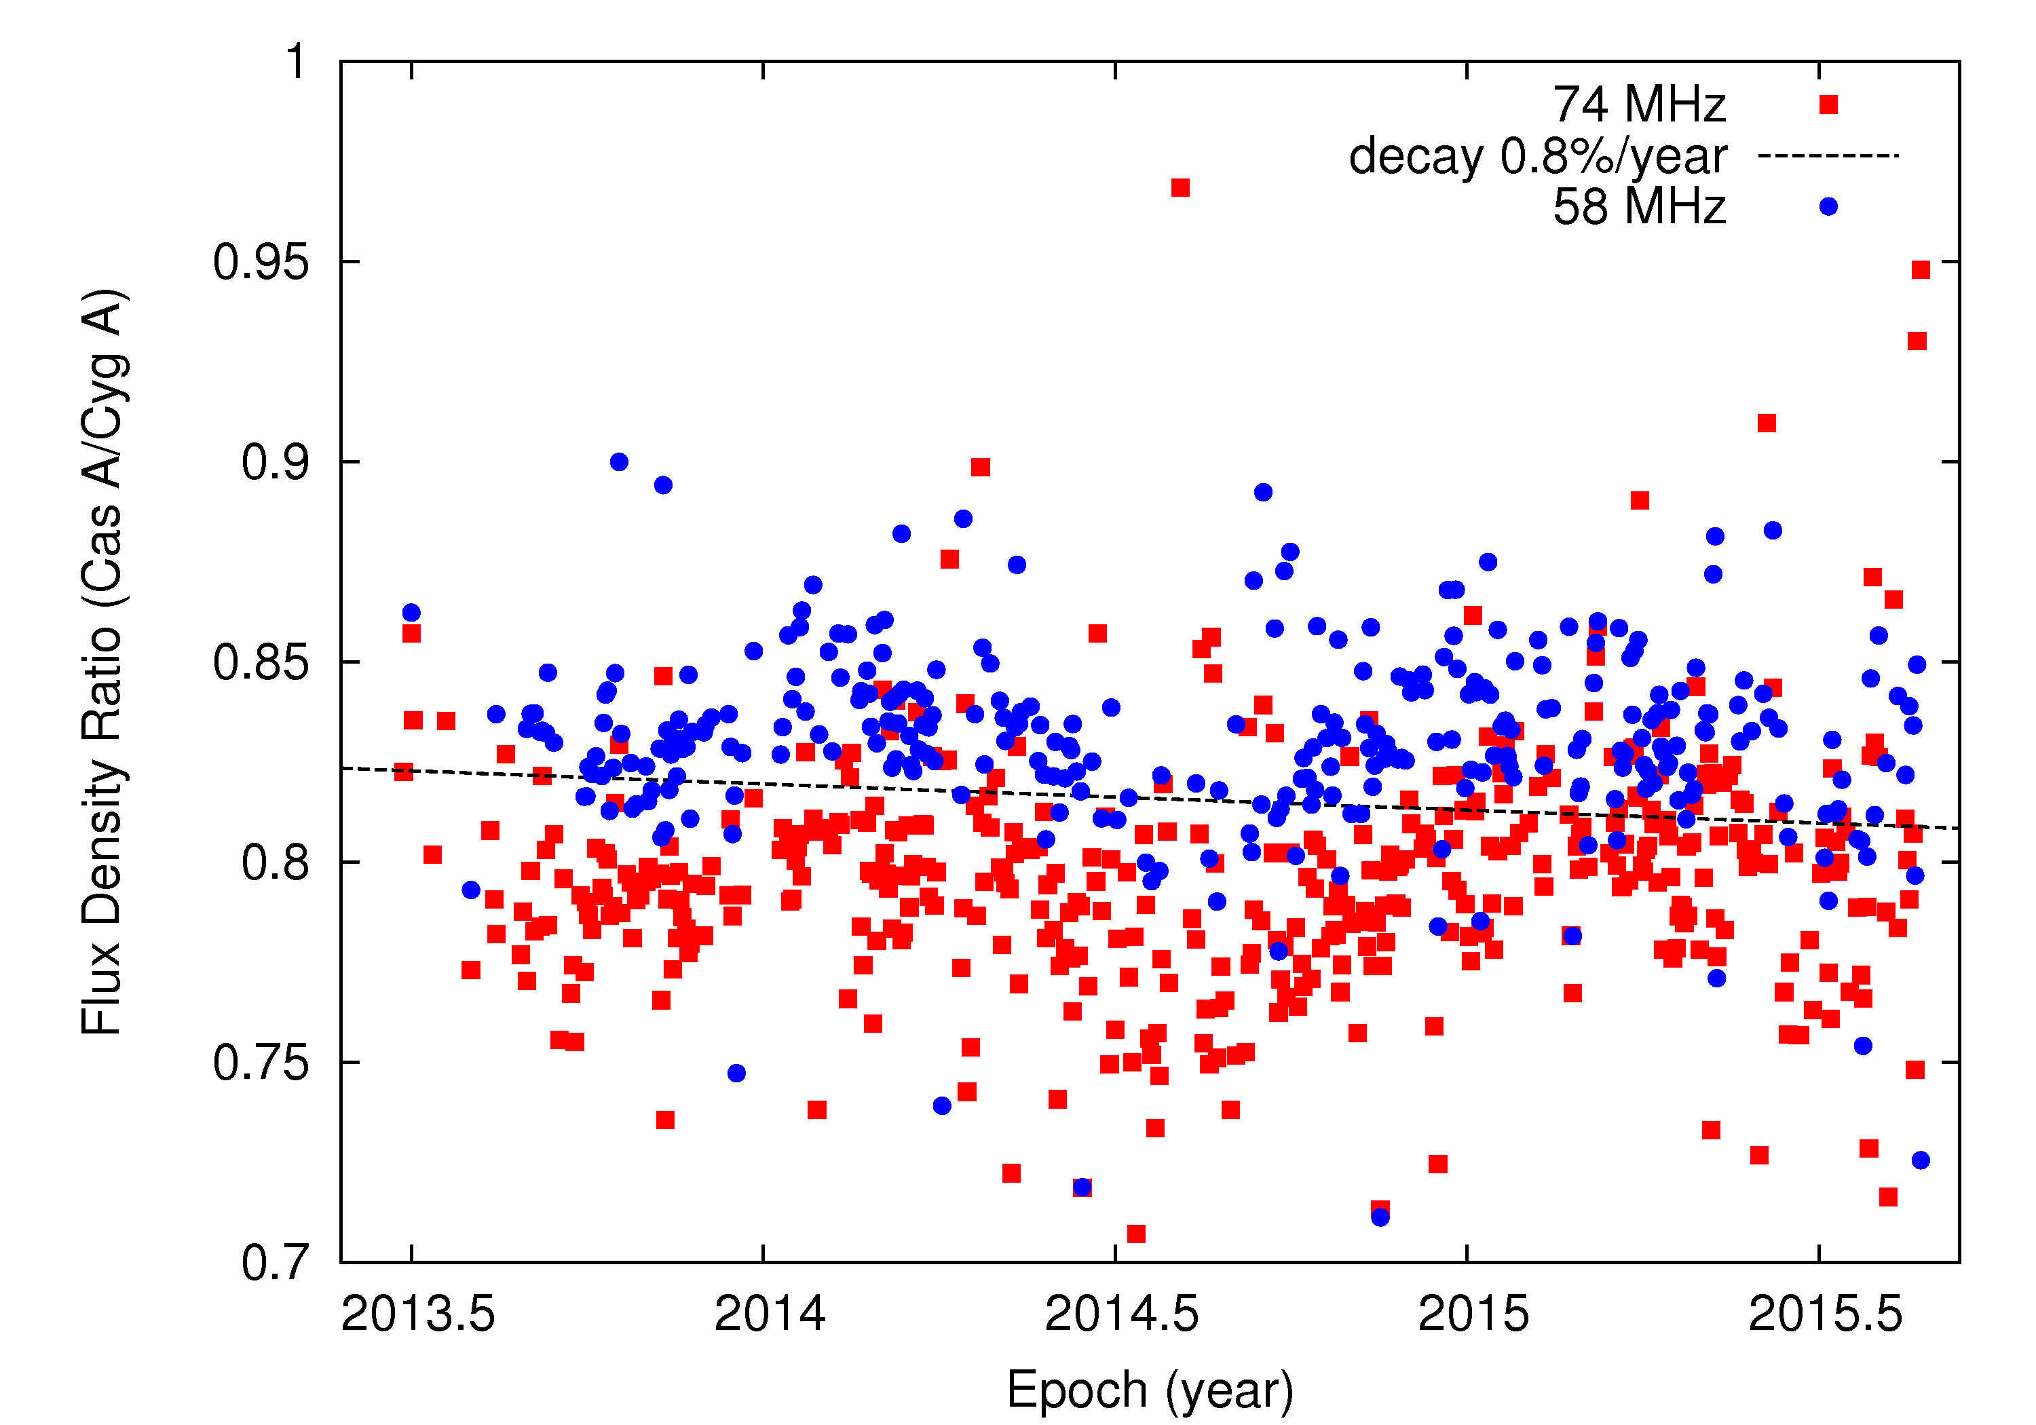
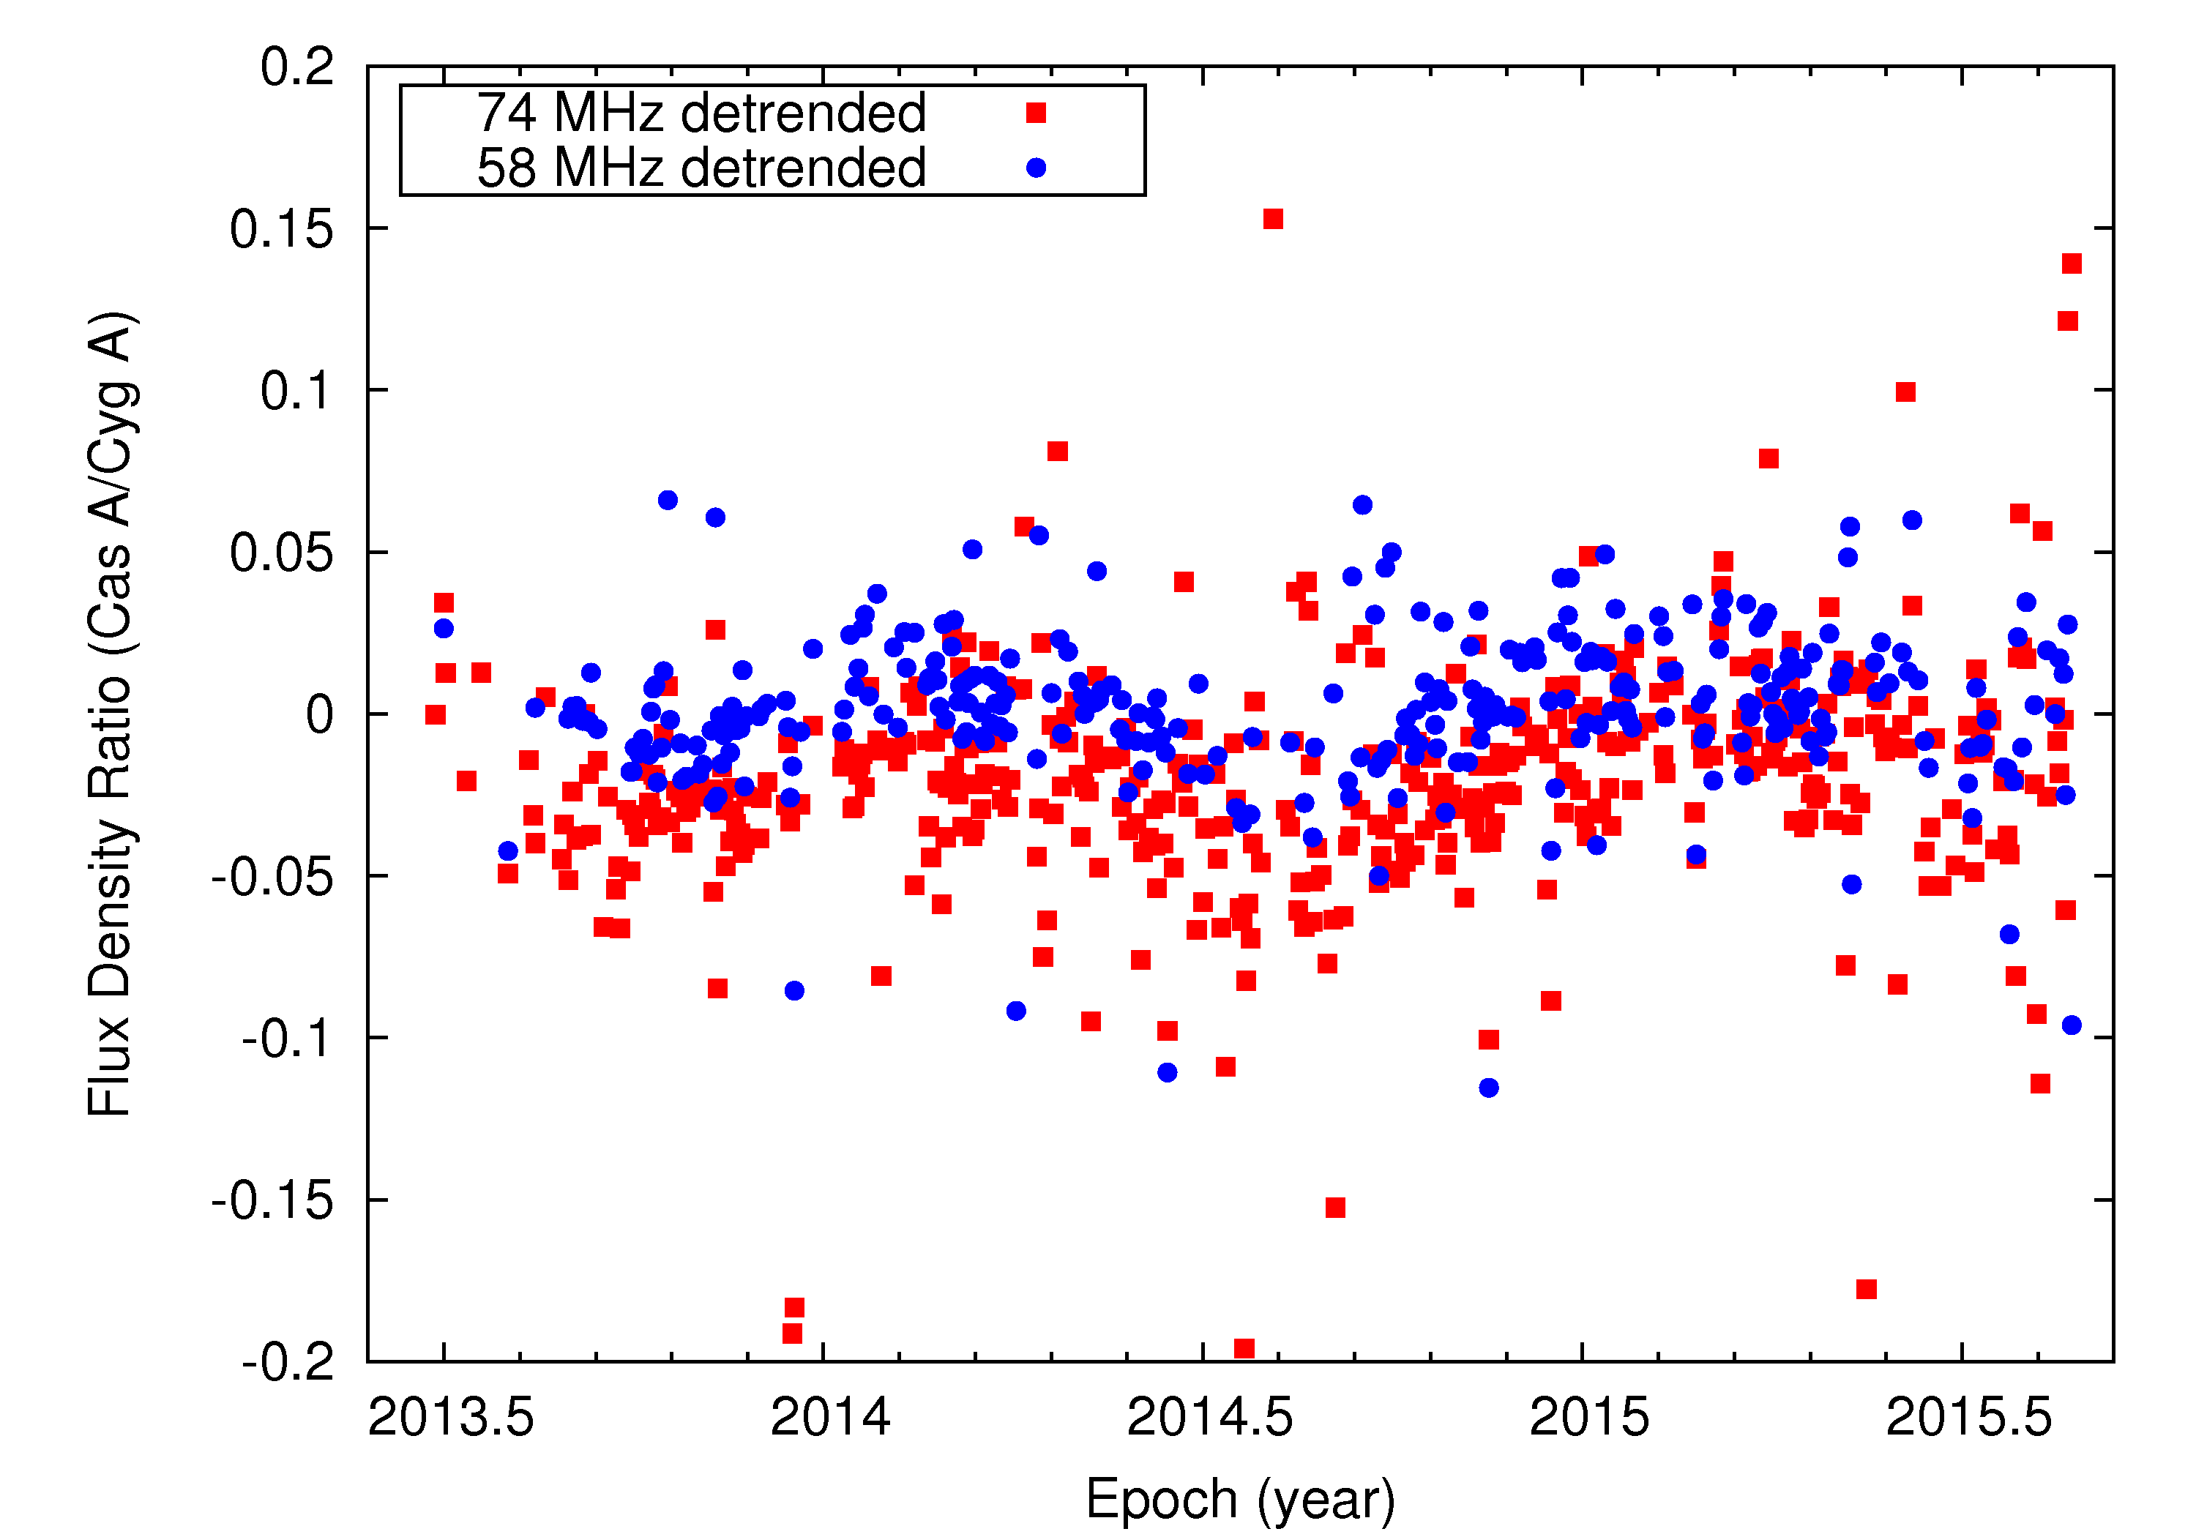
Cyg A/Cas A flux ratios 58/74 MHz
sunset
sunrise
day
Consistent with secular decay of -0.8%/year
Sinusoidal variation on-top of decay (intrinsic, ionosphere, instrumental, sun?)

Slide 8
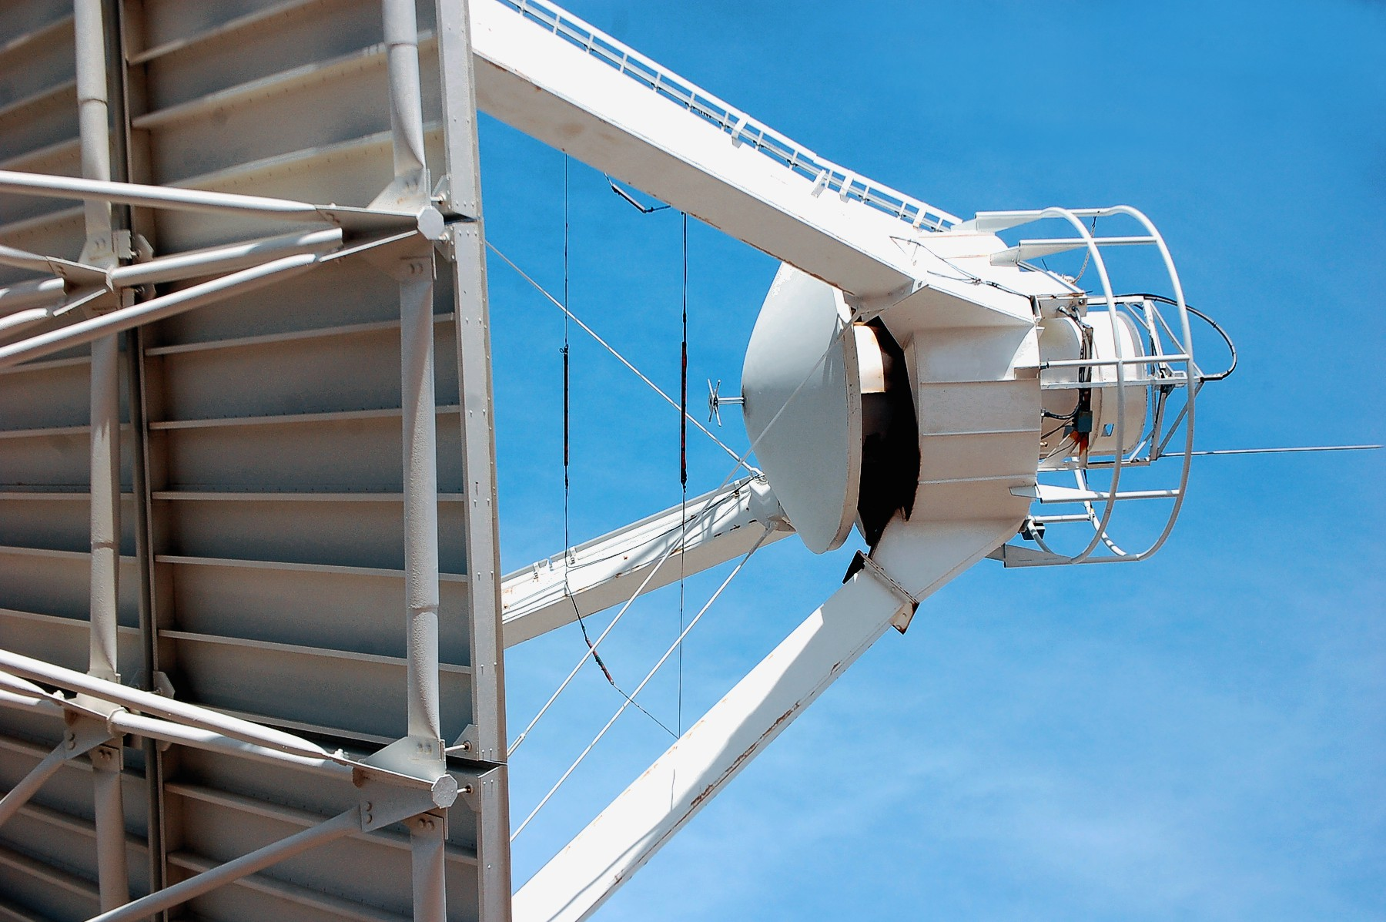
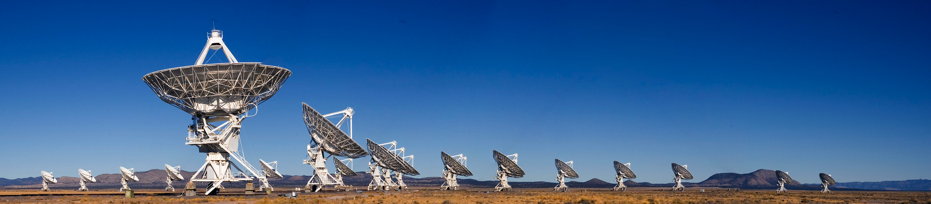
Low Frequency Receivers: VLA
VLA low band (dish + dipole) system transitioned to wide-bandwidth (2013)
Replaces narrow band receivers but still using legacy feeds:
  P band: 240 – 470 MHz
  4 band: 50 – 86 MHz
New 4 band feed (MJP) design being deployed for continuous use on 14 antennas (+5 in FY17)
Commensal VLA Low-band Ionospheric and Transient Experiment (VLITE) operating 24/7 on 10 (+5 in FY17) antennas
Up to date status: http://www.aoc.nrao.edu/lbr/

Slide 9
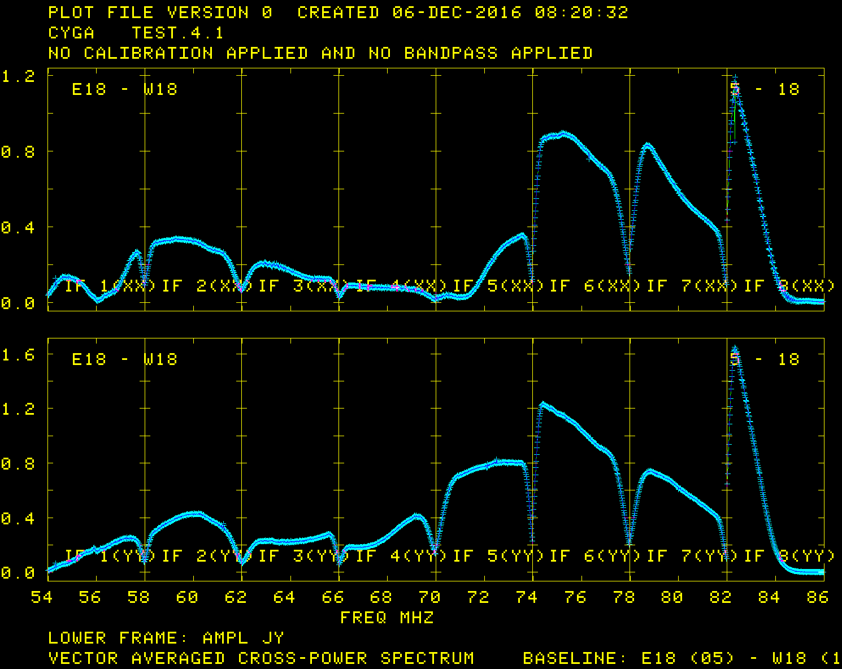
VLA MJP Bandpass WIDAR

Slide 10
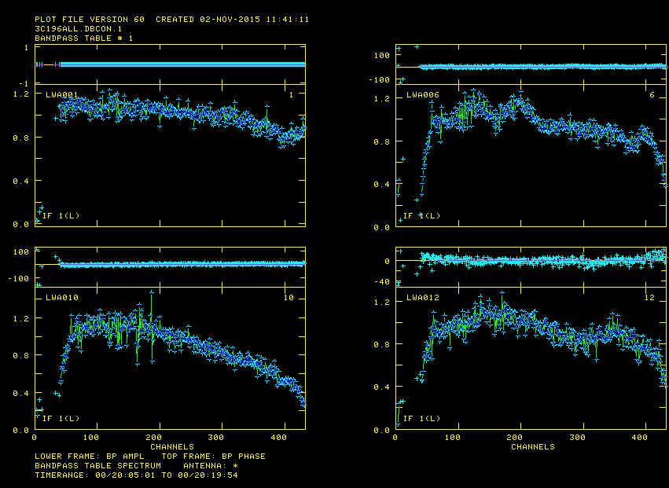
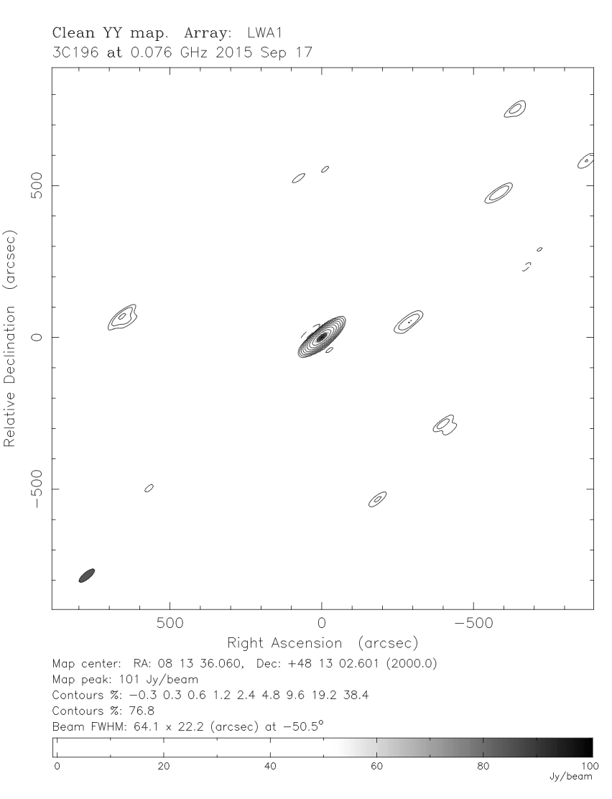
Low Frequency Receivers: LWA+VLA 4-band
First combined observations between LWA + VLA in fall 2015 (8 MHz/6 ant)
Goal:
  10 arcsec resolution at 74 MHz
  max. baseline min. 80 km
  20 mJy sensitivity

Slide 11
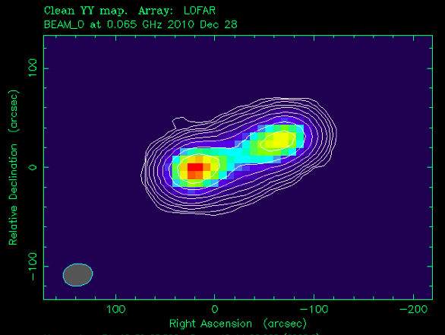
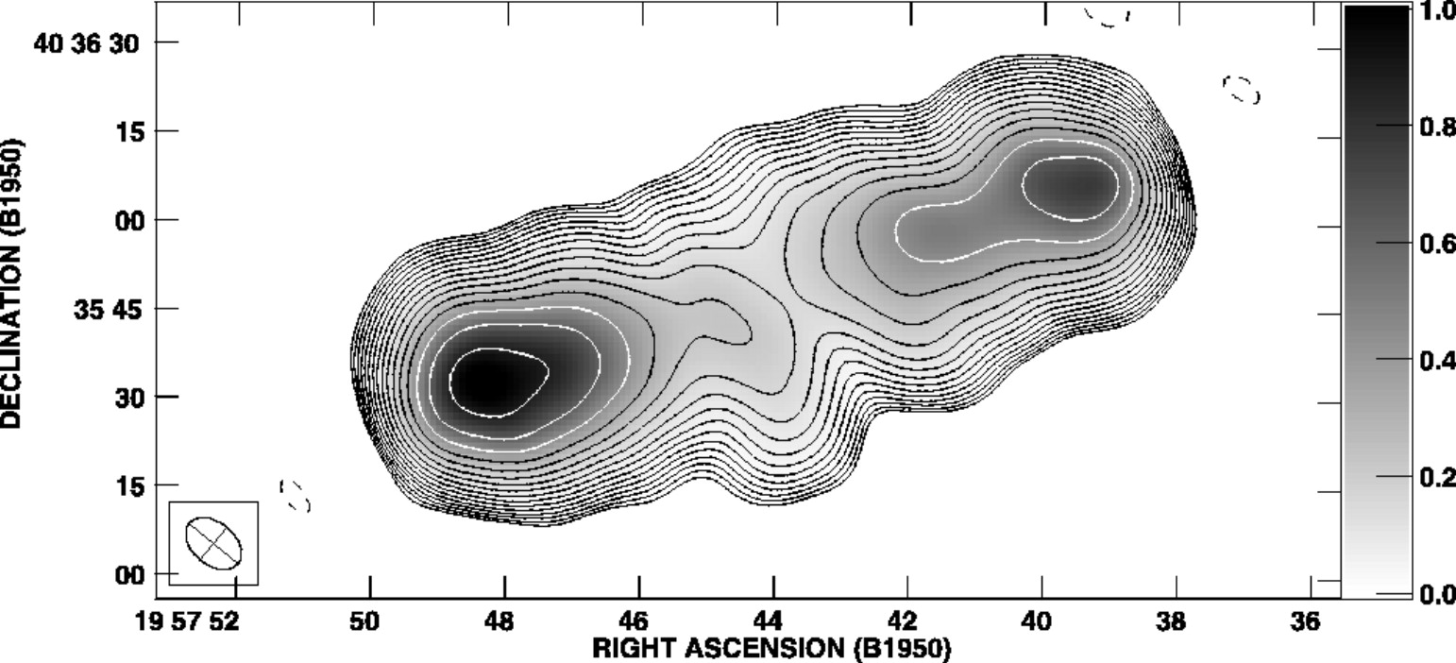
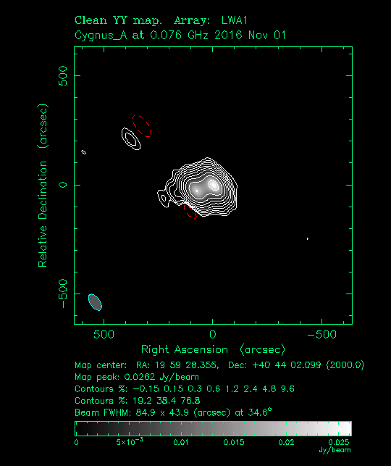
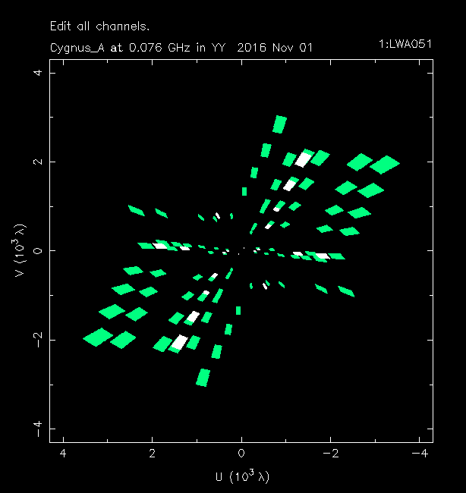
Cygnus A
Test observation on Nov 01st 2016, 20 min
12 antennas (A config.) + LWA1
16 MHz bandwidth/4 bit
Correlation with LSL, analysis w/ AIPS/Difmap
LOFAR 65 MHz (McKean)
Lazio et al. (2006): Old VLA 74 MHz
w/ Pie Town link
2000:1 (16 MHz b/w)

Slide 12
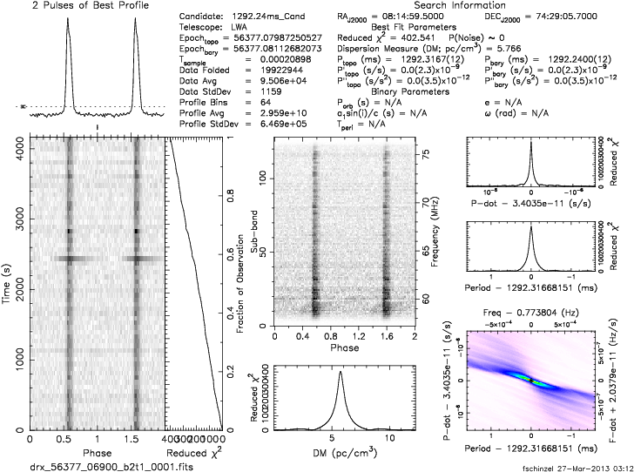
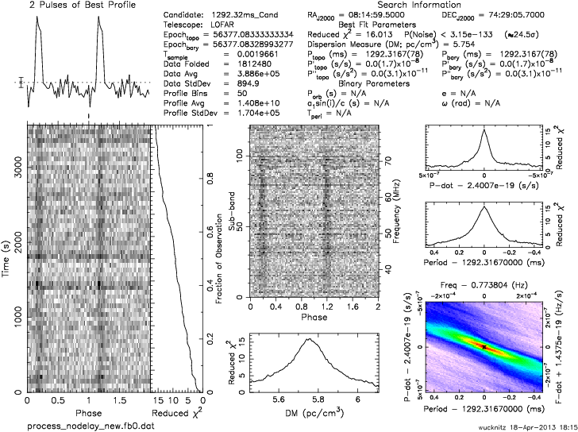
Using Pulsars to compare sensitivity
LWA1 Compared to LOFAR Int’l Station
LWA1 (59-75 MHz)
LOFAR SE607 (36-75 MHz)
256 dipoles vs 96 dipoles
PSR B0809+74 (Wucknitz, Schinzel, McKay, Carozzi)

Slide 13
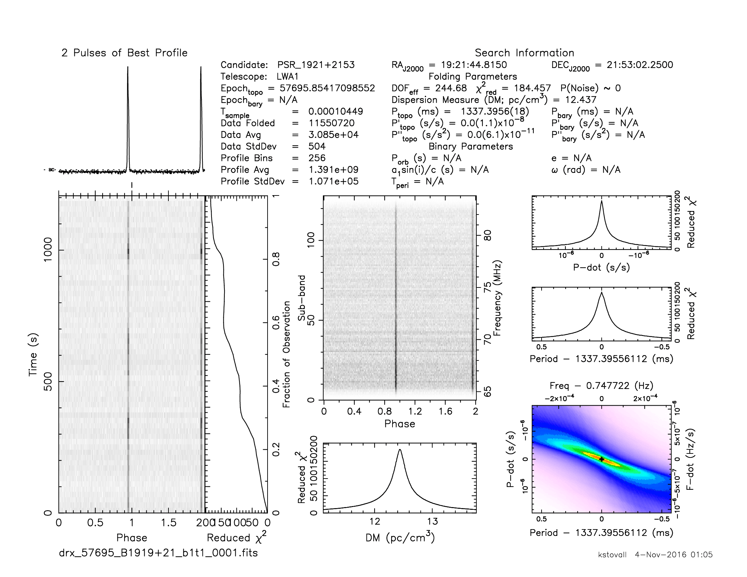
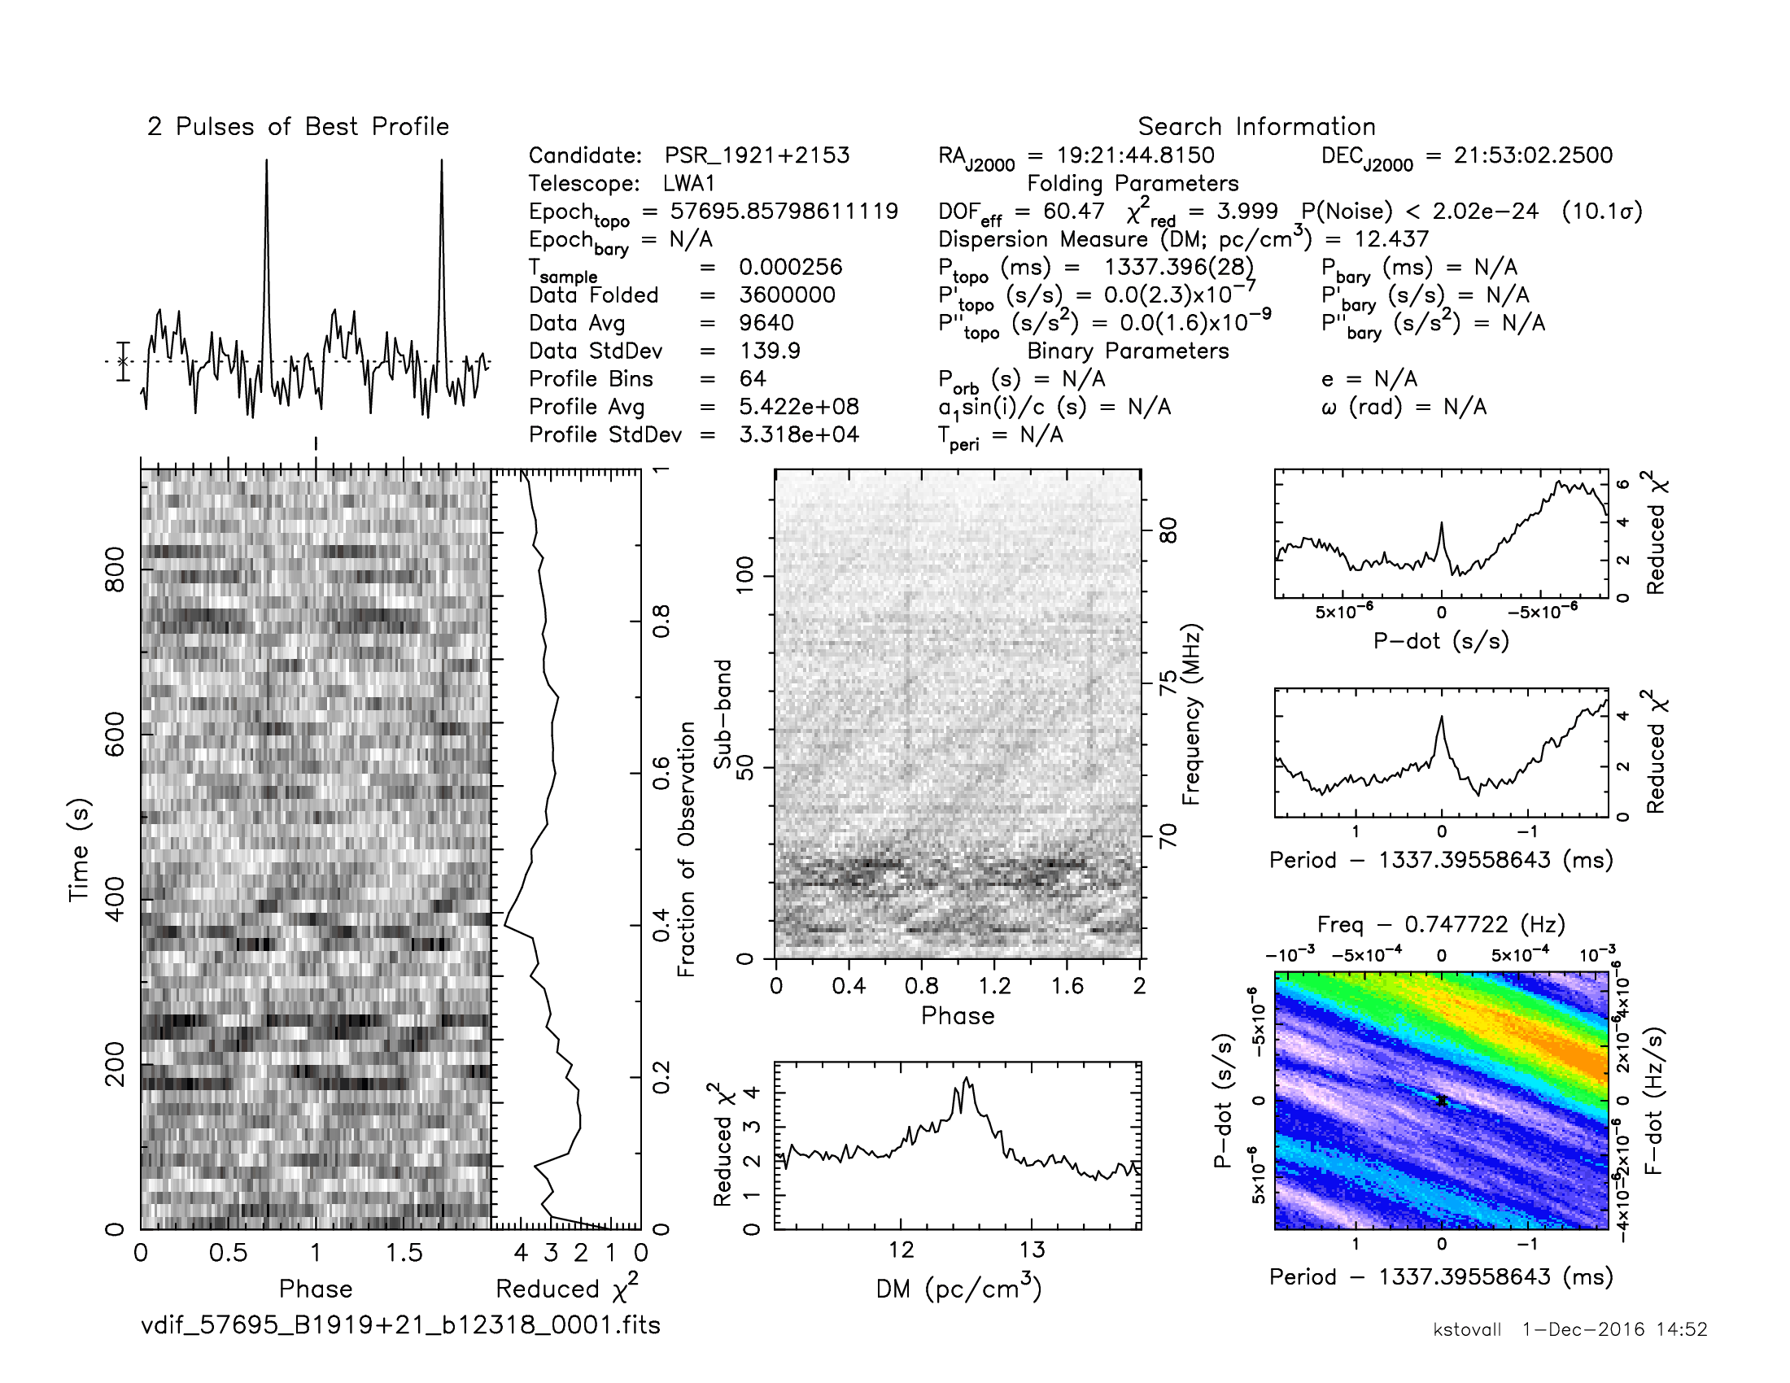
PSR B1919+21
Test observation on Nov 03rd 2016, 20 min
12 antennas (A config.) + LWA1
16 MHz bandwidth/4 bit
LWA1 256 dipoles vs. VLA ant18 25m dish with MJP

Slide 14

On the way to
Started early science observations as RSRO Dec. 3rd 2016
Target 3C84, 6 hour track with 14 VLA antennas and LWA1
(~450 MB/s data rate/~1.3 TB/hour) – currently correlating
Transition from fixed LST scheduling to enable dynamic
scheduling (Integration with VLA OPT, VLA trigger LWA
stations, speed-up data transport and correlation, serve
data products through NRAO archive)
By end of 2019 we expect to have 2 LWA stations and all
28 VLA antennas available, supporting 8 MHz/4 bit obs.
(or 2 LWA stations with 14 antennas supporting 16 MHz)

Slide 15
Summary
Ongoing Cyg A/Cas A monitoring with LWA1 shows a stable and reliable operation of LWA1 since 2013.
Cyg A/Cas A ratio shows unexpected annular oscillation, which nature unclear.
Major progress on the way to eLWA (VLA+LWA1) which will provide capabilities close to Dutch LOFAR-low w/ ~16 MHz
The future of eLWA depends on YOU! E.g. community interest through RSRO proposals paving the way to enable this mode for general observing. Could be combined with VLITE/LOBO observations, get simultaneous P-band data.
eLWA Team UNM: Jayce Dowell, Greg Taylor
NRL: Namir Kassim
NRAO: Paul Demorest, Frank Schinzel, Kevin Stovall, Frazer Owen HartRAO: Michael Bietenholz

