Slide 1
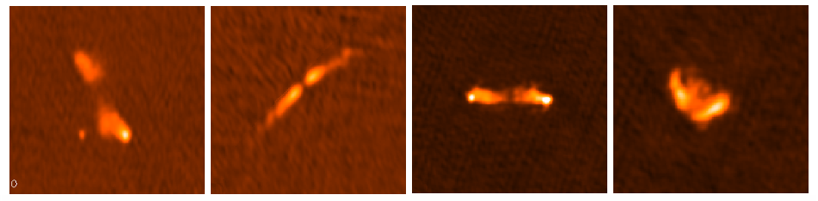
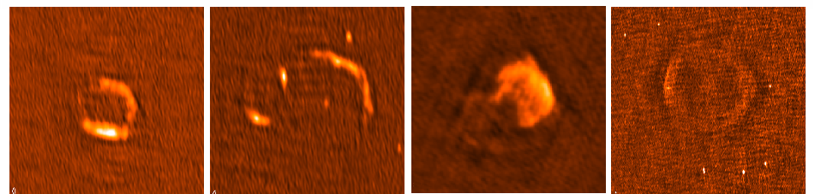

How to SPAM the 150 MHz sky
Huib Intema | Leiden/NRAO
Main collaborators: Preshanth Jagannathan (UCT/NRAO) Kunal Mooley (Oxford)
Dale Frail (NRAO)

Slide 2
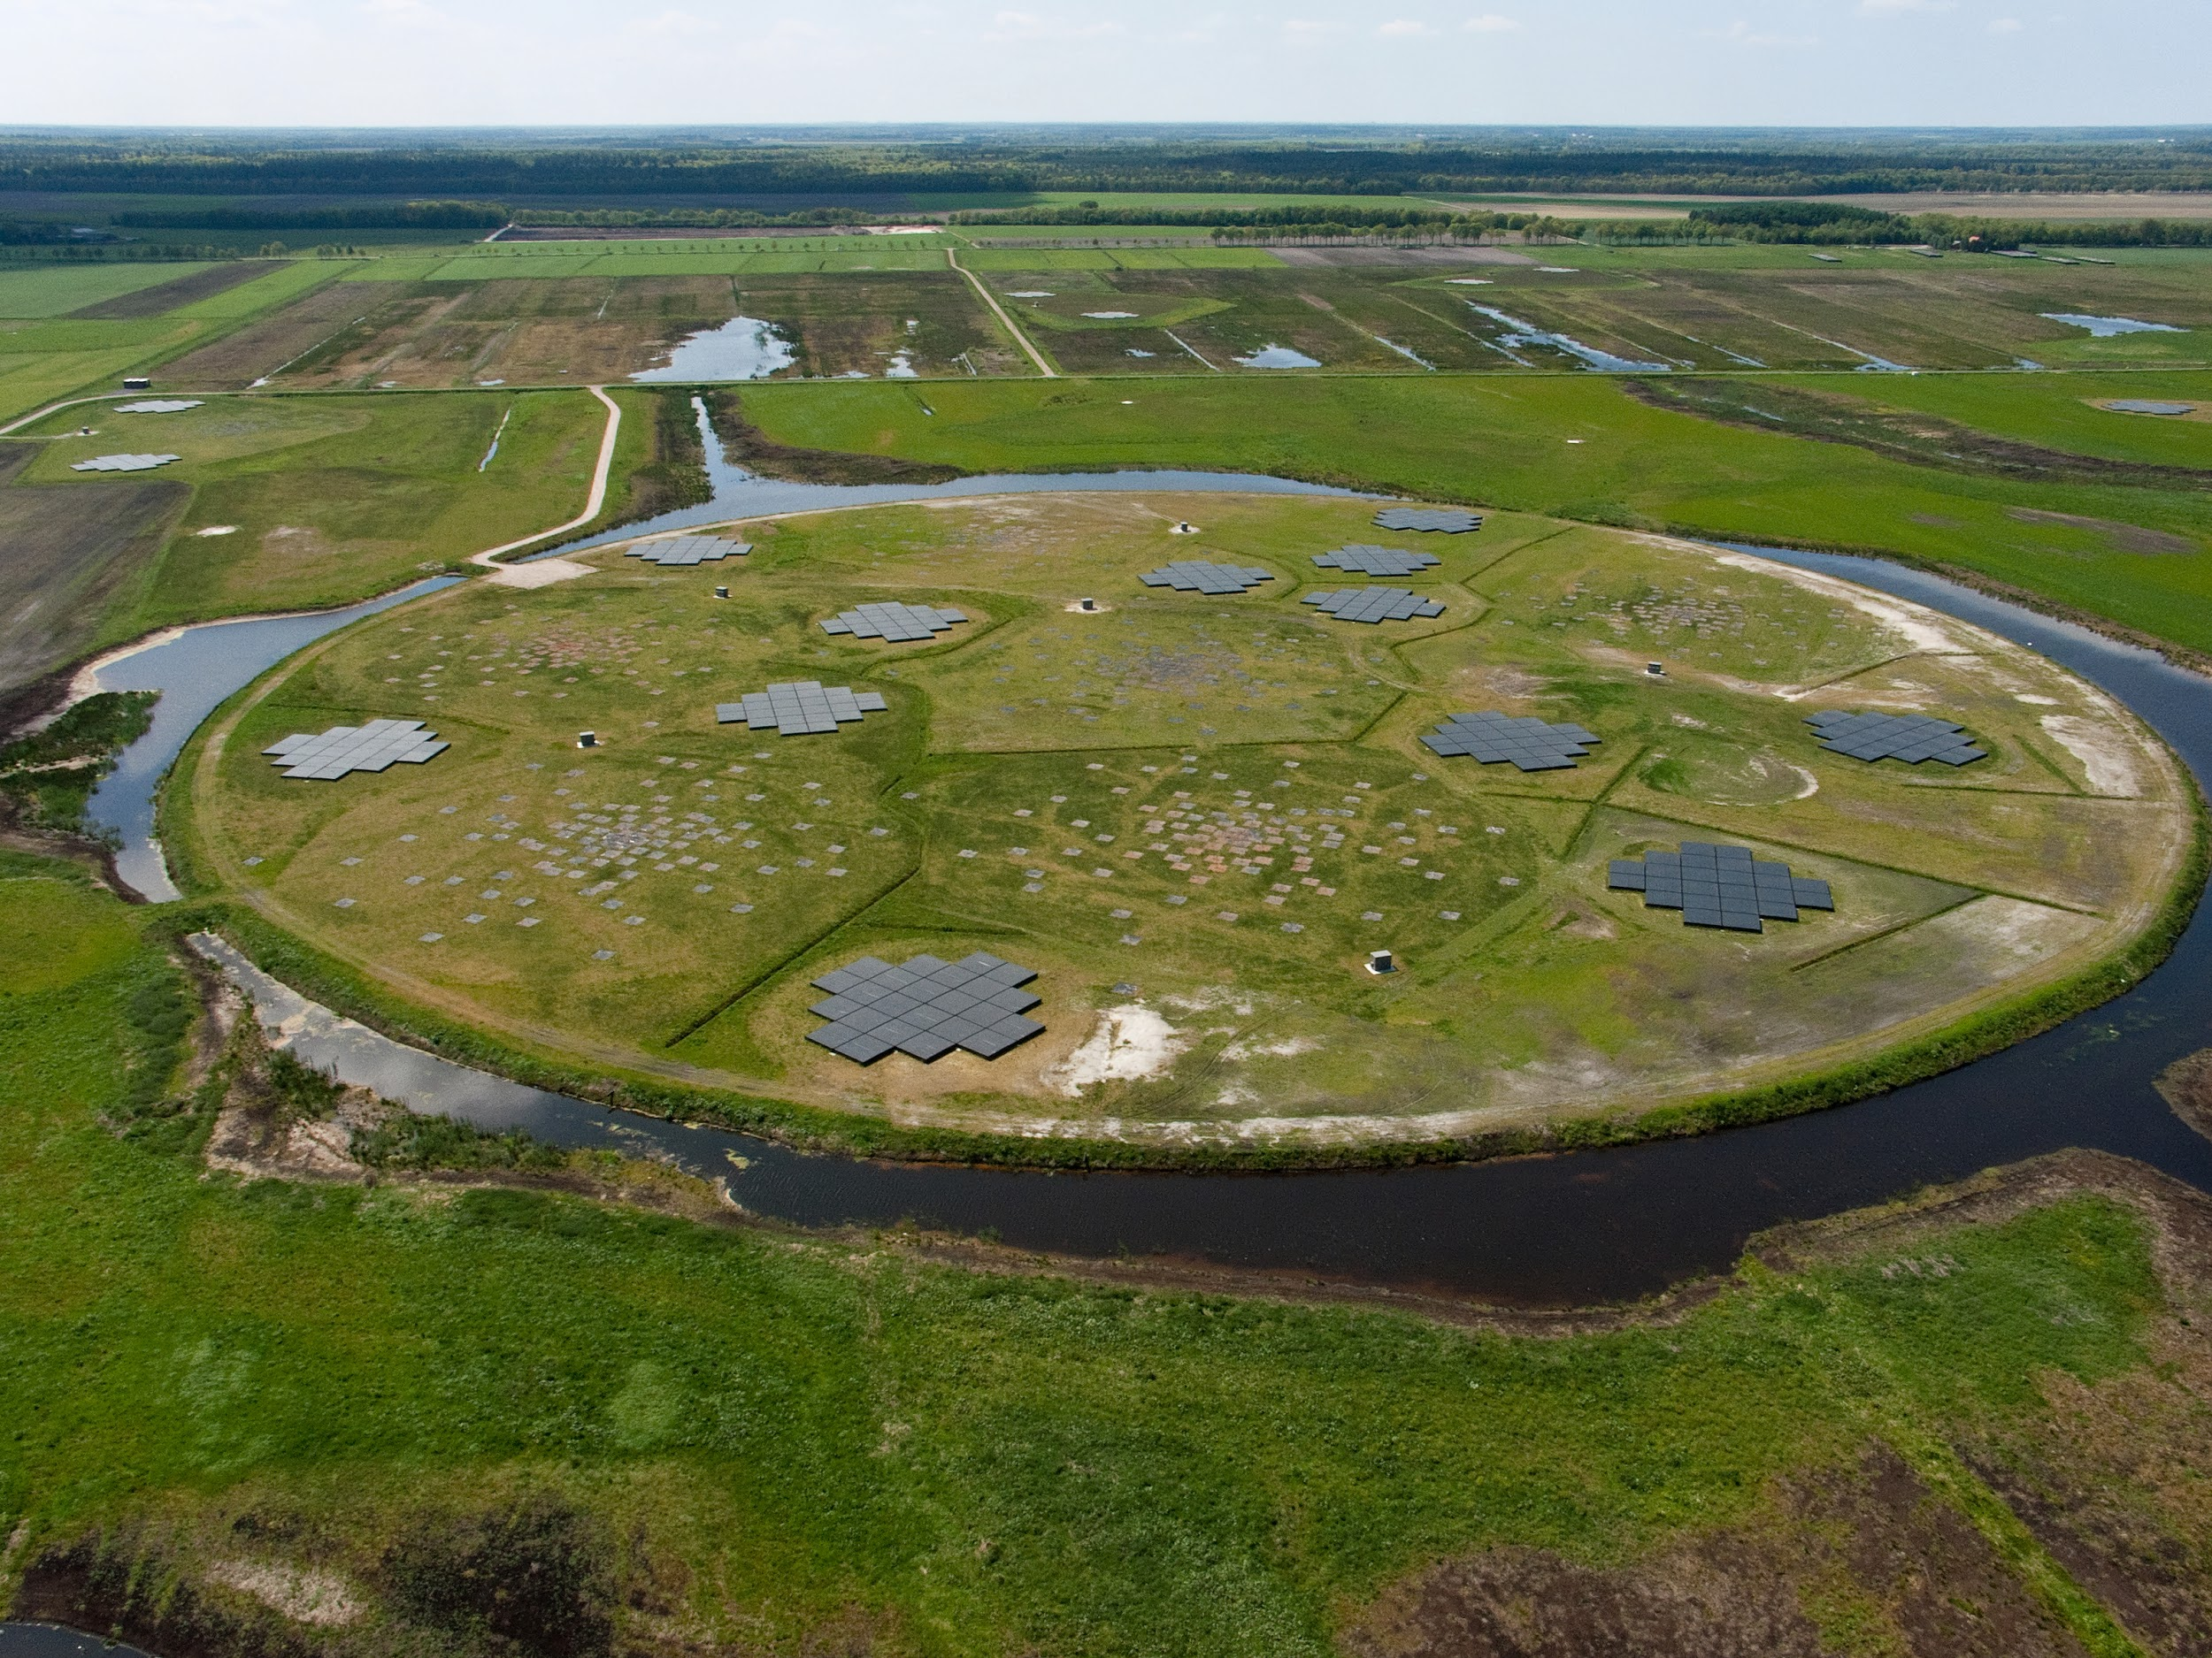

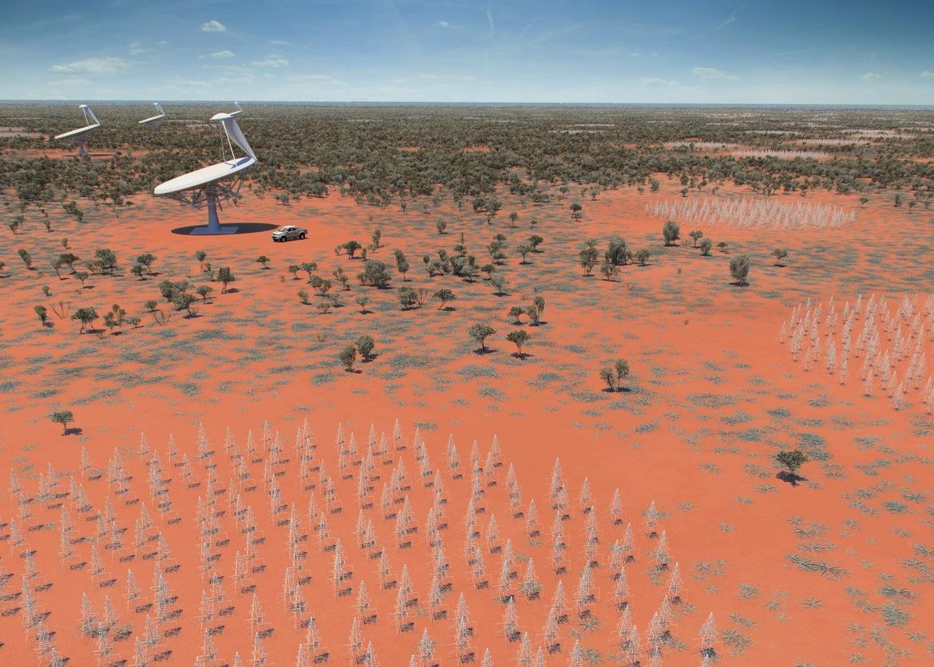
Talk outline
The need for a low-frequency radio reference survey
The TGSS survey
The SPAM pipeline
Application to TGSS
TGSS ADR as a reference survey
Current status and future plans
LOFAR: the Low Frequency ARray
SKA-low: Square Kilometer Array at low frequencies

Slide 3
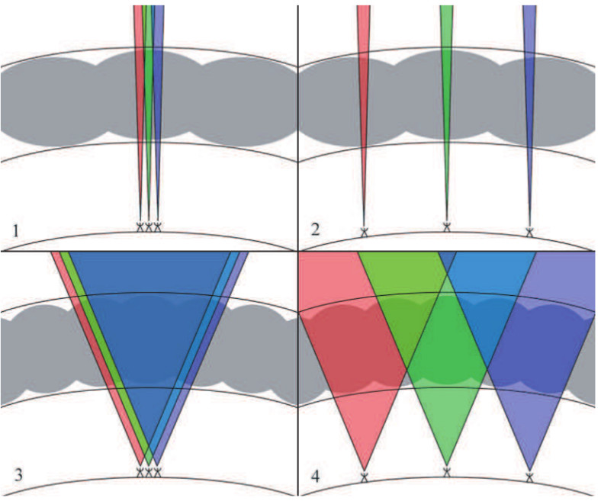
Scope
Direction-dependent effects are a major problem for wide-field, low-frequency radio surveys
Ionospheric dispersive delay and Faraday rotation
Complex antenna/station beam patterns
Main driver behind recent development of direction-dependent (DD) calibration schemes
field-based calibration, SPAM, MeqTrees, Sagecal, LOFAR facet calibration, KillMS, …
Having a good reference sky model at similar frequency and resolution is crucial
Local astrometry is not conserved due to DD ionospheric phase gradients
Complex antenna beam patterns introduce uncertainty in measured flux densities
Large uncertainty in low-frequency flux density scale in general
Intema+ 2009 (after Lonsdale 2005)

Slide 4
Scope
Selection of available/upcoming reference sky surveys
Heald+ 2015
MSSS-LBA
MSSS-LBA
MSSS-HBA
MSSS-HBA

Slide 5
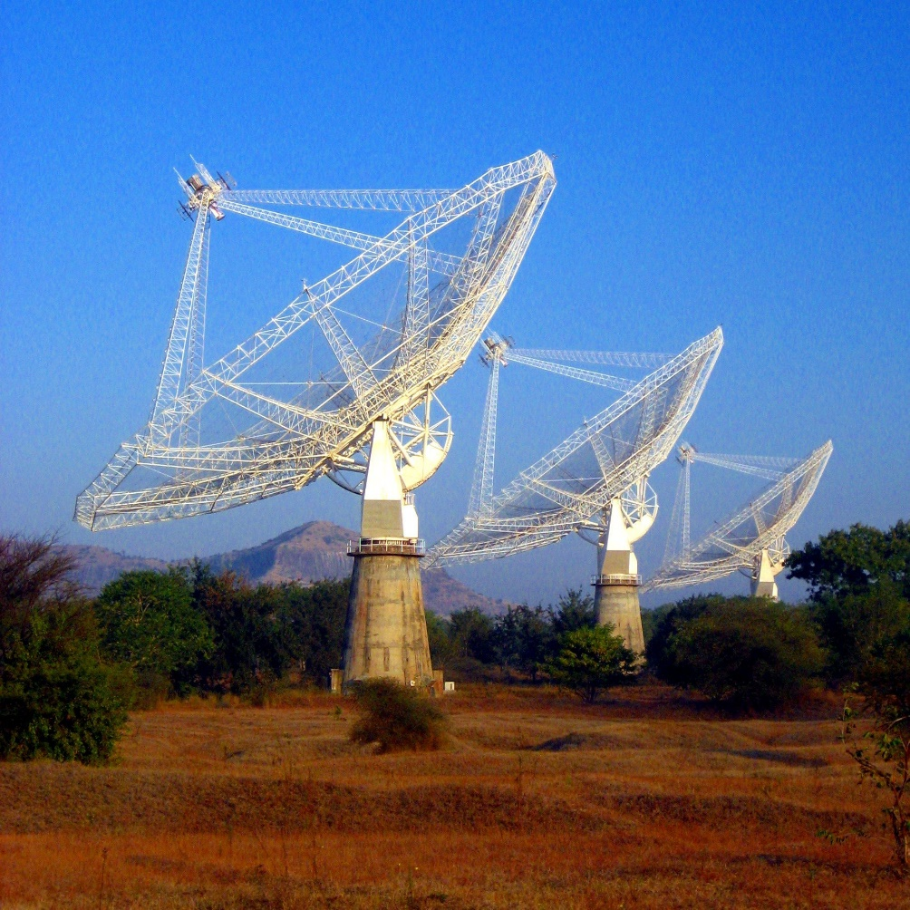
Overview of the TGSS
TIFR GMRT Sky Survey
Continuum survey at 150 MHz with the GMRT
16 MHz bandwidth, 20” resolution, ~3 degree FoV
5,336 pointings covering DEC +90 to -55 degrees 37,000 square degrees = 90 percent of the radio sky
Observing grid following FIRST scheme
15 minutes/pointing, median 5-7 mJy/beam RMS
2,000 hours granted and observed between 2010-2012
Dish-based system makes DD calibration relatively easy
http://tgss.ncra.tifr.res.in/

Slide 6
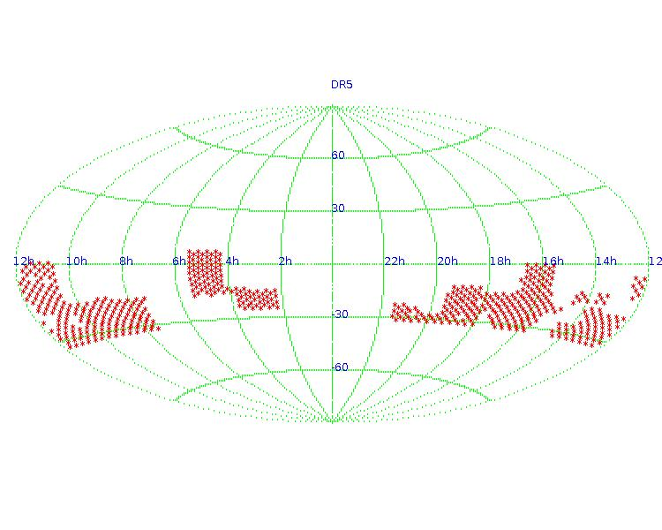
Overview of the TGSS
TGSS data processing and releases
Data processing based on old AIPS++ pipeline
Selfcal only, so no DD calibration applied
Dedicated 100-node compute cluster at NCRA
Recently upgraded to 1600 cores, 80 TB RAM, 1 PB diskspace
5 data releases to date, last one (DR5) in late 2012
DR5 contains about 10 percent of the survey area
New releases promised, but current state (still) unclear
Pilot and main survey remain unpublished
Website not updated since 4 years
All raw data has become publicly available through GMRT archive (https://naps.ncra.tifr.res.in/goa/)

Slide 7
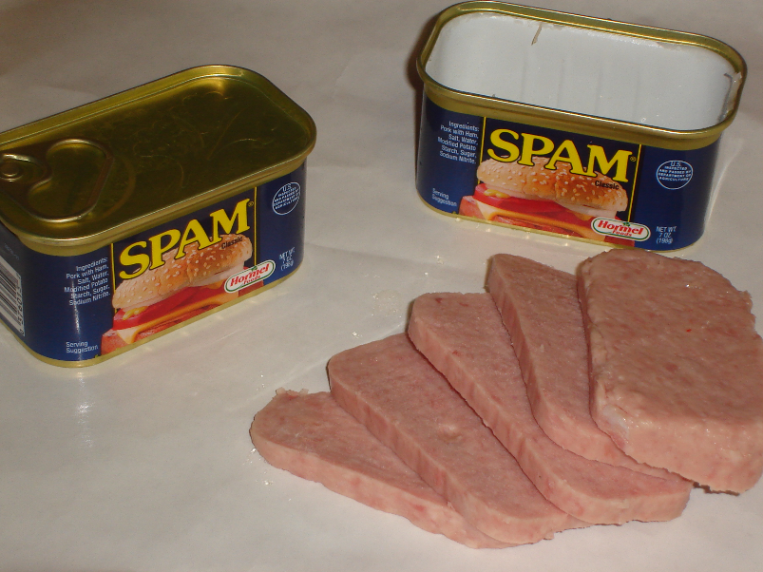
SPAM pipeline
Source Peeling & Atmospheric Modeling
Python/AIPS-based software for in-beam ionospheric calibration Relies heavily on ParselTongue
Performs wide-field (direction-dependent) ionospheric calibration, modeling, and imaging
Strategy and algorithms developed and improved for VLA and GMRT (since 2007)
Developed into fully automated pipeline for GEMS transient project (late 2014; PI Mooley)
Custom-build scheduler for parallel batch job processing on Linux compute cluster (thanks NRAO AOC computing staff)
Pipeline processing worked extremely well for both GEMS and TGSS data
“Small” steps from GEMS to DR5 (demonstrator) to whole TGSS survey

Slide 8
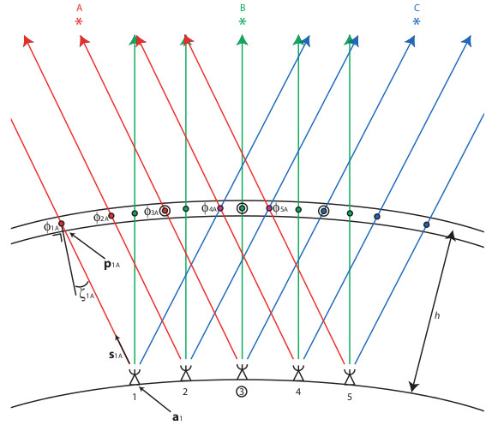
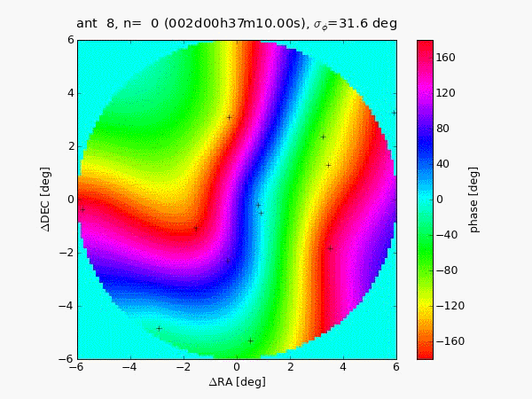
SPAM pipeline
SPAM core functionality
A measurement of the local ionospheric TEC structure is obtained by phase calibrating on bright sources within the field-of-view (e.g., peeling)
The measured phases of all source-antenna pairs can be mapped onto ionospheric layer
All phases per time interval are fitted with a single model (based on thesis work by Van der Tol, 2009)
Model predicts phases corrections in arbitrary directions for imaging full field-of-view
Example time series of a dual-layer phase screen model for narrow-band VLA 74 MHz observation
Phase screens fitted each 10 sec to peeling phases of ~10 sources
Intema+ 2009

Slide 9
Application to TGSS
SPAM pipeline performance
Total time-averaged raw data volume 1.8TB
Data conversion & pre-calibration: 30 minutes/observation
200 observations = 100 CPU hours
SPAM pipeline: 3 hours/pointing
5,500 pointings = 16,500 CPU hours = 1.9 CPU years
Comparison LUSTRE vs SSD vs HD vs RAM drive: RAM drive by far best performance Requires minimization of temporary data storage
Parallel SPAM processing: 12 jobs/node, 4 nodes = 2 weeks(!)
With 2 passes, 98 percent of the TGSS survey area was processed successfully
Remaining 2 percent were problematic data and sky areas, and required manual work
Several post-imaging corrections introduced to ensure internal flux consistency

Slide 10
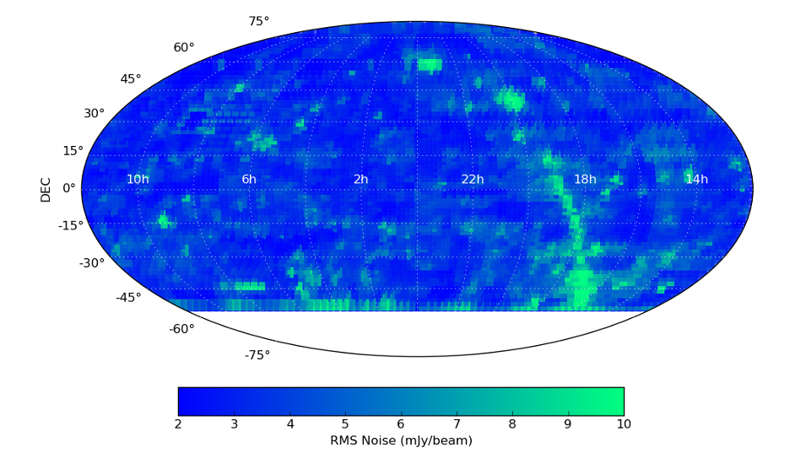
Application to TGSS
Sensitivity distribution
80 percent of the pointing images have a noise level between 2-5 mJy/beam
Higher noise mostly in Galactic plane, near bright sources (Cas A, Cyg A), and at very low DEC
°
Intema+ 2016

Slide 11
Application to TGSS
0.62 Million radio sources detected at 7-sigma level
Source density correlates with background noise
Majority of sources are unresolved at 25” resolution
Positional accuracy < 2”
Flux density accuracy ~10 percent*
Intema+ 2016, A&A (accepted), arXiv:1603.04368

Slide 12
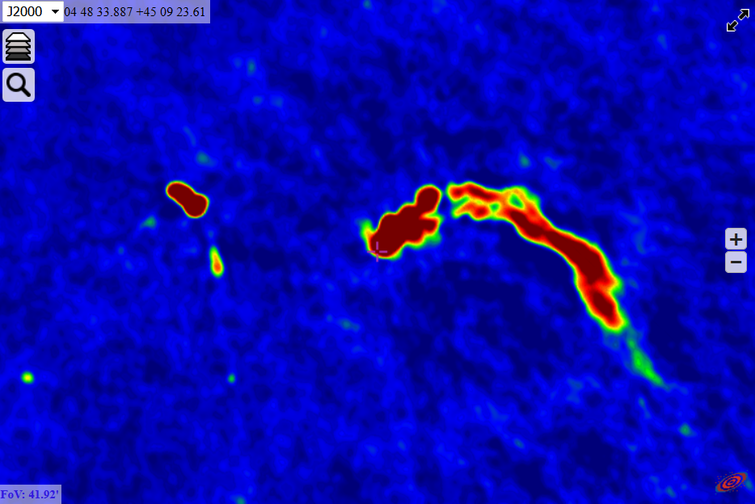

Application to TGSS
First full data release of the GMRT 150 MHz sky survey in March (TGSS Alternative Data Release)
Essential low-frequency reference survey at 25” resolution and 2-5 mJy/beam noise
Covers 90 percent of radio sky, nearly complete above -53° DEC (significant overlap with LOFAR, MWA and SKA)
Fully automated processing pipeline including (SPAM) DD ionospheric calibration
Pilot project for LOFAR surveys products on ASTRON VO (vo.astron.nl)
http://tgssadr.strw.leidenuniv.nl
Interactive access through CDS Aladin
Mosaicking options through NASA SkyView

Slide 13
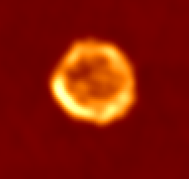
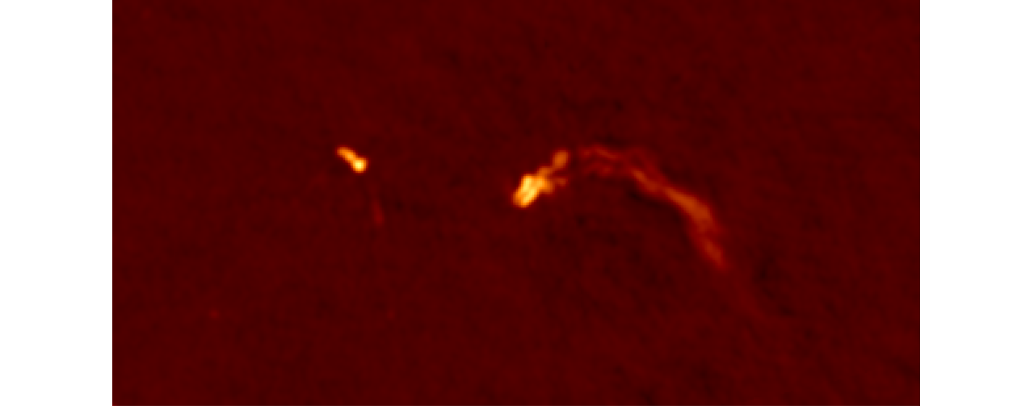
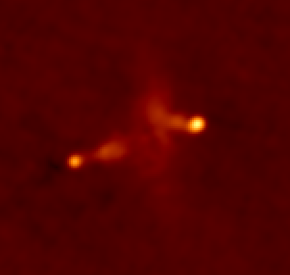
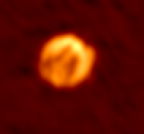
Application to TGSS
Pretty image gallery
G11.2-0.3
3C 31
NGC 4258
3C 452
3C 129
3C 136.1
4C 35.06
Kepler

Slide 14
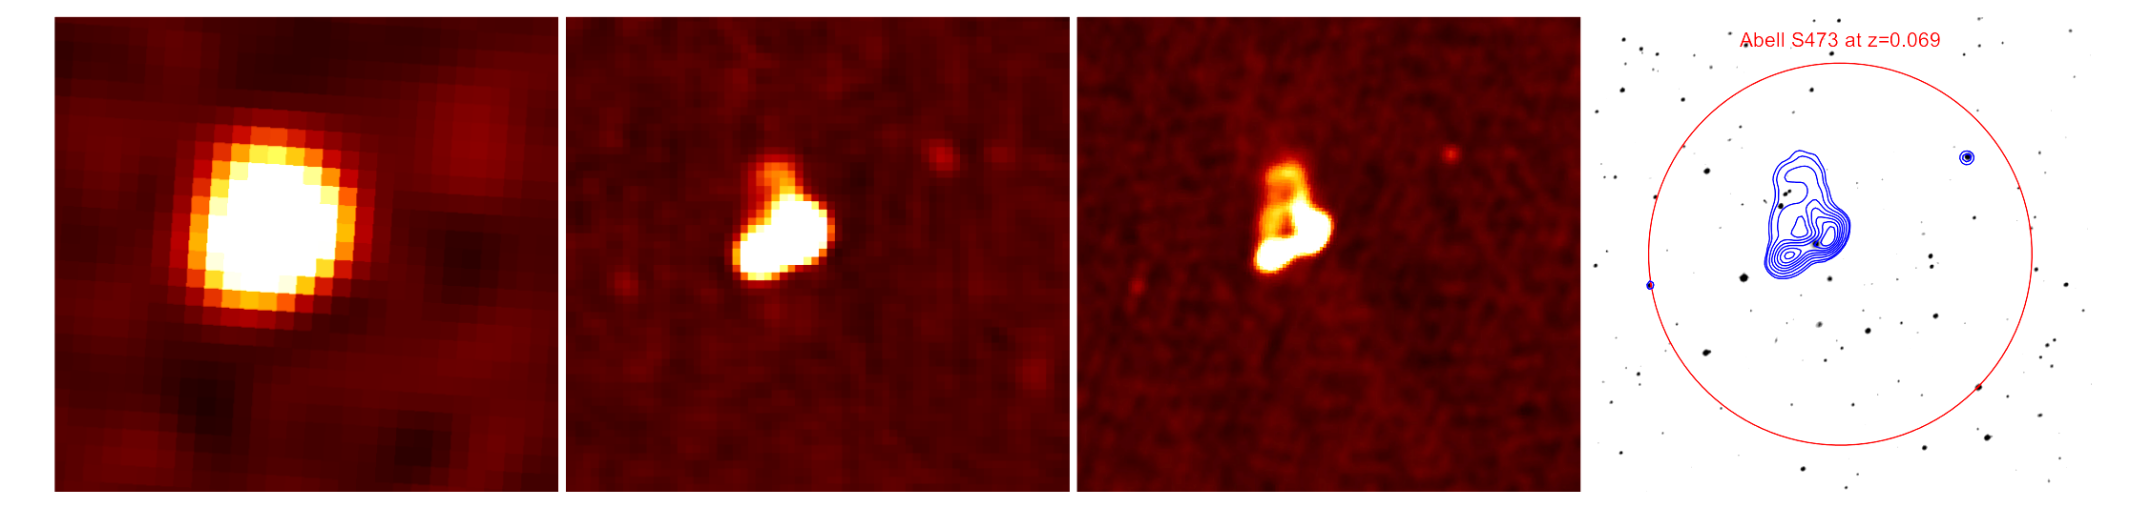
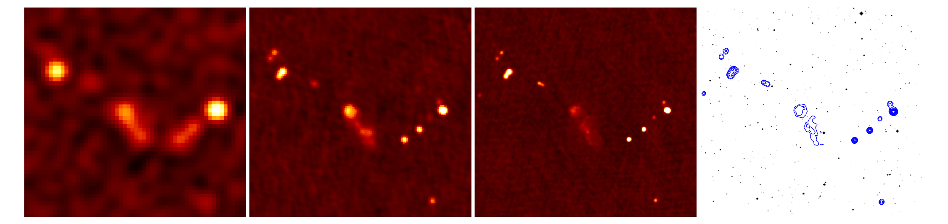
TGSS as a reference survey
Resolution versus surface brightness sensitivity
MWA
NVSS
TGSS
DSS2-R + TGSS

Slide 15
TGSS as a reference survey
Detailed source counts at 150 MHz
Fitted with 6-parameter polynomial in log-log space
See Intema+ 2016

Slide 16
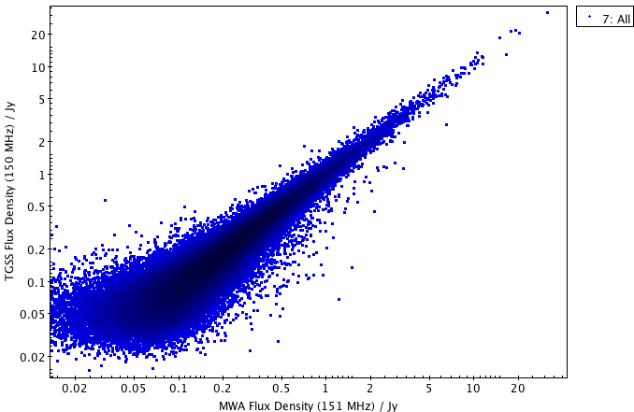
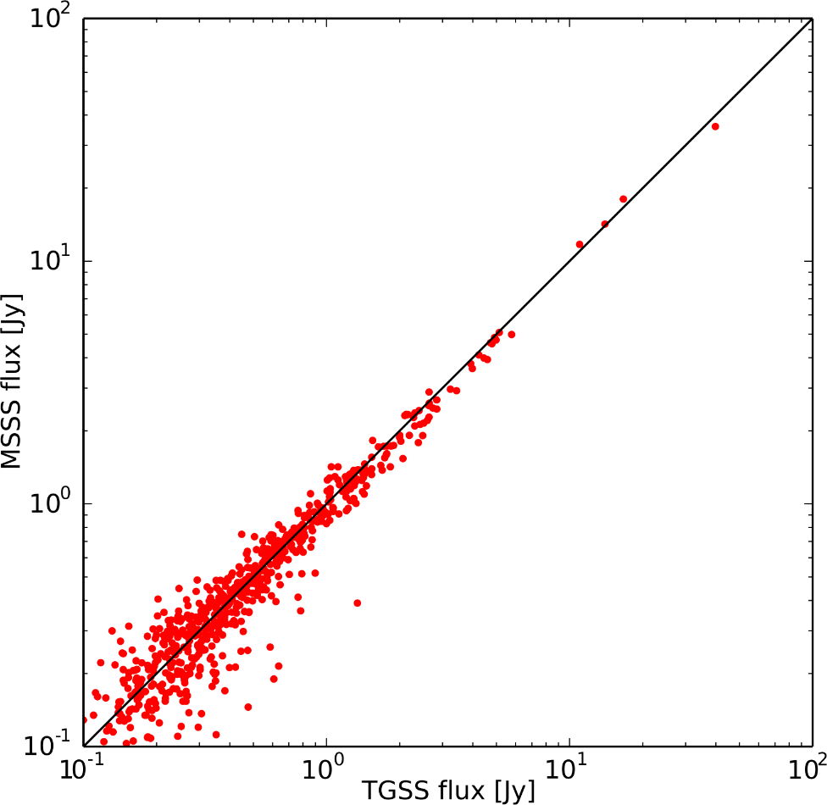
TGSS as a reference survey
TGSS versus MWA-GLEAM and LOFAR MSSS flux density comparison
TGSS and GLEAM
TGSS and MSSS

Slide 17
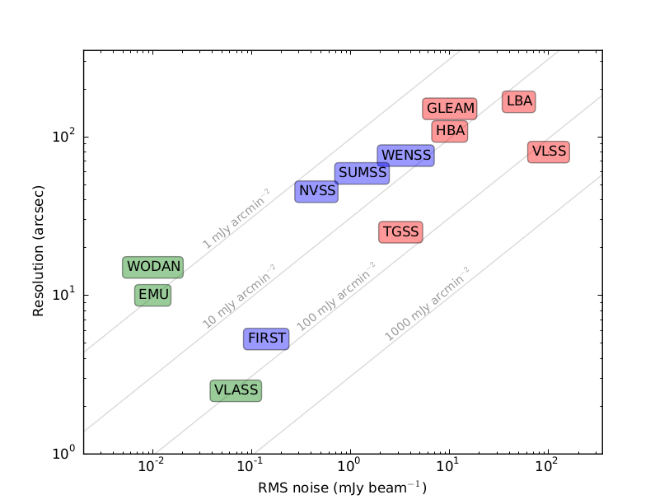
Current status and future plans
TGSS ADR covers 90 percent of the radio sky at 25” resolution and a 2-5 mJy/beam median noise
The full public data release includes
5 x 5 deg² FITS images
Image cut-out service (up to 1 x 1 deg²)
Source catalog with 0.62 Million entries
Resolution is better by factor of a few with respect to surveys at similar frequency
Sensitivity is similar or better with respect to surveys at similar frequency
Relatively high astrometric and flux density accuracy
Estimated reliability is extremely high down to the 7-sigma detection threshold (>99 percent)

Slide 18
Current status and future plans
TGSS images have been increasingly used as input models for LOFAR calibration
LOFAR Global Sky Model (GSM) generator now available on TGSS ADR webpage
TGSS source catalog is used for cross-match by MWA GLEAM survey
TGSS data products are in itself interesting, mainly because of the large area covered
Cross-matched to NVSS to identify steep-spectrum radio sources (Mandal, de Gasperin, Emig)
Looking for radio counterparts of gamma ray sources detected by Fermi (e.g., Frail+ 2016a)
Studying the spectral behavior of pulsars (compact steep-spectrum; Frail+ 2016b)
Finding high-z radio galaxy candidates based on their steep spectra (Saxena)
Targeted search for radio emission from exo-planets
Finding dying/dead radio galaxies
Finding merging galaxy clusters through their Mpc-scale diffuse radio emission
http://tgssadr.strw.leidenuniv.nl/

Slide 19
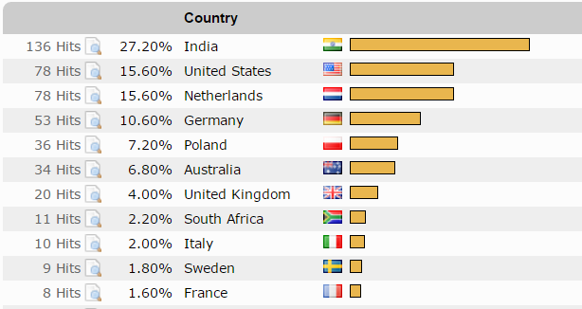
Current status and future plans
Impact of TGSS ADR1 is increasing
23 citations to main survey paper
10-15 visitors per day on project webpage
100+ followers on Facebook page
Various successful proposed follow-up observations
Candidate HzRGs with VLA, candidate milli-second pulsars with ATCA and GBT, candidate radio halos and relics in galaxy clusters (GMRT), candidate double-double radio galaxies (GMRT), …
Next data release (ADR2) planned for early summer 2017
Incorporation of new make-up observations (70 hours allocated, first observations done)
Incorporation of longer observations on extremely bright sources (A-team)
Possible inclusion of lowest declination fields (-53° to -55° DEC)
Flux scale corrections for subset of fields (~5 percent)

Slide 20
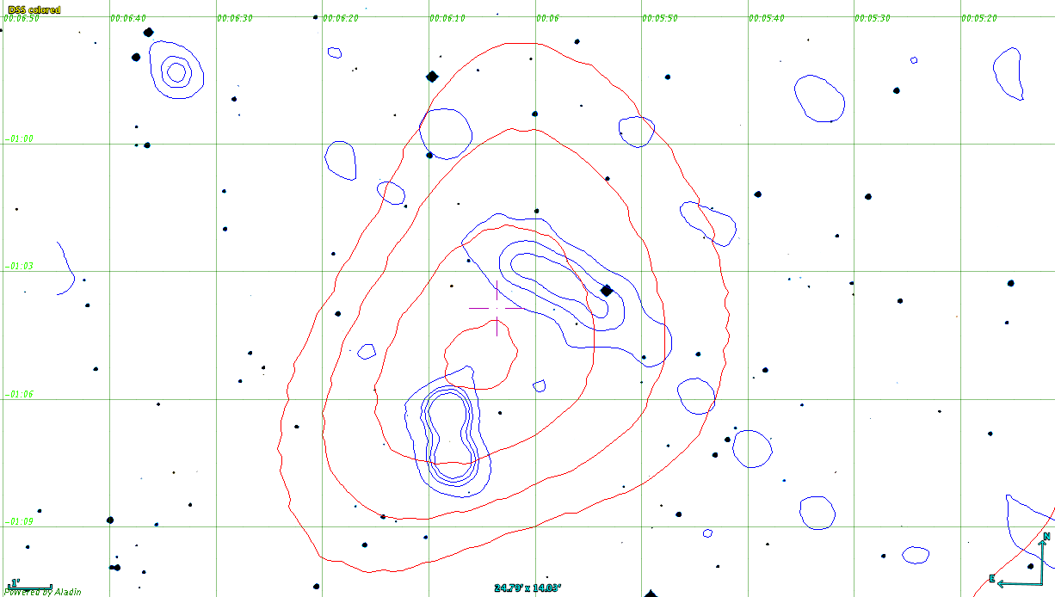
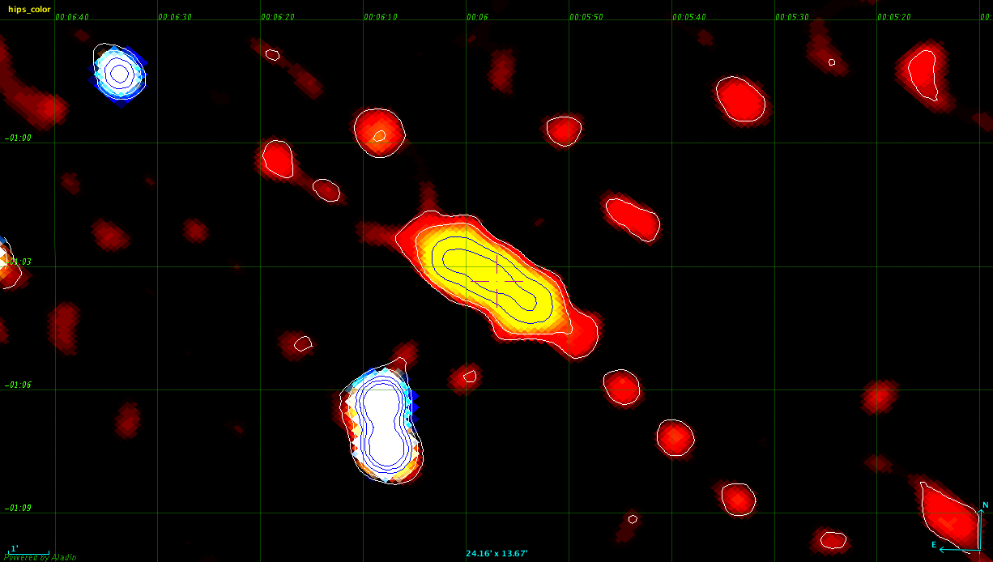
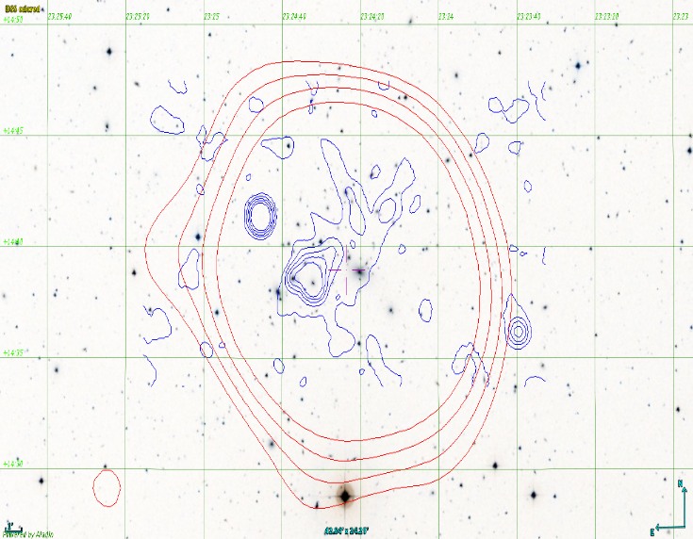
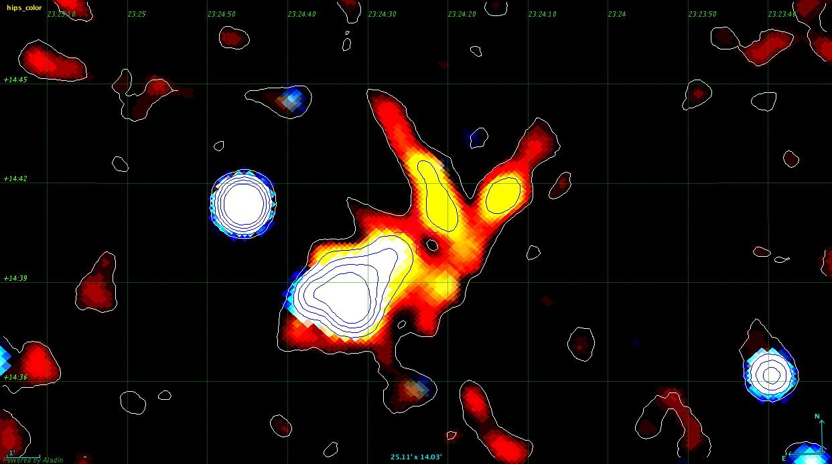
Science: A study of USSS in Galaxy Clusters
Automated search for USSS in TGSS-NVSS with spectral index <~ -2
Correlated to known cluster positions
Subset of 7 sources selected for follow-up with GMRT at 325 MHz
35 hours allotted for GMRT cycle 31 (PI Soumyajit Mandal, PhD Leiden)
Right: two USSS examples gray = DSS2R, red = ROSAT, blue = TGSS spectral index = -2.9 (top), -3.0 (bottom)

Slide 21
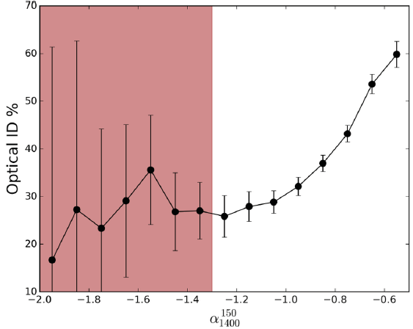
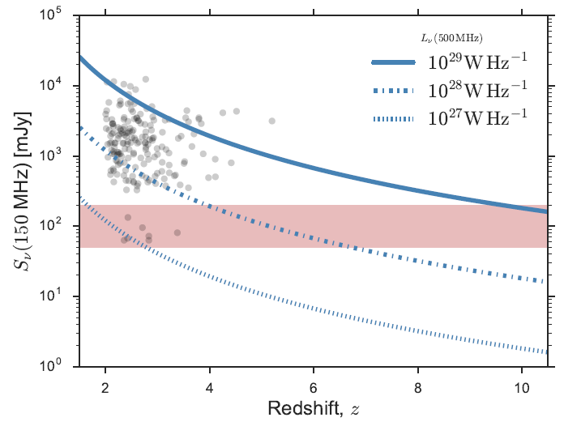
Science: High-Z Extreme Spectrum Project
Selected compact USSS with TGSS-NVSS spectral index < -1.3
Matched to FIRST to select on compactness and obtain good astrometry
Ensure no optical and/or IR counterparts in all-sky optical/IR surveys (SDSS, PanSTARRS, WISE, UKIRT surveys)
Selected 33 new USS sources for various follow-up (PI Aayush Saxena, PhD Leiden)
Sample probes unexplored area in parameter space
Hope to find the first HzRG at very high redshift (z>6) to probe HI absorption from the Epoch-of-Reionization

Slide 22
Science: Finding milli-second pulsars
In TGSS steep spectrum PSRs (< -2.5) are (γ-ray emitting) MSPs (Frail+ 2016)
Hope is to find exotic PSRs missed by traditional search methods
Method selects without regard to period, DM, orbital parameters and scattering
Measure compactness, spectrum, polarization position
11 PSR candidates in 3FGL, 12 in 4FGL
VLA/ATCA follow-up for improved positions and resolution
Promising candidates searched for pulsations in γ-ray (Fermi) and/or radio (GBT and Parkes)
TGSS-NVSS
Spectral Index Image
3FGL J1639.4-5146
SUMSS at 843 MHz
TGSS at 150 MHz

