Slide 1
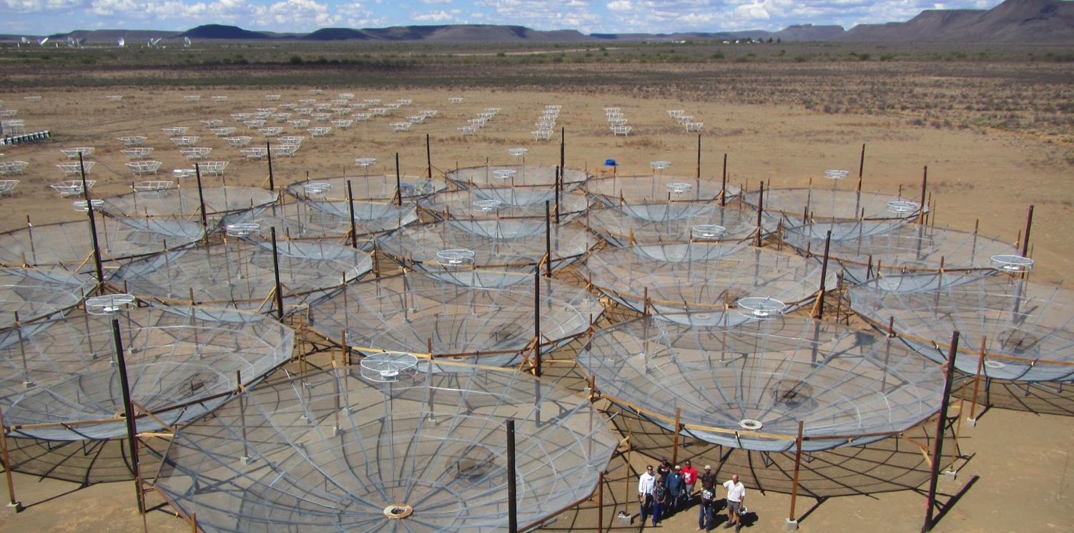

A First Peek at HERA

Slide 2
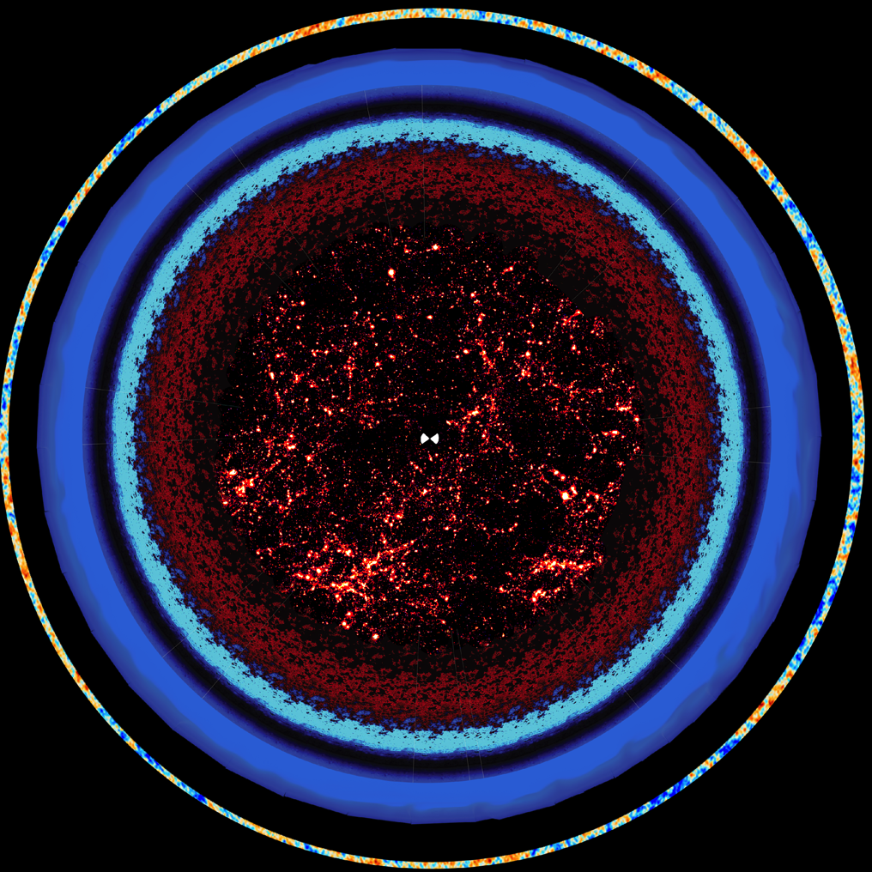
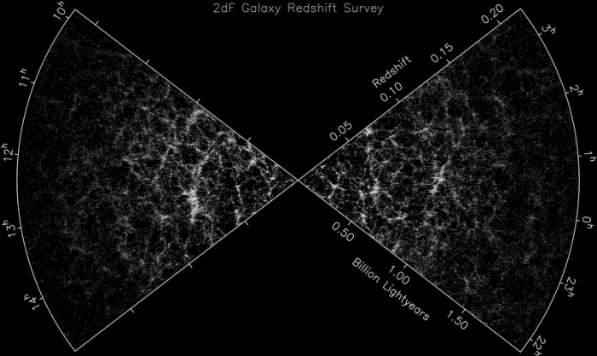
z ~ 6
z ~ 15
z ~ 30
z ~ 40
(Colless et al. 2002)
z ~ 150
z = 1088
(Mao et a. 2008, Zheng et al. 2014)

Slide 3
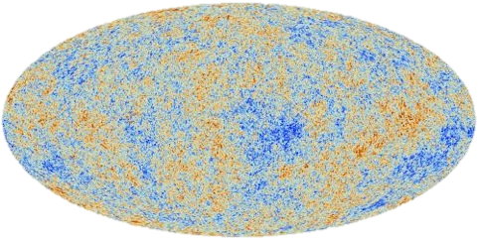
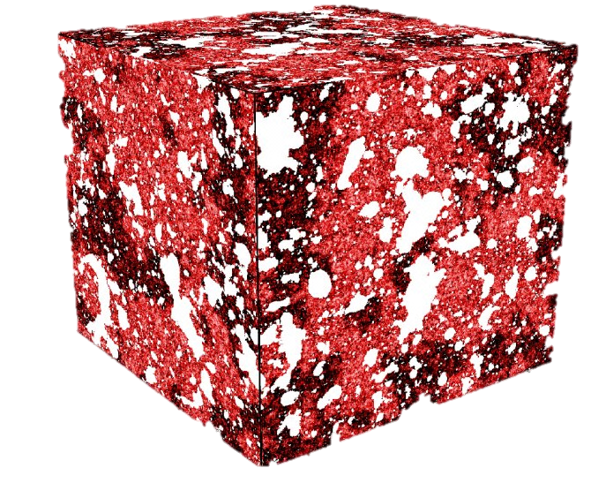
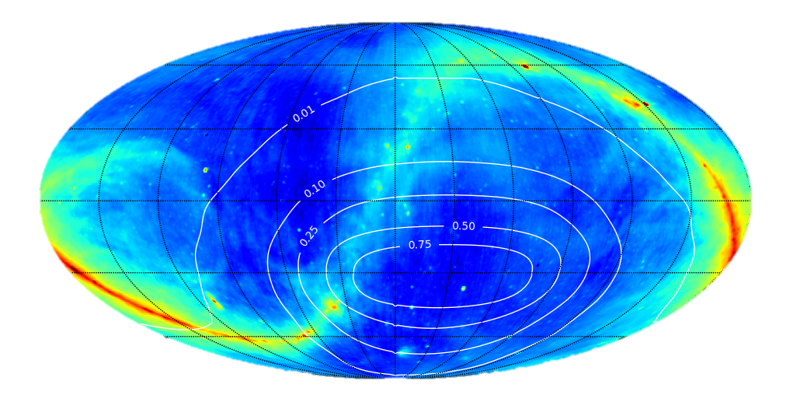
The (21cm) Frequency Axis
CMB
21cm
Measurements vs. frequency
Notes:
The cosmic microwave background is another cosmological probe that requires the extraction of small fluctuations from underneath a large signal. There is a crucial difference between the CMB and 21cm surveys though. Whereas CMB experiments probe a 3D signal, with two spatial dimensions and a frequency axis to get a 2D map of just two spatial dimensions, in 21cm our final product is 3D. This means the CMB has an entire extra axis of redundant information that can help distinguish between foregrounds and signal, whereas this is not the case for 21cm tomography. Every dimension contains unique info for us. As a result, one can show that blind methods don’t work as well for 21cm tomography as they do for the CMB. If we want to fight foregrounds, we have to model them. Returning to the current status of measurements, then, we have two options.

Slide 4
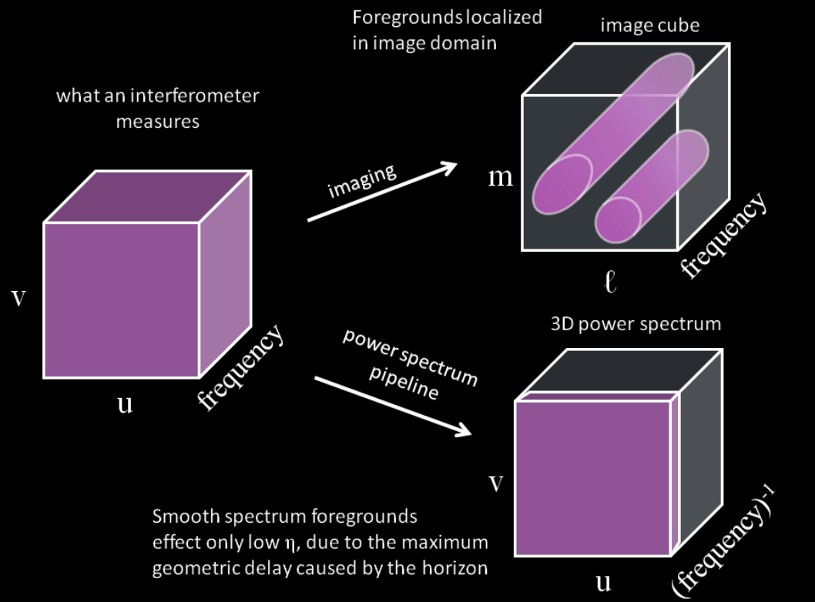
k_{y}
k||
k_{x}

Slide 5
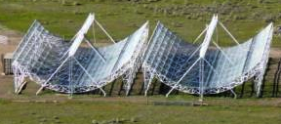
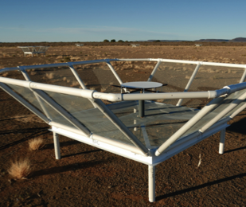
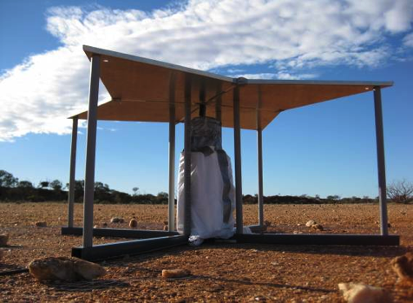
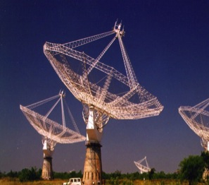
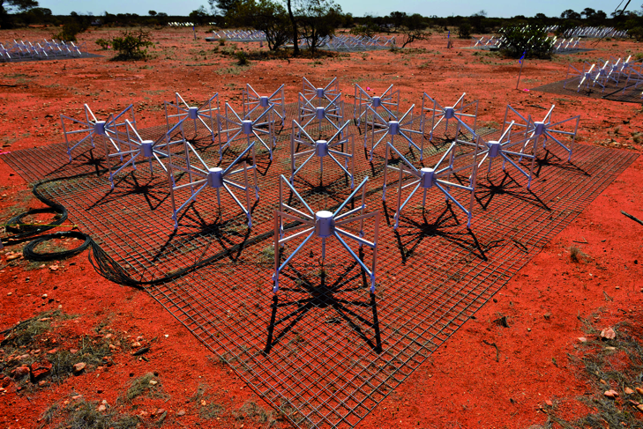
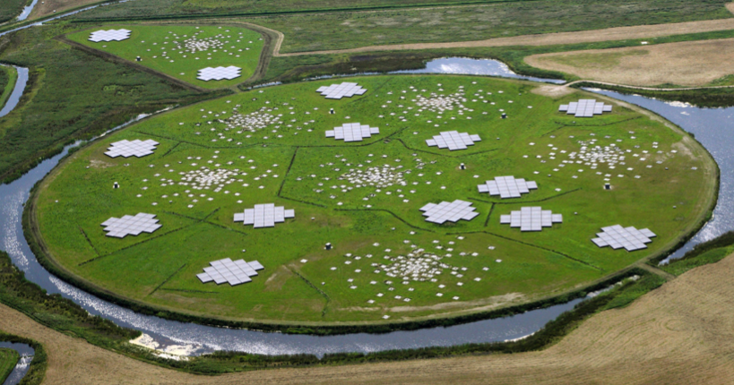

Slide 6
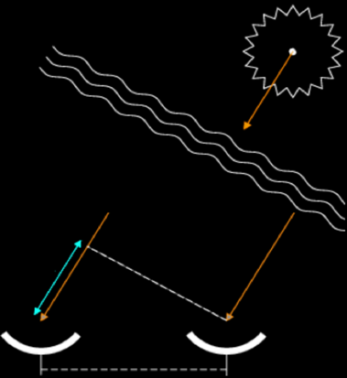
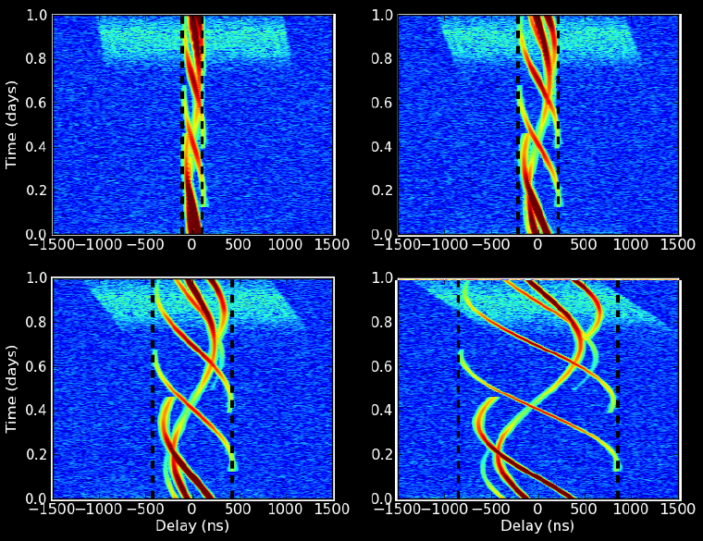
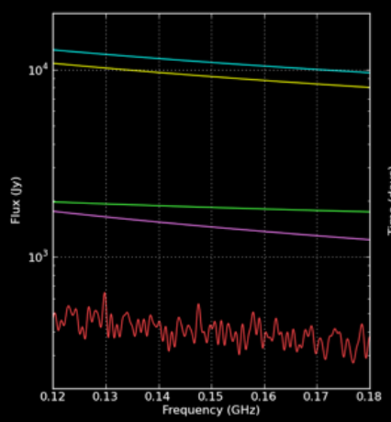
Parsons et al. (2012b) arXiv:1204.4749

Slide 7
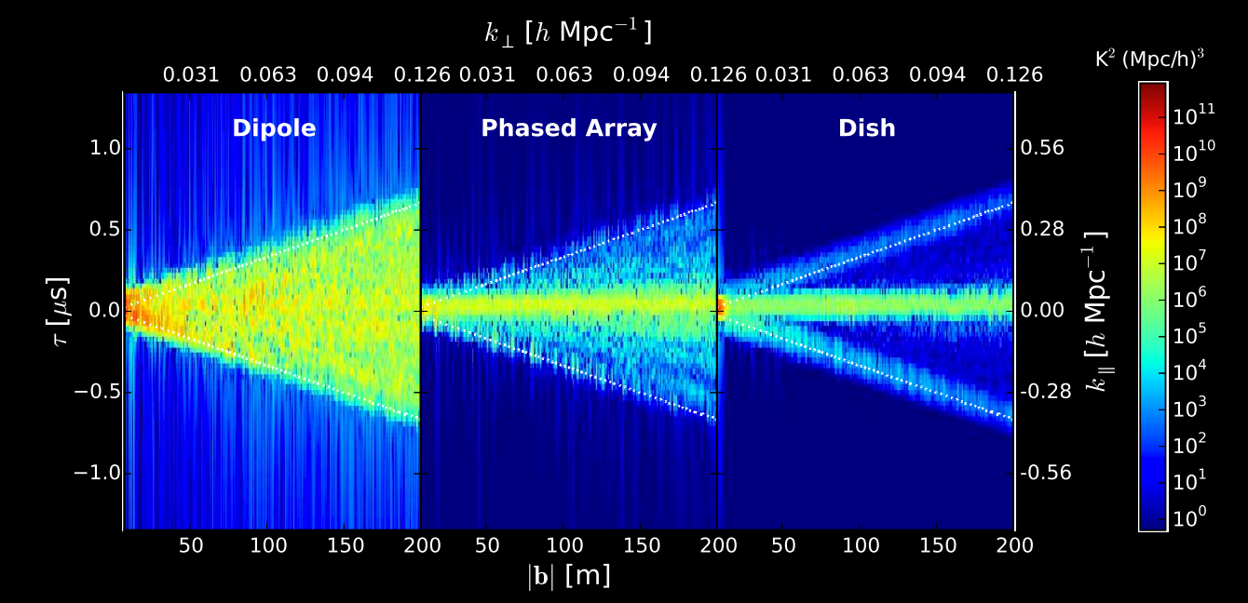
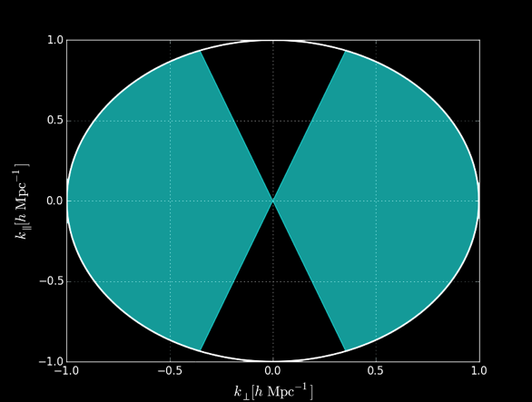
(Thyagarajan et al. 2015)
Notes:
PSA-64, 32 antennas in a maximum-redundancy configuration, 30m between rows, 4m spacing within rows

Slide 8
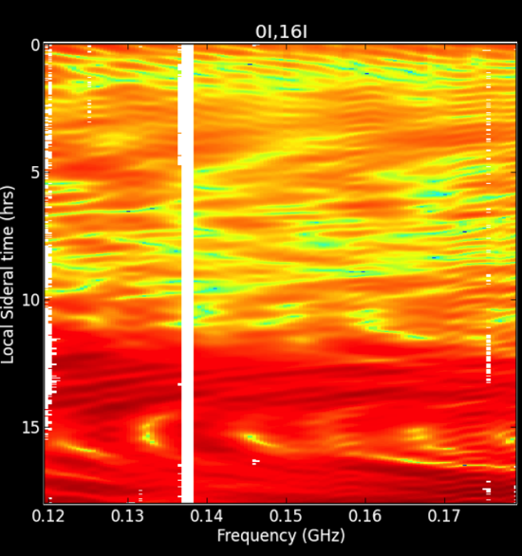
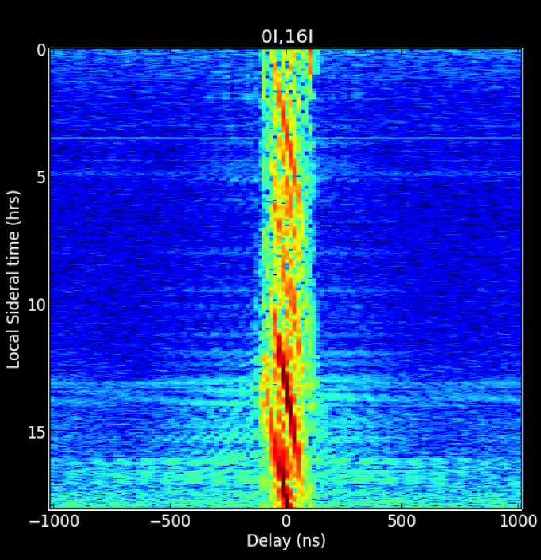
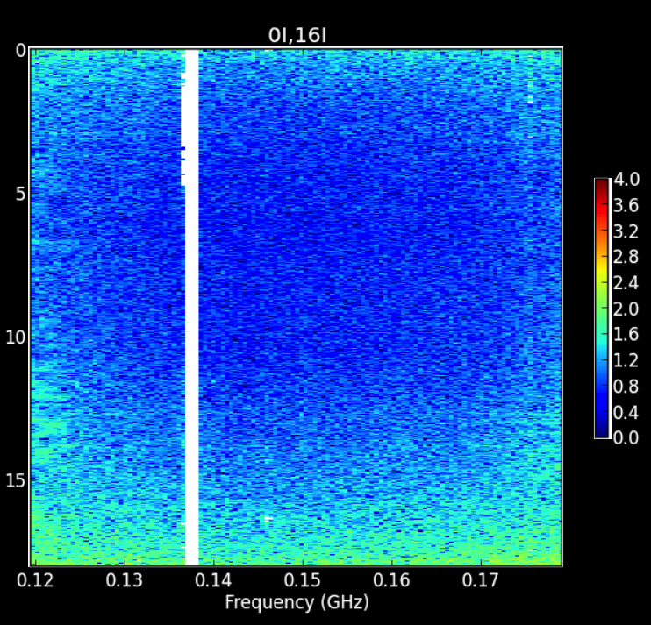
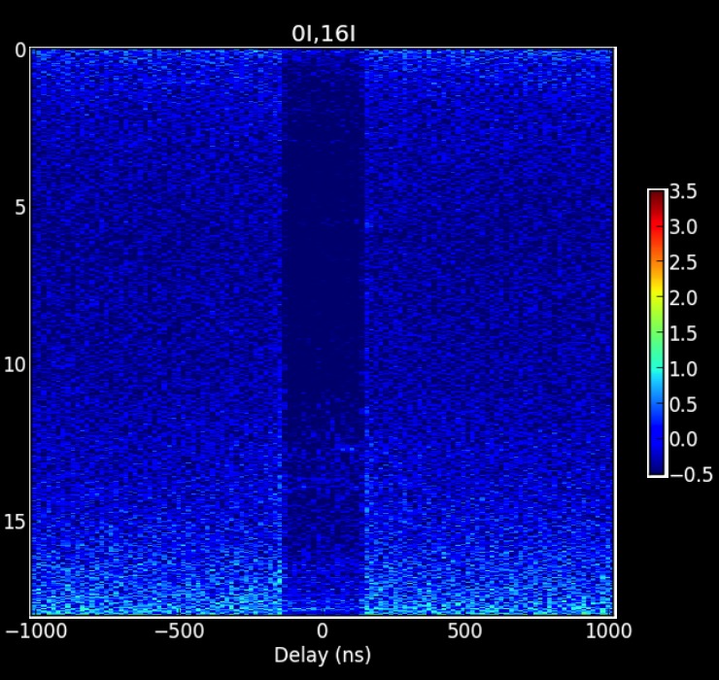

Slide 9
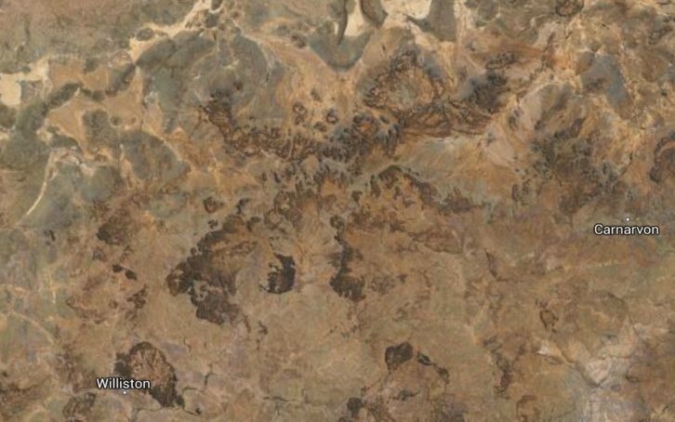
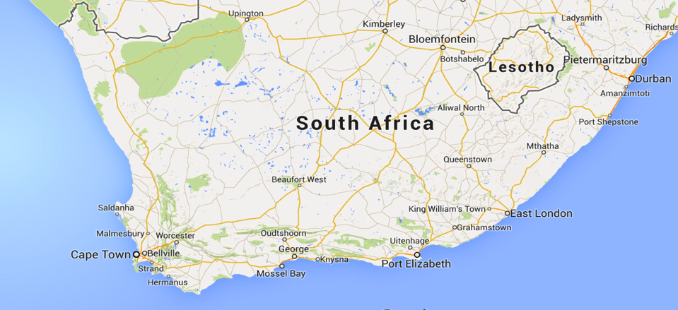

Slide 10
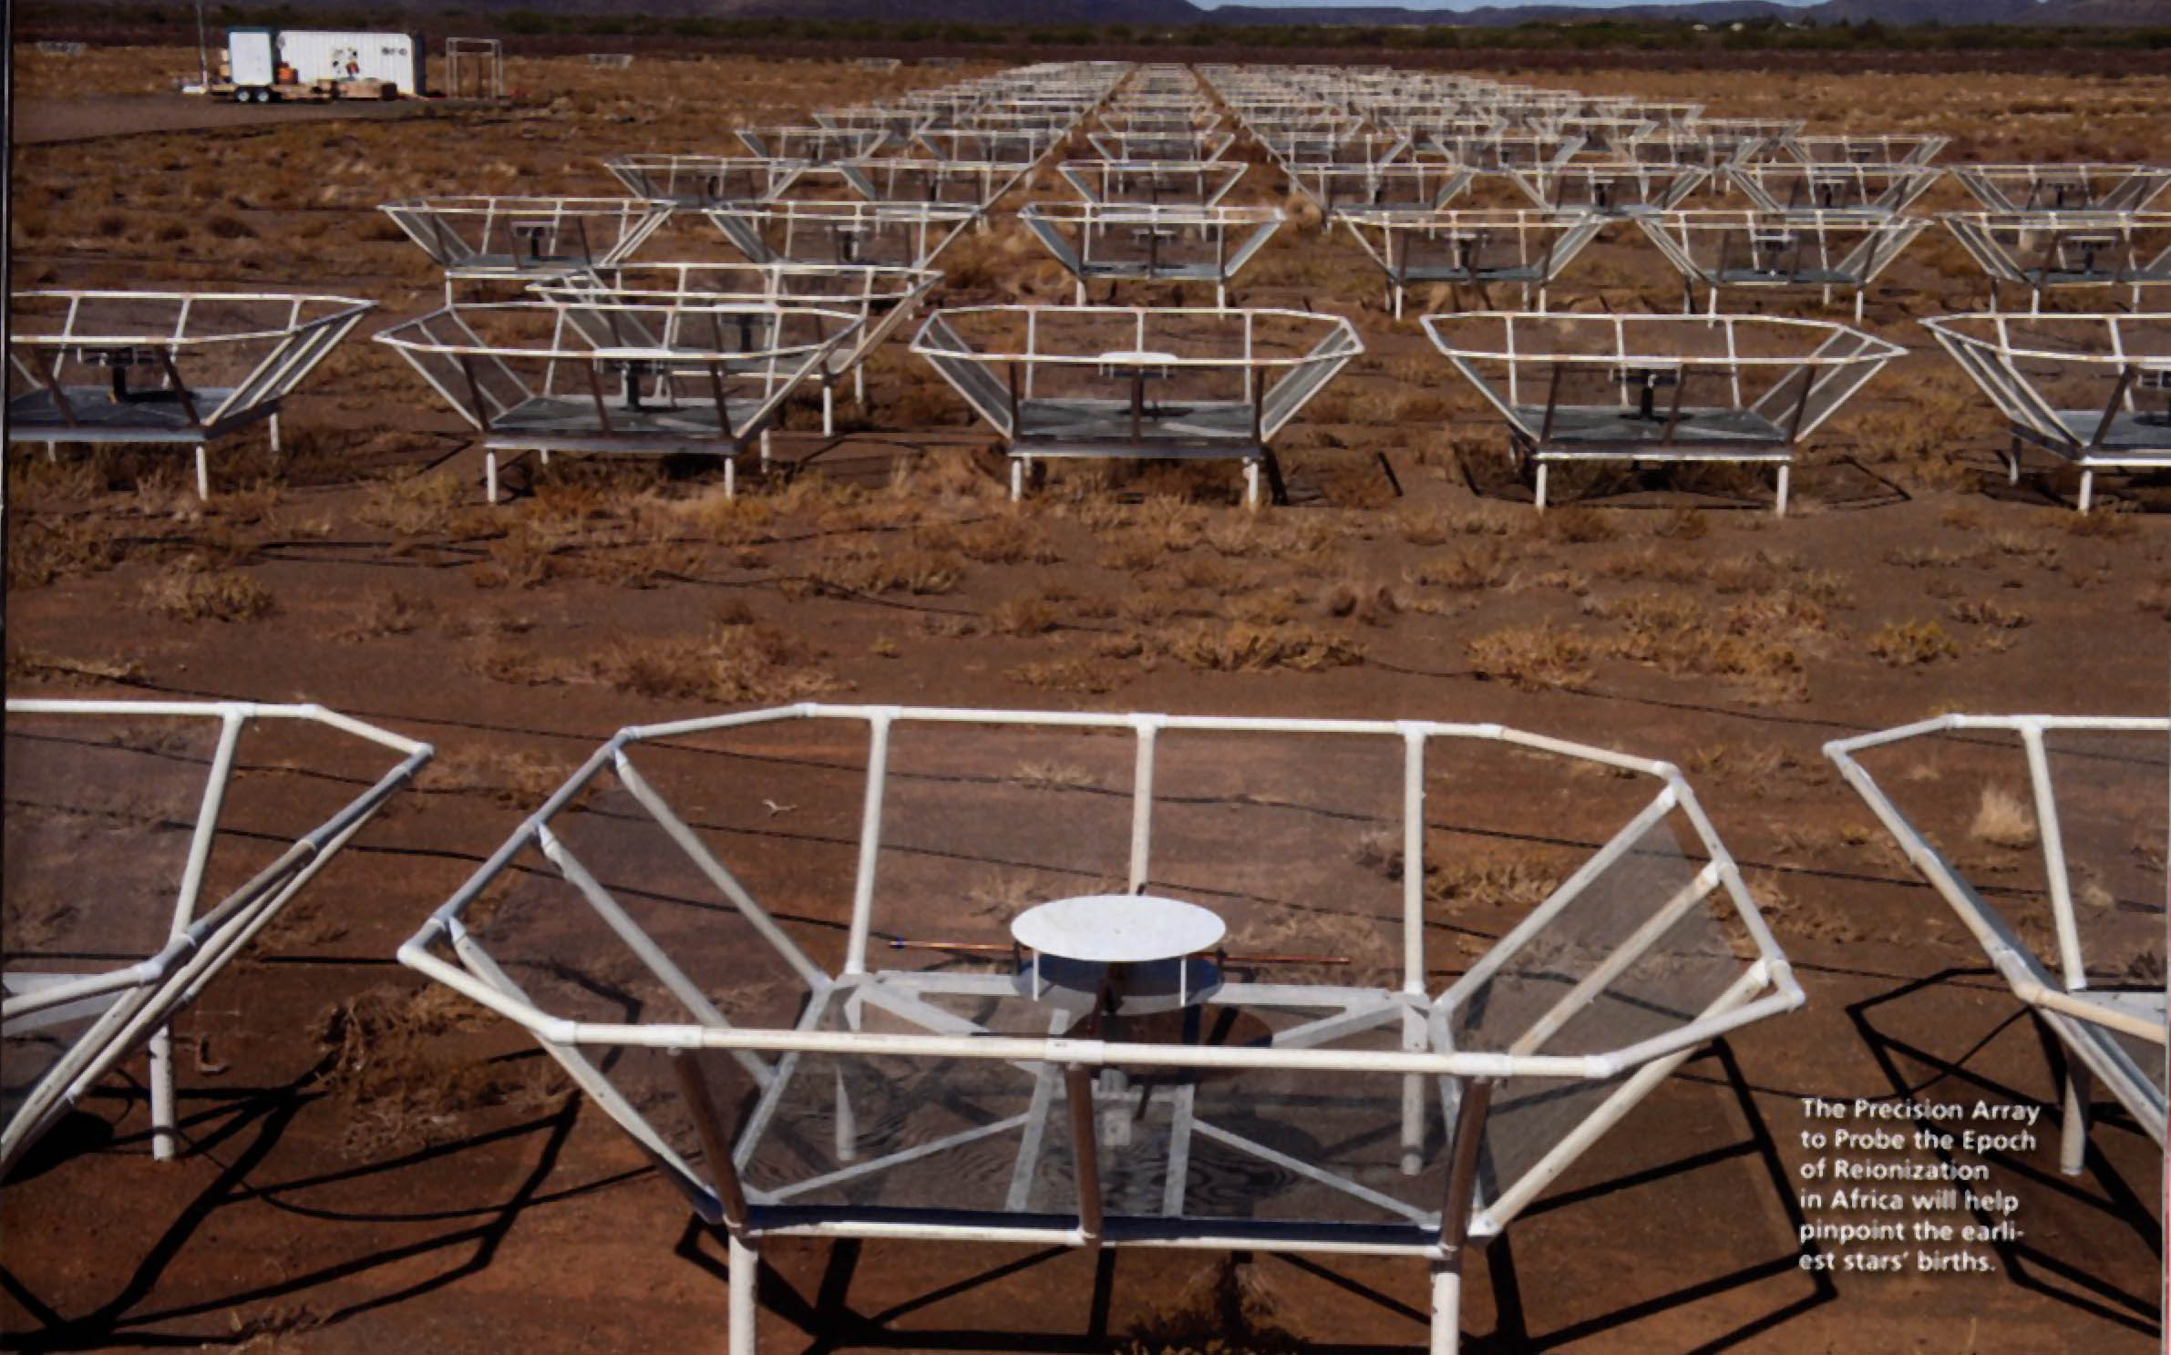

Slide 11
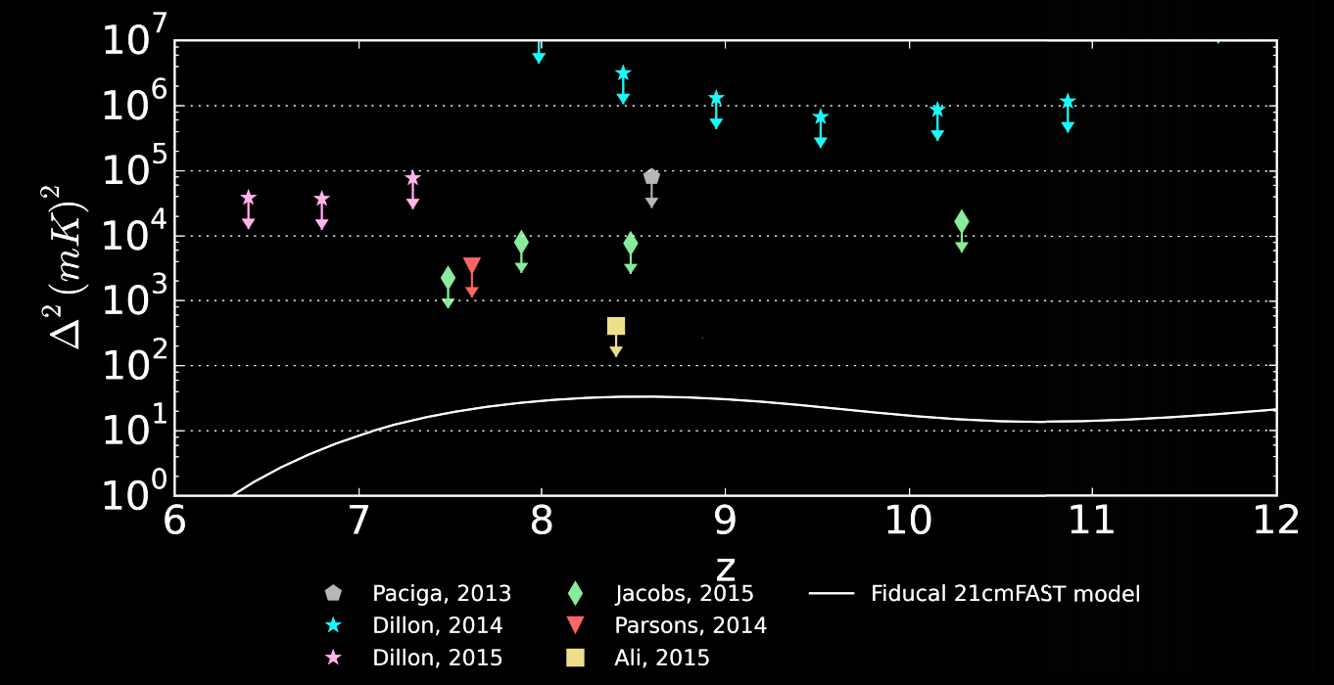
k = 0.2 h Mpc^-1

Slide 12
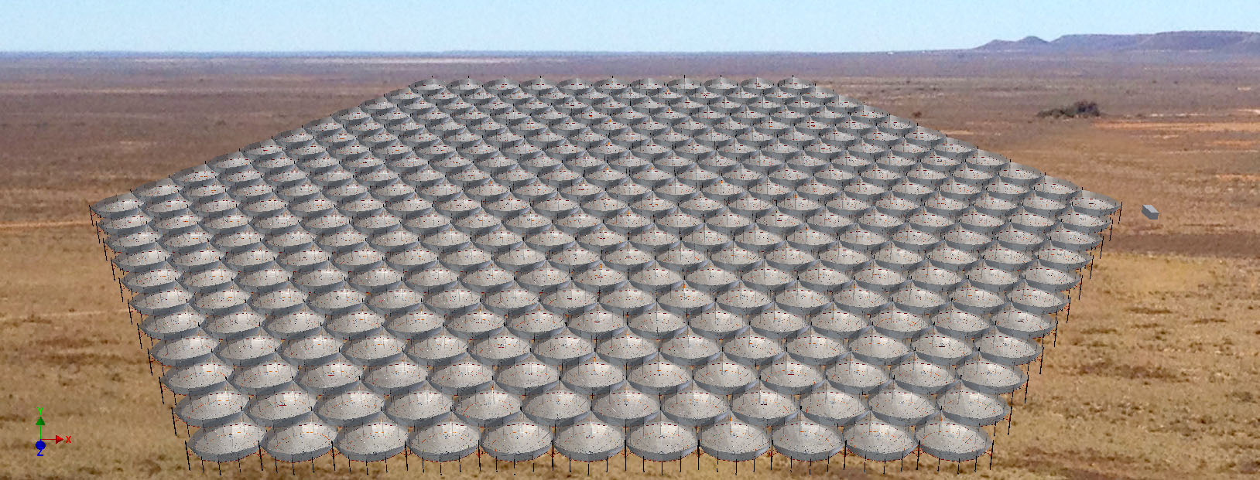
NSF Mid-Scale Innovations Program
Funded!
Notes:
PSA-64, 32 antennas in a maximum-redundancy configuration, 30m between rows, 4m spacing within rows

Slide 13
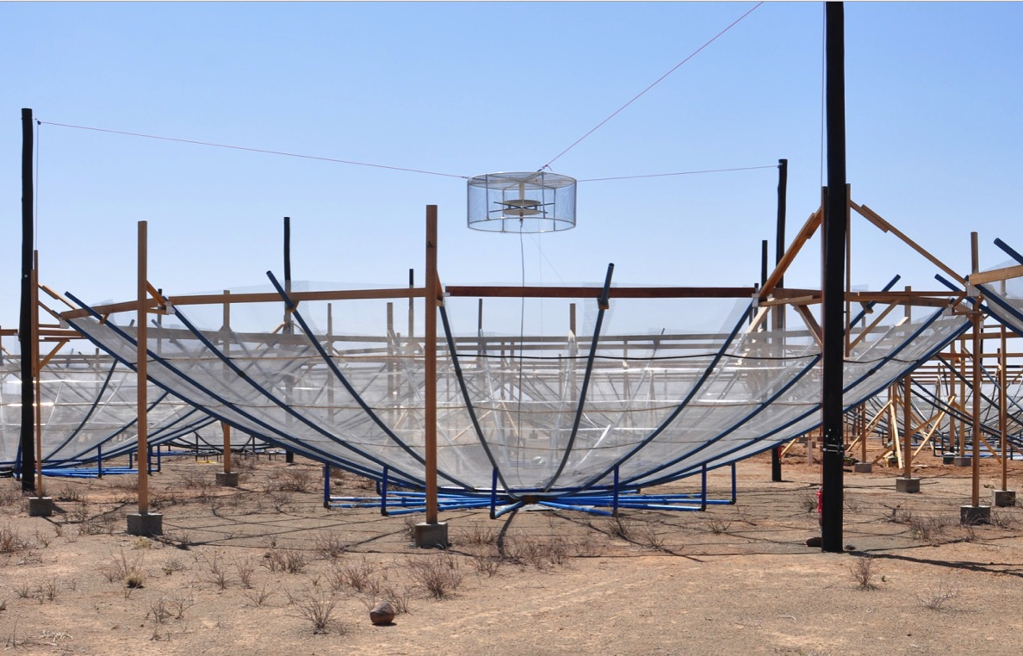
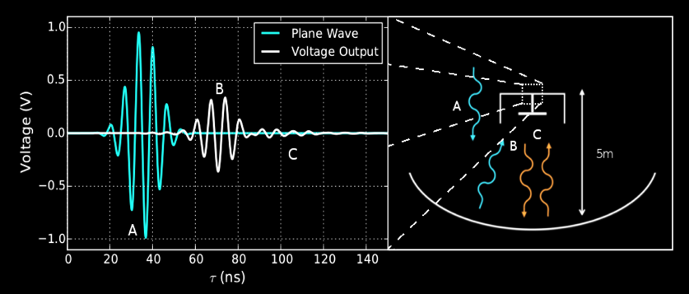
Patra et al., submitted
DeBoer et al., (2016)
Ewall-Wice et al. (2016)
Thyagarajan et al. (2016)

Slide 14
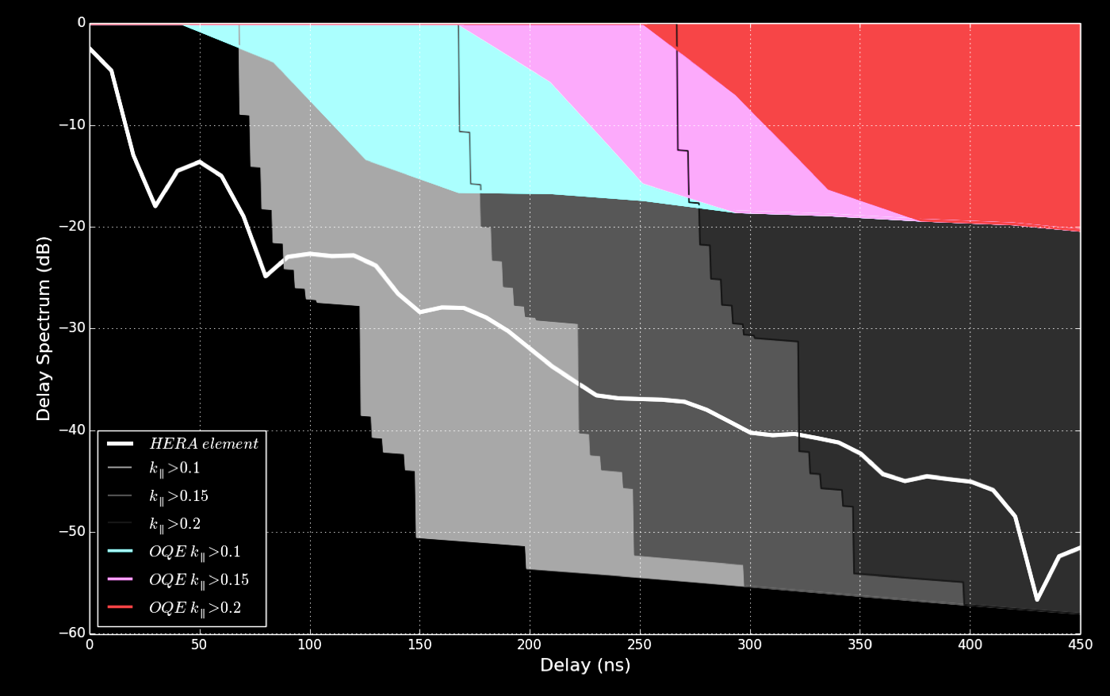
Patra et al., submitted
DeBoer et al., (2016)
Ewall-Wice et al. (2016)
Thyagarajan et al. (2016)

Slide 15
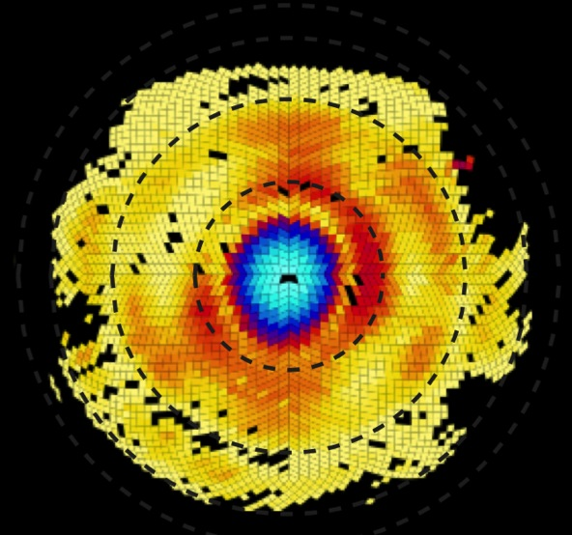
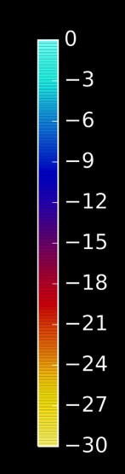
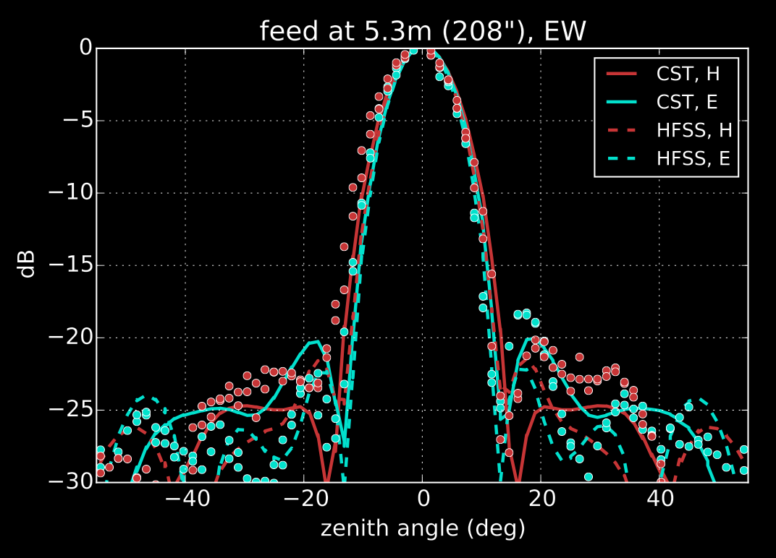
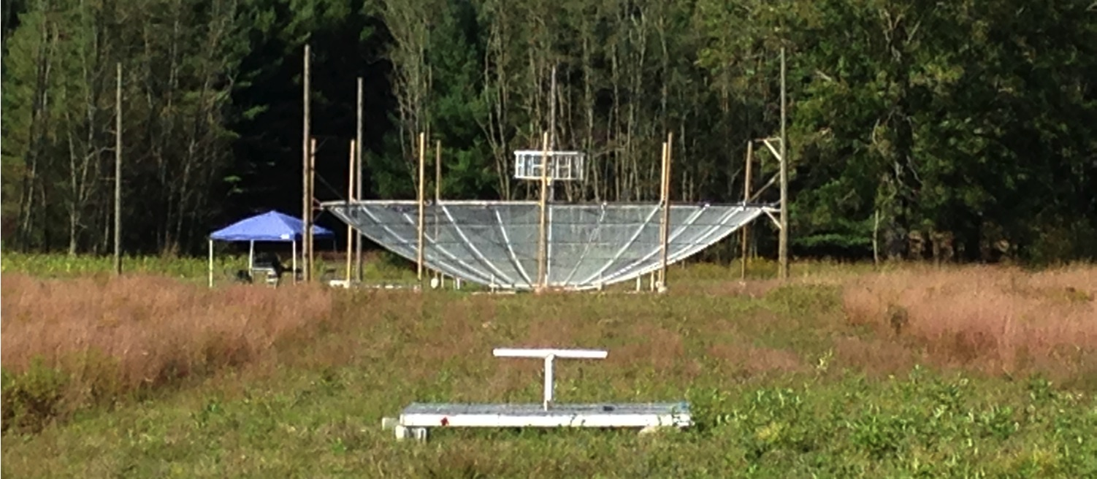
Neben et al. (2016)

Slide 16
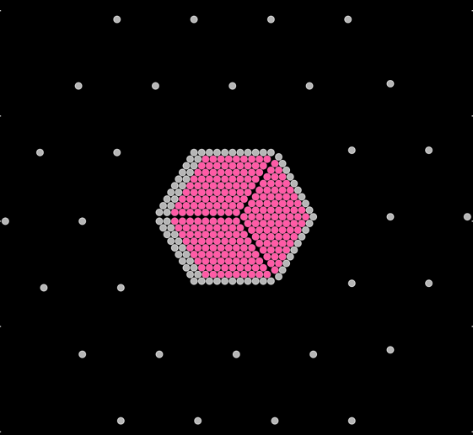

Notes:
Avoidance is what is promised under this grant, Modeling is enabled by the data taken but the associated analysis has been descoped.

Slide 17
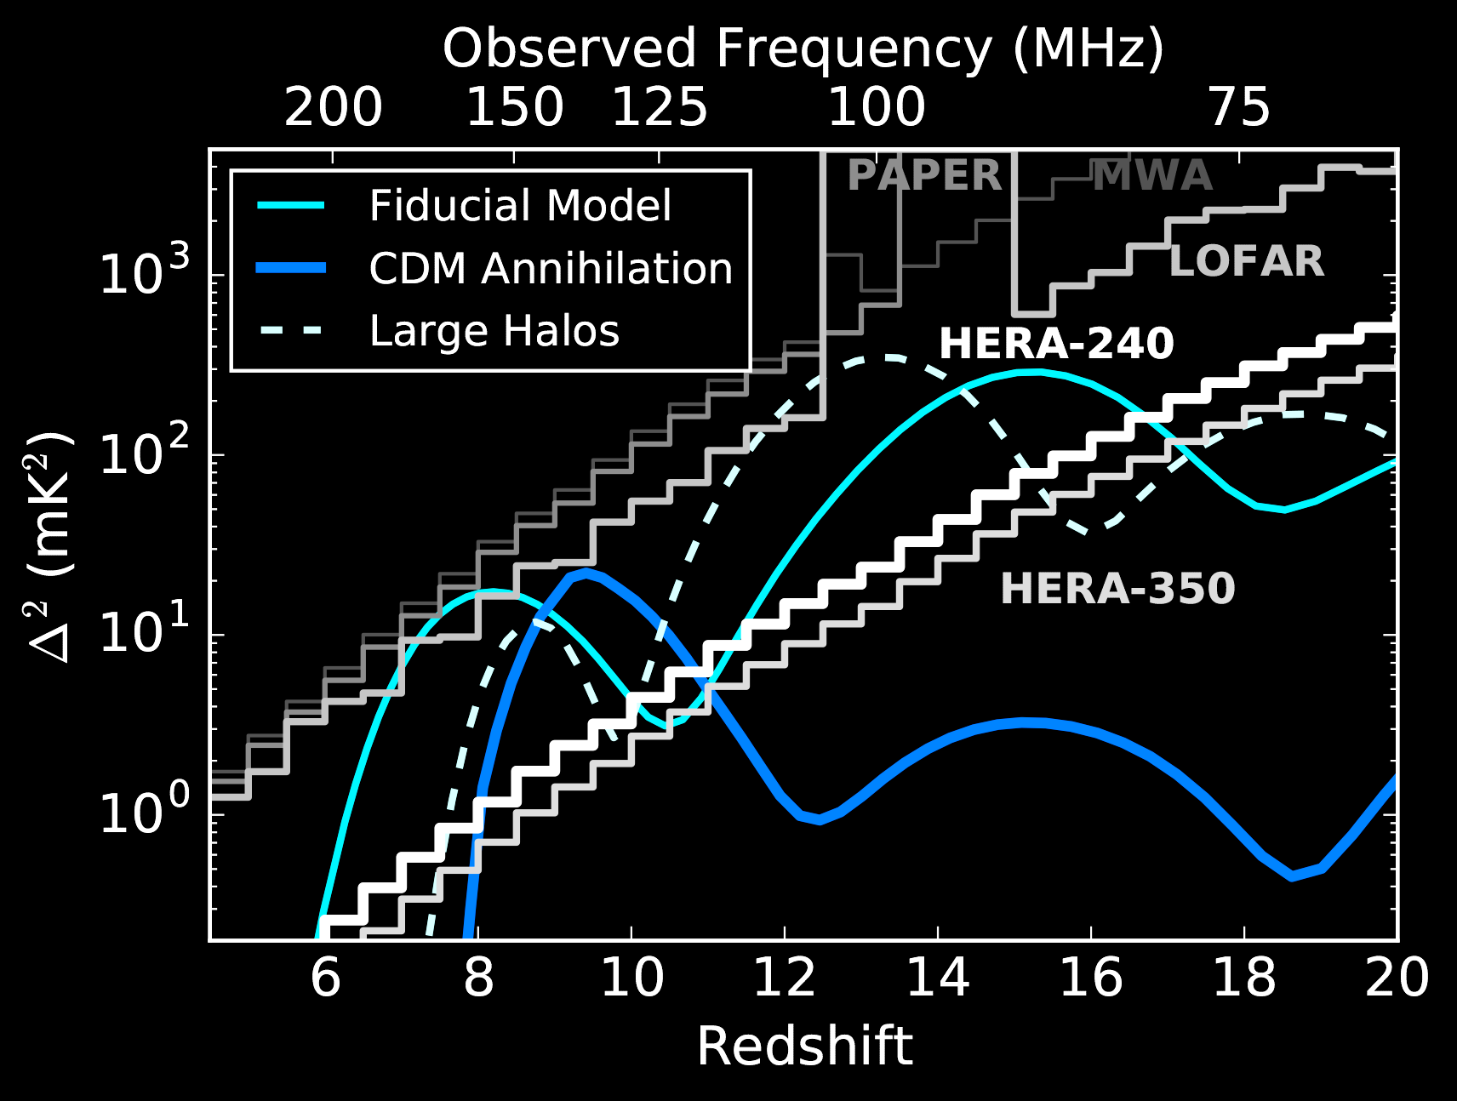
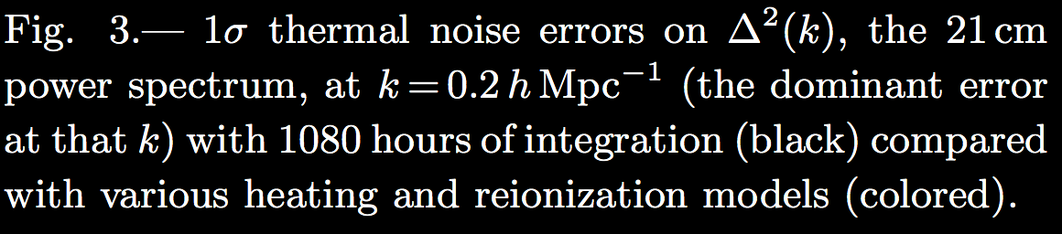

Slide 18
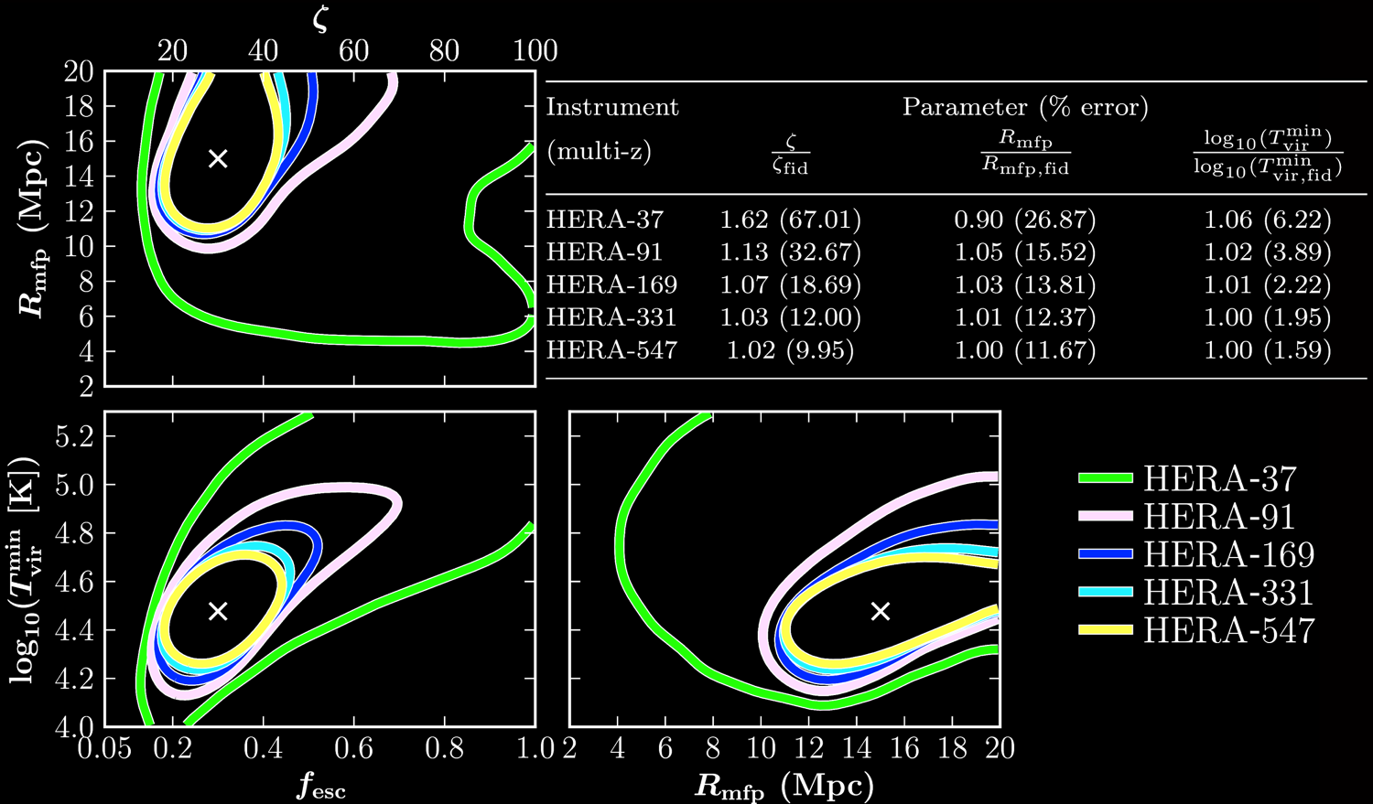

Slide 19
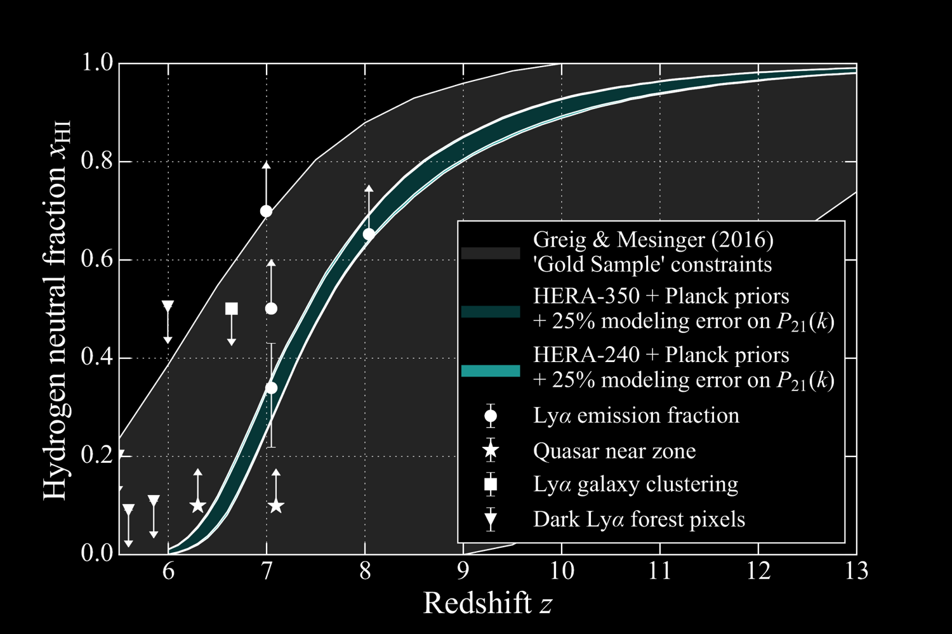

Slide 20
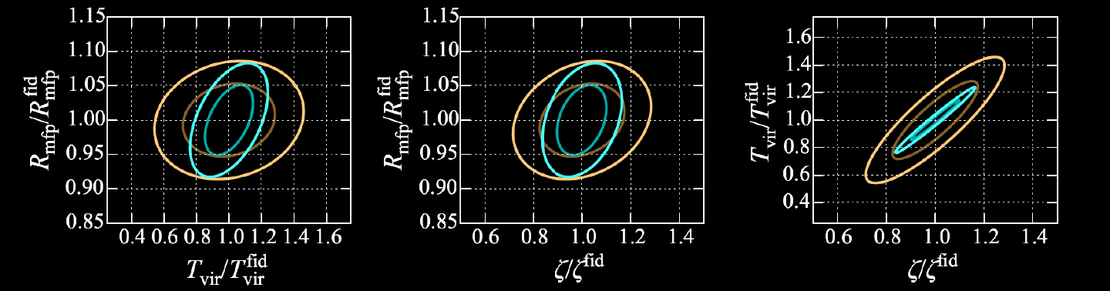
        Cosmo params fixed
        Cosmo params varied

Slide 21
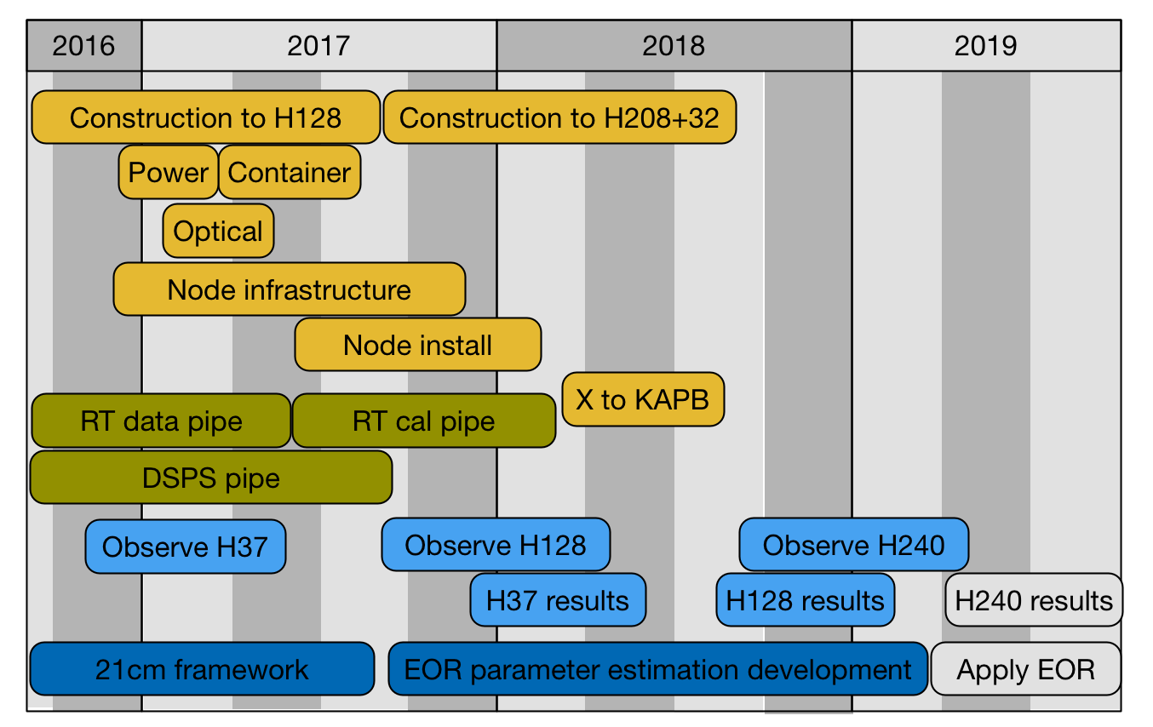
Timeline

Slide 22
