Slide 1
A simultaneous search for prompt radio emission associated with sGRBs using the all-sky OVRO-LWA
Marin M Anderson
Caltech

Slide 2
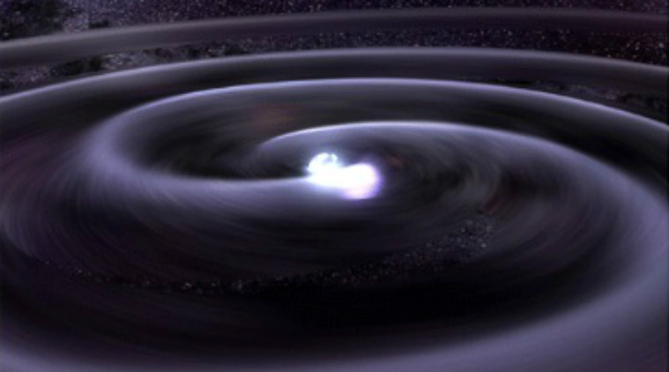
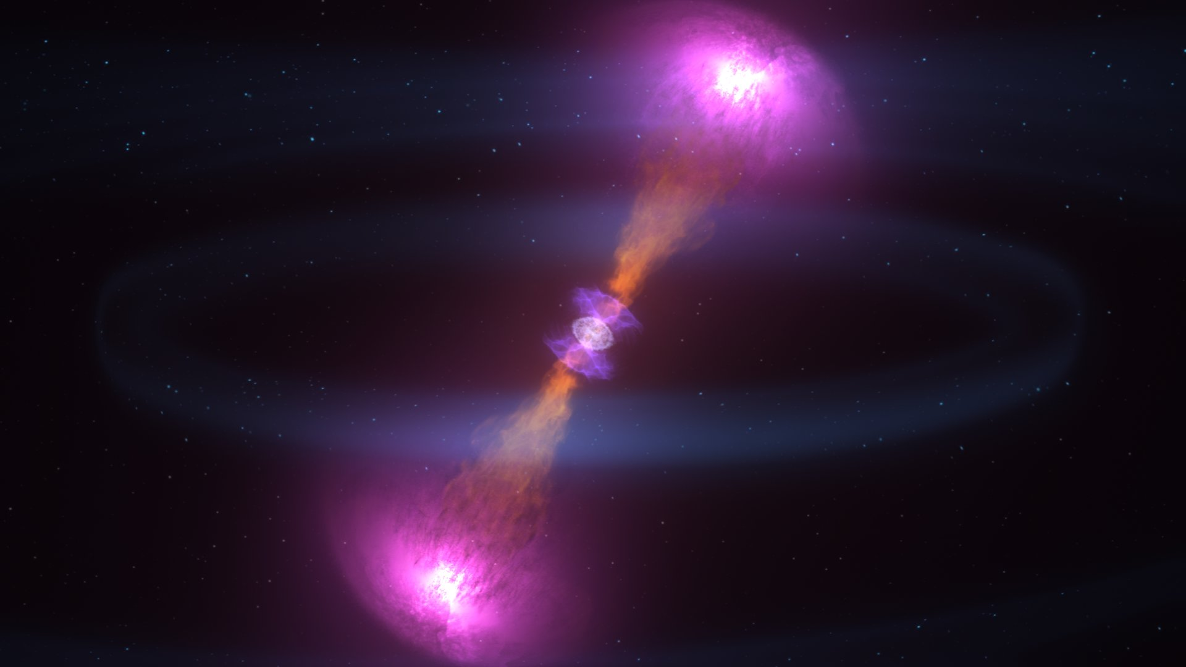
Short, bright pulse of prompt radio emission associated with compact object mergers?
Prompt low frequency pulse?

Slide 3
Short, bright pulse of prompt radio emission associated with compact object mergers?
Prompt low frequency pulse?
Anderson et al. 2018

Slide 4
A number of models predict a (highly speculative) counterpart to SGRBs and NS-NS mergers in the form of prompt, low frequency radio emission.
pre-merger
post-merger
GRB-phase
~0.1 Jy, ms-duration, seconds before GW emission
e.g. Hansen & Lyutikov 2001
Lyutikov 2019
~days prior to merger!
Notes:
2+1. Model 1 (for source at 100 Mpc, flux, frequency, expected dispersion time) Plot of flux versus frequency for model 1

Slide 5
A number of models predict a (highly speculative) counterpart to GRBs and NS-NS mergers in the form of prompt, low frequency radio emission.
pre-merger
post-merger
GRB-phase
~10⁵ Jy, 10-100 ms-duration, milliseconds before GRB
e.g. Hansen & Lyutikov 2001
e.g. Pshirkov & Postnov 2010
Notes:
3+1. Model 2 (for source at 100 Mpc, flux, frequency, expected dispersion time) Plot of flux versus frequency for model 2

Slide 6
A number of models predict a (highly speculative) counterpart to GRBs and NS-NS mergers in the form of prompt, low frequency radio emission.
pre-merger
post-merger
GRB-phase
~100 Jy, coincident with and same duration as GRB
e.g. Hansen & Lyutikov 2001
e.g. Pshirkov & Postnov 2010
e.g. Usov & Katz 2000
Notes:
4+1. Model 3 (for source at 100 Mpc, flux, frequency, expected dispersion time) Plot of flux versus frequency for model 3

Slide 7
A number of models predict a (highly speculative) counterpart to GRBs and NS-NS mergers in the form of prompt, low frequency radio emission.
pre-merger
post-merger
GRB-phase
All models predicting coherent, low frequency pulse require…
…for detection.
Jy-level sensitivity
at sub-100 MHz frequencies
Rapid response times
~100 Jy, coincident with and same duration as GRB
e.g. Hansen & Lyutikov 2001
e.g. Pshirkov & Postnov 2010
e.g. Usov & Katz 2000
Notes:
Point of slide: All theories have in common the need for an instrument that operates at low frequencies (the lower the better, theoretically), with ~Jy-level (or better) sensitivity, that can observe the field of a short GRB within (depending on the distance and frequency of observations) seconds to minutes to gamma-ray detection.
5.+1 Model summary
“theorists running wild”
- themes/requirements-for-detection which are consistent across the varying models — expect coherent, low frequency burst which will be dispersed by the intervening IGM, peaks at low frequencies, at sensitivities at the ~1Jy level for a NS-NS merger at ~100 Mpc, need to be able to observe instantaneously or within seconds of merger.
- plots for all models

Slide 8
Why is prompt pulse of low frequency radio emission accompanying GRB valuable?
Serves as probe of IGM density and turbulence.
Provides constraints on explosion physics in GRBs, including Lorentz factor and jet opening angle.
Provides EM-counterpart to GW source!
Notes:
Point of slide: why is prompt pulse of low frequency radio emission associated with a sGRB valuable

Slide 9
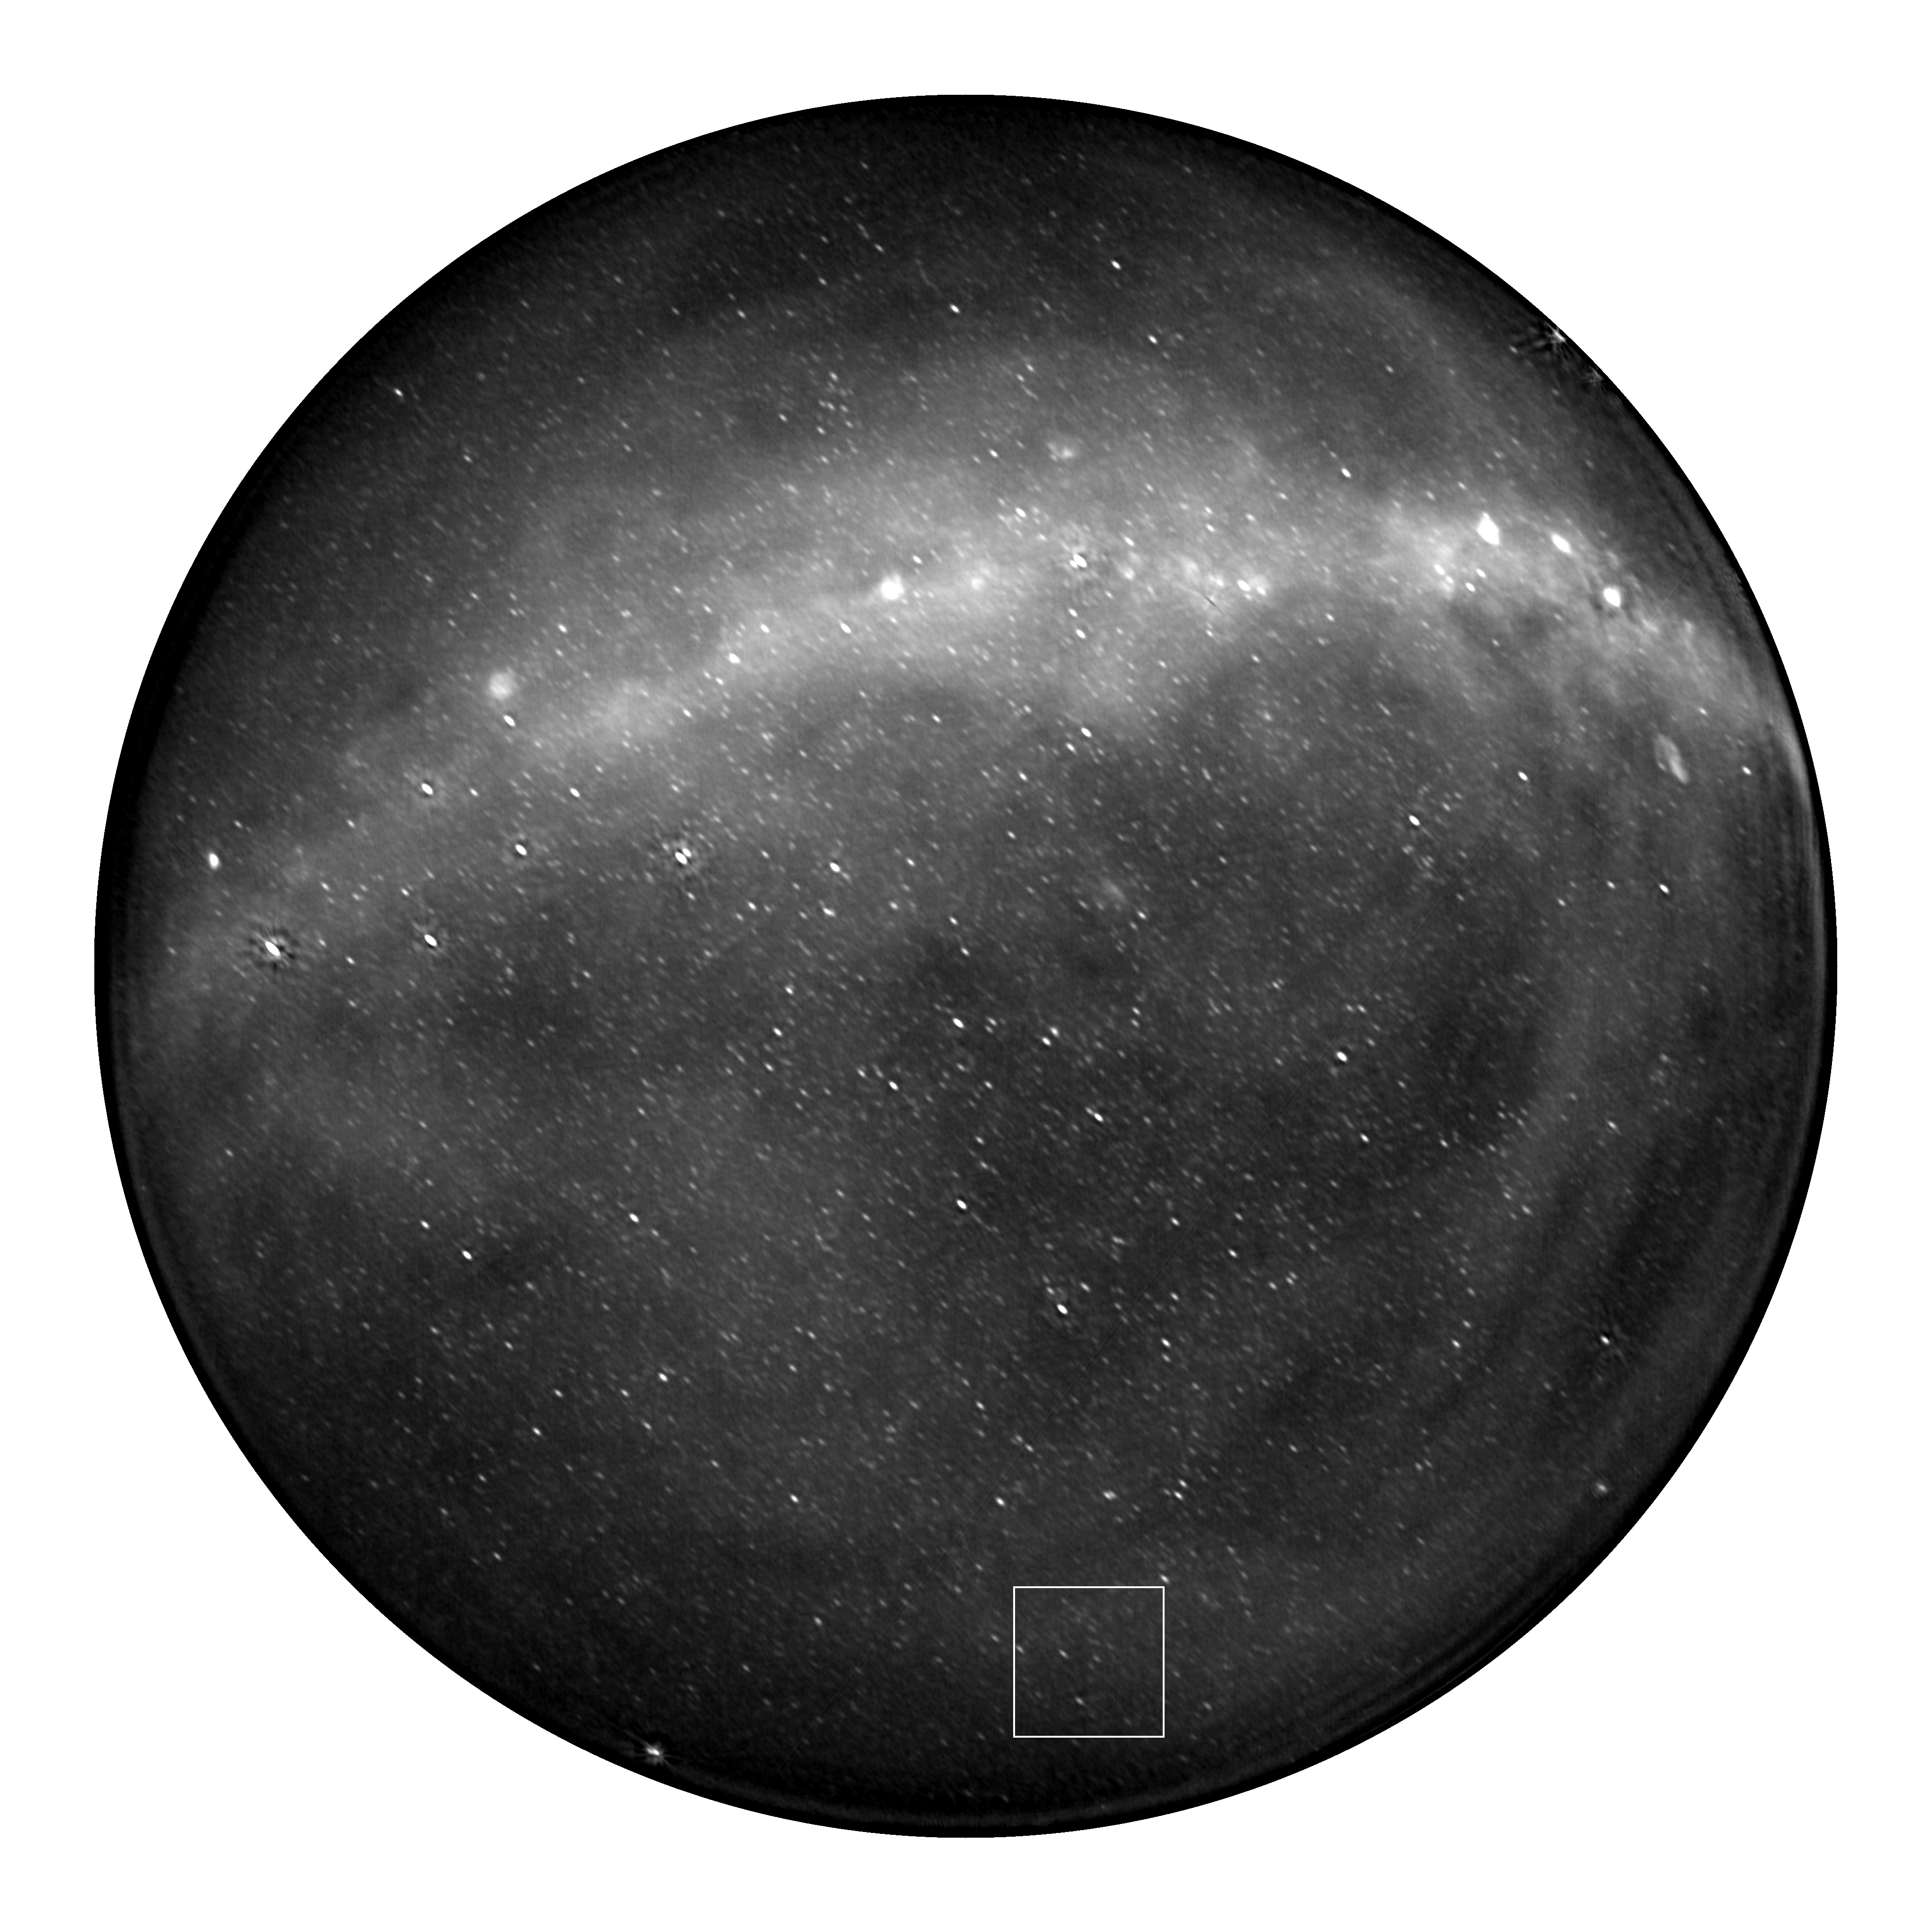
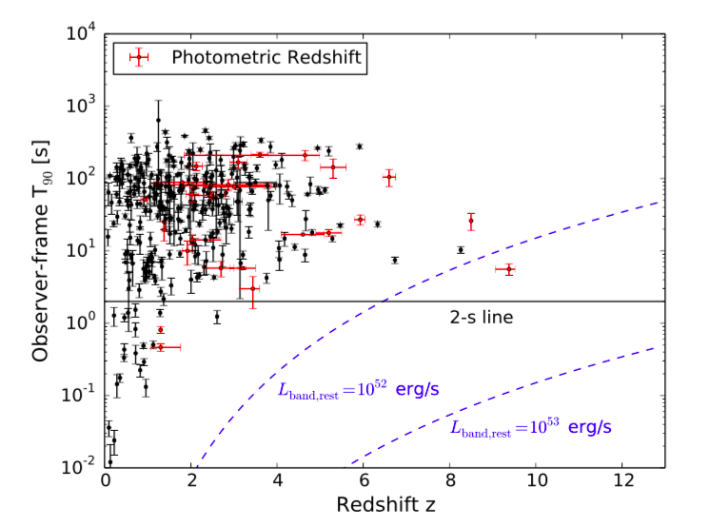
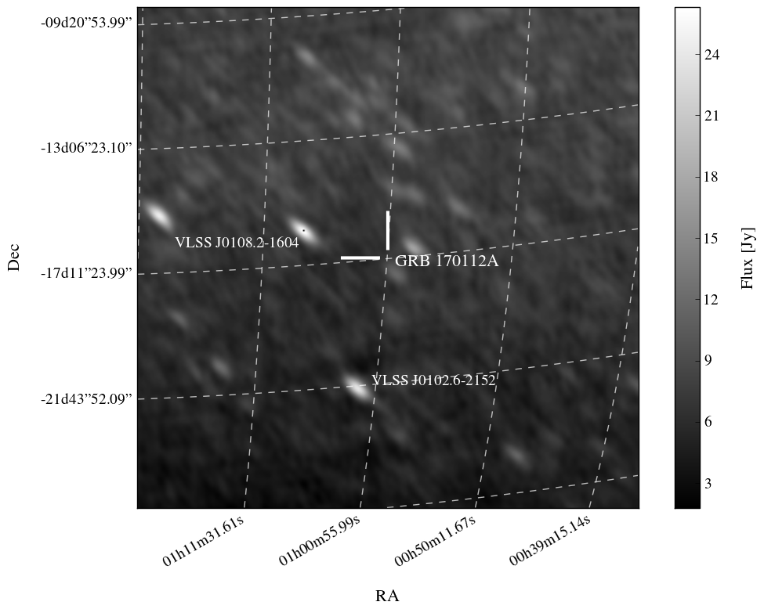
Deepest search for prompt, coherent emission associated with sGRB 170112A with the OVRO-LWA.
Lien et al. 2016

Slide 10
Deepest search for prompt, coherent emission associated with sGRB 170112A with the OVRO-LWA.
Anderson et al. 2018

Slide 11
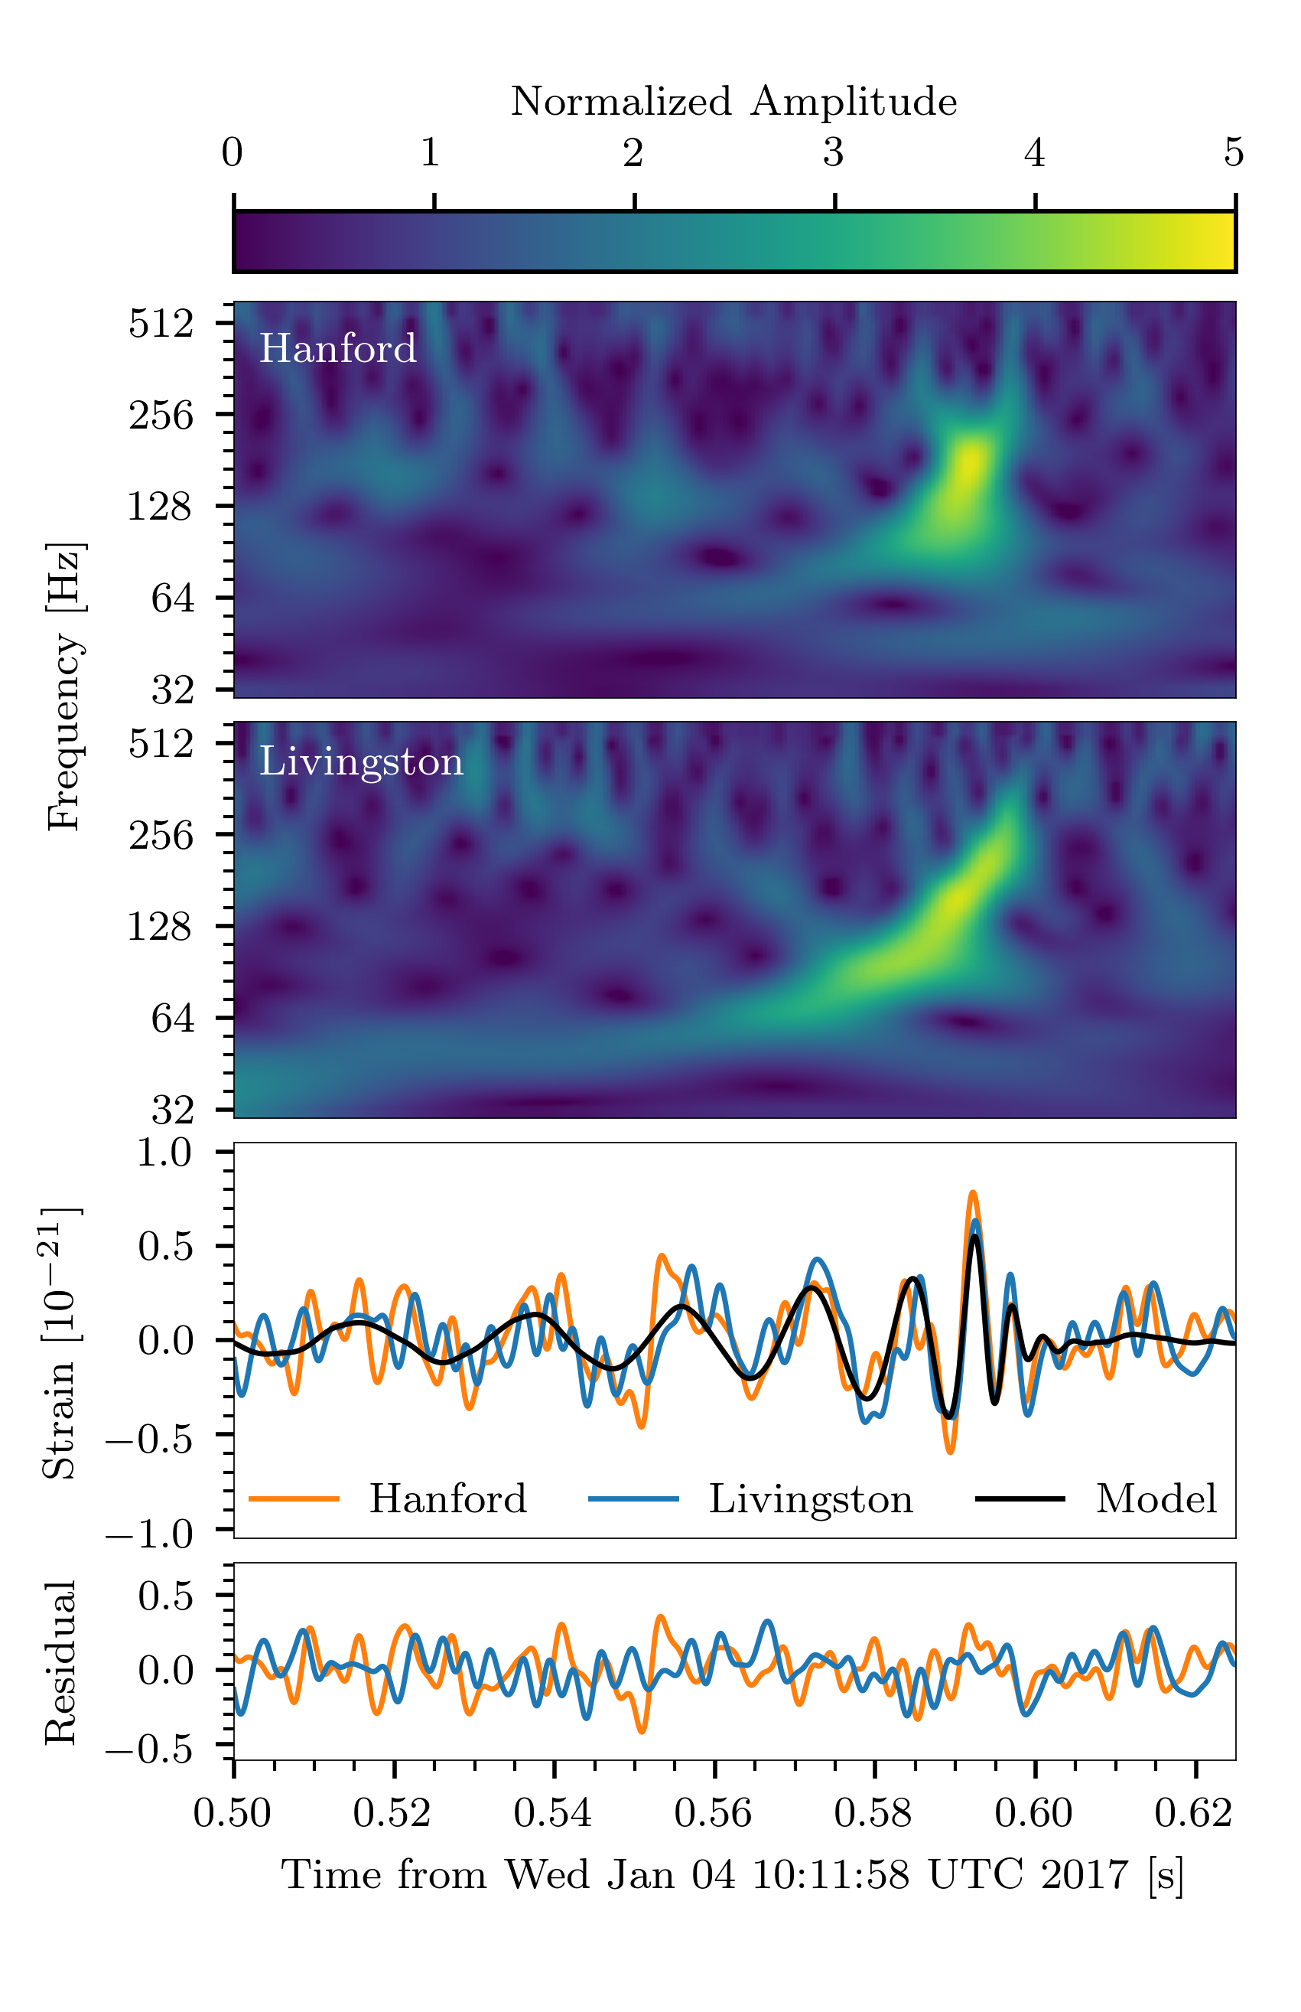
Using the OVRO-LWA to search for events coincident with LIGO triggers!
Callister, Anderson et al. 2019
GW 170104

Slide 12
Using the OVRO-LWA to search for events coincident with LIGO triggers!
Callister, Anderson et al. 2019

Slide 13
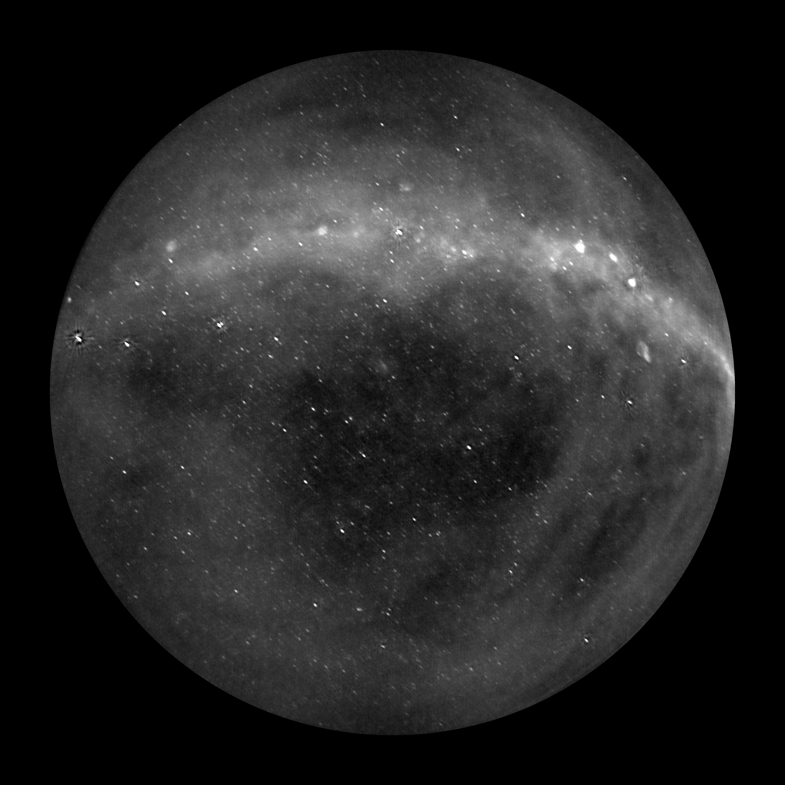
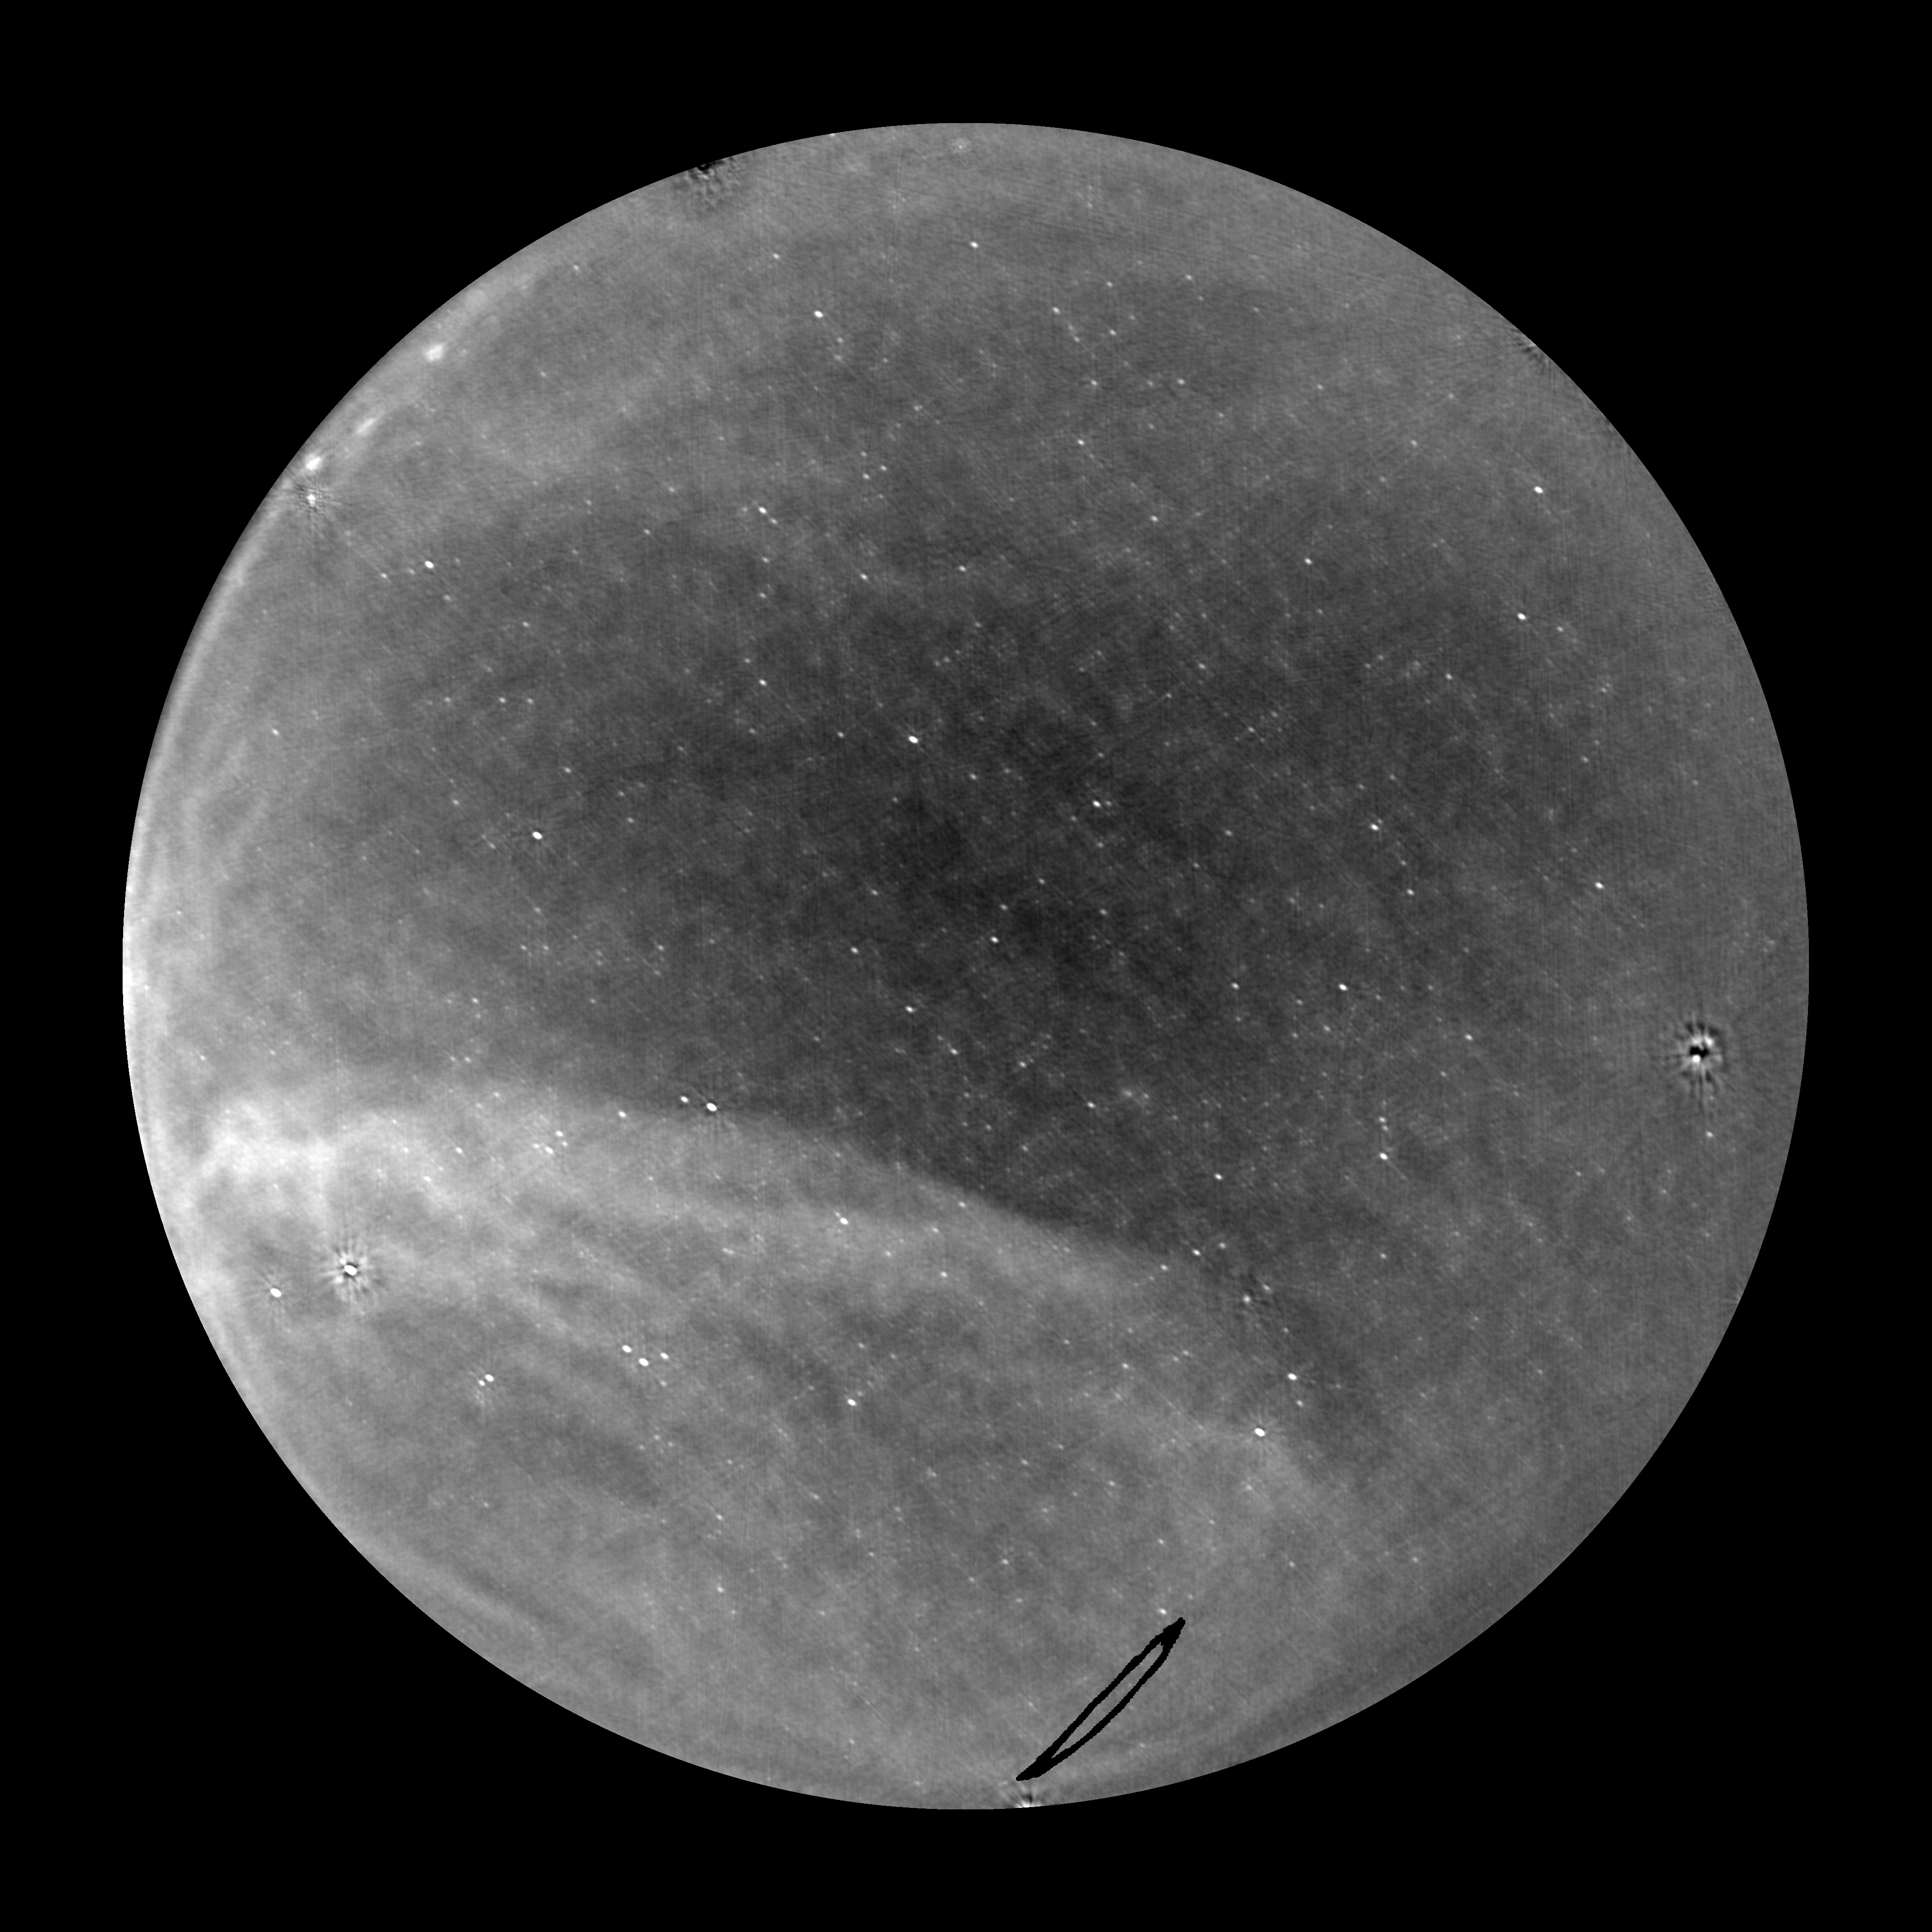
GW 170817

Slide 14
Summary
Prompt radio emission from NS-NS mergers
Prompt, coherent, short-duration burst predicted to accompany NS-NS mergers / SGRBs, brightest at low frequencies.
The Owens Valley Long Wavelength Array (OVRO-LWA)…
Operates at low frequencies
With sufficient sensitivity
And all-sky FOV…to detect prompt radio emission.
OVRO-LWA
Continuous mode of operation means we are observing simultaneous to GW event, regardless of trigger lag time.
GW-EM follow-up
Upgrading to 40TB RAM to buffer raw voltage data and search for pulses on all timescales.
Notes:
18. Conclusion
LWA-OVRO signed MOU with aLIGO/VIRGO, currently responding to triggers
- have been observing since near the start of O2 (december 2016)

Slide 15
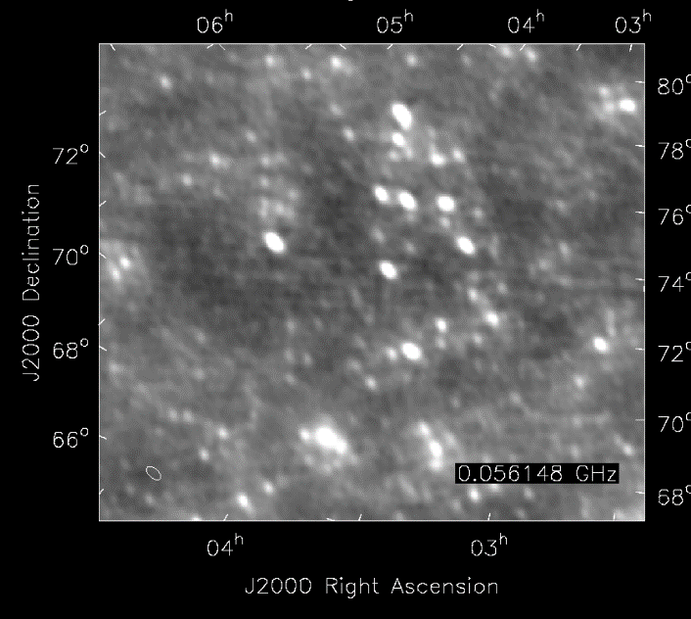
Currently ~800 mJy snapshot sensitivity.
Stage III array will achieve
~150 mJy snapshot sensitivity.
Notes:
14. Image cut-out
- for reference, meaning of 1Jy source, reference Crab, Cyg and Cas, noise in fullband images

