Slide 1
Monitoring nearly 4000 nearby stellar systems for extrasolar space weather with the OVRO-LWA
Marin M Anderson
Caltech

Slide 2
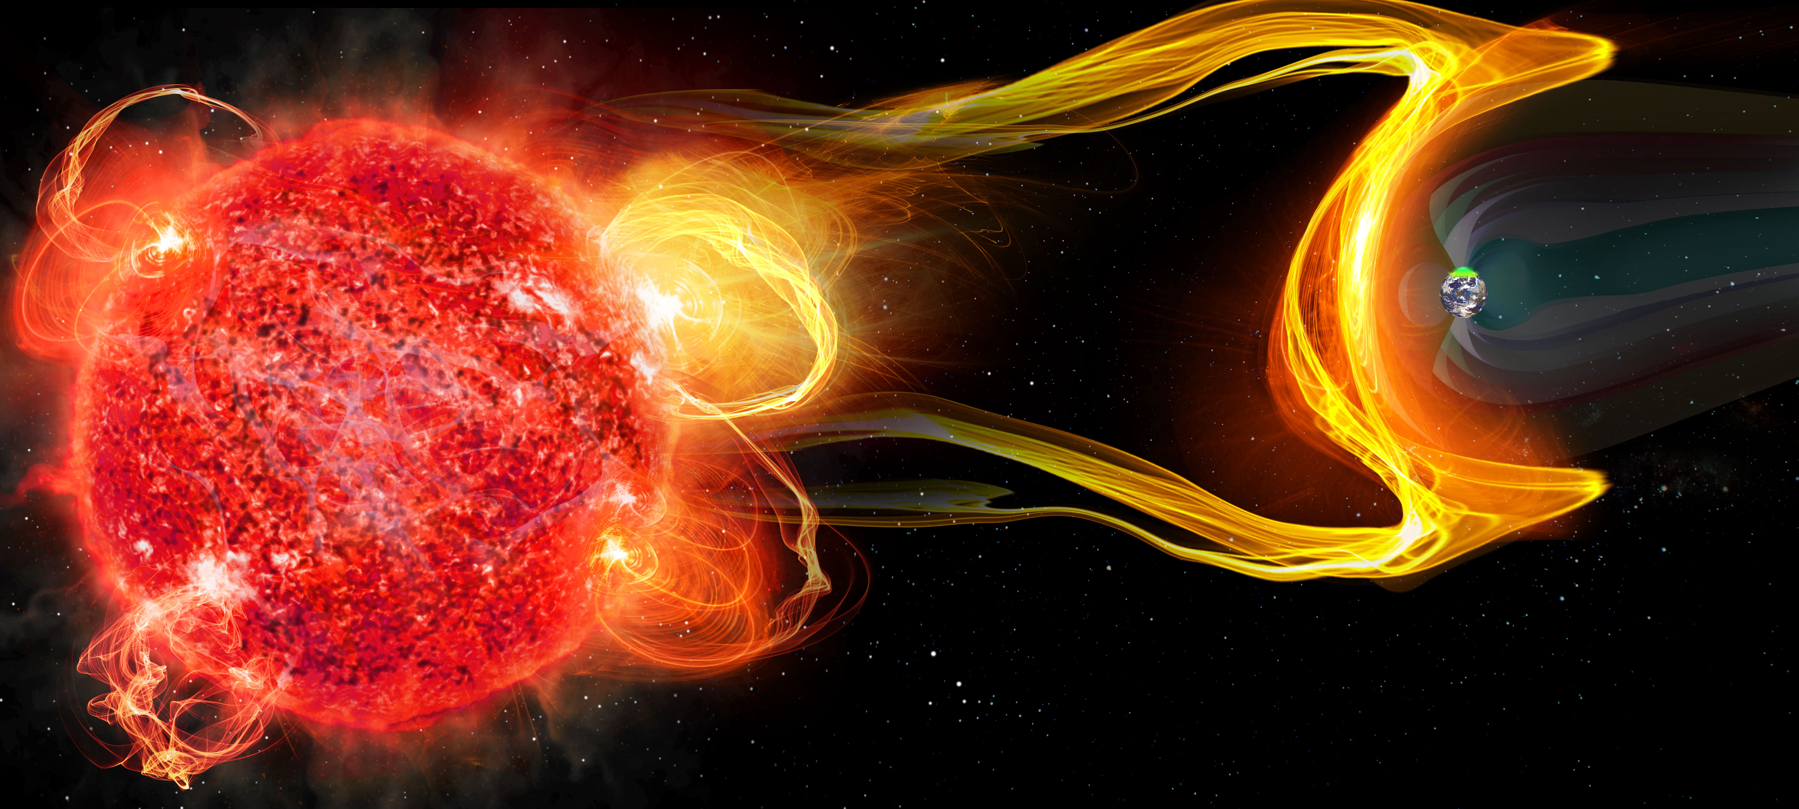
Characterizing stellar magnetic activity, planetary magnetic fields, and their interaction for a wide range of host mass and age.
How can we optimize the search for extrasolar space weather, and begin detecting and characterizing systems en masse?
Low frequency ( < 100 MHz )
Large-FoV instruments
Capitalize on characteristics of emission mechanisms (Stokes V)
Image credit: C. Carter & G. Hallinan
Notes:
Point of slide: Detection of exoplanetary radio emission in the form of ECME provides direct insight into planetary magnetic field, and therefore allows inferences about habitability. However, stellar magnetic activity plays just as important a role in defining planetary habitability, and observations of stellar radio emission are critical for informing how magnetically active stars influence the planetary environments.

Slide 3
Understanding how CMEs scale with flare energy and frequency is critical to diagnosing habitable environments around magnetically active stars.
Relationship between CME mass and flare flux for the Sun
Relationship between CME mass and flare flux for the Sun
We need to characterize both planetary magnetic fields
and stellar transient mass loss.
CME Mass
CME Mass
Flare Flux
Aarnio et al. 2012
Flare Flux
Notes:
Point of slide: Current tools for understanding how CMEs scale with flare energy is to extrapolate this relationship on the sun (or energy equipartition), but we don’t know how far this extrapolation holds. Understanding this relationship on other stars (and how it changes as a function of spectral type, magnetic field strength, etc.) is just as critical a part of the space weather equation for characterizing planetary habitability as planetary magnetic fields are.

Slide 4
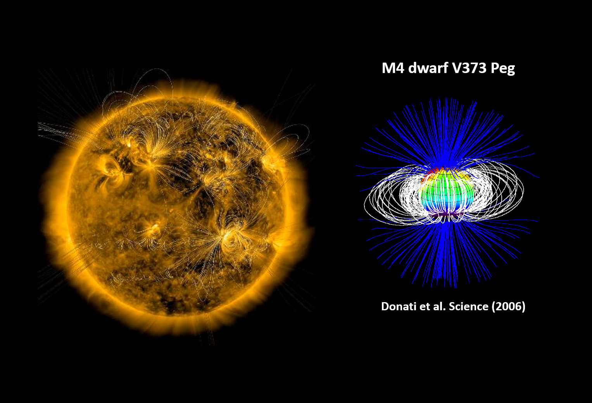
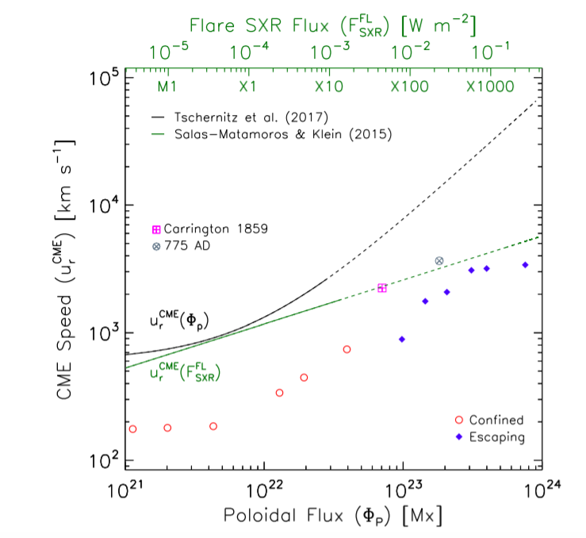
And understanding how CME mass, morphology, and velocity scale with magnetic field strength and topology.
Alvarado-Gómez et al. 2018
Notes:
Point of slide: Introduce the question of how the field strength and topology of a star can influence potential CMEs (mass, morphology, velocity) and critically whether strong overlying fields may suppress (examples of this with the Sun) CMEs

Slide 5
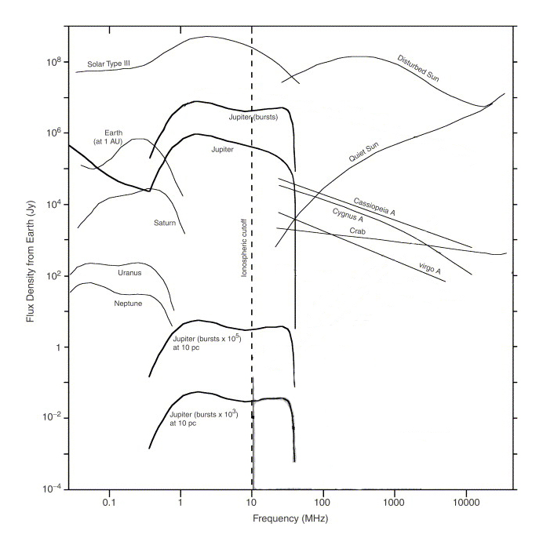
Low frequency ( < 100 MHz)
Extrapolation from our own SS suggests it is necessary to go below 100 MHz to directly detect exoplanetary radio emission.
Flux Density from Earth (Jy)
Zarka 2007
Frequency (MHz)
Notes:
Point of slide: Extrapolation from our own Solar System suggests we should be probing the low frequency range that corresponds to magnetized SS body magnetic field strengths (but what about tidally locked, hot Jupiters, minimal rotation energy to power dynamo?)
Jupiter at 5 pc ~ 20uJy
10% of the time ~ 0.2 mJy
1% of the time ~ 2 mJy

Slide 6
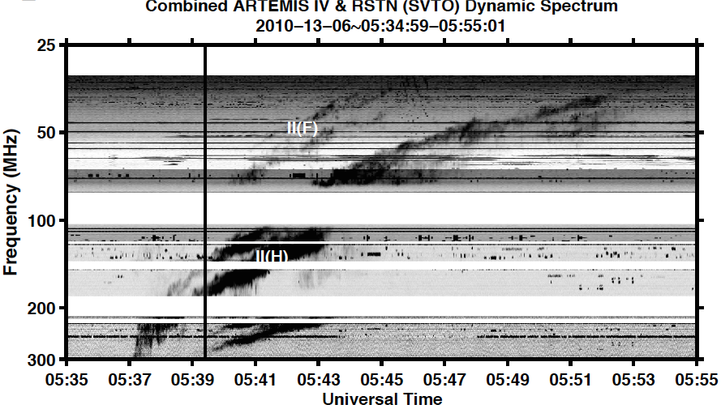
Low frequency ( < 100 MHz)
Extrapolation from our own SS suggests it is necessary to go below 100 MHz to directly detect exoplanetary radio emission.
Solar Type II radio bursts are associated with CMEs, and frequently occur in the sub-100 MHz regime.
300
200
harmonic
100
Frequency (MHz)
50
fundamental
25
Kouloumvakos et al. 2014
Figure c/o J. Villadsen
0
10
20
Time (minutes)
Notes:
Point of slide: Stellar magnetic activity, particularly CME-associated Type II solar burst-like emission, characteristics are a function of plasma density, shock/CME speed, atmospheric scale height, and based on

Slide 7
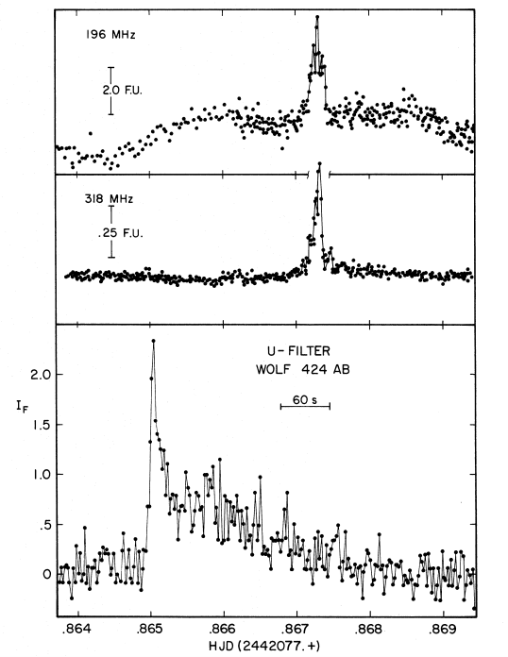
Low frequency ( < 100 MHz)
Extrapolation from our own SS suggests it is necessary to go below 100 MHz to directly detect exoplanetary radio emission.
Solar Type II radio bursts are frequently associated with CMEs, and peak in the sub-100 MHz regime.
Previous detections of flare star radio emission indicate flux increases at low frequencies.
300
5 Jy at 196 MHz
200
500 mJy at 318 MHz
harmonic
100
Frequency (MHz)
50
fundamental
25
0
10
20
Spangler & Moffett 1976
Time (minutes)
Notes:
Point of slide: Previous detections of stellar flares at radio wavelengths indicates an association between optical and radio flaring, and that significant fraction of flare energy in radio band is carried at sub-100 MHz frequencies.
Giant Type II burst from the Sun, detected in 1947, 10^11 Jy at 60 MHz. This would be >1 Jy at the distance of Alpha Cen, but is an extremely rare event.

Slide 8
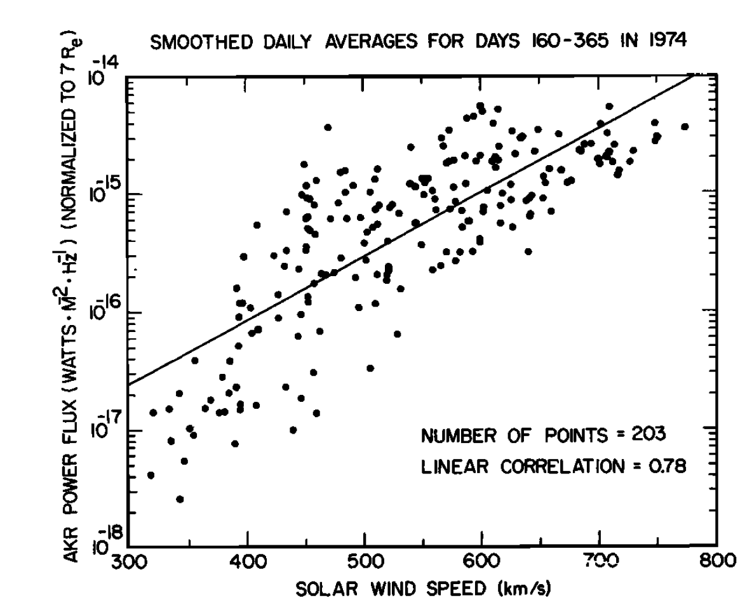
Large-FoV Instruments
Earth’s Auroral Emission
Capture a large fraction of sky in order to monitor a large sample of objects.
Sensitive to rare events associated with extreme flares / CMEs that may induce significant increase in exoplanetary radio power.
Flux Density from Earth (Jy)
Radio Power
1000x increase during Solar CME!
Solar wind speed [km/s]
Gallagher and D’Angelo 1981
Zarka 2007
Frequency (MHz)
Notes:
Point of slide: Low frequency instruments are also inherently wide FoV, and the larger fraction of sky captured the larger number of systems that can be monitored, which means more likely to capture rare brightening events, associated with extreme flares / magnetic activity.

Slide 9
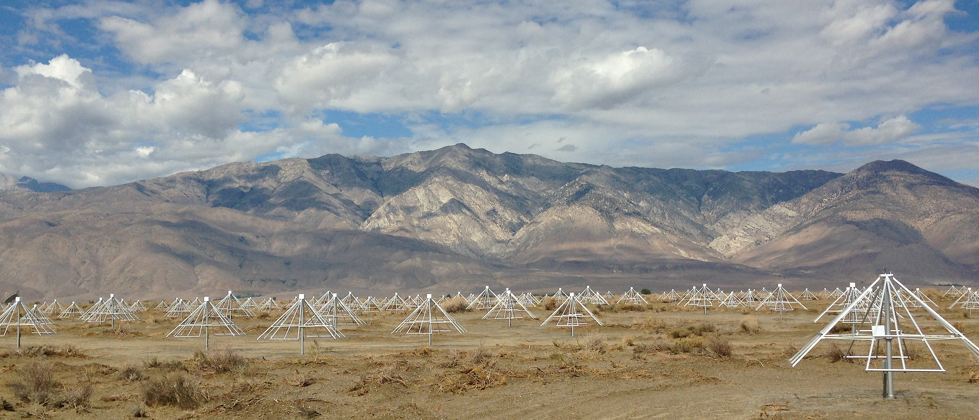
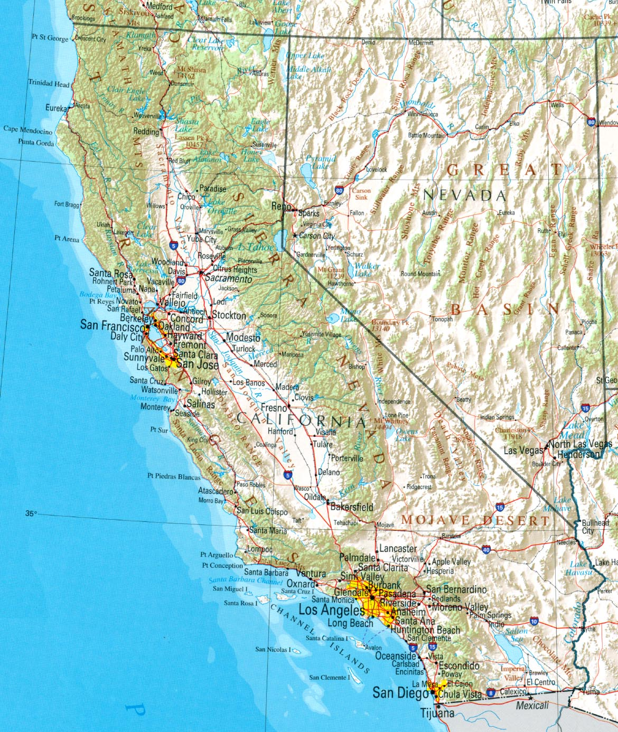
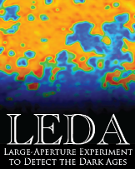
The Owens Valley Radio Observatory Long Wavelength Array (OVRO-LWA)

Slide 10
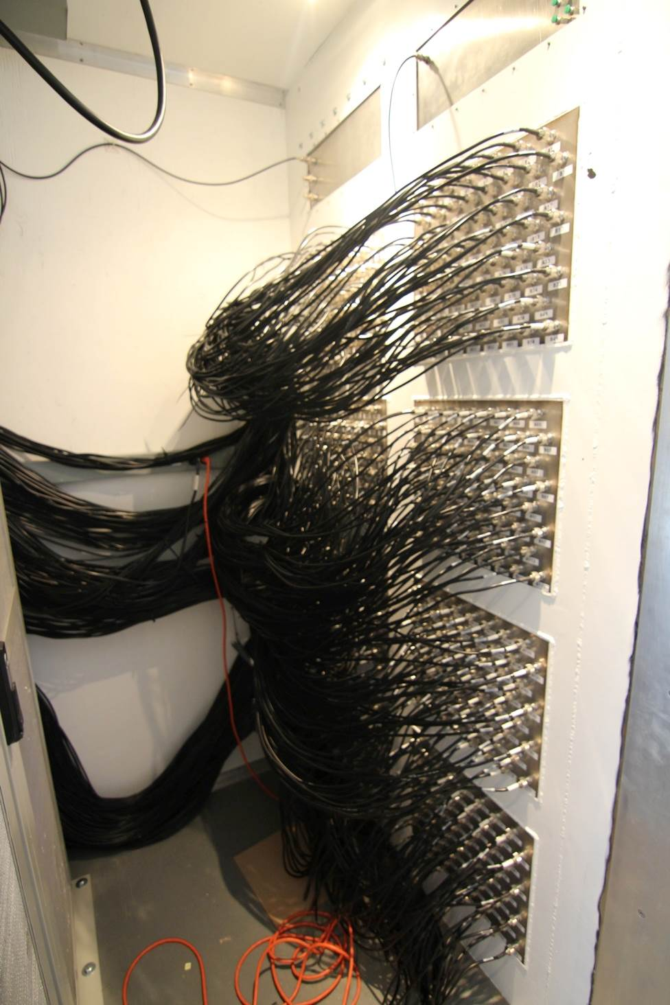
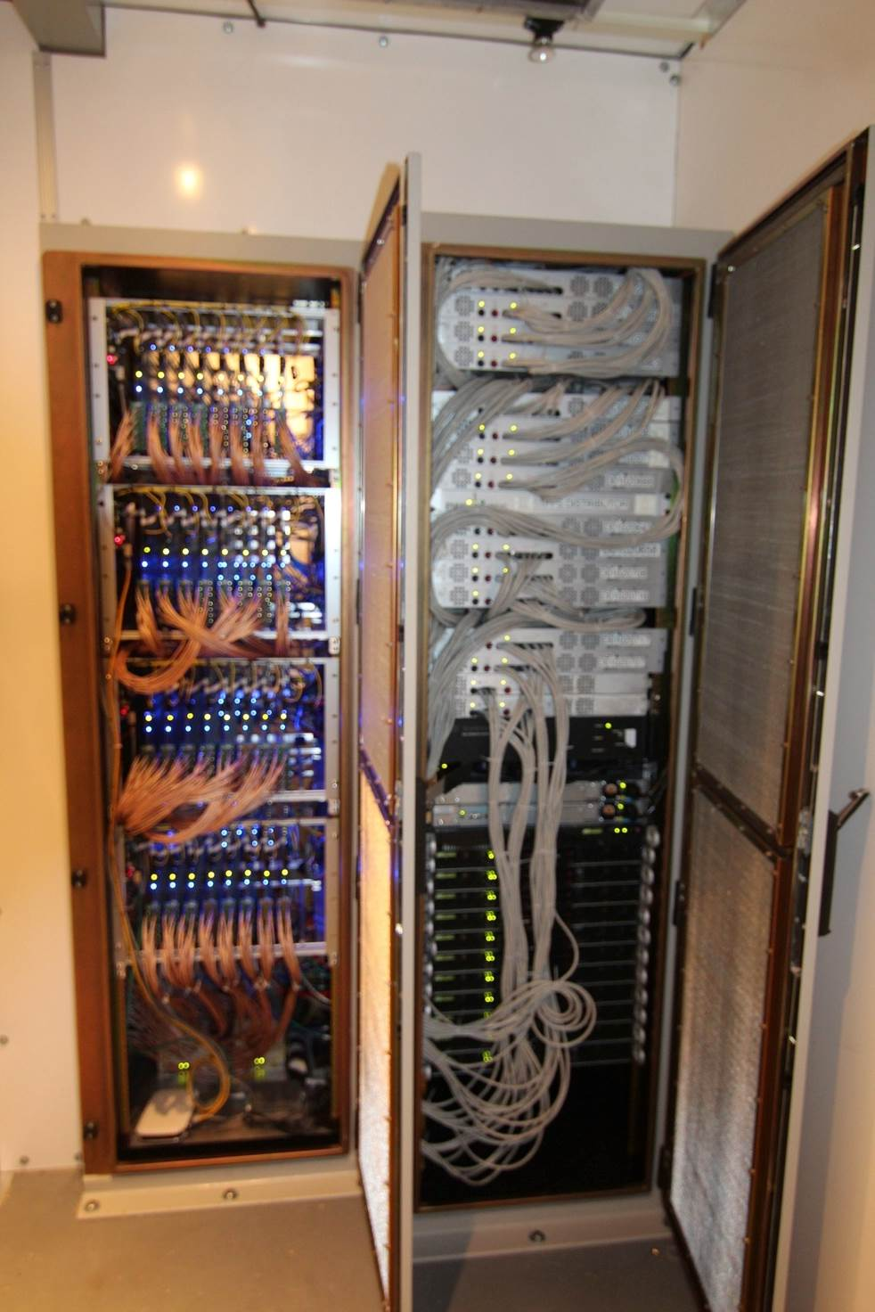
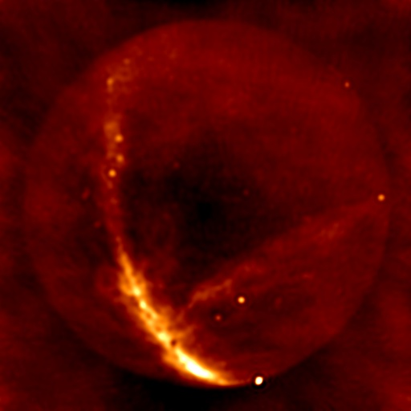
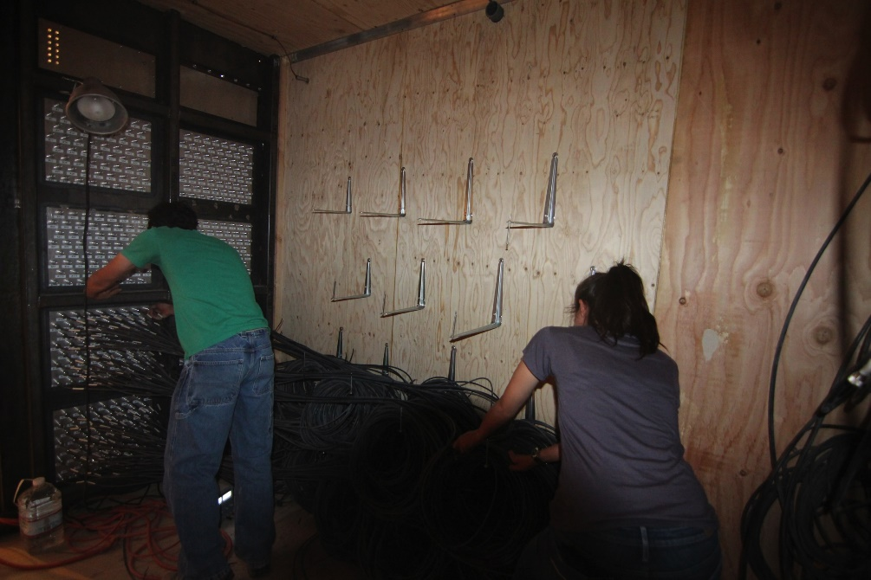
Stage I of the array was completed in 2014
256 crossed-dipoles
Spread out across 200-m diameter core
1
Image with the core

Slide 11
Stage II (and current status) of the array was completed in 2016
Added 32 additional dipoles
Increased maximum baseline out to ~1.5-km
256 crossed-dipoles
Spread out across 200-m diameter core
1
2

Slide 12
(The final) Stage III of the array will add an additional 64 antennas on long baselines, and vastly increase the capabilities of the existing OVRO-LWA.
Added 32 additional dipoles
Increased maximum baseline out to ~1.5-km
Final array of 352 antennas
New correlator for 704 inputs
256 crossed-dipoles
Spread out across 200-m diameter core
1
2
3

Slide 13
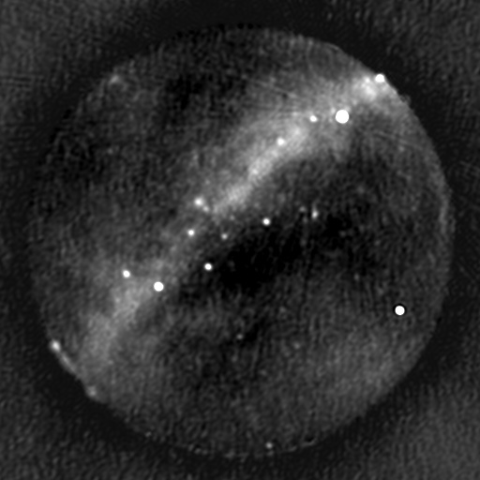

Slide 14
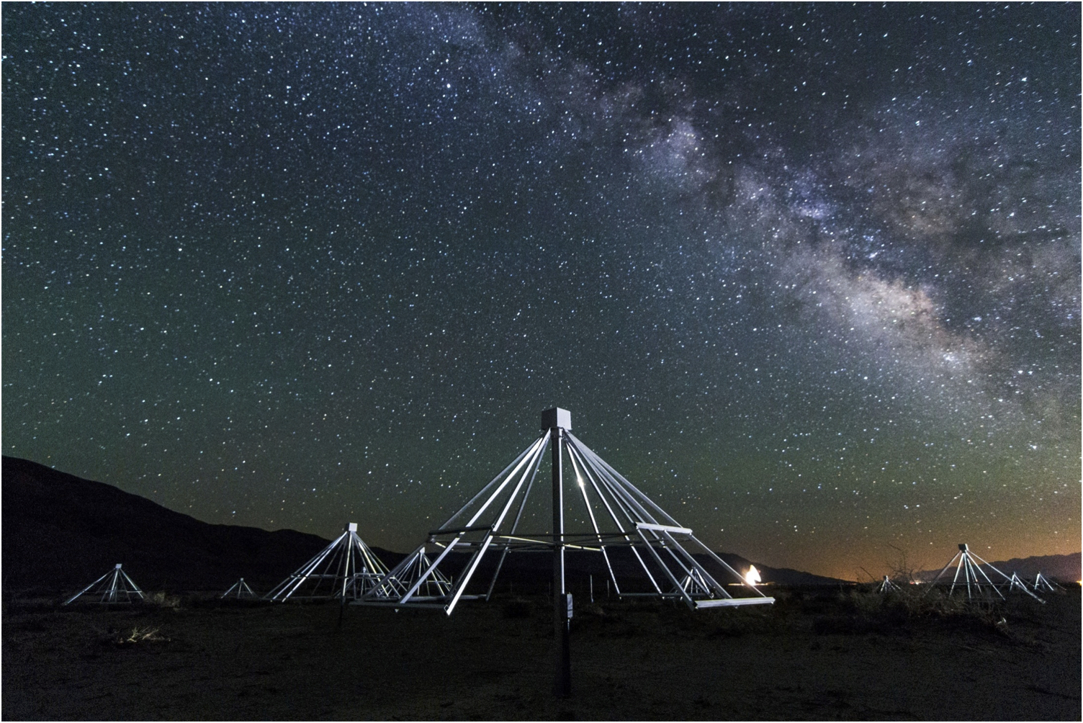
Current mode of operation with the Stage 2 OVRO-LWA
Continuously observing as of November 2016, in order to respond to external event triggers (including GW events from aLIGO, X-ray flares from Swift).
Initial 28-hour dataset monitoring 4000 objects out to 25 pc.
27-84 MHz with 24 kHz resolution
13-second integrations
Image credit: G. Hallinan
Notes:
Point of slide: Describe the current state of OVRO-LWA observations, and set the stage for 4000 object, continuous monitoring survey.

Slide 15
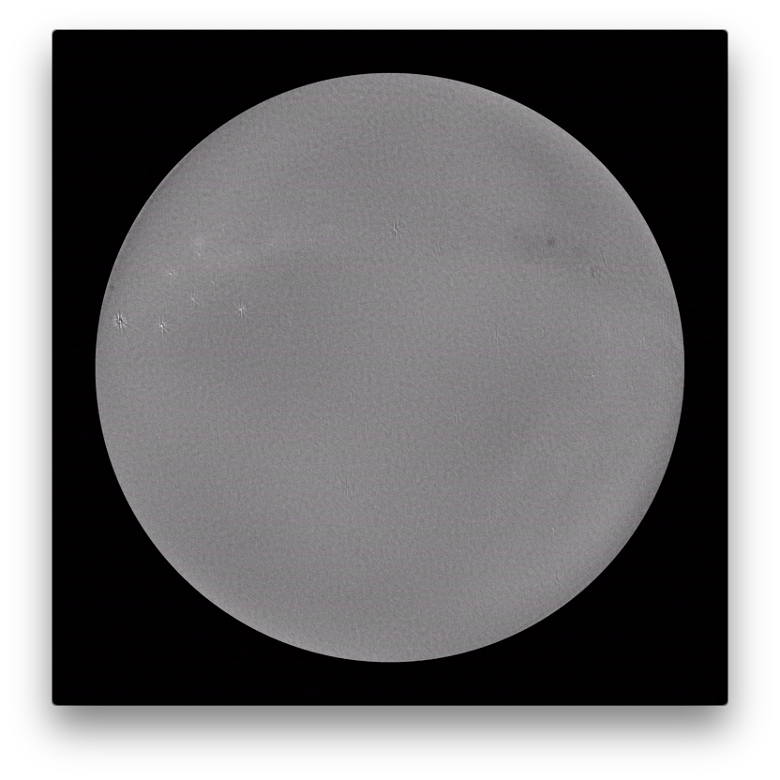
Notes:
Point of slide: Stokes V movie here

Slide 16
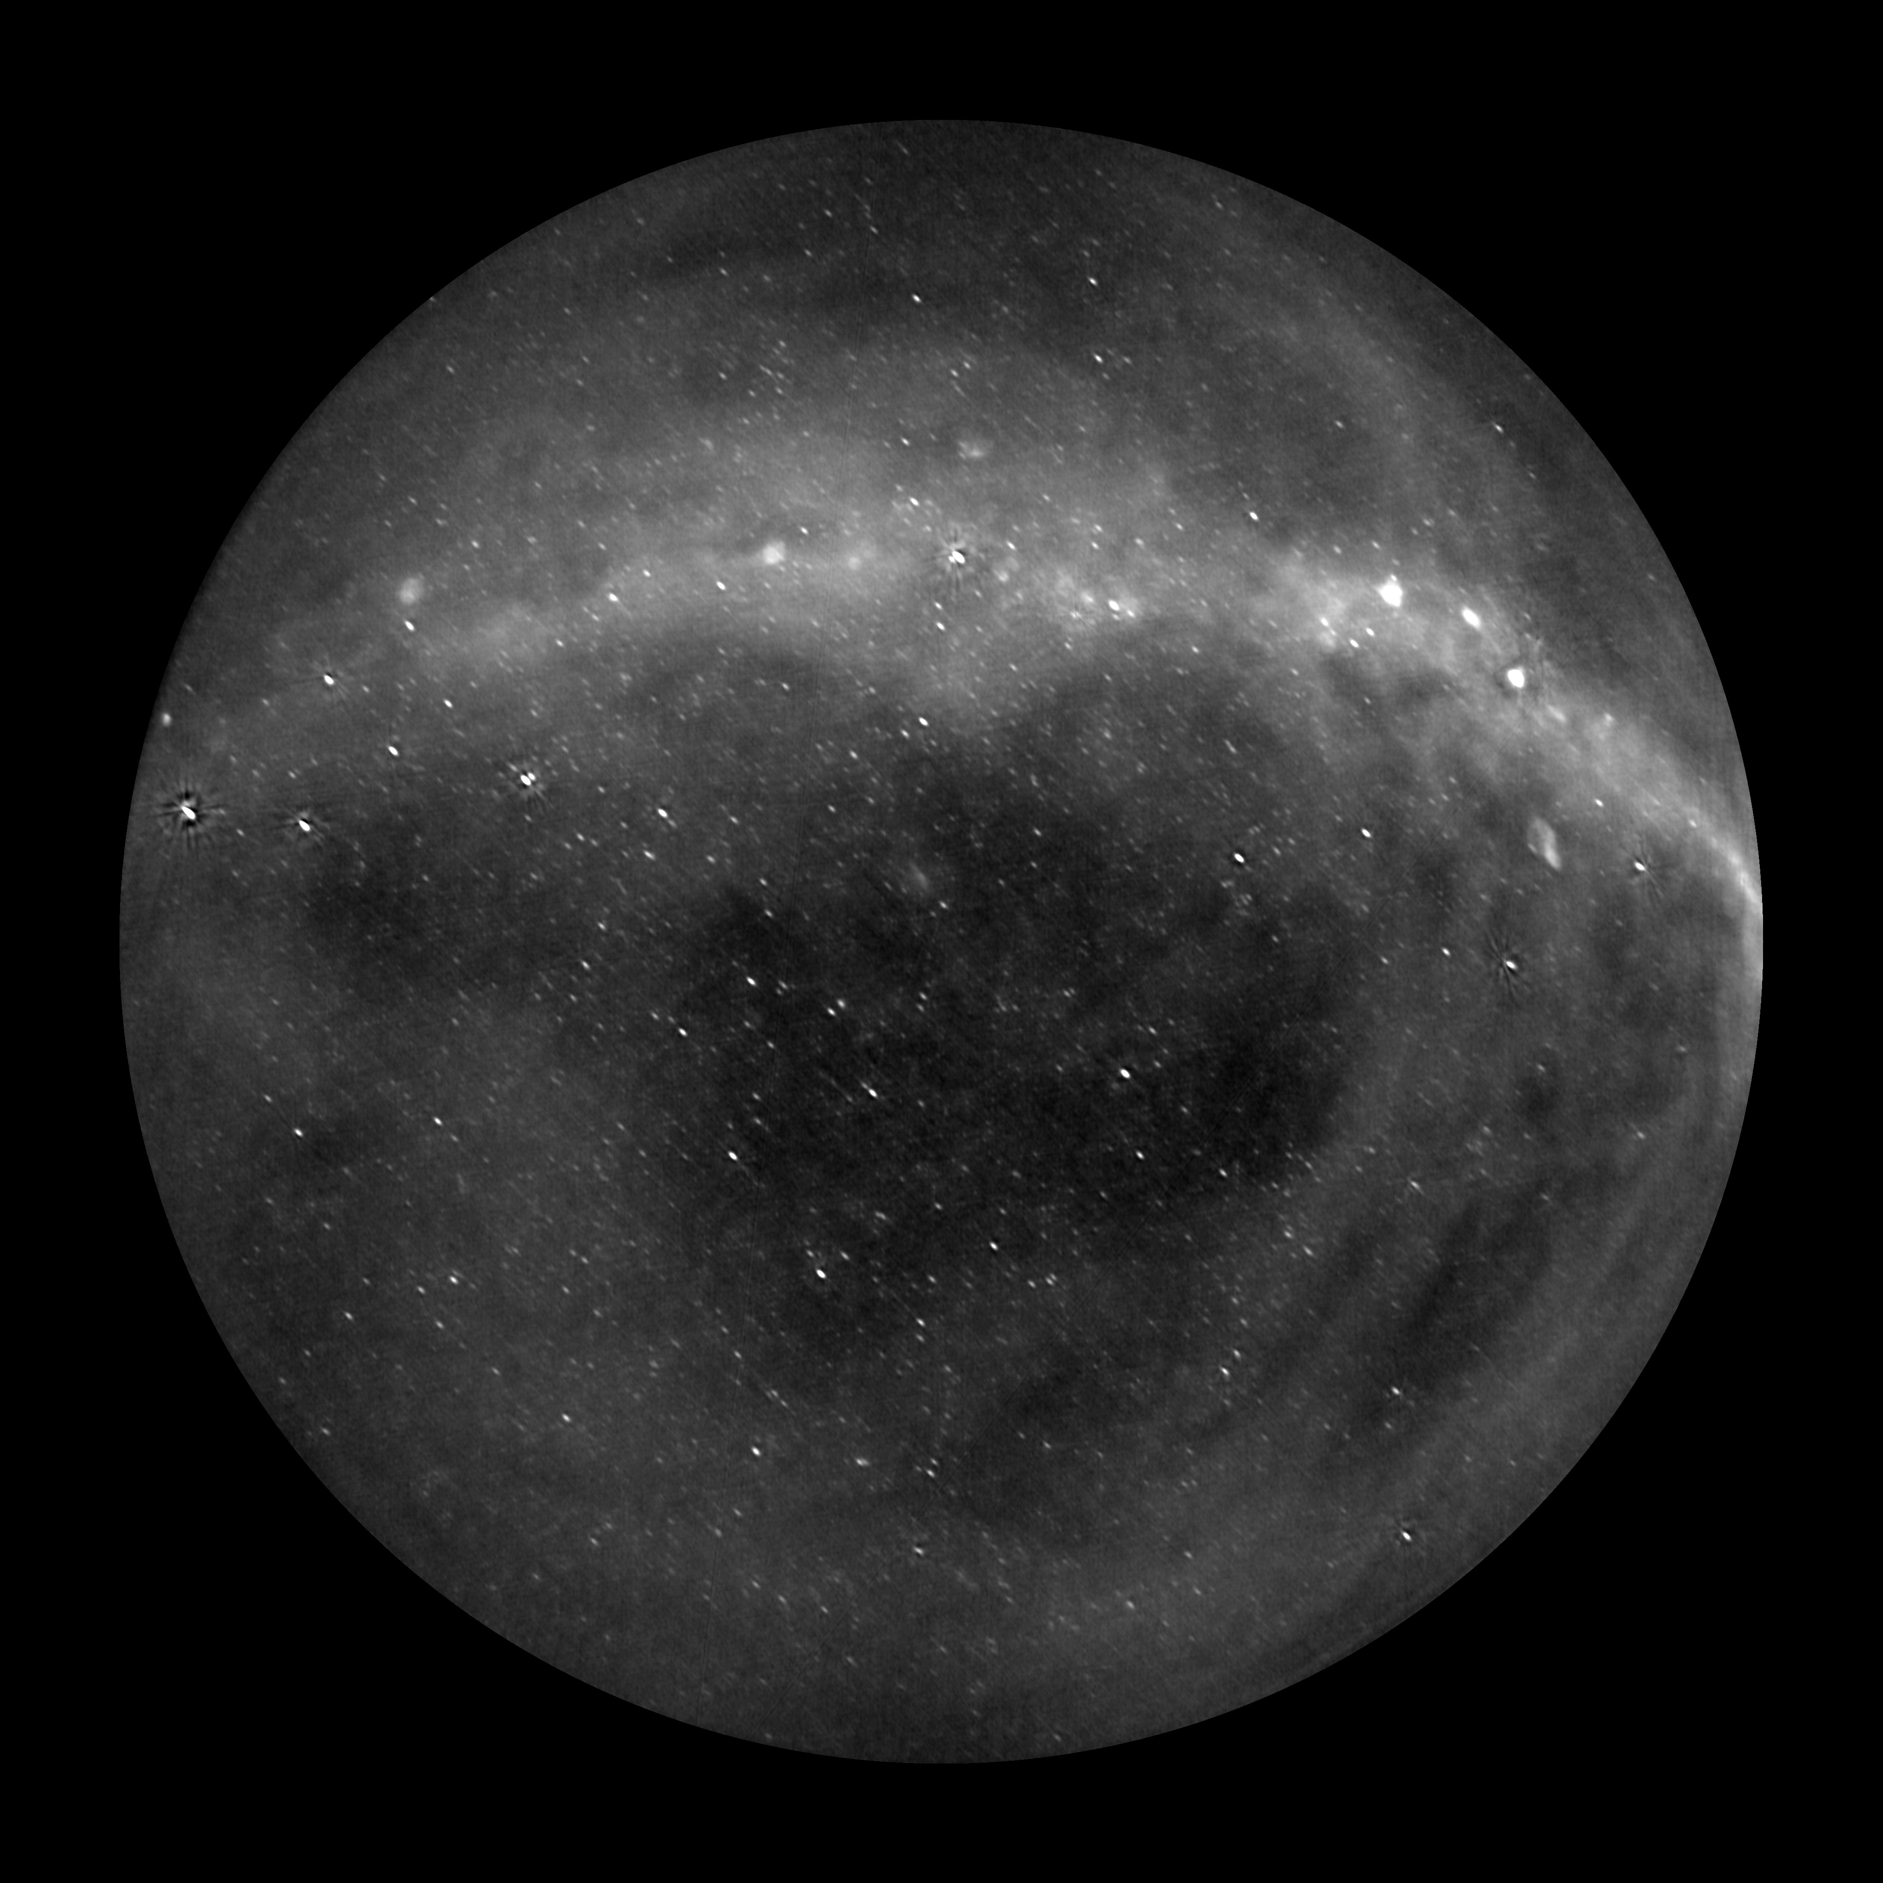
Notes:
Point of slide: Impact of LWA capabilities; describe movie, freq range + resolution, continuous obs + int time, N sources, sensitivity thermal + confusion, survey speed (? Contrast with e.g. LOFAR?)
Note: Add Stokes V movie

Slide 17
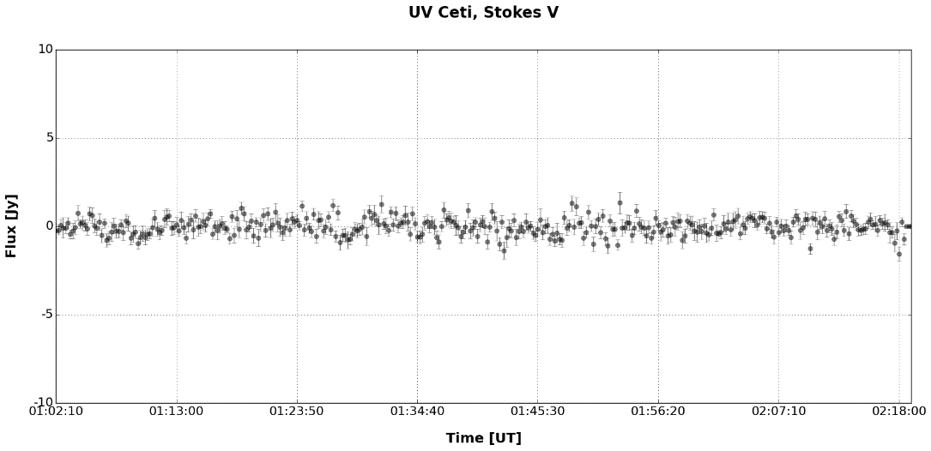
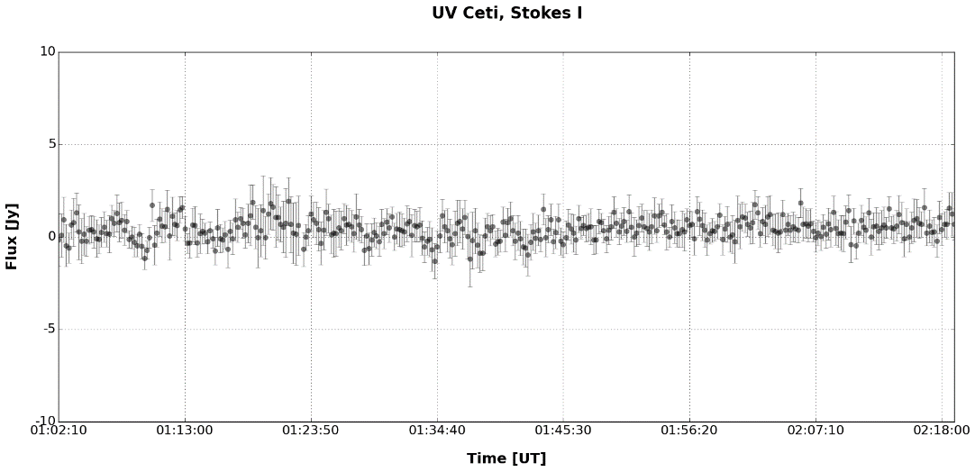
Initial results from a sample subset of flare stars.
Stokes V
~400 mJy
Stokes I
~330 mJy
Averaging down for 2 minutes in Stokes V - ~100 mJy.
Notes:
Point of slide: Show first-results and current sensitivity limits, using sample of known flare stars.

Slide 18
OVRO-LWA light curves for the usual flare star suspects.
5 Jy at 196 MHz
<100 MHz
500 mJy at 318 MHz
A Wolf 424-like flare would be >10 σ detection!
Spangler & Moffett 1976
Notes:
Point of slide: Demonstrate that the sensitivity achieved is sufficient to detect previous examples of low frequency flaring events.

Slide 19
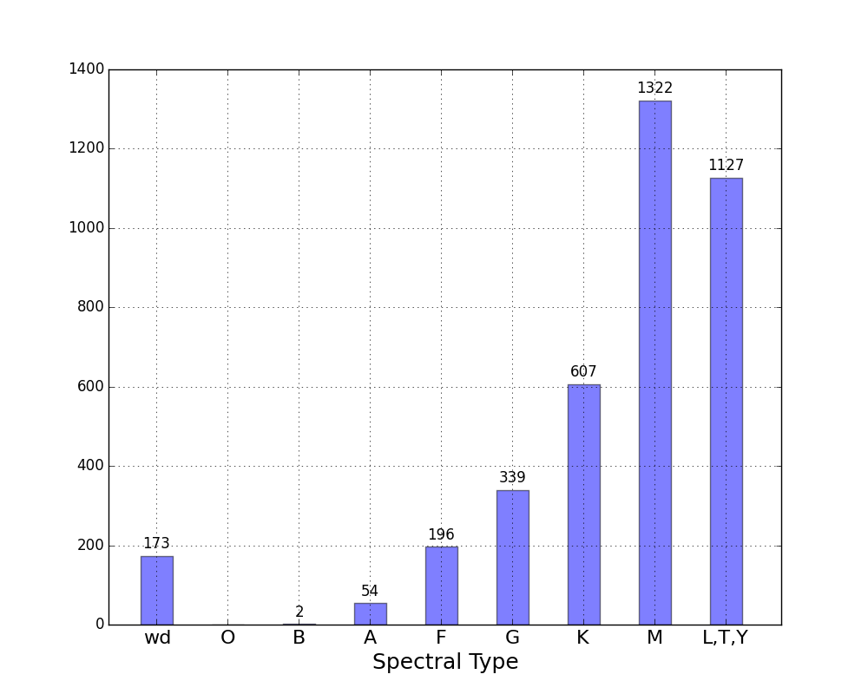
Searching for signatures of magnetic activity in a volume-limited sample of systems.
Simultaneous monitoring of nearly 4000 objects, out to 25 pc
Equivalent to 5 years of targeted observation
Notes:
Point of slide: Introduce the complete “nearly 4000 / 25 pc sample,” and intentional use of volume-limited sample (as opposed to targeted sample) to capture a range of host mass and age (e.g. point of first slide); and huge number of “equivalent hours” means we are sensitive to rare brightening events.

Slide 20
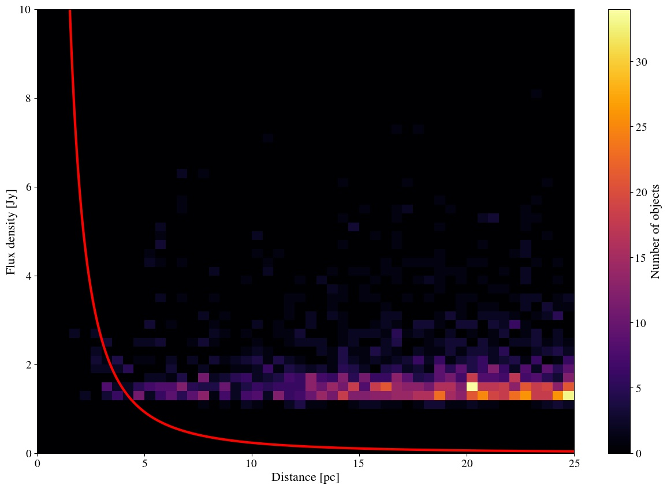
Sensitivities achieved for all objects in the 28-hour survey.

Slide 21
Scientific goals of the OVRO-LWA
Establish flare and CME rates across a wide range of mass and age.
Investigate the relationship between flare energy and CME kinetic energies for low mass stars.
Inform the community of extreme events.
Receive triggers for highest energy events (e.g. Swift super-flares).
Provide the most meaningful constraints (or detections) of radio exoplanets.
Notes:
Point of slide: The completed array, combined with simultaneous coverage by Evryscope North, will provide unprecedented sensitivity and multi-wavelength coverage of nearby stellar systems, enabling a more comprehensive study of flare frequency and energetics, and establishing a relationship between flare occurrence rates and energetics (in the optical) with transient mass loss rates (as probed by the radio observations) for a diverse range of systems (rather than relying on extrapolations from solar); as well as inform next-generation exoplanet searches and survey targets.

