Slide 1
Monitoring nearly 4000 nearby stellar systems with the OVRO-LWA in search of radio exoplanets
Marin M Anderson
Caltech

Slide 3
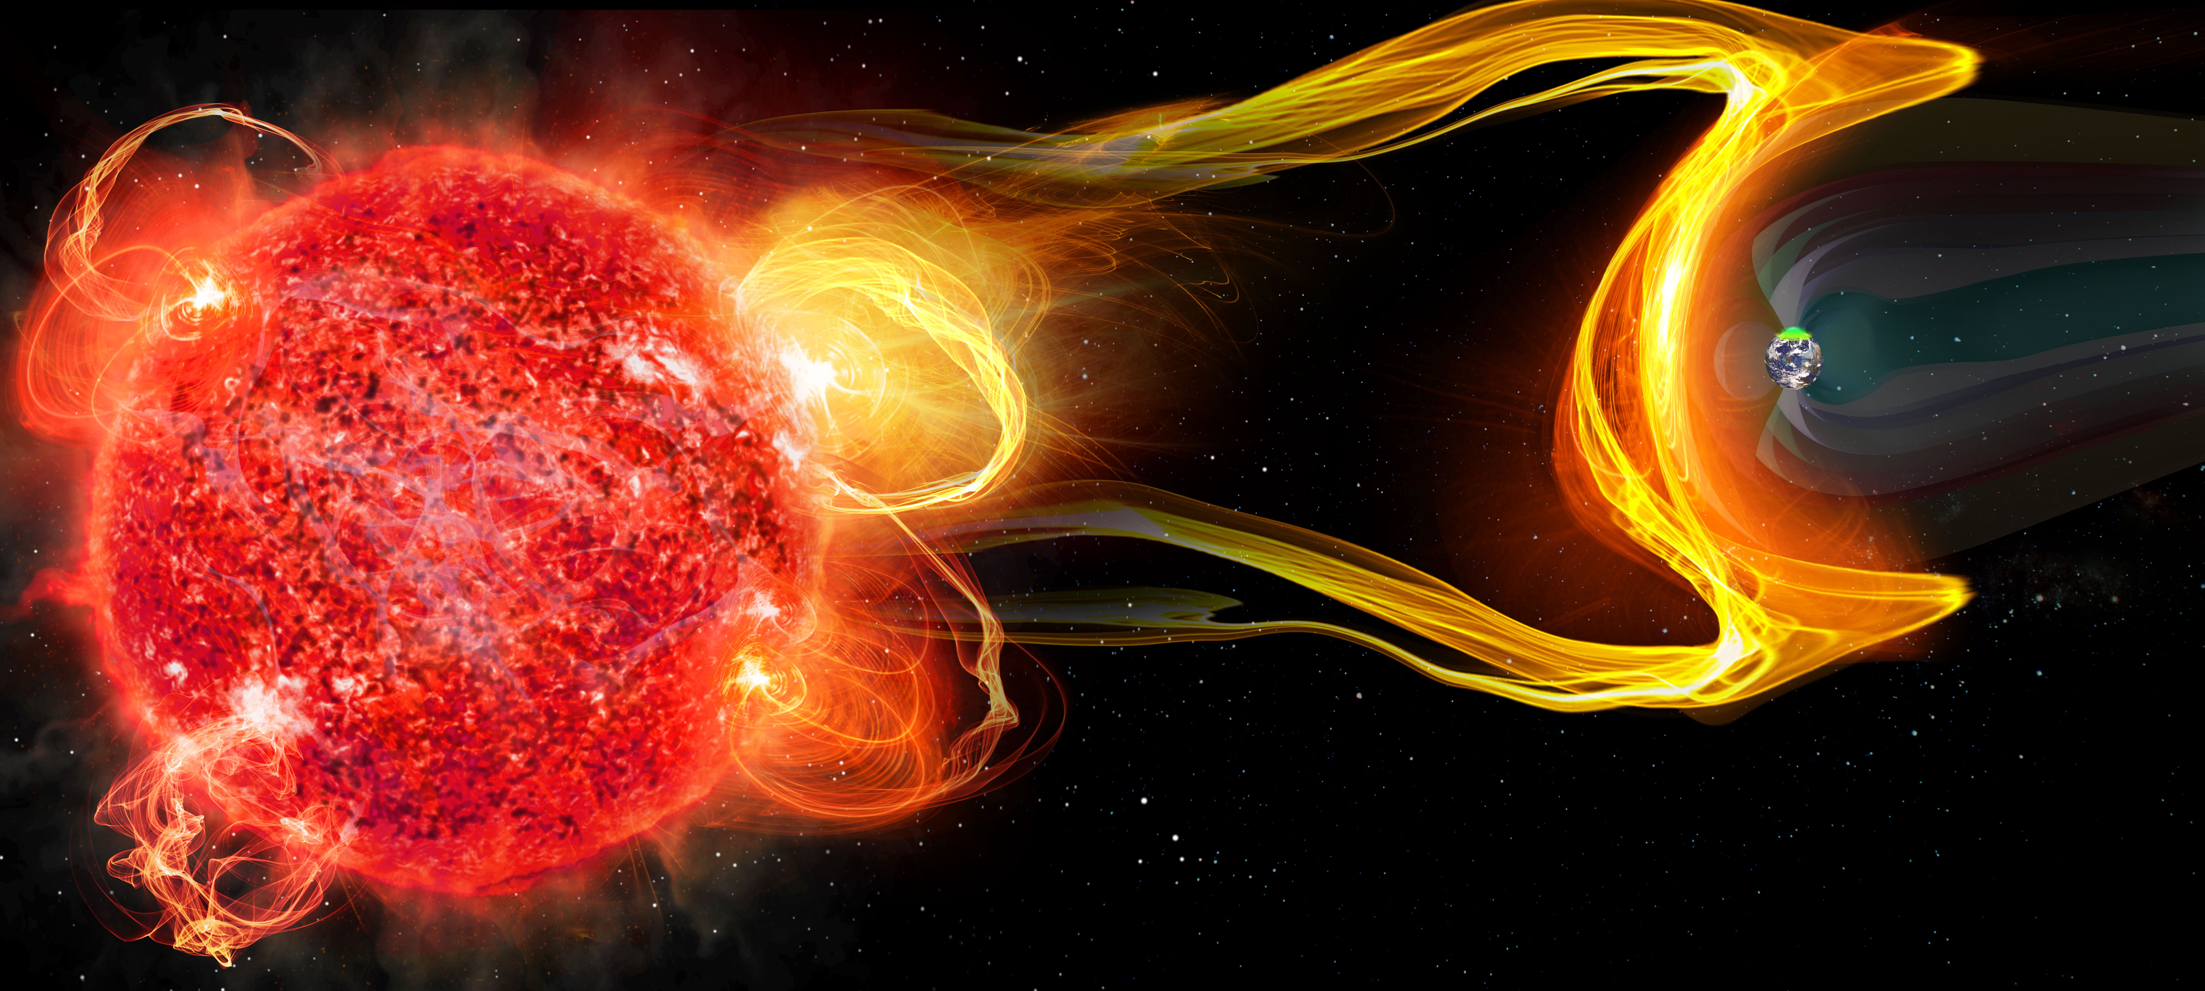
Understanding how CMEs scale with flare energy and frequency is critical to diagnosing habitable environments around magnetically active stars.
Relationship between CME mass and flare flux for the Sun
Relationship between CME mass and flare flux for the Sun
We need to characterize both planetary magnetic fields
and stellar transient mass loss.
CME Mass
CME Mass
Flare Flux
Aarnio et al. 2010
Flare Flux

Slide 4
Characterizing stellar magnetic activity, planetary magnetic fields, and their interaction for a wide range of host mass and age.
How can we optimize the search for extrasolar space weather, and begin detecting and characterizing systems en masse?
Low frequency ( < 100 MHz )
Large-FoV instruments
Capitalize on characteristics of emission mechanisms (Stokes V)
Image credit: C. Carter & G. Hallinan

Slide 5
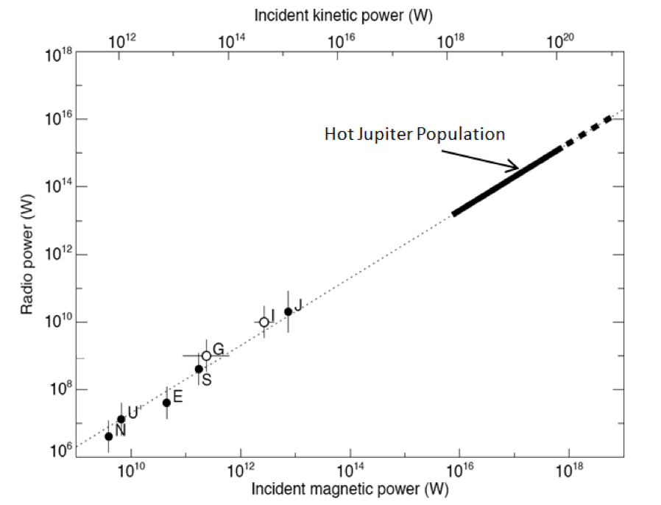
Low frequency ( < 100 MHz)
Incident kinetic power (W)
Hot Jupiter population
Radio power (W)
Flux Density from Earth (Jy)
Solar System bodies
Zarka 2001
Zarka 2007
Incident magnetic power (W)
4

Slide 6
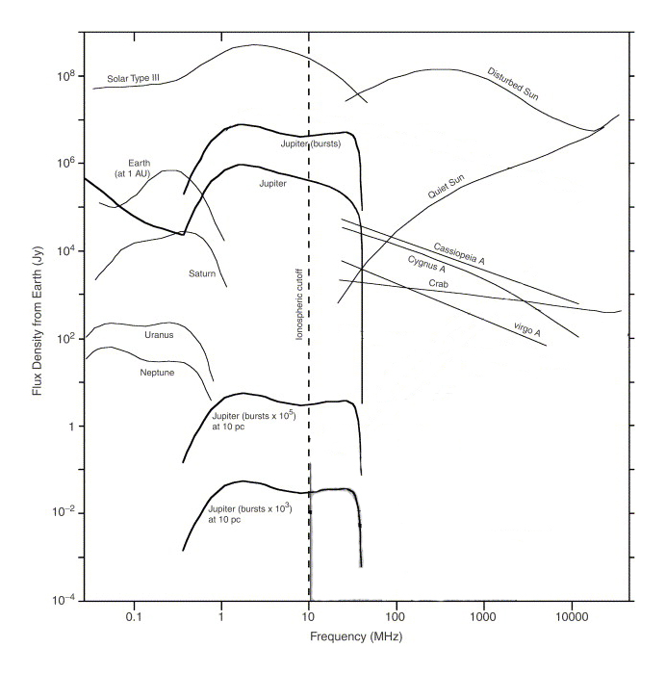
Low frequency ( < 100 MHz)
Extrapolation from our own SS suggests it is necessary to go below 100 MHz to directly detect exoplanetary radio emission.
Flux Density from Earth (Jy)
Zarka 2007
Frequency (MHz)

Slide 7
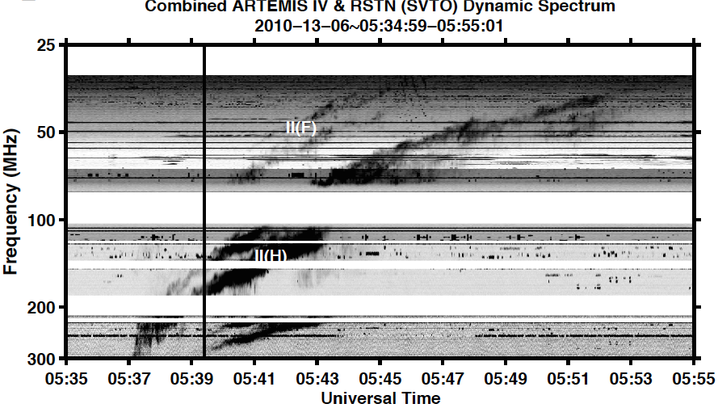
Low frequency ( < 100 MHz)
Extrapolation from our own SS suggests it is necessary to go below 100 MHz to directly detect exoplanetary radio emission.
Solar Type II radio bursts are associated with CMEs, and frequently occur in the sub-100 MHz regime.
300
200
harmonic
100
Frequency (MHz)
50
fundamental
25
Kouloumvakos et al. 2014
Figure c/o J. Villadsen
0
10
20
Time (minutes)

Slide 8
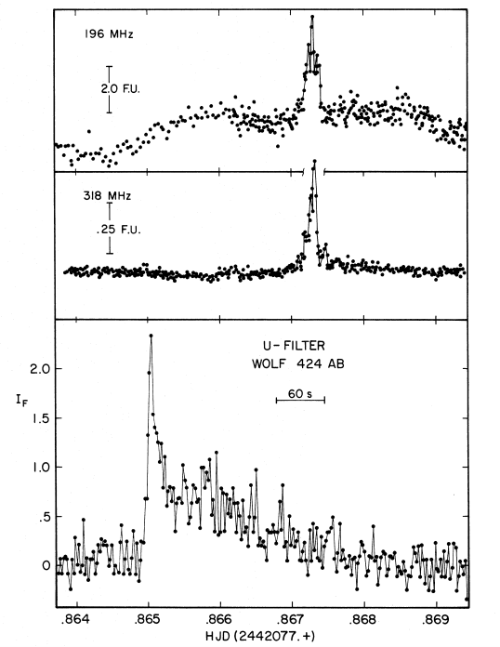
Low frequency ( < 100 MHz)
Extrapolation from our own SS suggests it is necessary to go below 100 MHz to directly detect exoplanetary radio emission.
Solar Type II radio bursts are frequently associated with CMEs, and peak in the sub-100 MHz regime.
Previous detections of flare star radio emission indicate flux increases at low frequencies.
300
5 Jy at 196 MHz
200
500 mJy at 318 MHz
harmonic
100
Frequency (MHz)
50
fundamental
25
0
10
20
Spangler & Moffett 1976
Time (minutes)

Slide 9
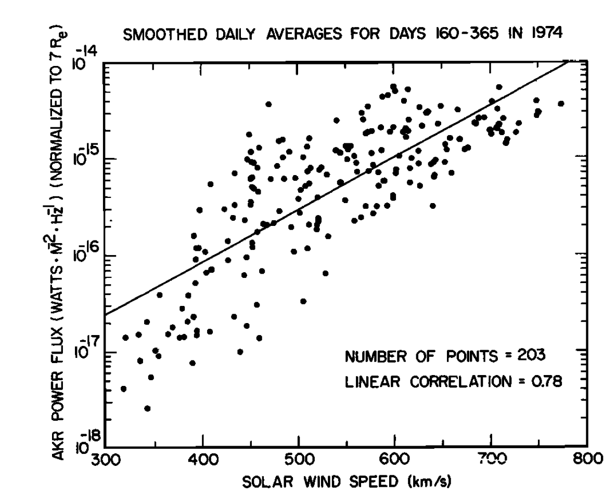
Large-FoV Instruments
Earth’s Auroral Emission
Capture a large fraction of sky in order to monitor a large sample of objects.
Sensitive to rare events associated with extreme flares / CMEs that may induce significant increase in exoplanetary radio power.
Flux Density from Earth (Jy)
Radio Power
1000x increase during Solar CME!
Solar wind speed [km/s]
Gallagher and D’Angelo 1981
Zarka 2007
Frequency (MHz)

Slide 10
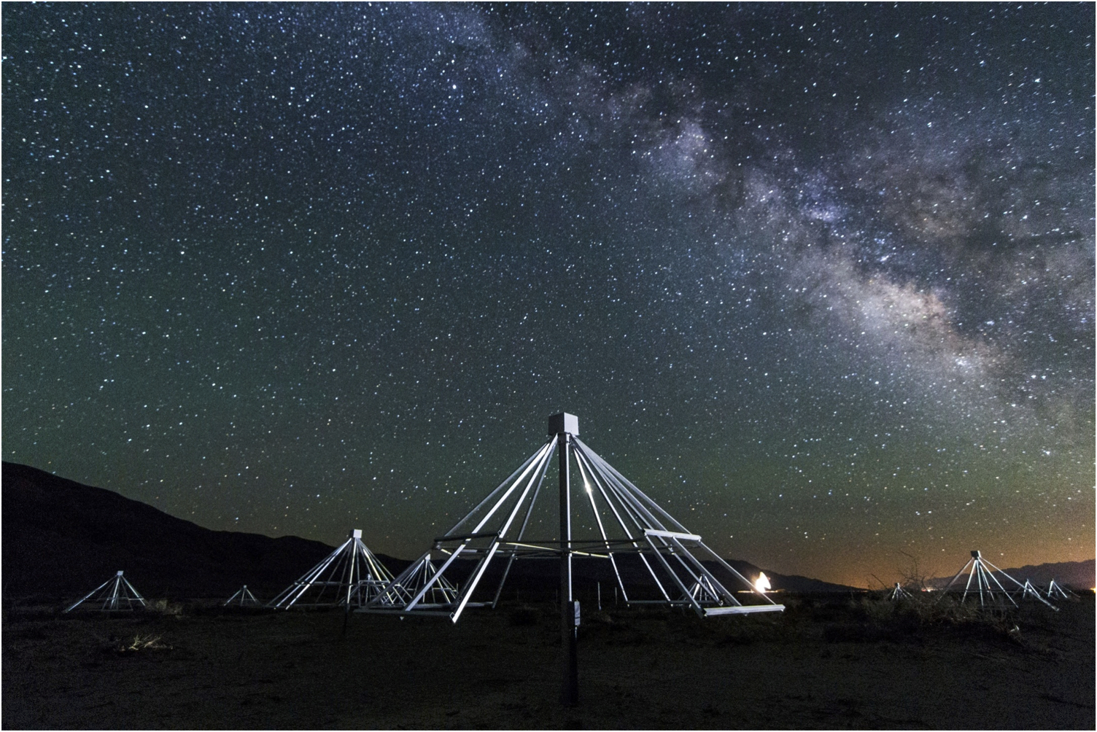
Current mode of operation with the Stage 2 OVRO-LWA
Continuously observing as of November 2016, in order to respond to external event triggers (including GW events from aLIGO, X-ray flares from Swift).
Initial 24-hour dataset monitoring 4000 objects out to 25 pc.
27-84 MHz with 24 kHz resolution
13-second integrations
Image credit: G. Hallinan

Slide 11
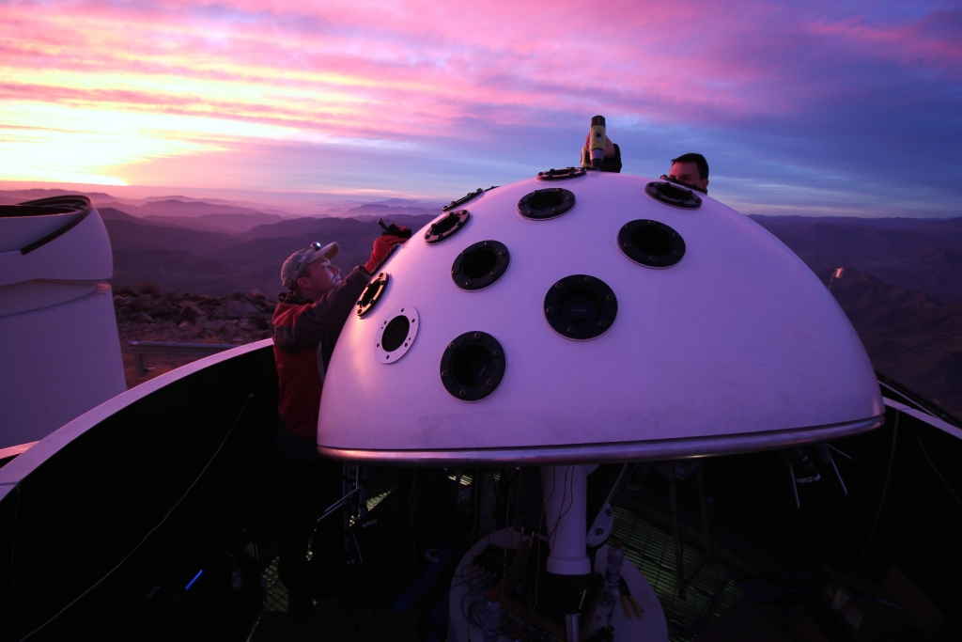
Simultaneous optical monitoring with Evryscope
Evryscope is an 8,600 sq. deg. FoV telescope at CTIO, that has 1.5 year-long coverage at 2 minute cadence for all stars g > 16.5.
45% FoV overlap between Evryscope and OVRO-LWA.
Simultaneous optical and radio monitoring…
Can begin to establish how flare frequency correlates with CME occurrence-rate for large range of spectral type and age.
Evryscope: Nick Law et al.
See Ward Howard’s Poster 202.05 – EvryFlare: Flare rates and intensities for every 10 < g' < 15 solar-type and red dwarf star in the Southern sky

Slide 12
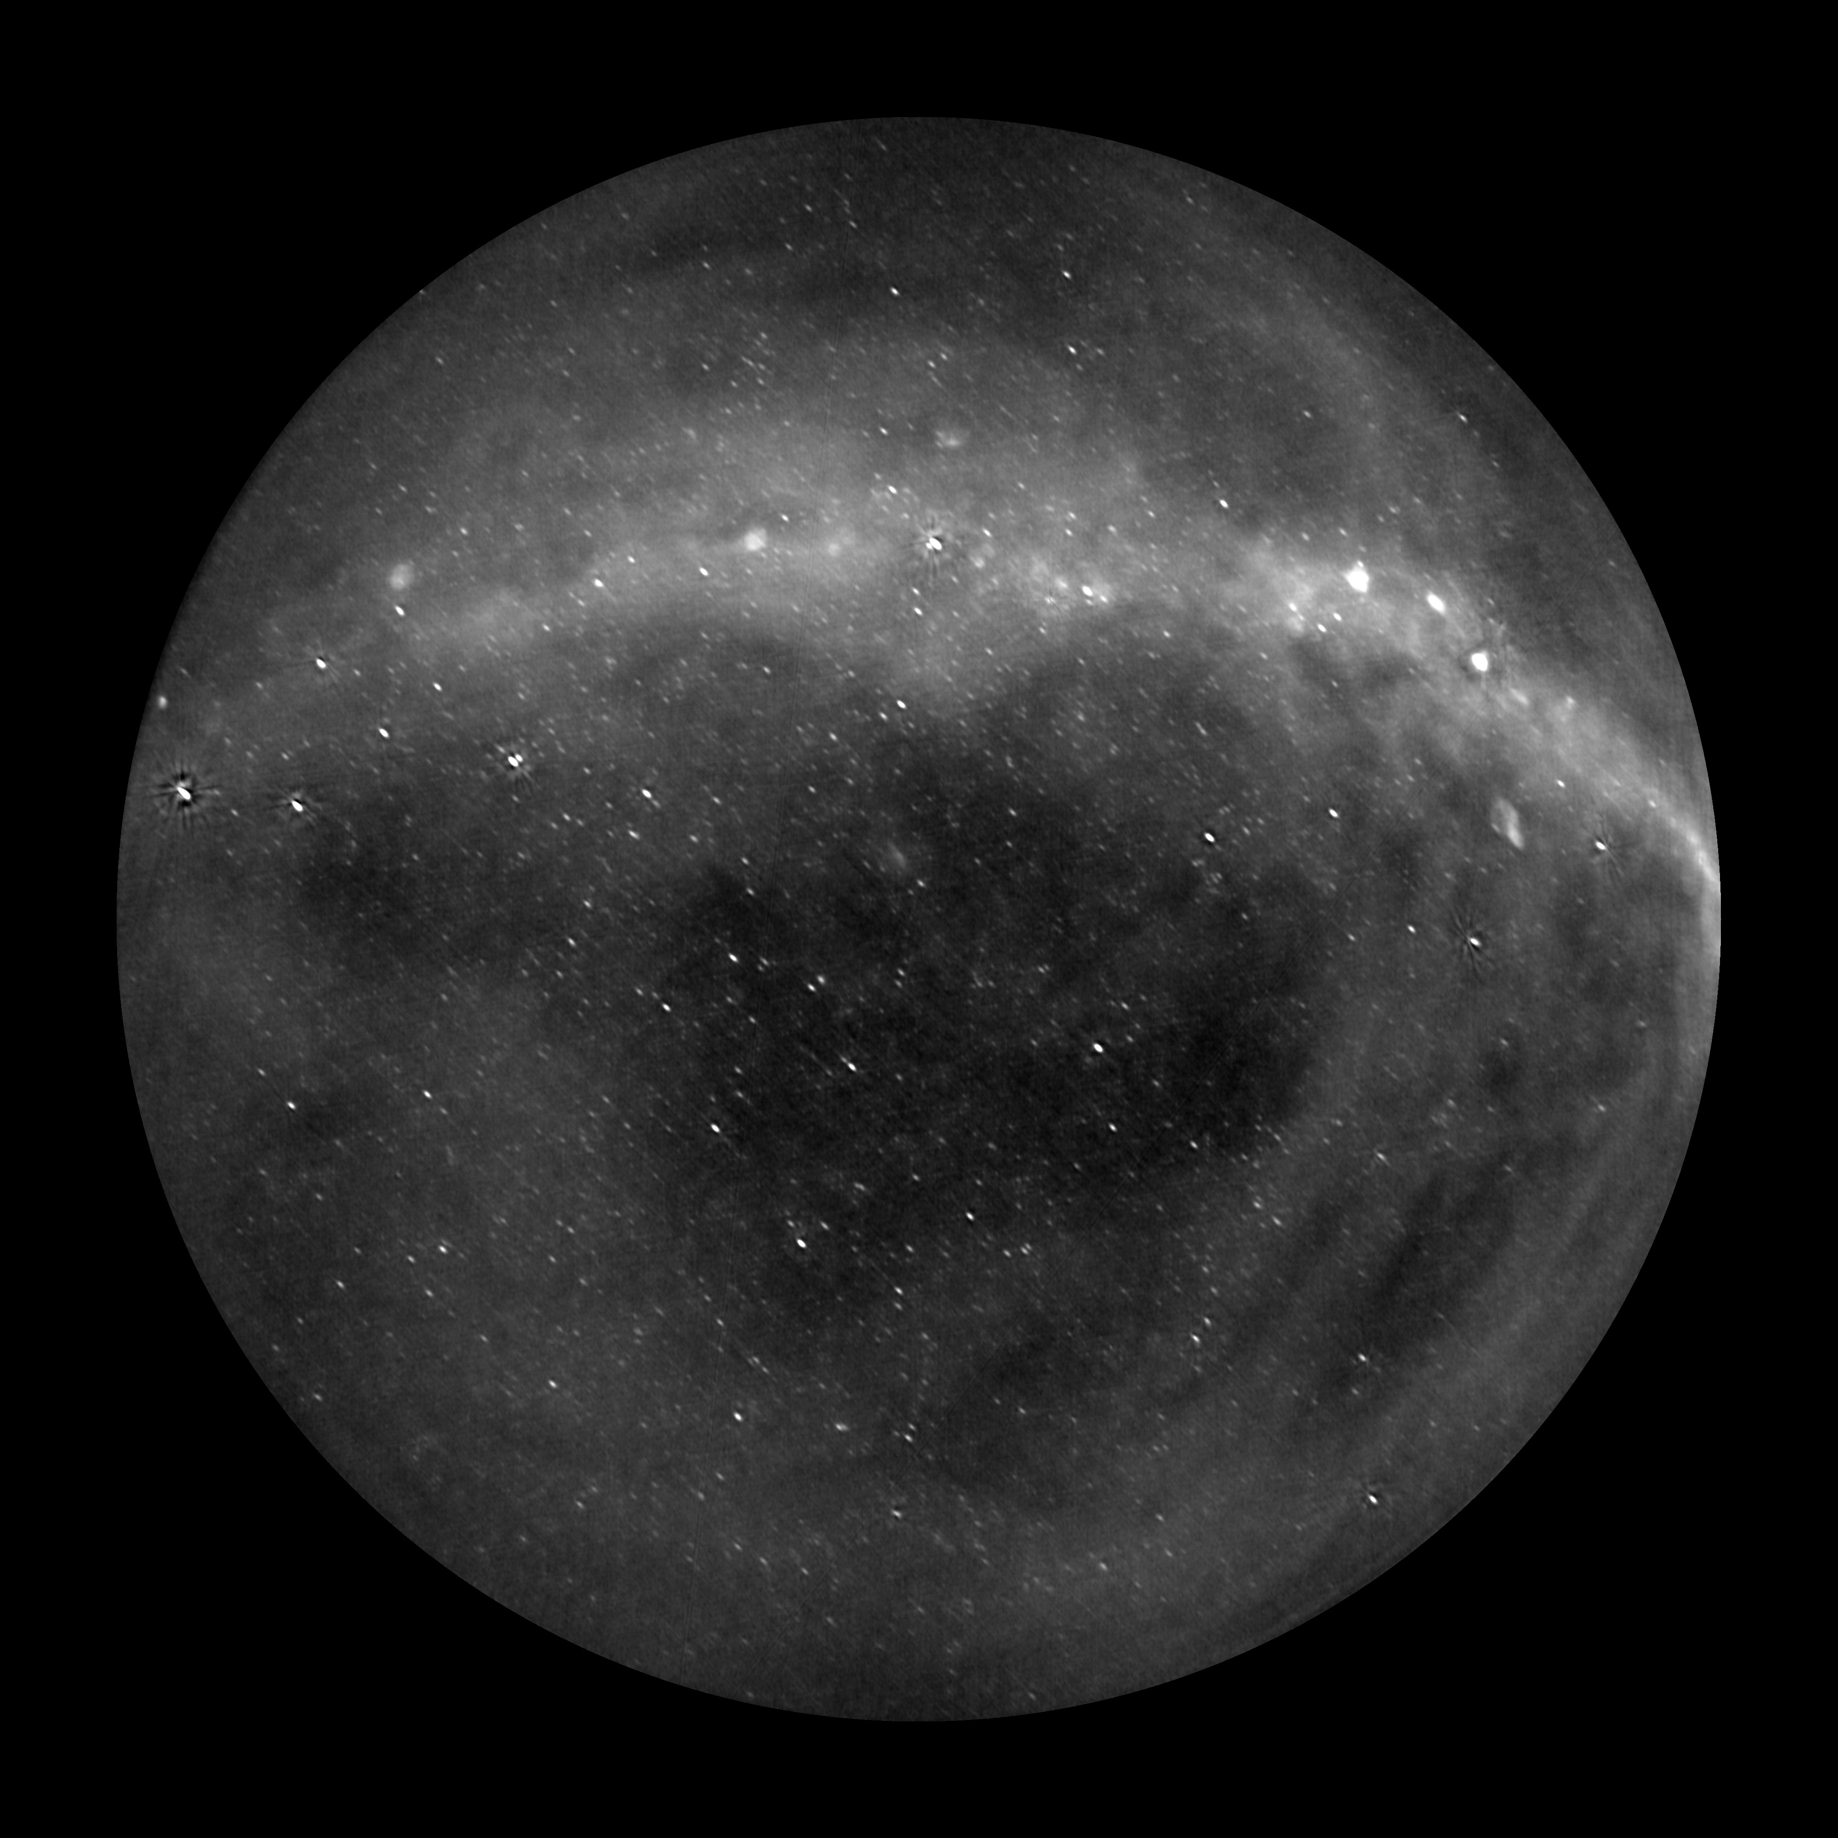

Slide 13
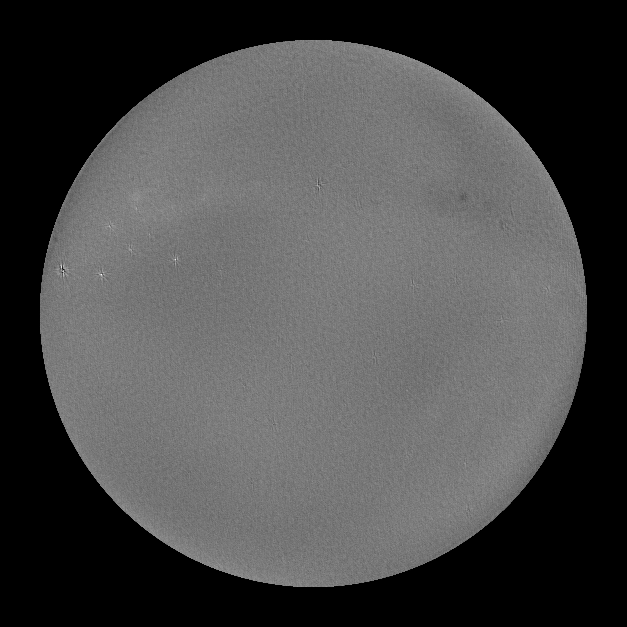

Slide 14
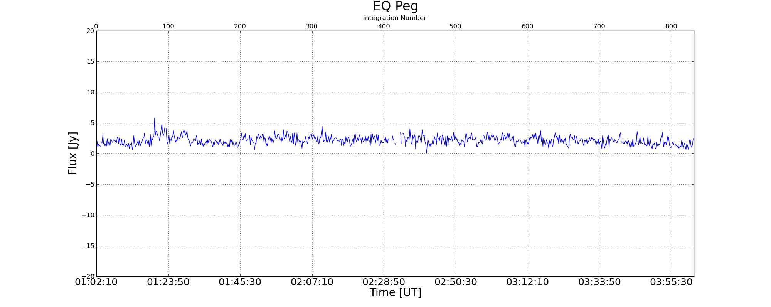
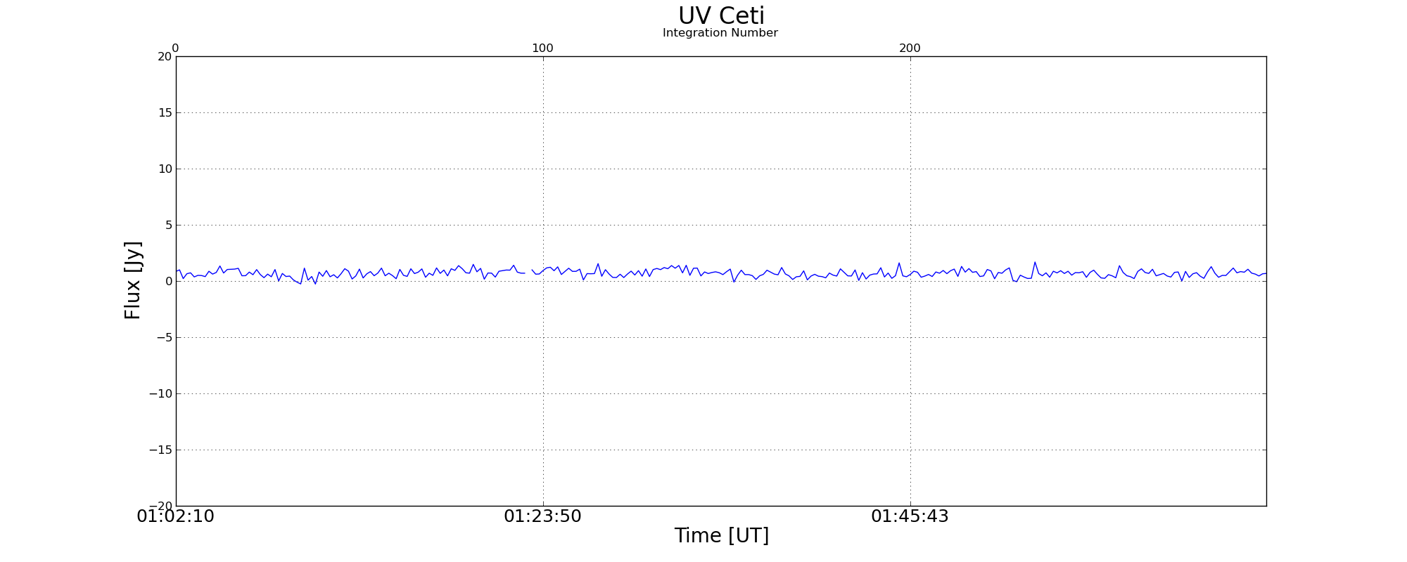
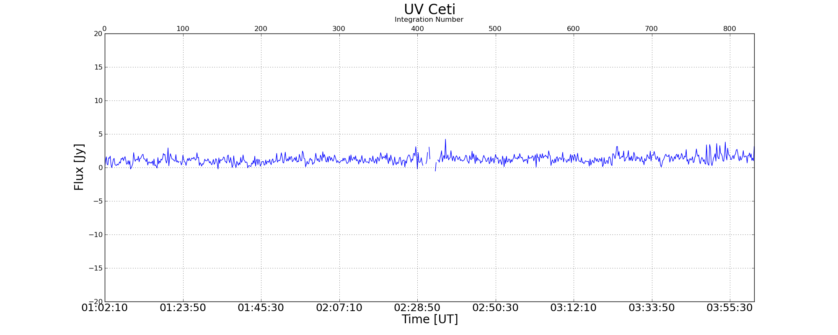
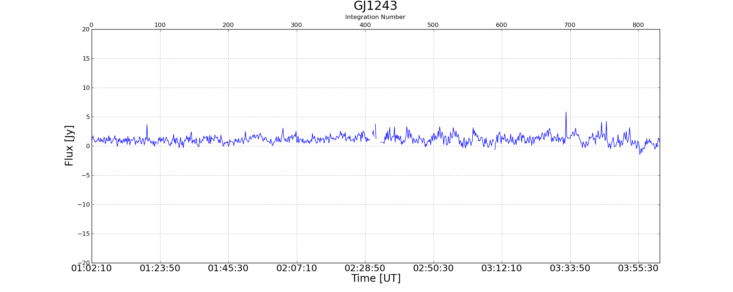
Initial results from a sample subset of flare stars.
Stokes V
~400 mJy
~330 mJy
Integrating down in Stokes V, we can get down to 100 mJy.

Slide 15
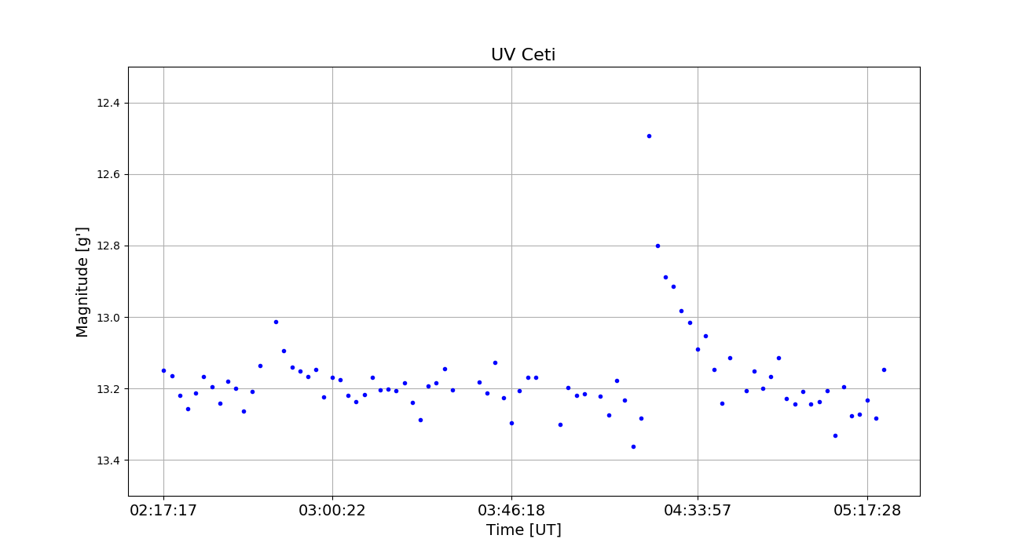
OVRO-LWA light curves for the usual flare star suspects.
5 Jy at 196 MHz
<100 MHz
500 mJy at 318 MHz
Optical Evryscope observations of UV Ceti
A Wolf 424-like flare would be >10 σ detection!
Spangler & Moffett 1976

Slide 16
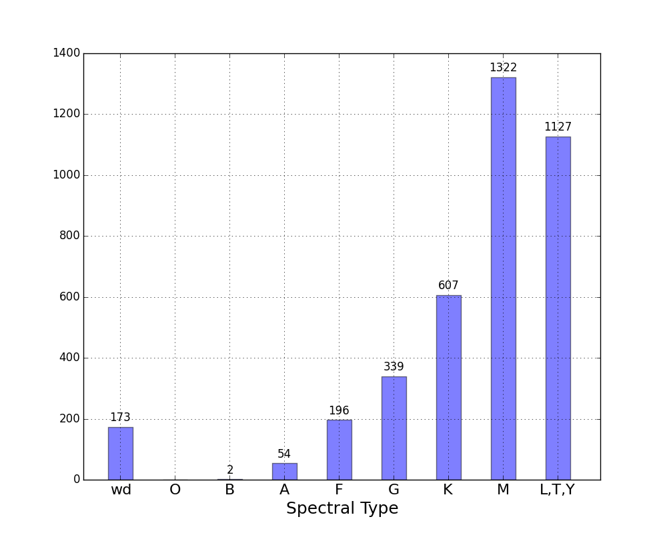
Searching for signatures of magnetic activity in a volume-limited sample of systems.
Simultaneous monitoring of nearly 4000 objects, out to 25 pc
Equivalent to >5000 hours of targeted observation
Increases to 5 years with the full 24-hour dataset

Slide 17
The completed stage-III OVRO-LWA, in coordination with Evryscope-North…
…will provide unprecedented statistics on flare and CME activity
…with nearly 100% overlap in sky coverage
Planned 1000-hour survey
with few-seconds cadence and ~100 mJy snapshot sensitivity with OVRO-LWA
and 2-minute cadence for every star down to 16.5 mag with Evryscope-N
Evryscope: Nick Law et al.

Slide 18
Scientific goals of the OVRO-LWA
Establish flare and CME rates across a wide range of mass and age.
Investigate the relationship between flare energy and CME kinetic energies for low mass stars.
Inform the community of extreme events.
Receive triggers for highest energy events (e.g. Swift super-flares)
Provide the most meaningful constraints (or detections) of radio exoplanets!

