Slide 1
with the OVRO-LWA
- EM-GW
- Extrasolar Space Weather
- Transients
VERY PRELIMINARY
Marin M. Anderson

Slide 2
OUTLINE
EM-GW
Follow-up of compact object mergers for prompt radio emission
Transient science with OVRO-LWA
Extrasolar Space Weather
Stellar and exoplanetary radio bursts, in Stokes I and V
Transient Surveys
Serendipitous transient surveys
Current limitations
What is limiting each science case in the current array, and science requirements for Stage III

Slide 3
A number of models predict a (highly speculative) counterpart to SGRBs and NS-NS mergers in the form of prompt, low frequency radio emission.
pre-merger
post-merger
GRB-phase
~few Jy, ms-duration, seconds before GW emission
e.g. Hansen & Lyutikov 2001

Slide 4
A number of models predict a (highly speculative) counterpart to GRBs and NS-NS mergers in the form of prompt, low frequency radio emission.
pre-merger
post-merger
GRB-phase
~Jy, 10-100 ms-duration, milliseconds before GRB
e.g. Hansen & Lyutikov 2001
e.g. Pshirkov & Postnov 2010

Slide 5
A number of models predict a (highly speculative) counterpart to GRBs and NS-NS mergers in the form of prompt, low frequency radio emission.
pre-merger
post-merger
GRB-phase
~100 Jy, coincident with and same duration as GRB
e.g. Hansen & Lyutikov 2001
e.g. Pshirkov & Postnov 2010
e.g. Usov & Katz 2000

Slide 6
A number of models predict a (highly speculative) counterpart to GRBs and NS-NS mergers in the form of prompt, low frequency radio emission.
pre-merger
post-merger
GRB-phase
All models predicting coherent, low frequency pulse require…
…for detection.
Jy-level sensitivity
at sub-100 MHz frequencies
Rapid response times
~100 Jy, coincident with and same duration as GRB
e.g. Hansen & Lyutikov 2001
e.g. Pshirkov & Postnov 2010
e.g. Usov & Katz 2000

Slide 7
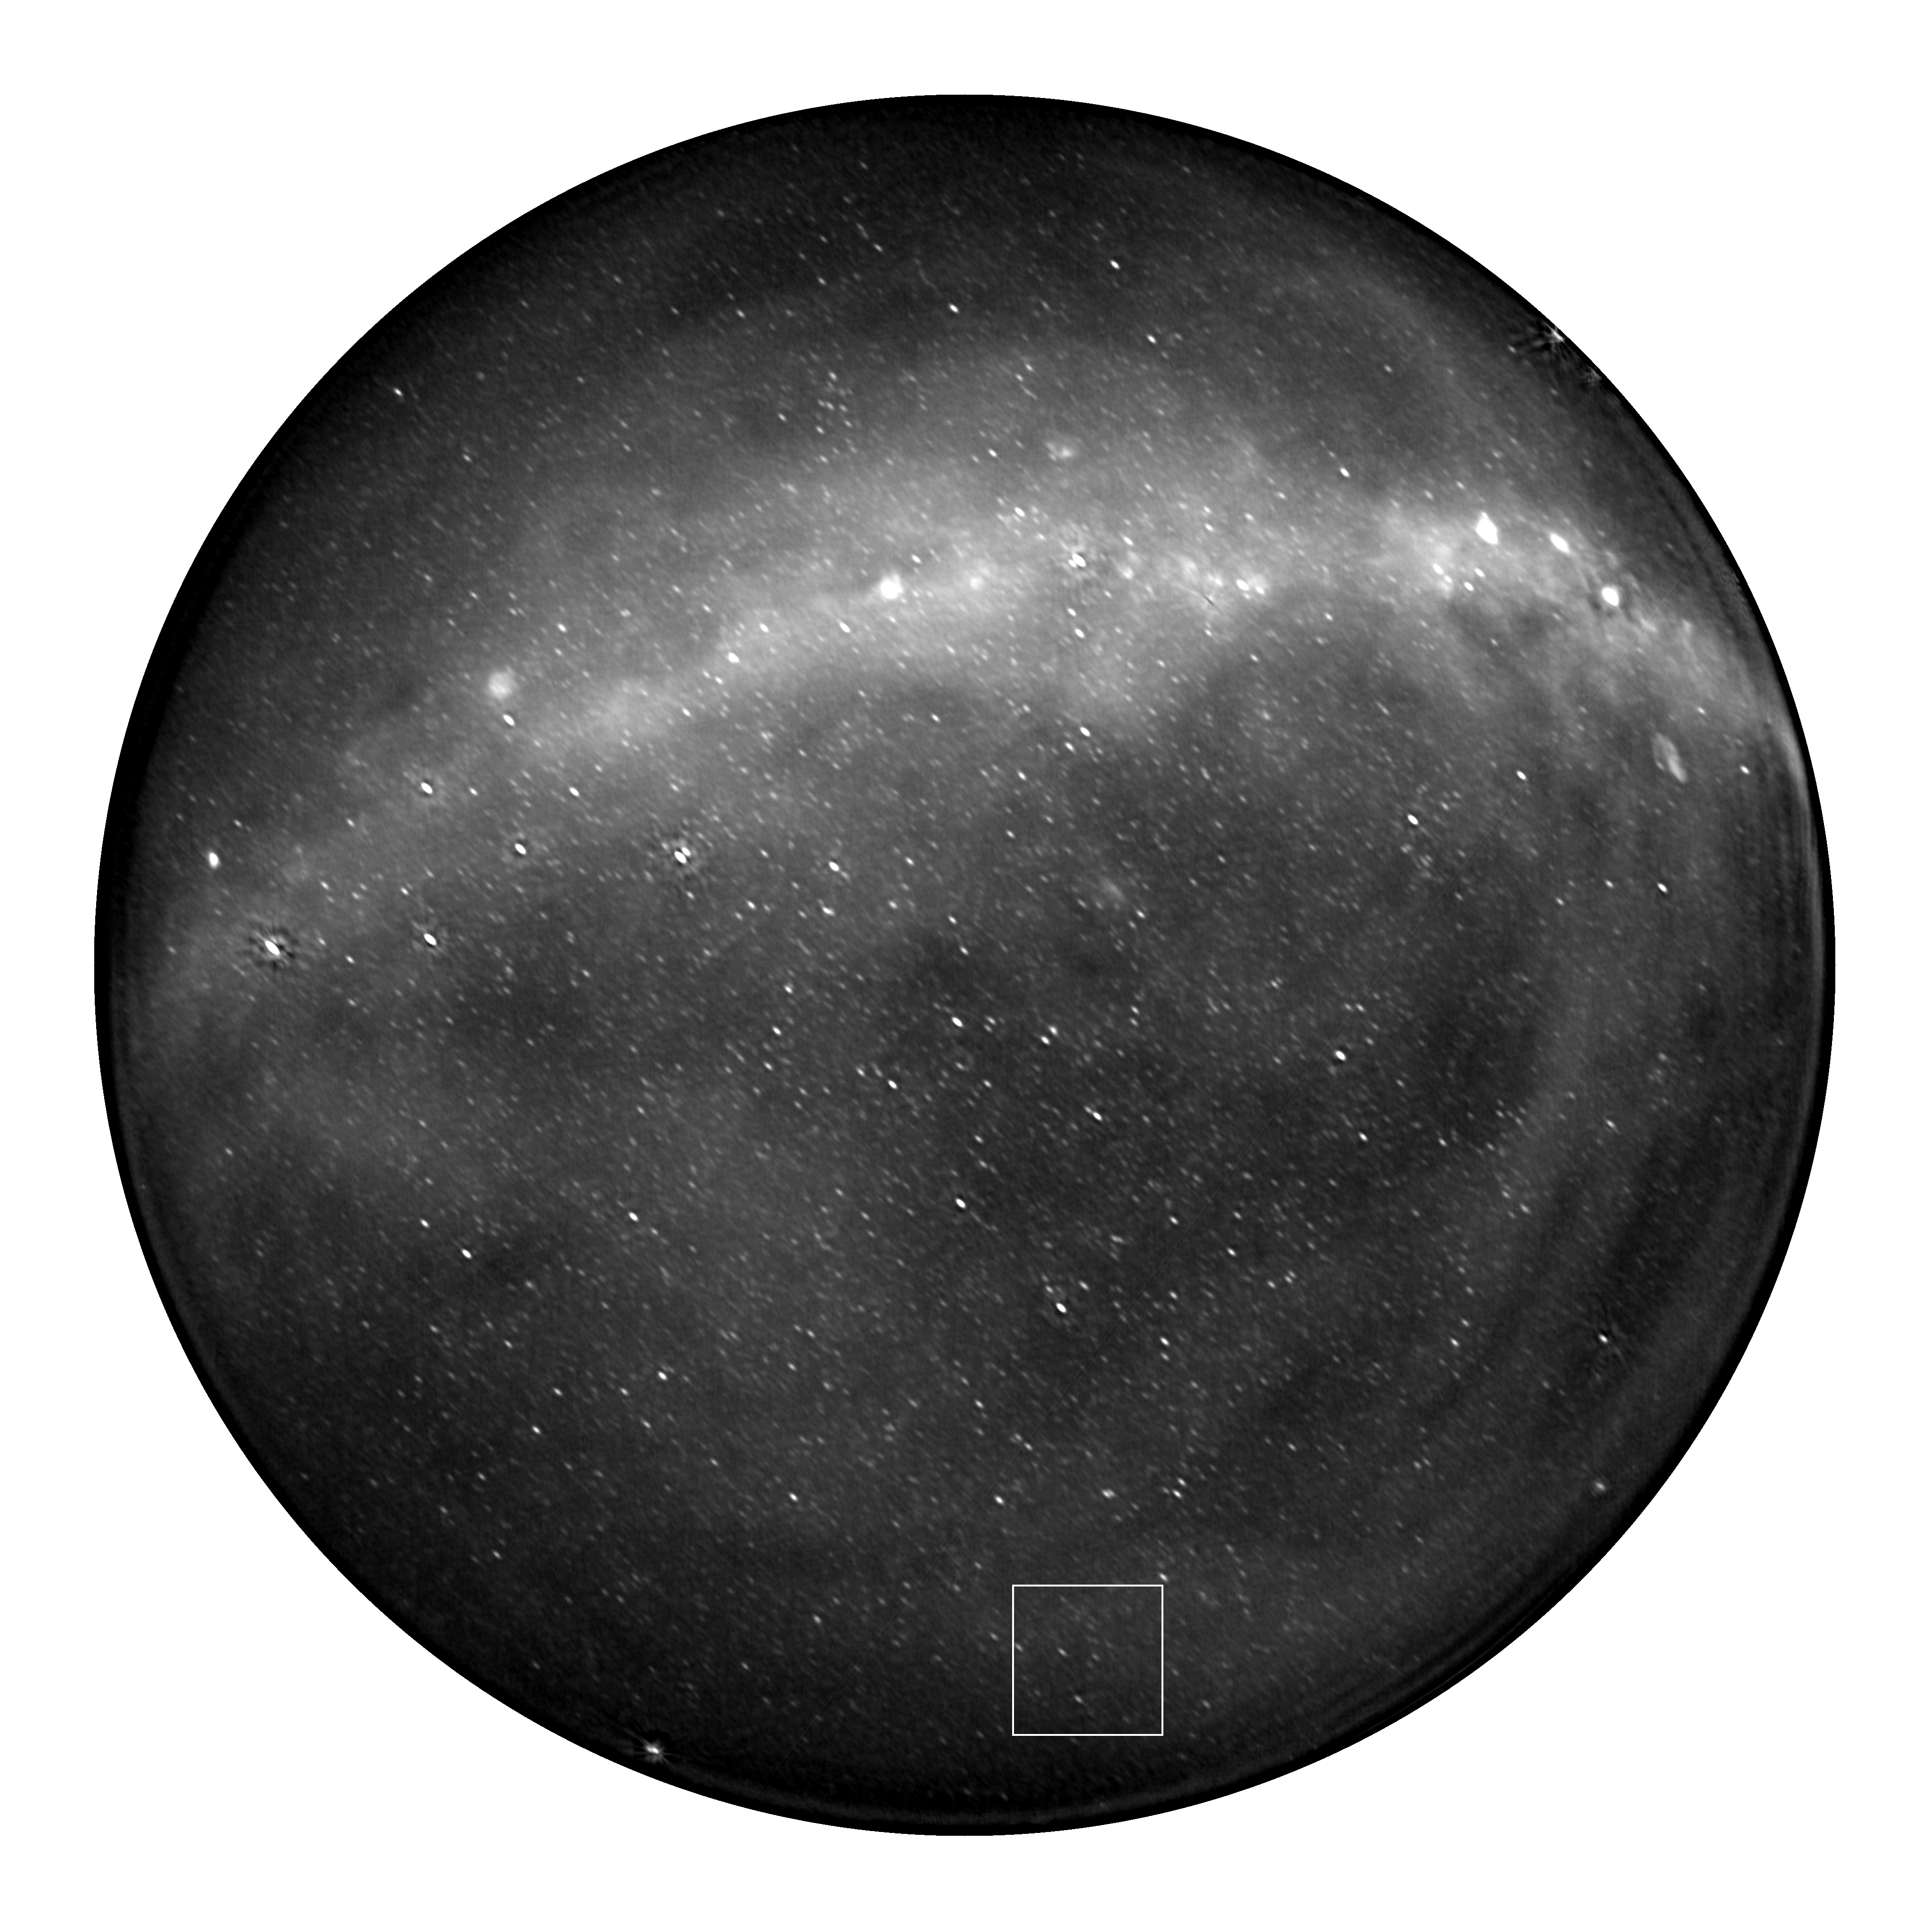
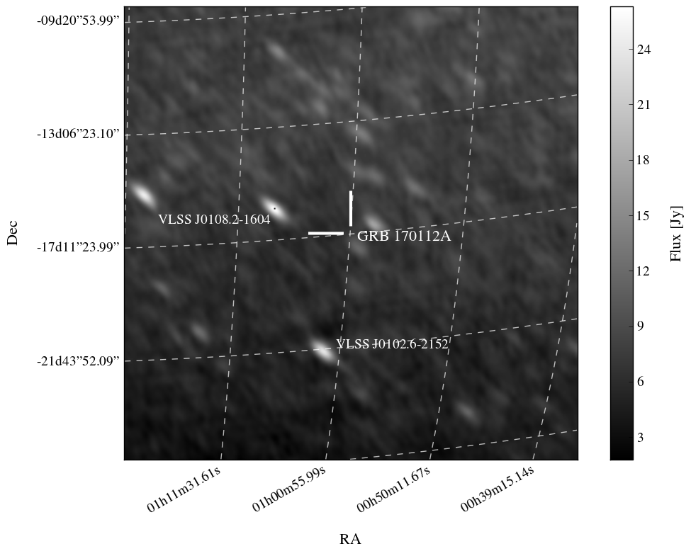
Deepest search for prompt, coherent emission associated with a short GRB.
Anderson et al. 2018

Slide 8
First prompt radio emission counterpart search from GW trigger.
Callister et al. 2019

Slide 9
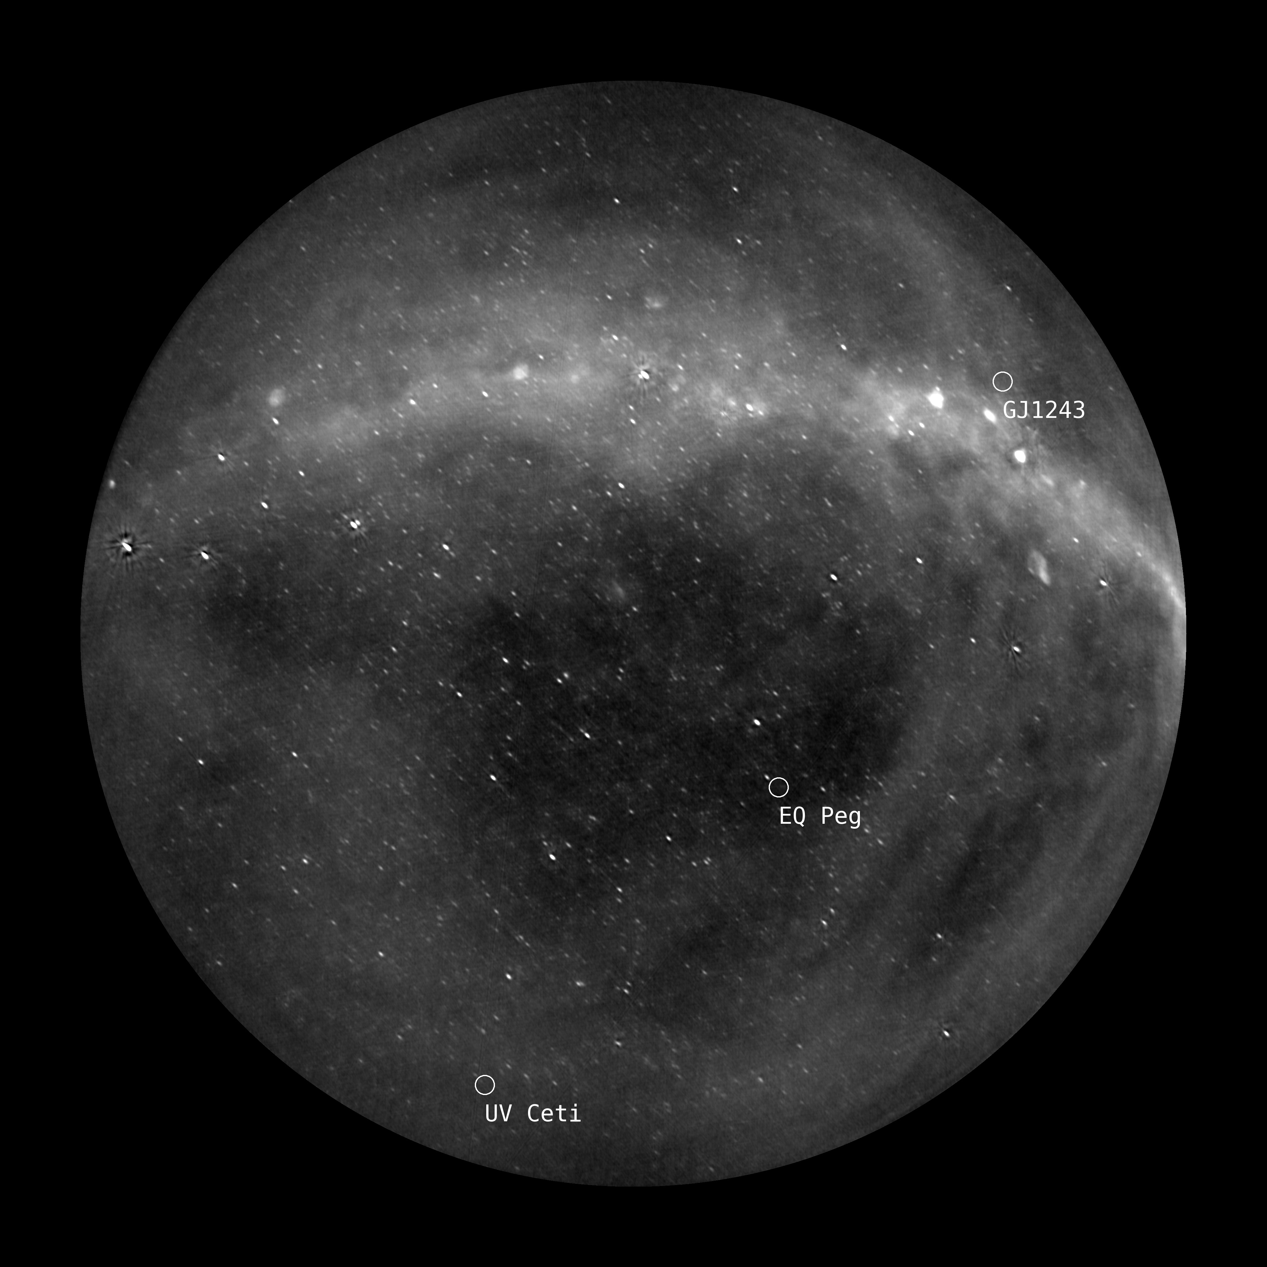
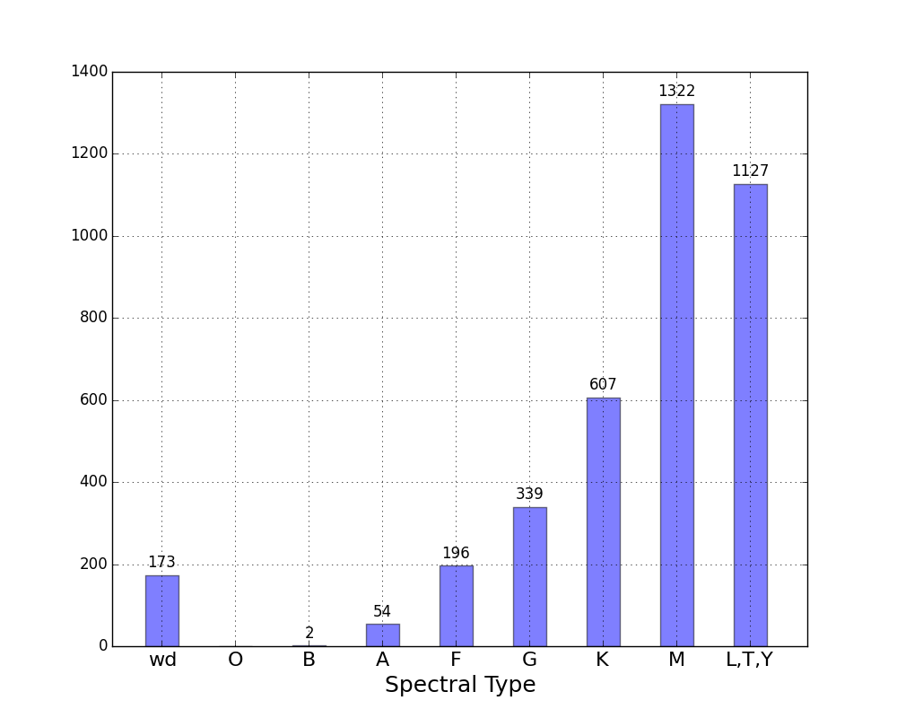
Searching for signatures of magnetic activity in a volume-limited sample of systems.
Simultaneous monitoring of nearly 4000 objects, out to 25 pc
Equivalent to 5 years of targeted observations

Slide 10
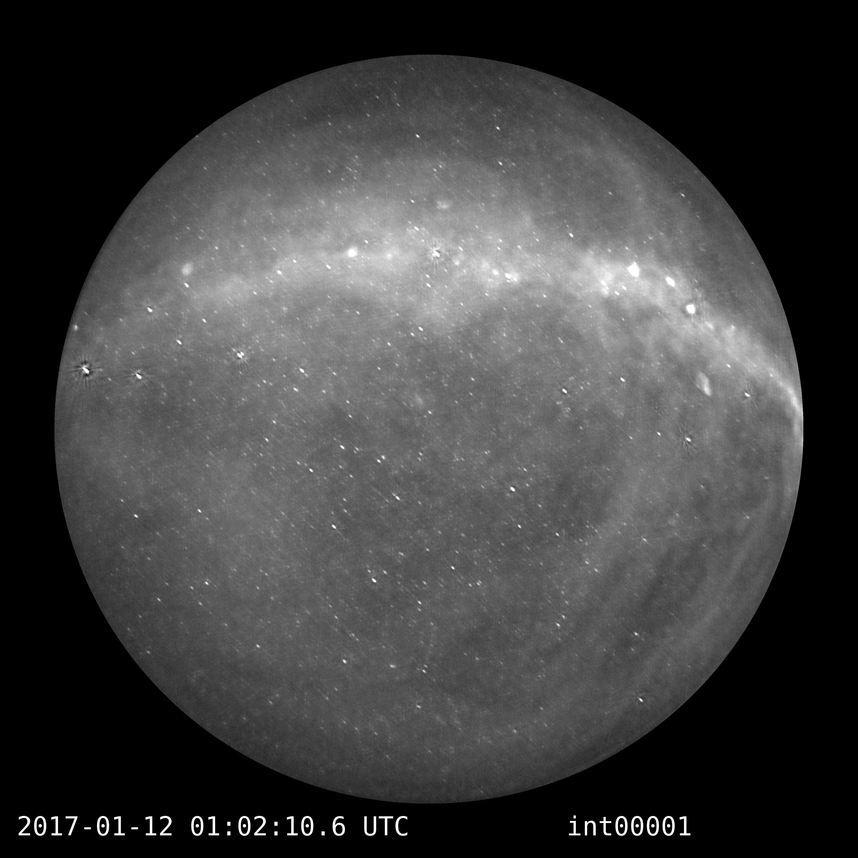

Slide 11
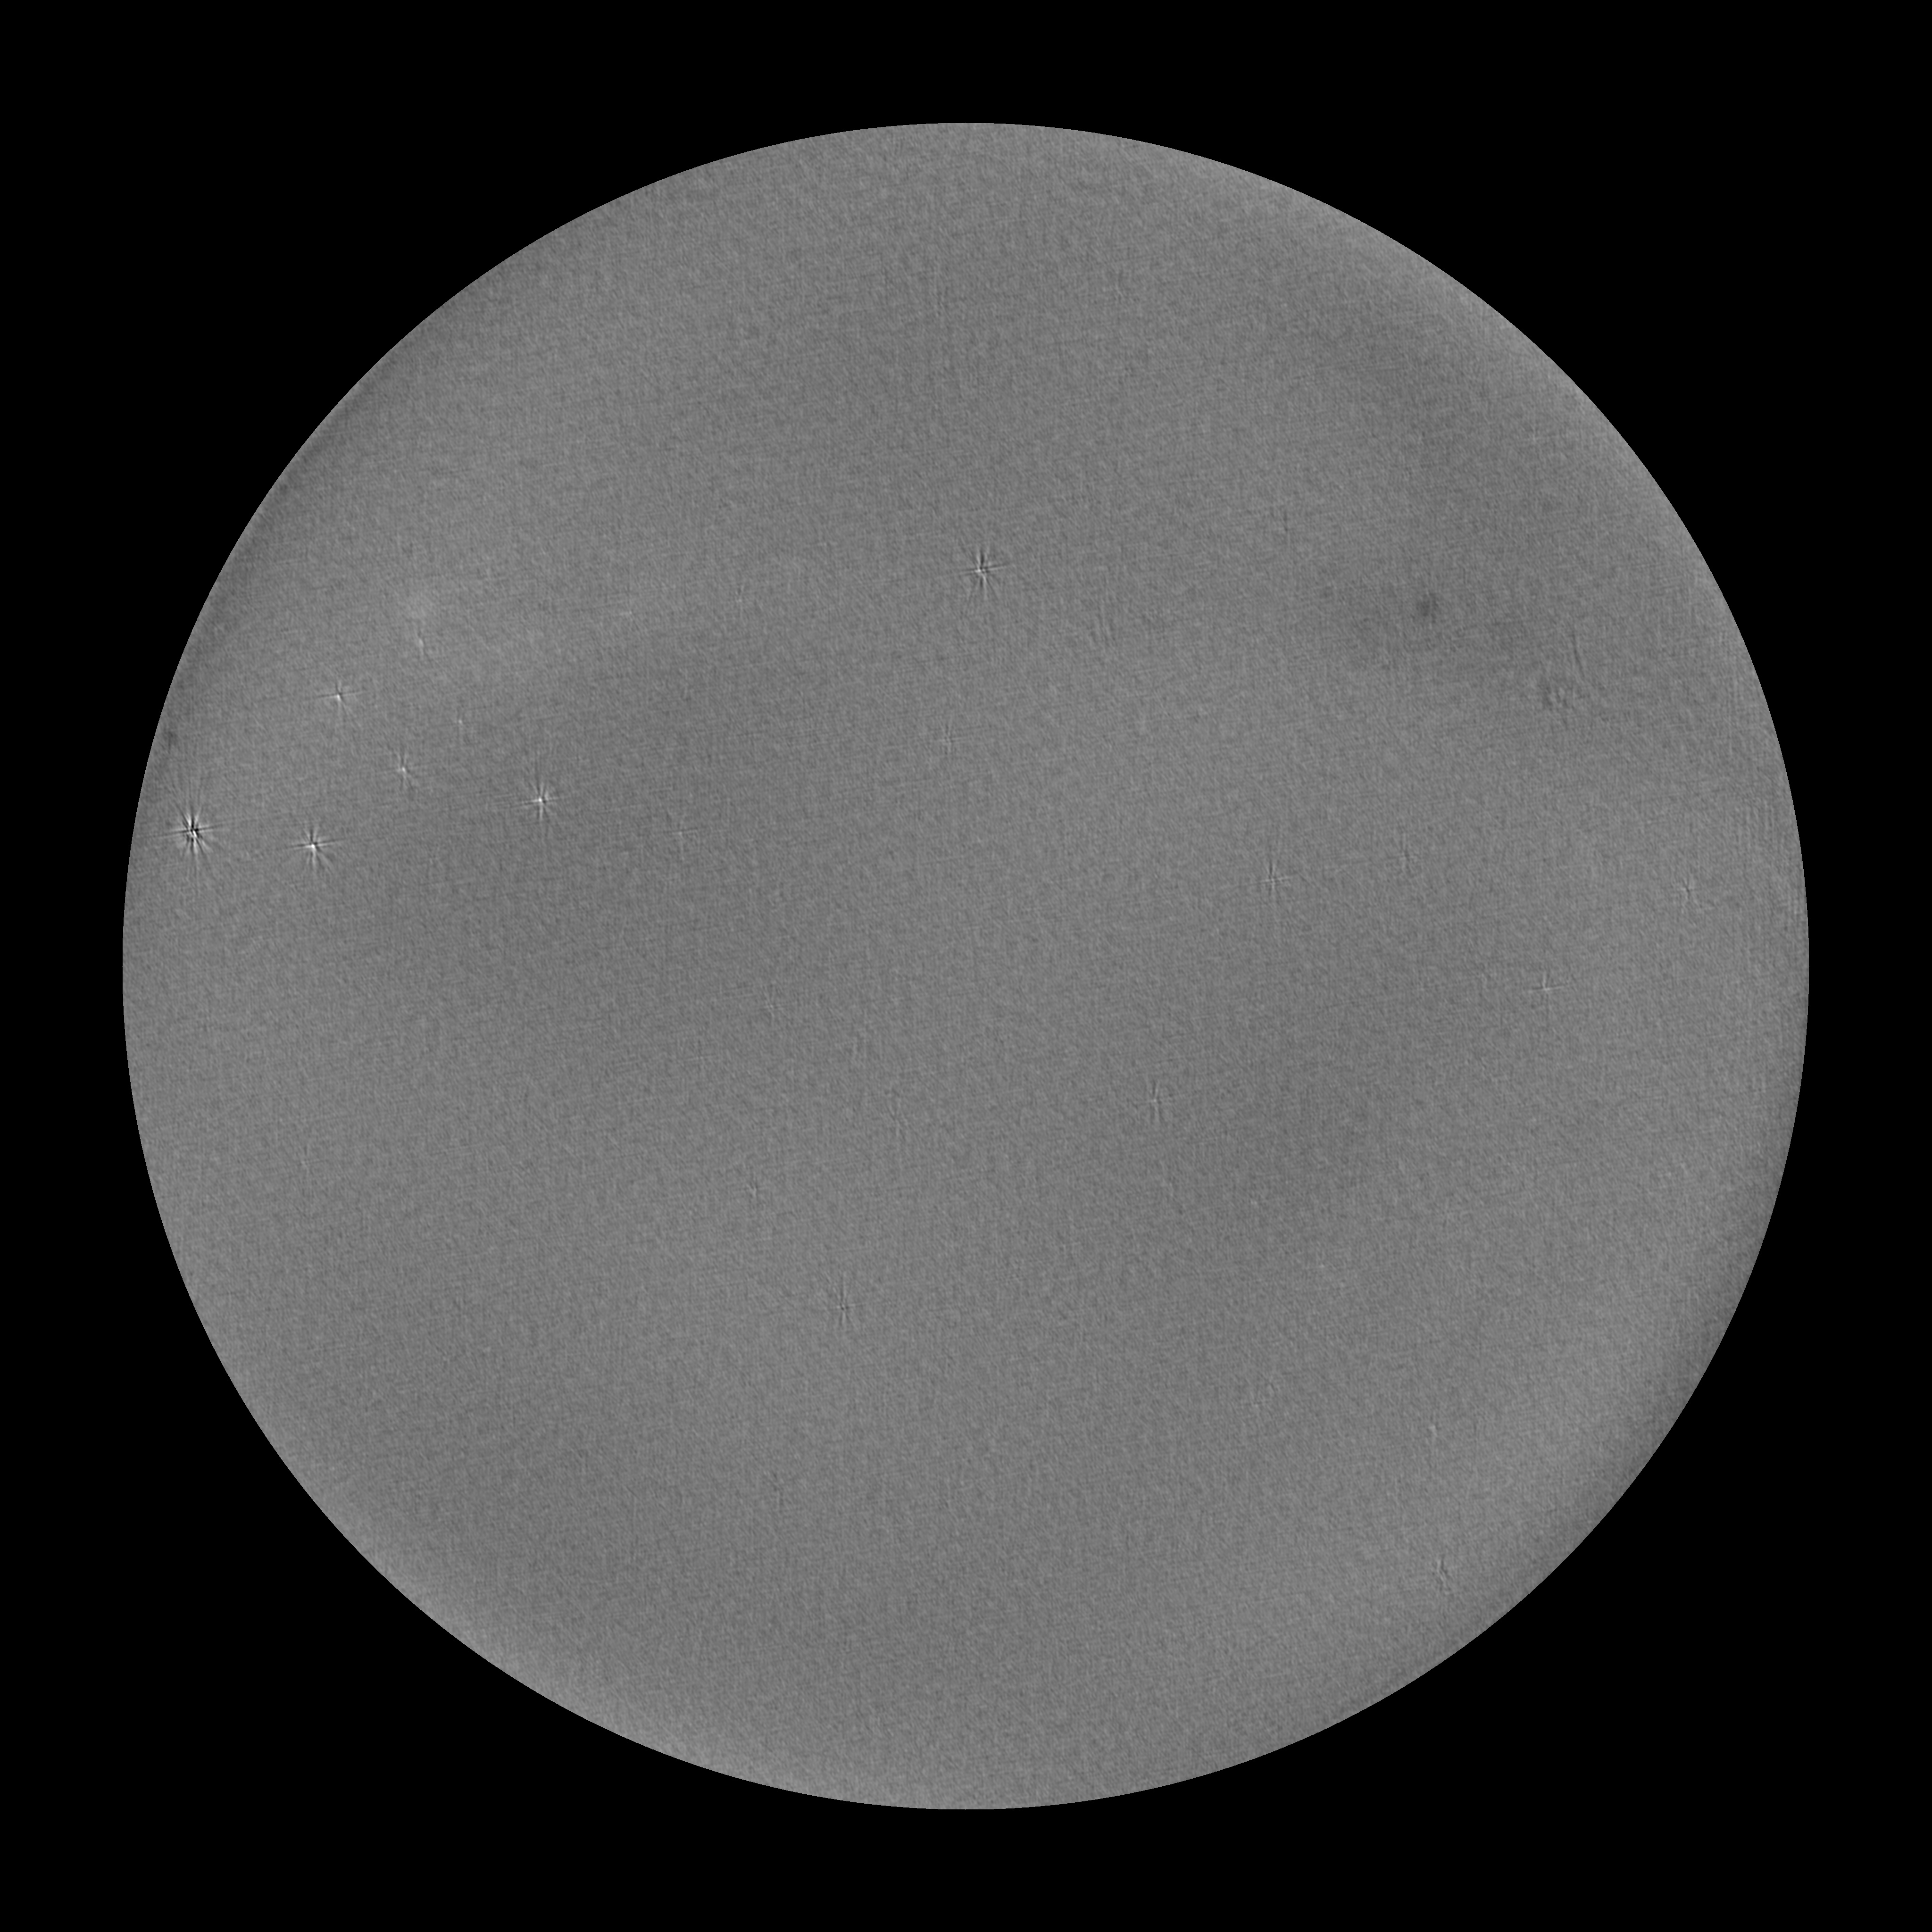

Slide 12
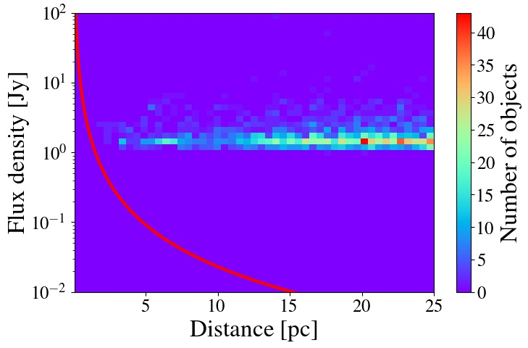
Sensitivities achieved for all objects in the 28-hour survey.
Anderson et al. 2019, in prep

Slide 13
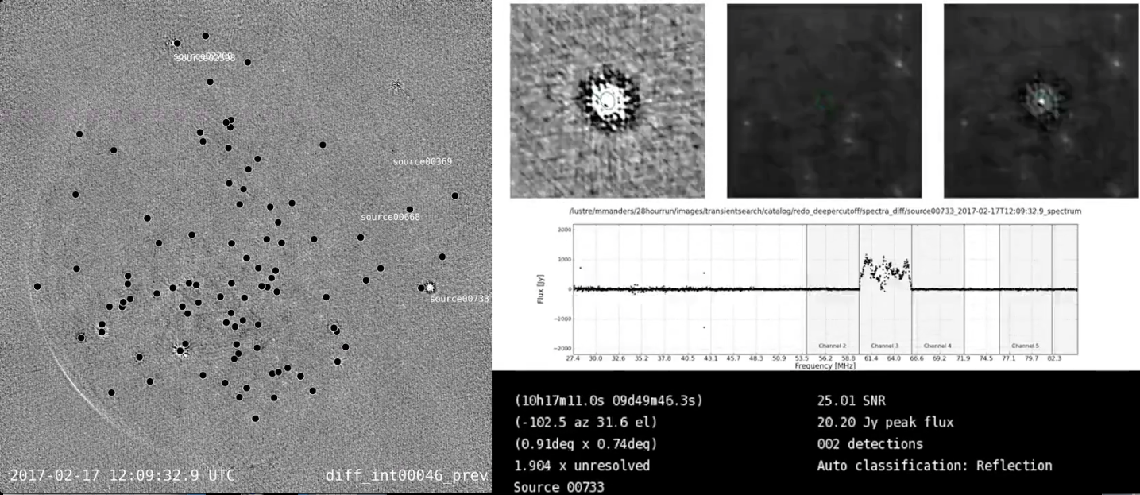

Slide 14
Anderson et al. 2019

Slide 15
Current limitations for each science case
Science case | Limitation | Stage III system design
EM-GW | Timescale | Buffering of raw voltages
Extrasolar space weather | Sensitivity, Stokes V | ARX re-design, individual beam mapping
Transient surveys | Sensitivity, Stokes V | ARX re-design, individual beam mapping

