Slide 1
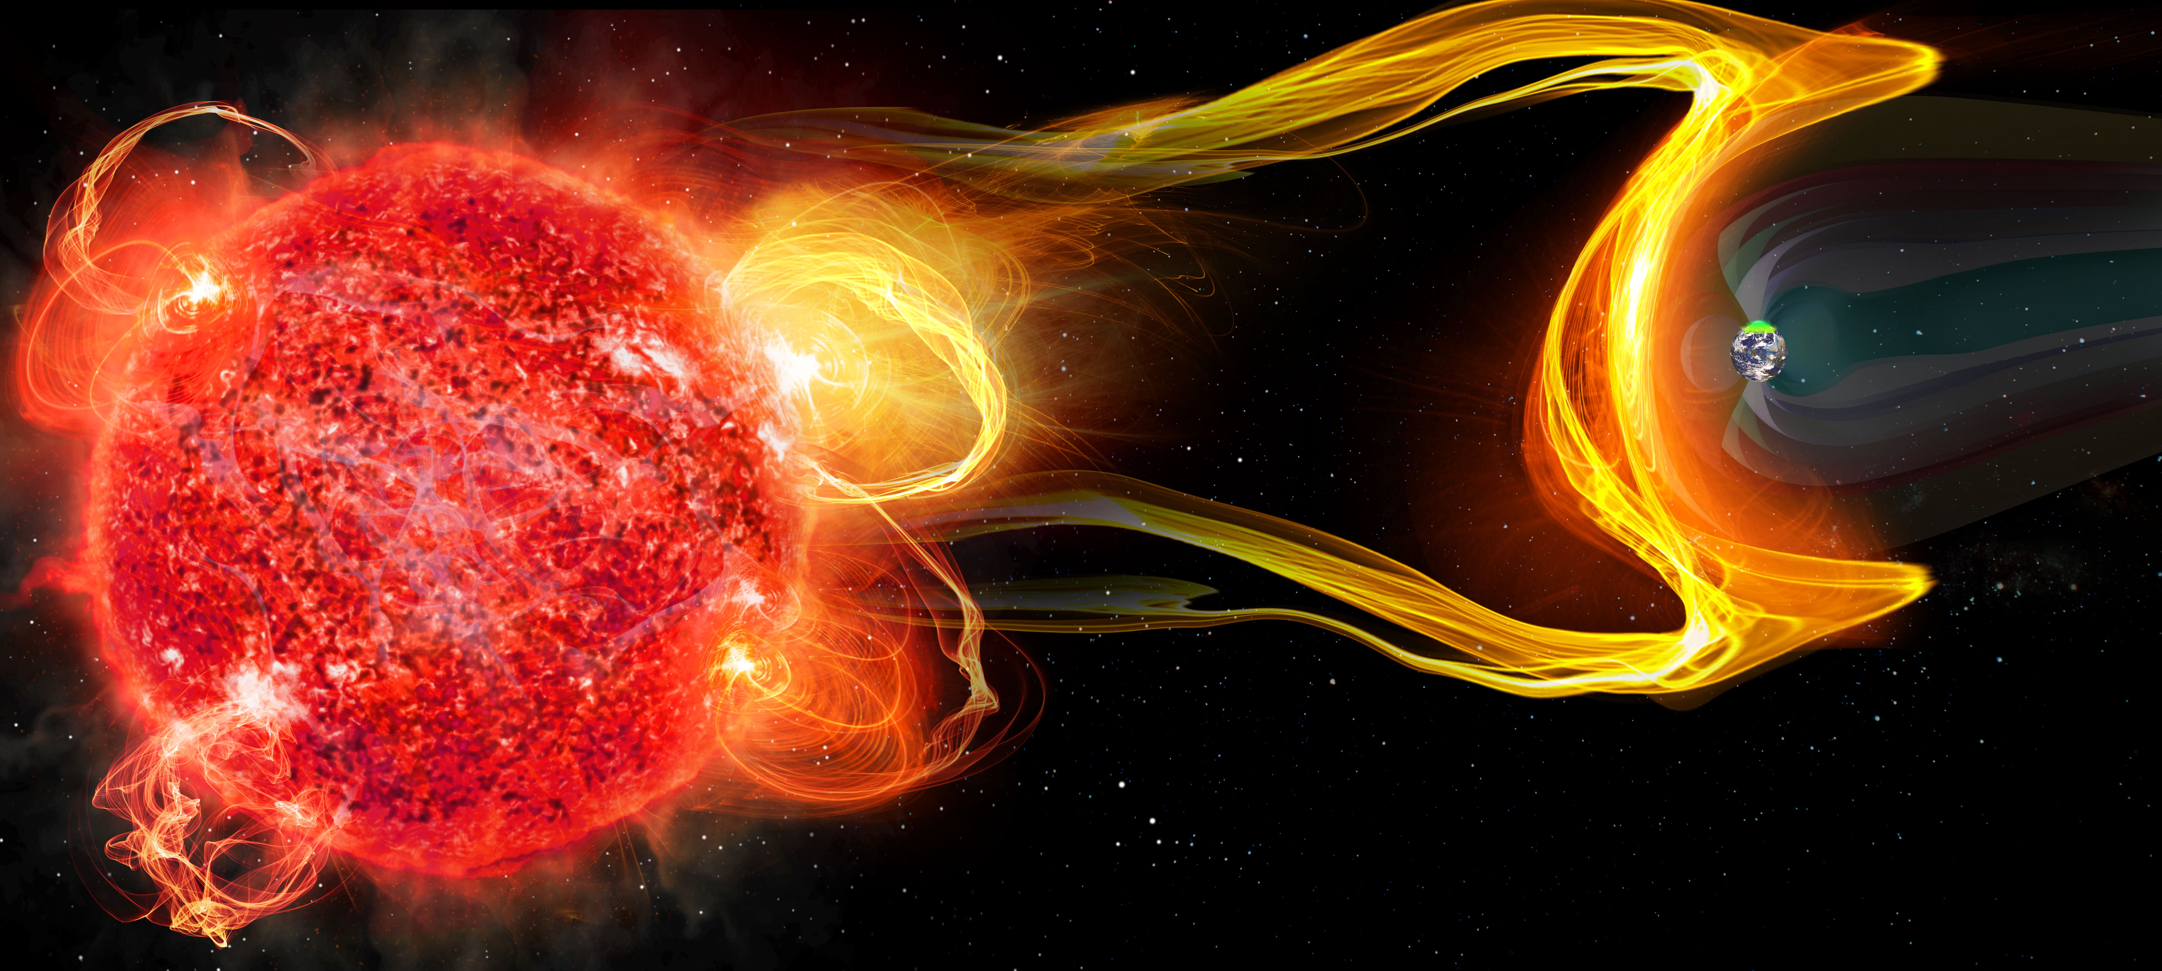
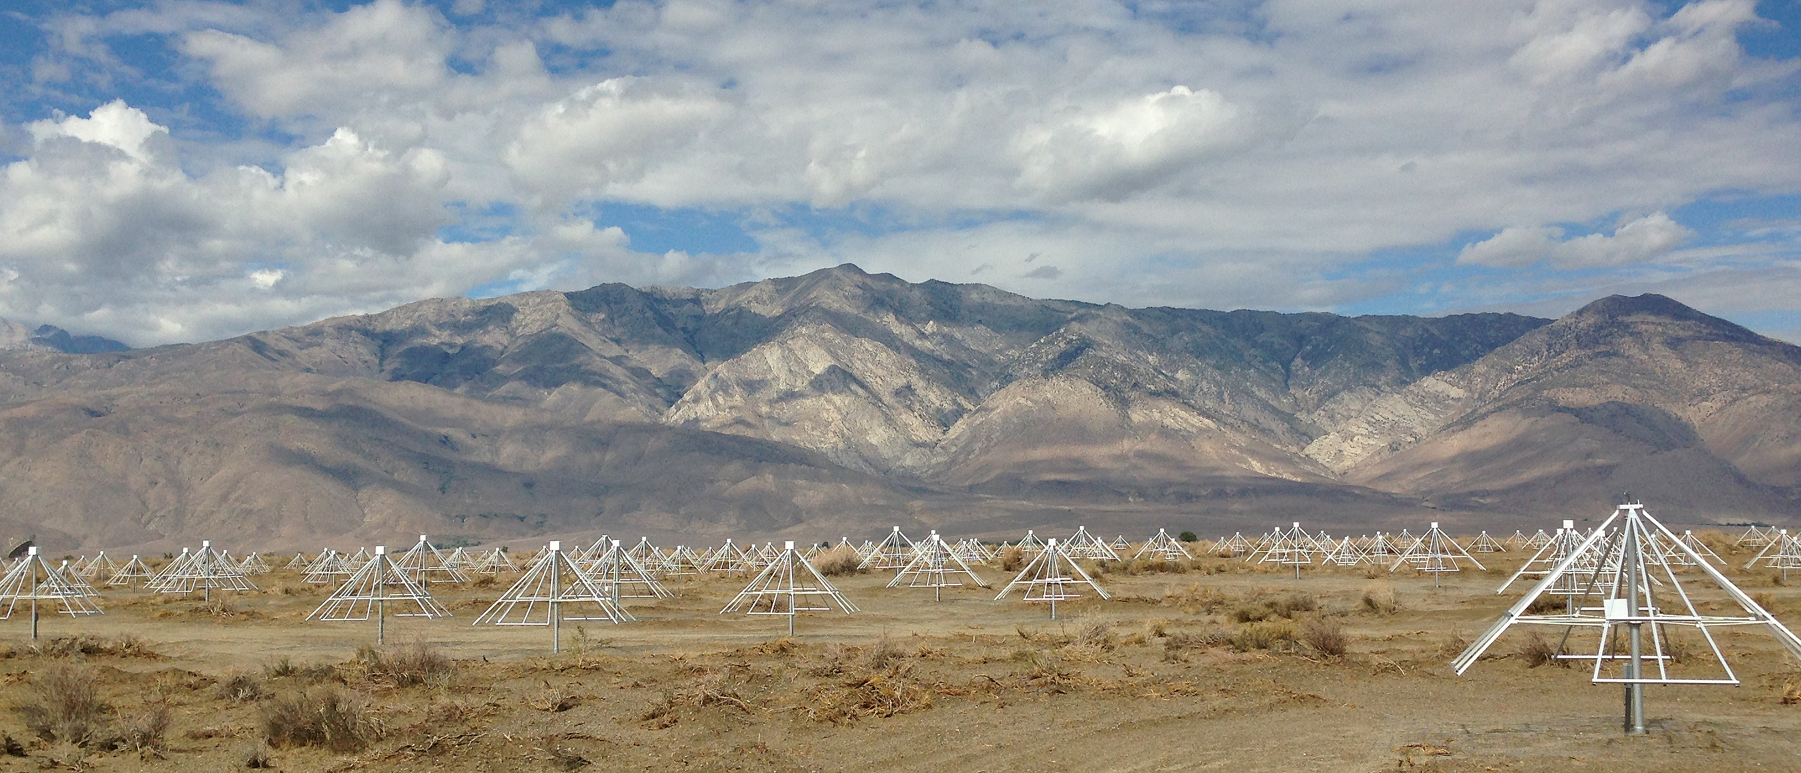
Extrasolar space weather and impact on habitability
Marin Anderson mmanders@astro.caltech.edu
Targeting CMEs and SEPs from nearby stars…
and auroral emission from their planets
…at low radio frequencies (<100 MHz)
…in order to probe space weather environments of other stars and understand the influence of exoplanet magnetospheres on potential biospheres.
Owens Valley Radio Observatory Long Wavelength Array (OVRO-LWA)

